Slide 1
WRITE your thoughts!
Welcome to Class!
-Can you think of any words, phrases or ideas that people may be confused or misinformed about? List a few.
Notes:
MOTIVATION:
Ask students to read the question and respond on a piece of paper or in a journal.
Give class ~1 minute to read and respond
Ask students, “What did you write down?” quickly discuss some of their ideas and add some of your own.
Some good examples are that many people think that:
-FFA stands for “Future Farmers of America”, it no longer does.
-All Texans ride tractors and horses to school, they do not.
-The word cow represents all sexes of cattle, it actually only represents a previously bred female. (a steer, bull, heifer or calf is not the same as cow)

Slide 2
WRITE your thoughts!
-THINK: What about the idea of animal welfare and animal rights?
-WRITE: Do you think animal welfare and animal rights are the same thing? Why or why not? How do you define these concepts?
Notes:
MOTIVATION continued:
Ask students to read the second question and to again, write a written response.
Give class ~1 minute to read and respond.
Ask students, “What did you write down?” quickly discuss some of their ideas and add some of your own, explaining that “Animal rights is a different concept than animal welfare.”

Slide 3
Pre-Quiz answer these questions on a sheet of scratch paper.
A
I only eat free range eggs, I believe in ___________.
I think that it is wrong to eat meat because it is cruel to animals, I believe in ____________.
My rabbit is kept in a large cage with lots of room to move around in, I believe ____________ is very important
Keeping animals in zoos is unethical, I believe in _________.
I won’t ever buy a pet from a breeder who breeds their female too often because it is unfair. I believe in ____.
I believe in _________. Humans should not be forcing animals to do tricks for our entertainment.
Animal welfare B. Animal rights
B
A
B
A
B
Notes:
MOTIVATION
Students should answer the 6 questions in their journal or on a sheet of paper. After the class is done, review the answers with the class. This should evaluate how much the class already knows about the topic.

Slide 4
Animal Rights and Animal Welfare
Animal Rights and Animal Welfare Unit Part 1
I’m eager to learn!

Slide 5
Today we will…
Identify the differences between animal rights and animal welfare
Define animal rights and animal welfare
Examine examples of animal rights/welfare advocacy and promotion
Research current issues in animal rights and animal welfare

Slide 6
Contrary to popular belief, rights and welfare are NOT the same idea!
Animal Rights
Based on the philosophy that all animals have equal rights with humans. This involves not using animals (or their byproducts) for food, clothing or as pets.
Animal Welfare
Based on the science of well-being and productivity of an animal. This involves the humane treatment of animals.

Slide 7
Animal Rights
Animal Rights, as defined by PETA: (People for the Ethical Treatment of Animals, PETA, is the largest animal rights organization in the world.)
“People who support animal rights believe that animals are not ours to use for food, clothing, entertainment, experimentation, or any other purpose and that animals deserve consideration of their best interests regardless… regardless of whether any human cares about them at all.”
Notes:
http://www.peta.org/about/faq/What-do-you-mean-by-animal-rights.aspx

Slide 8
Animal Rights
Another definition of animal rights:
“Humans have no moral justification for using nonhuman animals for human purposes, however humanely animals are treated. ”
The goal of animal rights is to abolish animal use.
Notes:
http://vimeo.com/4808086

Slide 9
Animal Welfare
Animal Welfare, as defined by the AVMA: (The American Veterinary Medical Association, AVMA)
“Animal Welfare is a human responsibility that encompasses all aspects of animal well-being, including proper housing, management, disease prevention and treatment, responsible care, humane handling, and, when necessary, humane euthanasia.”
Notes:
https://www.avma.org/KB/Resources/Reference/AnimalWelfare/Pages/default.aspx

Slide 10
Animal Welfare
Another definition of animal welfare:
“It is morally acceptable to use nonhuman animals for human purposes as long as we treat them humanely and do not impose unnecessary suffering on them.”
The goal of animal welfare is the regulation of animal use.

Slide 11
Visual Impact?
View this Video posted by PETA.
How does it make you feel?
How might it influence the public?
Click to play!
Notes:
Video can be found at PETA’s YouTube channel: http://www.youtube.com/watch?v=-KONb-xSZvg&list=PLV2RDOhiGtcRplpAKH4Id5lsSoXqXqJX_
DISCUSSION:
Ask students, the displayed questions. Allow for discussion.
**This video should bring up discussion but there is no right or wrong answer or opinion regarding this subject!**

Slide 12
Visual Impact?
View this Video posted by The Humane Society of The United States.
How does it make you feel?
How might it influence the public?
Click to play!
Notes:
Video can be found at HSUS’ YouTube channel: http://www.youtube.com/watch?v=BF3KQ71qp3M
DISCUSSION:
Ask students, the displayed questions. Allow for discussion.
**This video should bring up discussion but there is no right or wrong answer or opinion regarding this subject!**

Slide 13
Rights or Welfare?
I believe using animals for our benefit is wrong!
I believe all animals should be treated humanely!
Tommy Wright
Sally Wellfair
Notes:
APPLICATION:
Students should be able to identify that Tommy Wright believes in animal rights and that Sally Wellfair believes in animal welfare.

Slide 14
WRITE your thoughts!
-Do you have a different definition of these two concepts now?
-How would you define animal rights and animal welfare now?

Slide 15
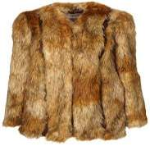
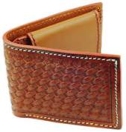
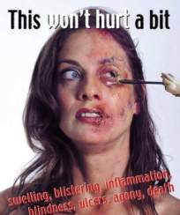
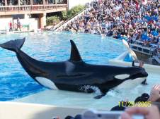
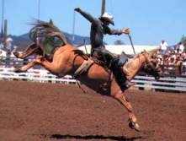
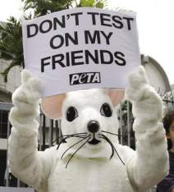
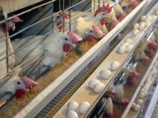
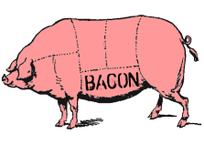
Current Issues in Animal Rights
Fur and Leather production
Entertainment animals
Food Animals
Animal Testing
Notes:
AVMA issues- https://www.avma.org/advocacy/stateandlocal/pages/state-issues-welfare.aspx
Ag Alliance Issues- http://www.animalagalliance.org/current/home.cfm?Category=Current_Issues&Section=Main

Slide 16
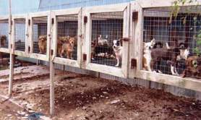
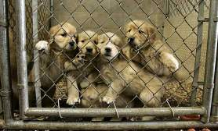
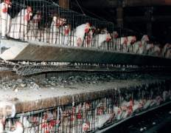
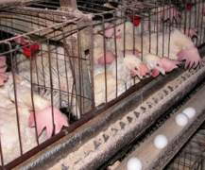
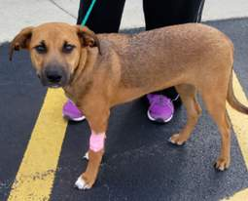
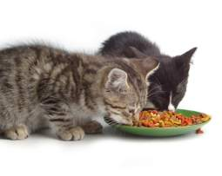
Current Issues in Animal Welfare
Pet sales (Puppy mills)
Egg production (hen housing)
Companion animal care
Notes:
There are many more issues. These three are the most common related to small animals.

Slide 17
Break into 7 Groups!
Notes:
APPLICATION:
Give each group one of the seven animal rights and animal welfare issues. Each student will also need a research handout. Ask each group to research their issue and to prepare a class presentation on it. You may ask them to make this project as in-depth and elaborate as you choose. This means you may ask them to do quickly research and briefly read their handouts to the class or, on the other end of the spectrum you may ask them to in-depth research and prepare a PowerPoint or poster.

Slide 18
Today we…
Identified the differences between animal rights and animal welfare
Defined animal rights and animal welfare
Examined examples of animal rights/welfare advocacy and promotion
Researched current issues in animal rights and animal welfare

Slide 19
Influences on Animal Rights and Animal Welfare
Animal Rights and Animal Welfare Unit Part 2
How do people, groups and legislations influence animals?
Notes:
http://communities.naae.org/message/6380#6380

Slide 20
Today we will…
Compare and contrast different organizations in animal rights and animal welfare
Identify, compare and contrast influential people in animal rights and animal welfare
Arrange important dates and legislative acts
Identify the five freedoms of animal welfare

Slide 21
What Influences Animal Rights and Animal Welfare?
Organizations and Groups
Influential people
Important Events

Slide 22
Groups and Organizations
Rights
People for the Ethical Treatment of Animals (PETA)
In Defense of Animals (IDA)
Mercy for Animals (MFA)
Welfare
The American Society for the Prevention of Cruelty to Animals (ASPCA)
American Humane Association (AHA)

Slide 23
Groups and Organizations
Click on each logo to visit their website
www.peta.org
www.idausa.org
www.mercyforanimals.org
PETA IDA MFA
ASPCA AHA
www.aspca.org
www.americanhumane.org
Notes:
APPLICATION:
Break the class into 5 groups. Each group should spend 5-10 minutes researching one of the five organizations from above. They should find the organization’s mission statement and learn more about the goals of the organization. Next allow each group 1-2 minutes to teach the class about the organization They will need to pull the webpage up on the screen and give a quick tour of the site. This is an important skill for students to have; students need to have knowledge and understanding of how to research and identify important aspects of organizational webpages. The class should be able to identify how each organization is different or similar.
http://www.mercyforanimals.org/
http://www.idausa.org/
http://www.peta.org/
http://www.americanhumane.org
http://www.aspca.org/
**Note that these organizations do not all believe in the same ideas. They may fit into different sections of the animal rights or animal welfare spectrums. When looking into these organizations it is important to remember that animal rights and animal welfare are current debates and there are many varying ideas of each.**

Slide 24
Influential People
Read “Who’s who in the Animal Rights Movement” and compare and contrast their impacts.
Draw a T-Chart of Pros and Cons of their impact on the public.
(PROS)
(CONS)
What did these people do that was helpful?
What did these people do that was not helpful?
Notes:
http://animal-rights.com/arpage.htm
APPLICATION:
Allow 10-20 minutes, depending on the grade level and reading abilities of your students, to complete the task explained above.

Slide 25
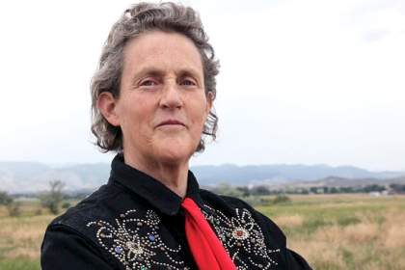
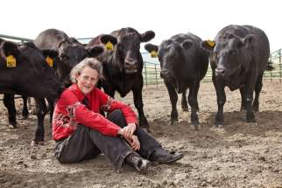
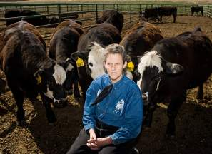
Influential People
Temple Grandin, Ph.D
Professor of Animal Science
Animal Welfare Advocate
Researches and designs humane animal handling methods.
Known for being able to think like animals because of her autism.
Click to play!
Notes:
APPLICATION: The red play button links to a YouTube video of Dr. Grandin touring a small animal turkey facility. The video can also be found by copying and pasting the following URL into your internet browser. http://www.youtube.com/watch?v=852zxDEAR-Q

Slide 26
Timeline of Animal Welfare
1866 The American Society for the Prevention of Cruelty to Animals (ASPCA) was created.
1876 The American Humane Association (AHA), focused on farm animals and child protection, was founded.
Late 1800s- late 1830s other humane societies and SPCAs emerged.
Late 1930’s more animals became companions, hobbies and recreational pastimes
Notes:
APPLICATION:
Students will fill out the note taking worksheet using the given information above.

Slide 27
Animal Welfare Timeline Continued…
1958 “The Humane Slaughter Act” was passed
1960’s-1970’s Welfare concerns and acts are more focused on:
-laboratory and research animals -horse protection -marine mammal protections -endangered species…
1990’s Additional welfare concerns in farm animal protection and Research Facilities
2000’s Animal welfare focuses on cracking down on animal fights and protecting wildlife
Notes:
This slide is an overview and the following slides will go into detail over each to allow students to fill out their note sheet.
APPLICATION: Discuss the trend change of animal welfare focus over the years. Students should understand that animal welfare has been a topic of importance for a very long time but has grown to focus on specific areas rather than animals as a whole. Remind your students that this is a good thing so that each different animal in a different situation may still receive humane handling, humane care or humane harvest.

Slide 28
Important Legislative Acts in Animal Welfare
Humane Methods of Slaughter Act
Animal Welfare Act
Public Health Service Policy on Humane Care and Use of Laboratory Animals
State and Local Laws
Notes:
https://awionline.org/content/legislation
https://www.ffa.org/documents/learn/MS.AI.4.1.pdf
http://animalwelfarecouncil.com/welfare-vs-rights/

Slide 29
Humane Slaughter Act
Established in 1958
Regulates slaughter practices
livestock must be slaughtered in a humane manner to prevent needless suffering
Notes:
http://www.animallaw.info/statutes/stusfd7usca1901.htm
Students will fill out the note taking worksheet using the given information above.

Slide 30
Animal Welfare Act
Regulates research facilities, animal dealers, exhibitors (zoos aquariums circuses, etc.) and other handlers of animals. (for non-agricultural, domestic animals)
Concerned primarily with basic animal husbandry and veterinary care.
Provides for criminal penalties, civil penalties and revocation of permits for violations of the AWA.
Notes:
http://www.animallaw.info/statutes/stusawa.htm
Students will fill out the note taking worksheet using the given information above.

Slide 31
Public Health Service Policy on Humane Care and Use of Laboratory Animals
Institutions that perform experiments on animals must follow all federal, state and local laws
These institutions must:
provide animal care
Establish a committee that will oversee animal facilities, care and procedures when using animals
This law helps to increase animal welfare in research!
Notes:
Students will fill out the note taking worksheet using the given information above.

Slide 32
State and Local Laws
Varies from state to community
Usually concerned with local pounds, animal cruelty, research facilities and animals used in education.
Notes:
Students will fill out the note taking worksheet using the given information above.

Slide 33
Animal Welfare- 5 Freedoms
Freedom from hunger or thirst by ready access to fresh water and a diet to maintain full health and vigor
Freedom from discomfort by providing an appropriate environment including shelter and a comfortable resting area
Freedom from pain, injury or disease by prevention or rapid diagnosis and treatment
Freedom to express (most) normal behavior by providing sufficient space, proper facilities and company of the animal's own kind
Freedom from fear and distress by ensuring conditions and treatment which avoid mental suffering
Notes:
https://www.avma.org/KB/Policies/Pages/AVMA-Animal-Welfare-Principles.aspx

Slide 34
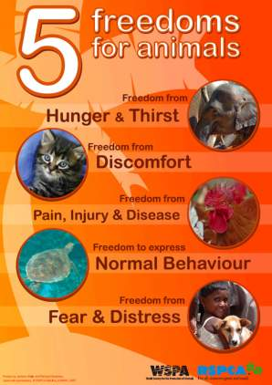
Trace your Hand on a piece of paper!
On each finger:
Name a Freedom of animal welfare
Draw an example
Notes:
APPLICATION:
Allow 10-15 minutes to complete the task explained above. You may ask them to be as creative as you would like.

Slide 35
Today we…
Compared and contrasted different organizations in animal rights and animal welfare
Identified, compared and contrasted influential people in animal rights and animal welfare
Arranged important dates and legislative acts
Identified the five freedoms of animal welfare

Slide 36
Animal Rights and Animal Welfare
What “STUCK” with you, today?
Notes:
TICKET OUT OF CLASS:
Give each student a sticky post-it note.
They should write their name on the back (the sticky side) and write 1 thing they learned on the front.
As students exit the room, ask them to stick their note to the board!

