Slide 1
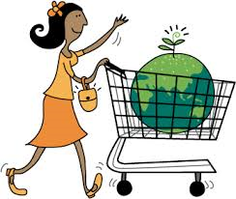
S2 Business Admin
Ethical Business – Fast Fashion

Slide 2
Success Criteria
By working through the tasks and videos in this unit. I will be able to:
Describe what the term Fast Fashion means
Identify ways clothing businesses encourage customers to buy more clothes and why
Consider the impact on the environment of making clothes and disposing of clothes
Carry out research on ways the clothing industry can be more environmentally friendly

Slide 3
Starter Activity
Think of your favourite clothes shop or clothing brand.
Write a list (or draw a mind map) that lists all the things that you like about the shop or brand.
Think about what you look for in your clothes and then watch the following video about Fast Fashion
https://www.youtube.com/watch?v=tLfNUD0-8ts

Slide 4
All of your favourite clothing brands are a business and ….
The main objective of a business is to make a
PROFIT

Slide 5
Sales – Costs = Profit

Slide 6
In order to make more profit the business must….
Make more sales
OR
Reduce their costs

Slide 7
What is Fast Fashion?
https://www.youtube.com/watch?v=fR7bXsoNwwE
How do the fast fashion brands keep people buying clothes?
Why do the clothing brands want you to keep buying clothes?
How do the clothing brands keep their costs down?
If they keep costs low, what does that mean for you as a customer?

Slide 8
Where do all the clothes go?
THINK
What do you do with all your old clothes?
Do you know where they go and what happens when you no longer want them?

Slide 9
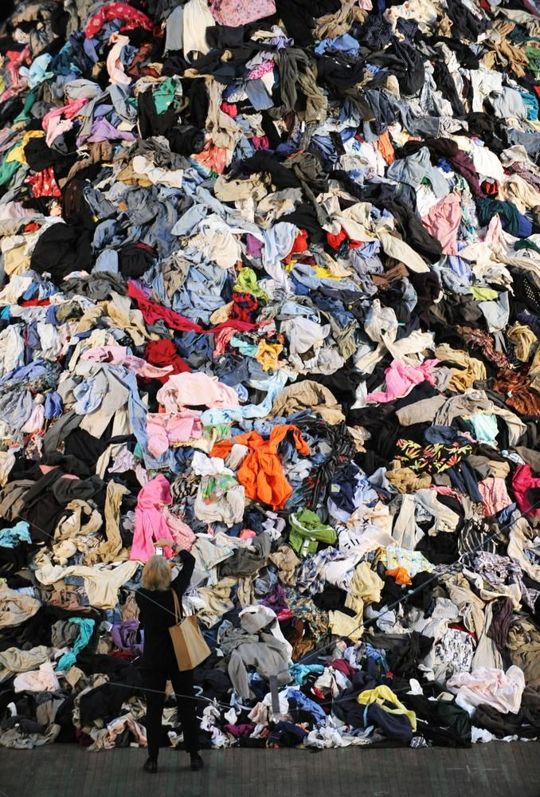
Is Fast Fashion bad for the environment? https://www.bbc.co.uk/news/av/business-51243912/fast-fashion-can-it-ever-be-ethical-and-cheap

Slide 10
Business Opportunity
Some businesses may make a decision to use SUSTAINABLE materials and encouarge customers to recycle their clothes. This means that they will get a good reputation for being an ethical business
Customers will be loyal and more likely to buy from a business that they think is ethical

Slide 11
Future Fabrics
https://www.bbc.co.uk/iplayer/episode/p07ktc8g/fashion-conscious-future-fabrics 7 mins
What does it mean if a material or fabric is SUSTAINABLE?
What is the social or environmental cost of using materials that are not sustainable?
Do you agree that the manufacturer (the maker) of the clothes should pay for damage to the environment that happens when materials are produced?
If the manufacturer (maker) does have to pay for damage, what will happen to the COST of the material? So what will happen to the PRICE you pay for clothes?
Would you be willing to pay more for clothes if they were made from sustainable fabric? Why/why not?

Slide 12
Research and Present Task
Research
Carry out research on a clothing brand that you know. How do they protect the environment? For example, H&M encourages customers to bring in old clothes, Primark use paper bags which can be recycled etc.
Activity
Design an advertising poster for a fashion business that takes steps to protect the environment. Maybe they use sustainable or organic materials or perhaps they encourage customers to bring in old clothes for recyclying.
Your advert should use their ethical approach as a marketing opportunity and attract customers who care about the environment
Email the finished advert to your teacher

Slide 13
Link with literacy
You could read the following article from the Guardian.
This is a good source of information because it is well known and will be fact checked. Reading newspaper articles from quality newspapers will help develop your language skills.
https://www.theguardian.com/fashion/2020/apr/07/fast-fashion-speeding-toward-environmental-disaster-report-warns

