Slide 1
International School Contest THINK SMART, CREATE GREEN 2nd Highschool_Cholargos_the gardenistas

Slide 2
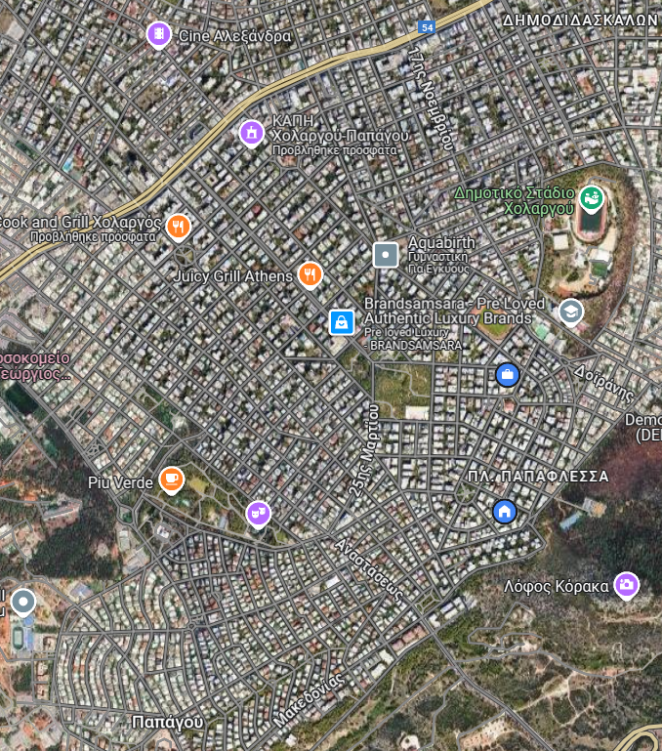
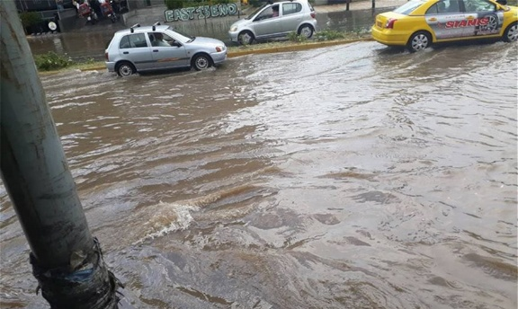
RAIN GARDENS: RETHINKING OUR NEIGHBORHOOD
URBAN CHALLENGES IN CHOLARGOS
Rapid urbanization and loss of green
Rare but heavy rainfall, poor rainwater retention
Surface runoff carrying pollutants
into aquifers
Urban Heat Island effect raising temperatures

Slide 3
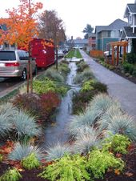
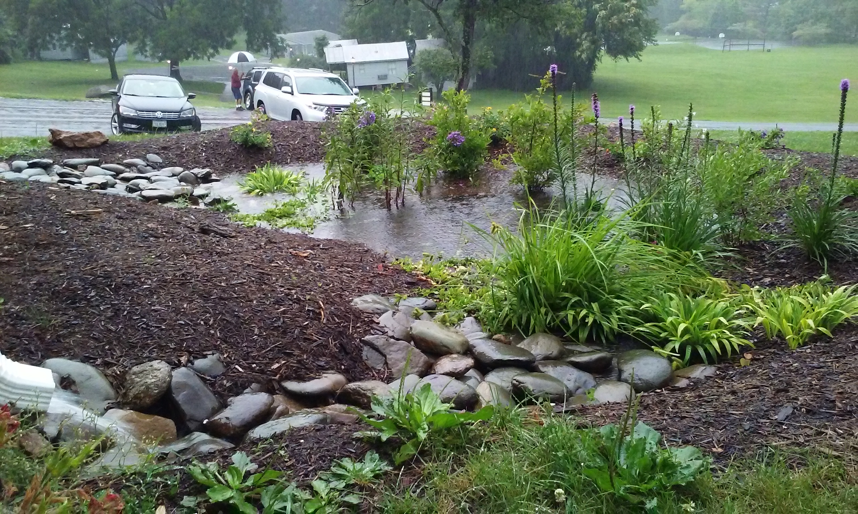
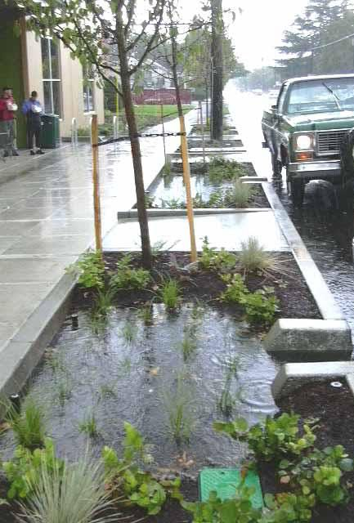
RAIN GARDENS: RETHINKING OUR NEIGHBORHOOD
A SOLUTION FOR SMART SUSTAINABLE URBAN AND COASTAL RESILIENCE
RAIN GARDEN IS A PLANTED BASIN

Slide 4
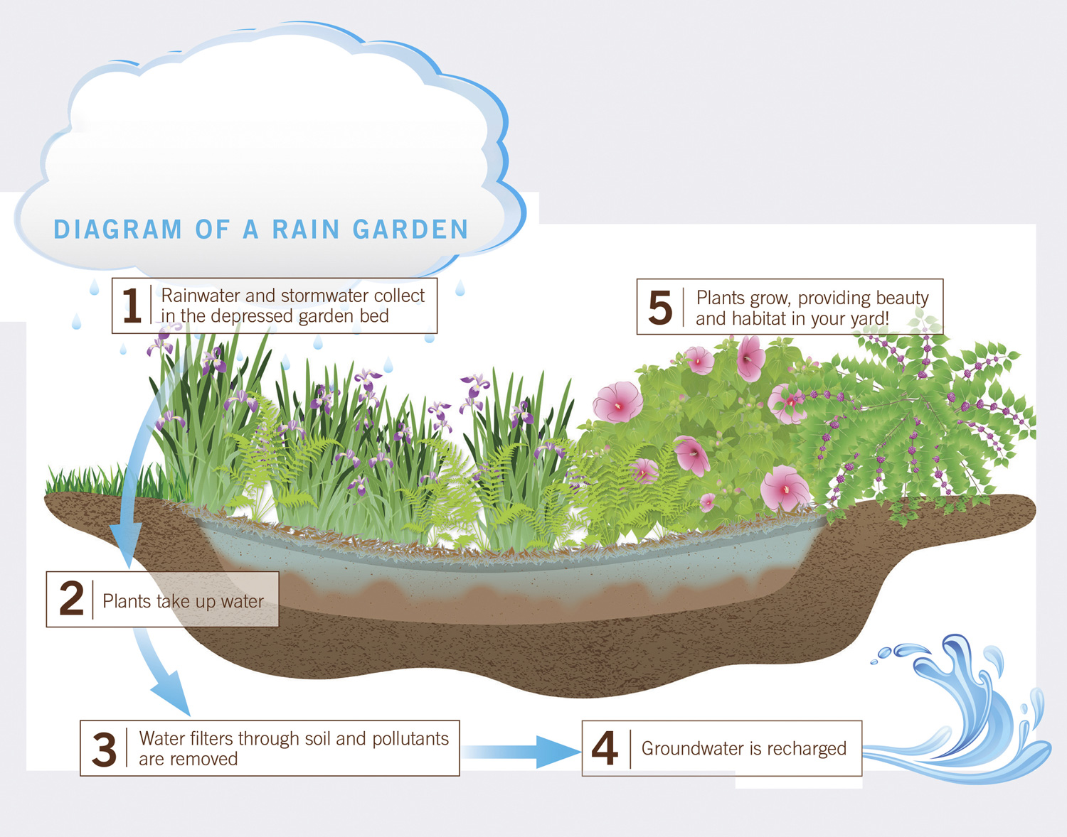
RAIN GARDENS: RETHINKING OUR NEIGHBORHOOD

Slide 5
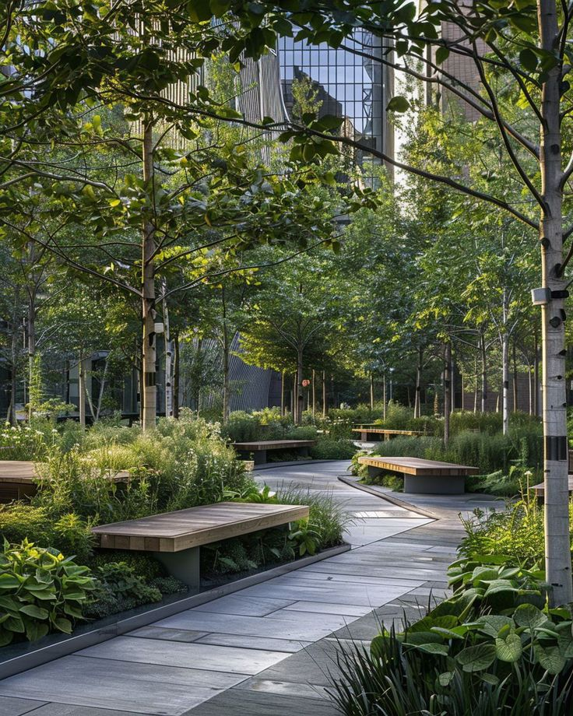
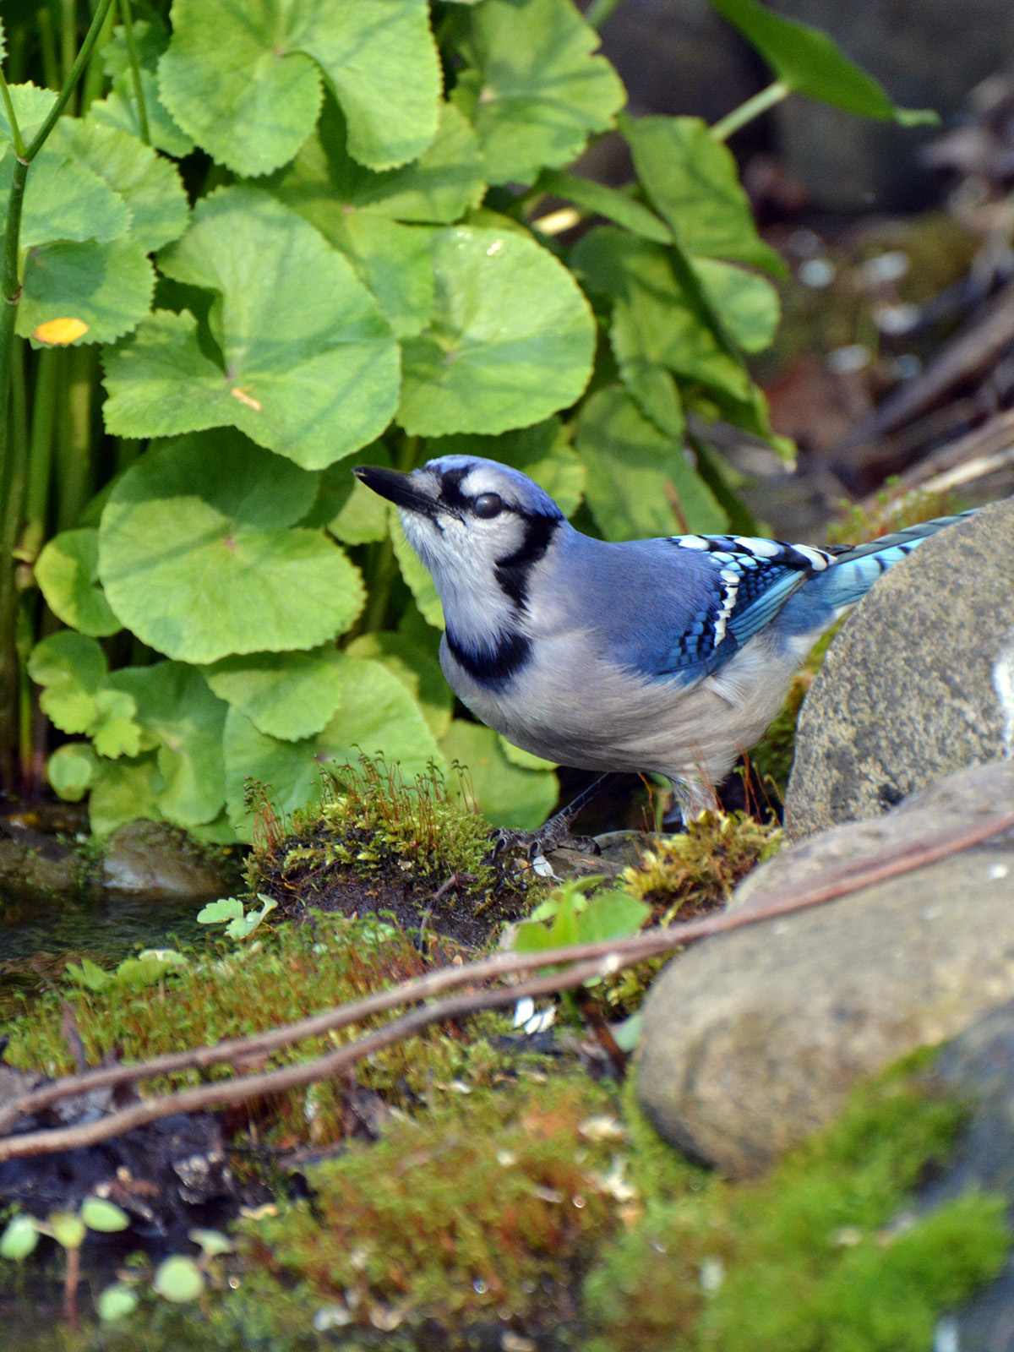
RAIN GARDENS: RETHINKING OUR NEIGHBORHOOD
ENVIRONMENTAL AND SOCIAL BENEFITS
Reduces floodings and financial losses
Mitigates urban heat island effect
Improves water quality
Provides food and shelter for wildlife.

Slide 6
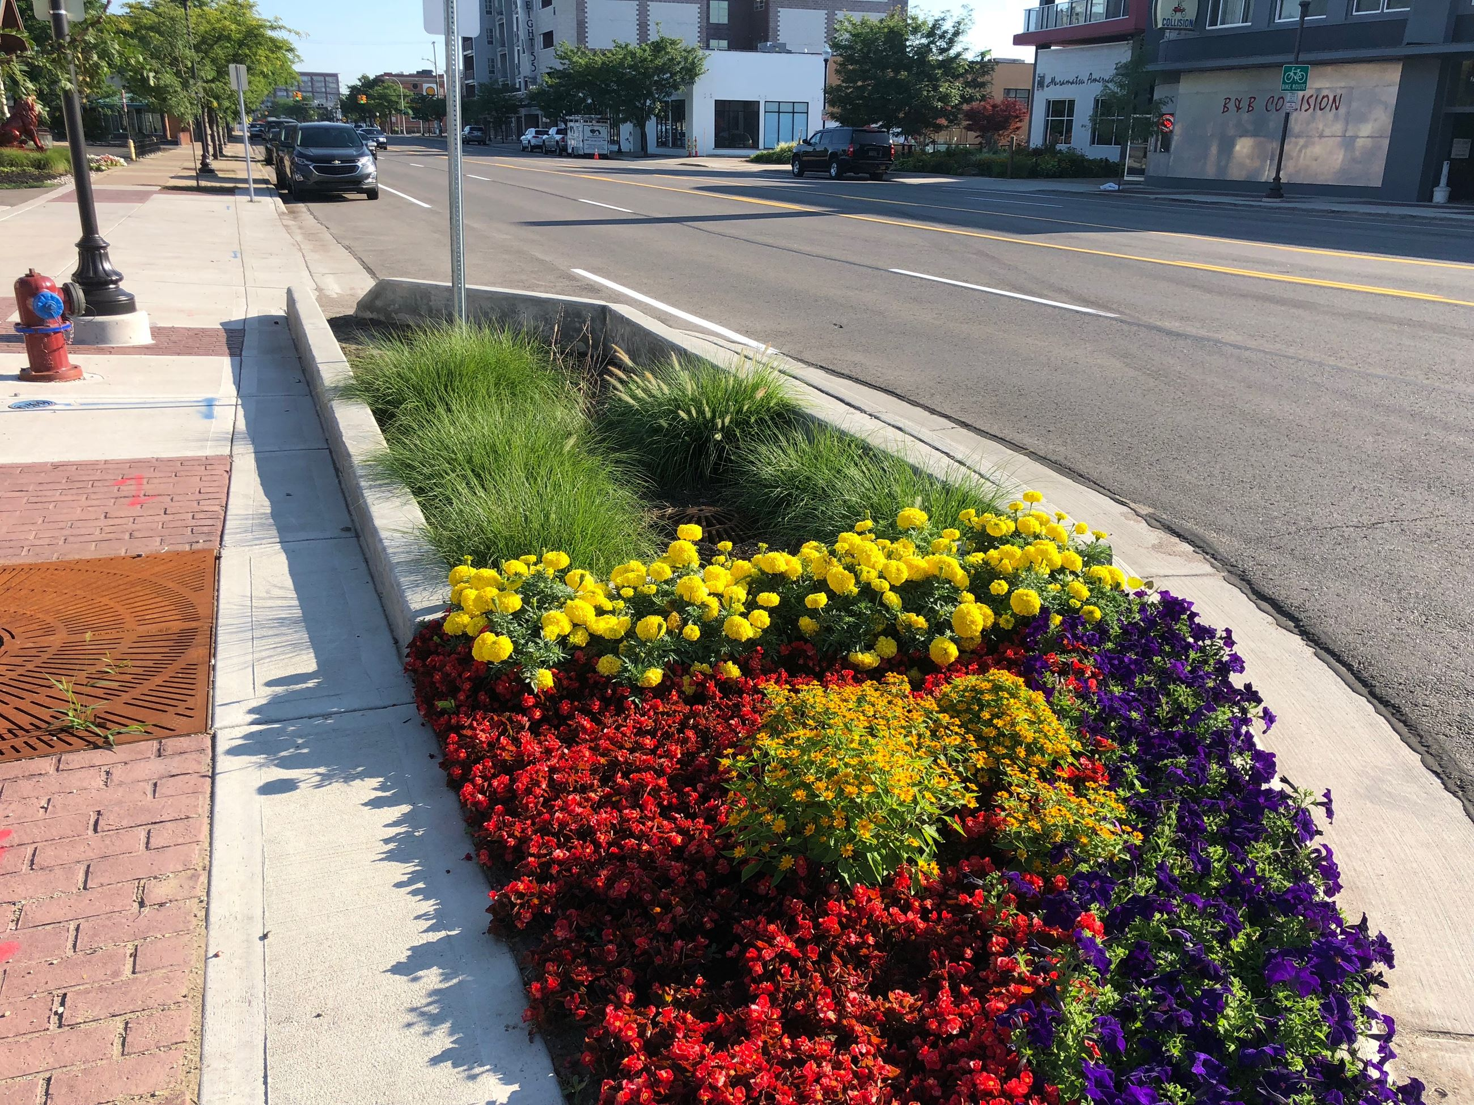
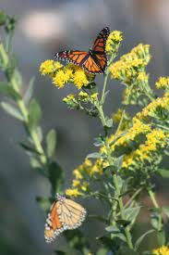
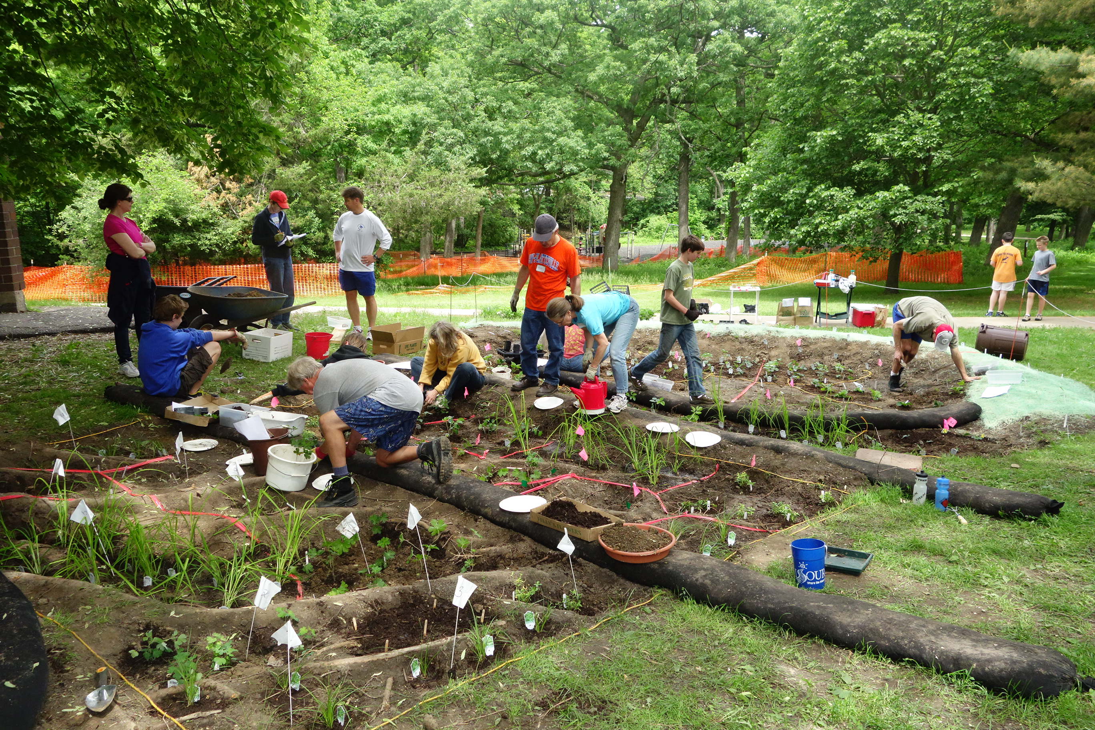
RAIN GARDENS: RETHINKING OUR NEIGHBORHOOD
ENVIRONMENTAL AND SOCIAL BENEFITS
Enchances biodiversity
Creates green spaces
Strenghtens community engagement
Supports food growth with bioretention planting.

Slide 7
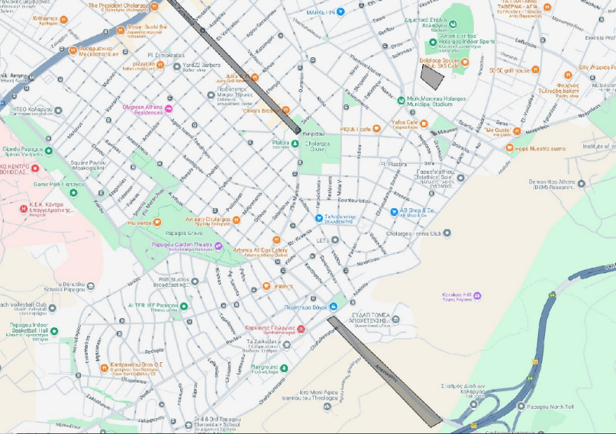
RAIN GARDENS: RETHINKING OUR NEIGHBORHOOD
Proposed Locations for Rain Gardens
abandoned Skate Park in Ntamari
median of Perikleous Street
17 Noemvri Fountain Square (Pilot Project)
Sidewalks Anastaseos Avenue

Slide 8
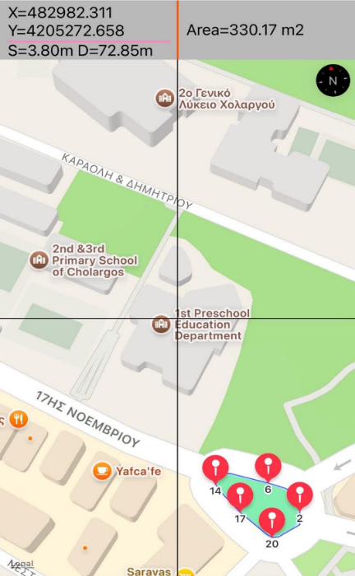
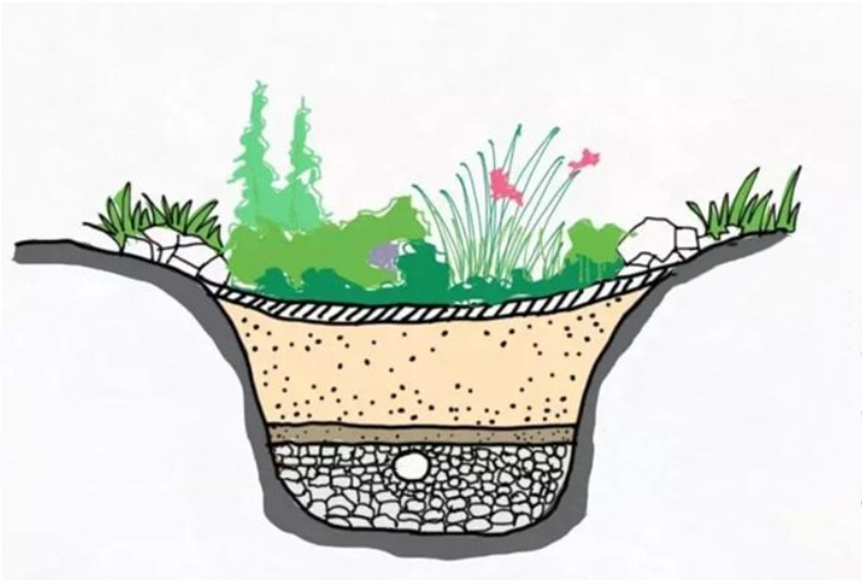
RAIN GARDENS: RETHINKING OUR NEIGHBORHOOD
IMPLEMENTATION PLAN FOR 17 NOEMVRI SQUARE
Secure approvals from the Municipality
- Excavate and prepare the land
- Install gravel and drainage systems
- Select and plant suitable vegetation
- Engage community volunteers for planting

Slide 9
RAIN GARDENS: RETHINKING OUR NEIGHBORHOOD
Estimated Cost & Budget
Flood damages costs 100.000-400.000 €
Estimated cost per square meter: €74
Total cost for 250-270 m²: ~€18,500
Funding options: Municipality grants community volunteering
Rain Garden Area (m²) | Stormwater Managed (lt) | Peak Runoff Delay
10 m² | 3,000 liters | 40- 60 minutes
250 m² | 75,000 liters | 16-25 hours

Slide 10
RAIN GARDENS: RETHINKING OUR NEIGHBORHOOD
PROMOTE SUSTAINABLE PRACTICES AND STRENGTHEN COMMUNITY TIES
Awareness campaigns via social media
Workshops and seminars on rain gardens
Collaboration with schools and universities
Motivation for homeowners to create gardens and compost organic waste
MAKE IT A RAIN GARDEN
Thank you!

