Slide 1
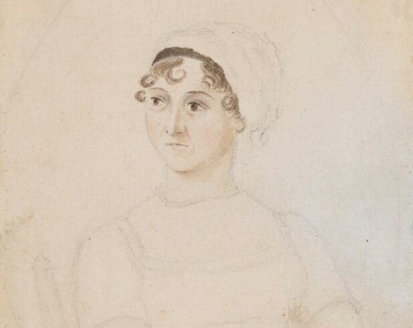
In Jane Austen’s Footsteps

Slide 2
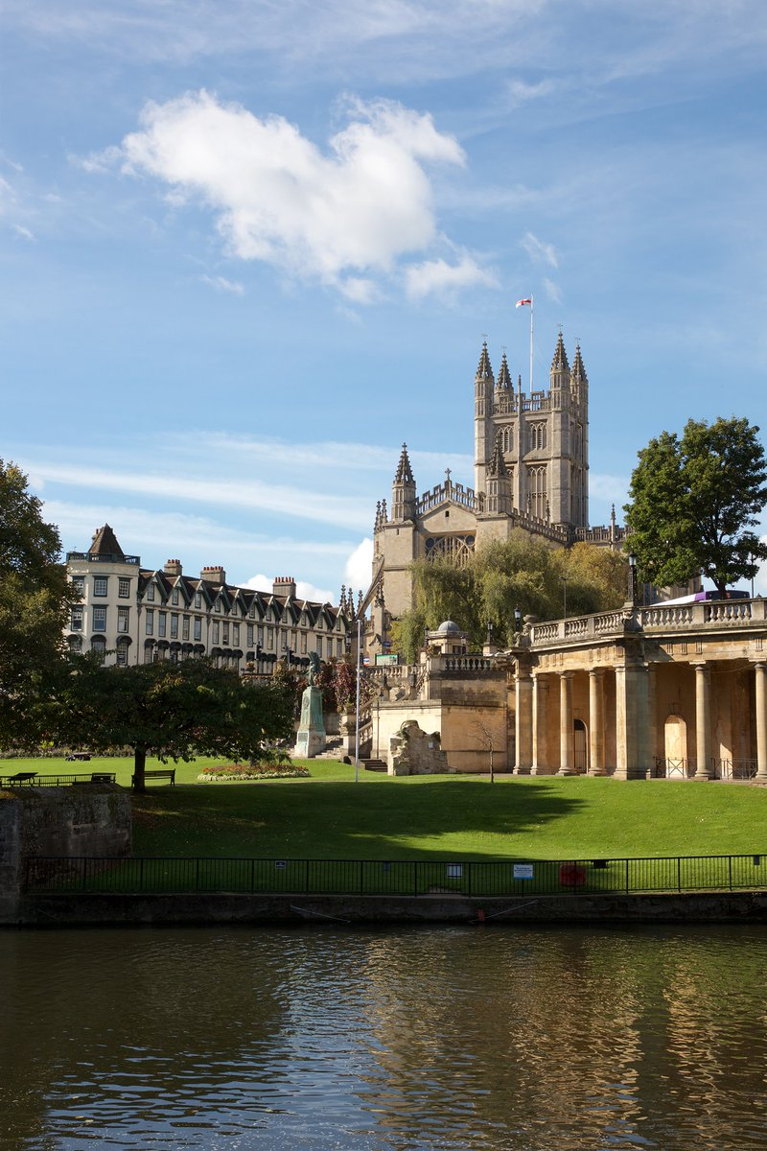
Bath

Slide 3
Royal Crescent
The Royal Crescent, one of Bath’s most iconic landmarks, was built between 1767 and 1775 and designed by John Wood the Younger.
This impressive landmark is arranged around a perfect lawn overlooking Royal Victoria Park and forms a sweeping crescent of 30 Grade I Listed terrace houses. It is without doubt one of the greatest examples of Georgian architecture anywhere in the UK.
https://visitbath.co.uk/listings/single/the-royal-crescent/

Slide 4
Southampton

Slide 5
https://historicsouthampton.co.uk/austen/
Jane Austen was born in Steventon, Hampshire, in 1775. She moved to Bath with her family in 1801, but the sudden death of her father in 1805 left Jane, her sister, and her mother, in a precarious financial position. The three women arrived in Southampton in 1806 and they moved in with Jane’s brother, Frank. Jane would have known the town from previous visits. In 1783, she had been sent to Mrs Cowley’s school in Oxford along with her sister, Cassandra, but Mrs Cowley soon moved the school to Southampton and took the two sisters with her. Jane Austen returned to Southampton ten years later in 1793 when she danced at a ball – possibly at the Dolphin Hotel – and then, by the end of 1806, the once fashionable spa town on the South Coast of England had become her home.

Slide 6
Historical Context of the novel: Late 18th century and the Regency Period
https://www.college.columbia.edu/core/node/1765
Jane Austen’s brief life and writing career overlapped with one of the most transformative eras in British history, marked by revolution abroad and unrest at home. The signing of the Declaration of Independence in 1776, the year after Austen’s birth, signaled the start of the American Revolution, followed in the next decade by the beginning of the French Revolution in 1789. For the next two decades, Britain was engaged almost without cease in the Revolutionary and Napoleonic Wars of 1793–1815, one of the most significant conflicts in British history. Among the effects of England’s foreign wars during this period were great financial instability and monetary volatility. The precariousness of the late eighteenth-century was followed in the 1810s and 1820s by what is known as the Regency period. The Regency officially began in 1811, when King George III went permanently insane and his son George, Prince of Wales, was sanctioned to rule England in his place as Regent.

Slide 7
Port

