Slide 1
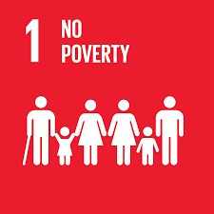
Universal Declaration of
Human Rights
Article(s):

Slide 2
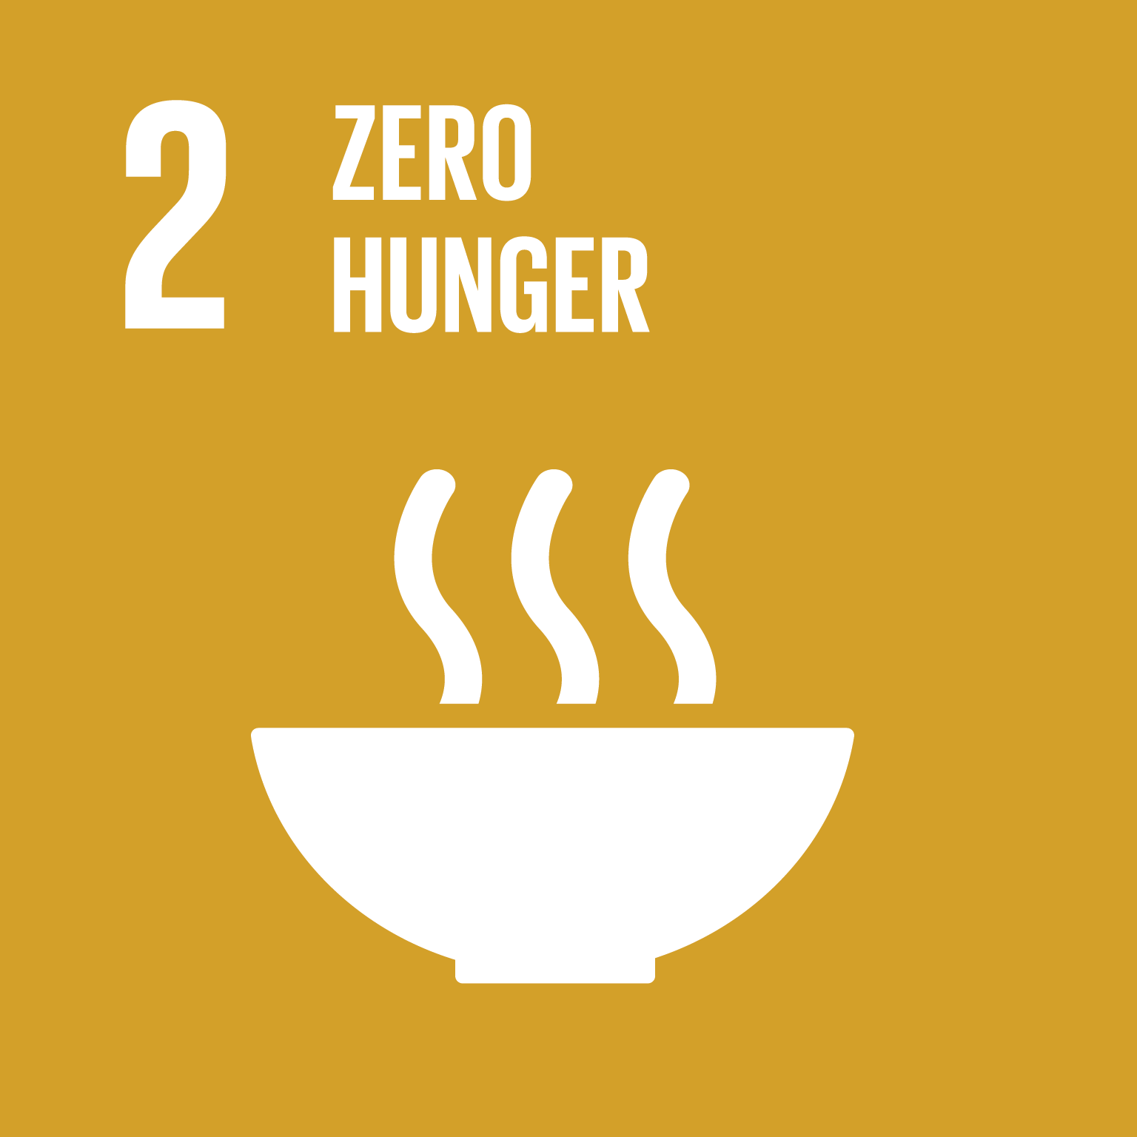
Universal Declaration of
Human Rights
Article(s):

Slide 3
Universal Declaration of
Human Rights
Article(s):

Slide 4
Universal Declaration of
Human Rights
Article(s):

Slide 5
Universal Declaration of
Human Rights
Article(s):

Slide 6
Universal Declaration of
Human Rights
Article(s):

Slide 7
Universal Declaration of
Human Rights
Article(s):

Slide 8
Universal Declaration of
Human Rights
Article(s):

Slide 9
Universal Declaration of
Human Rights
Article(s):

Slide 10
Universal Declaration of
Human Rights
Article(s):

Slide 11
Universal Declaration of
Human Rights
Article(s):

Slide 12
Universal Declaration of
Human Rights
Article(s):

Slide 13
Universal Declaration of
Human Rights
Article(s):

Slide 14
Universal Declaration of
Human Rights
Article(s):

Slide 15
Universal Declaration of
Human Rights
Article(s):

Slide 16
Universal Declaration of
Human Rights
Article(s):

Slide 17
Universal Declaration of
Human Rights
Article(s):

