Slide 1
The Starry night
Εύα Αθανασάκη και Μαρία Ρουσσάκη Β4

Slide 2
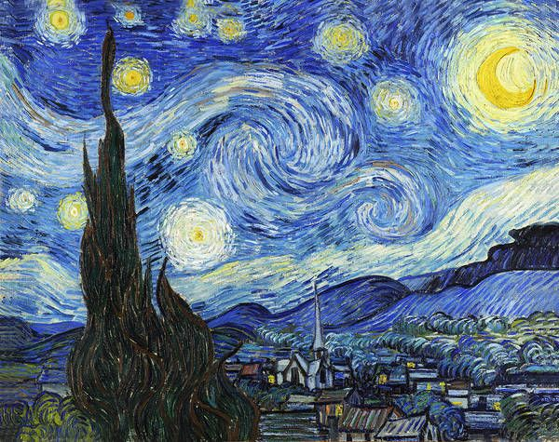
This is Vincent Van Gogh’s painting called “The Starry Night”
It was painted in June 1889
It’s an oil-on-canvas painting and its size is 73.7 × 92.1 cm
The painting depicts a night scene with eleven vertices of stars and a bright yellow crescent. In the background there are hills, in the middle of the ground there is a moonlit city with a church that has an elongated bell tower and in the foreground is the dark green silhouette of the cypress.

Slide 3
The painting shows the view from the east-facing window of Vincent Van Gogh’s asylum room at Saint-Rémy-de-Provence, just before sunrise with the addition of an imaginary village.
The view has been identified as the one from his bedroom window, facing east, a view which Van Gogh painted variations of no fewer than twenty-one times, including The Starry Night. Van Gogh depicted the view at different times of the day and under various weather conditions, such as the sunrise, moonrise, sunshine-filled days, overcast days, windy days and one day with rain.
It has been in the permanent collection of the Museum of Modern Art in New York City, since 1941, acquired through the Lillie P. Bequest.

Slide 4
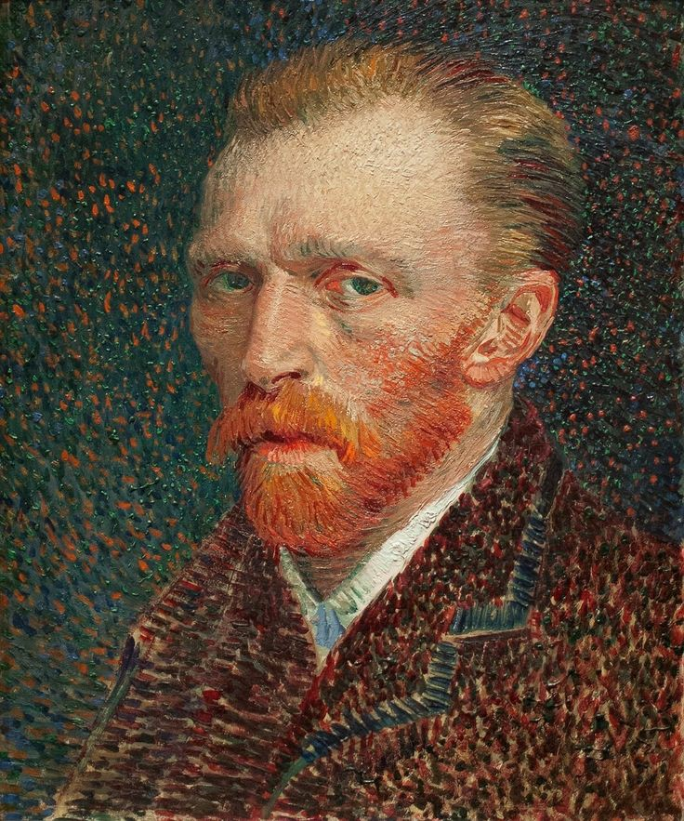
Vincent Van Gogh’s self portrait
While the hospital staff did not allow Van Gogh to paint in his bedroom, he was able to make sketches in ink or charcoal on paper. Eventually, he would base newer variations on previous versions.

Slide 5
The Starry Night is the only nocturne in the series of views from his bedroom window. In early June, Vincent Van Gogh wrote to his brother, Theo : “This morning, I saw the countryside from my window a long time before sunrise with nothing but the morning star, which looked very big.” Researchers have determined that Venus was indeed visible at dawn in Provence in the spring of 1889 and was at the time nearly as bright as possible.
So the brightest “star” in the painting, just to the viewer’s right of the cypress tree is actually Venus.

