Slide 1
Climate Change In Greece

Slide 2
Contents
Climate Change Diagrams
Wildfires
Floods
Consequences

Slide 3
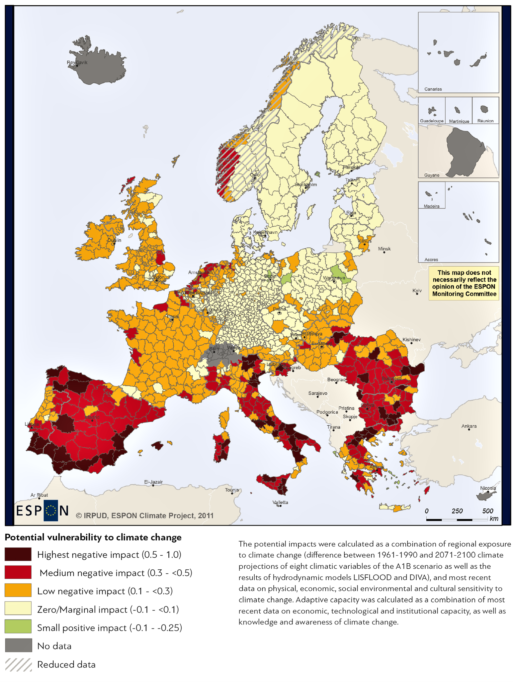
Climate Change Impact In Europe

Slide 4
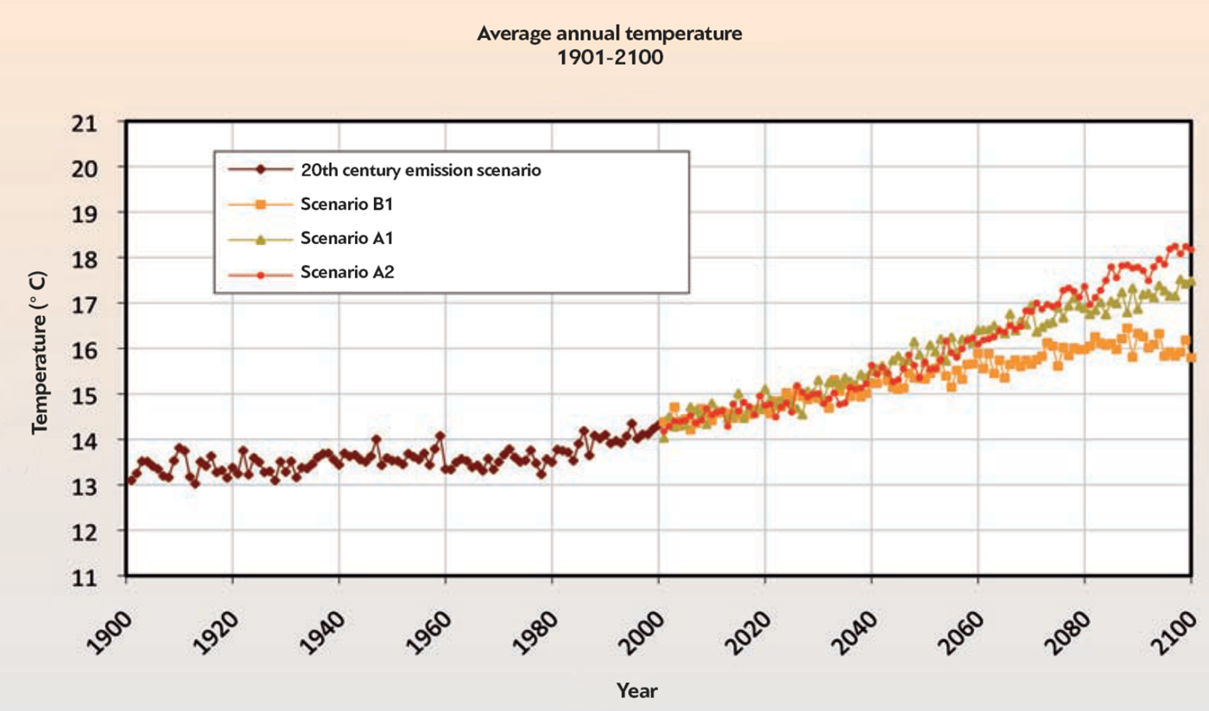
Temperature Increase In Greece

Slide 5
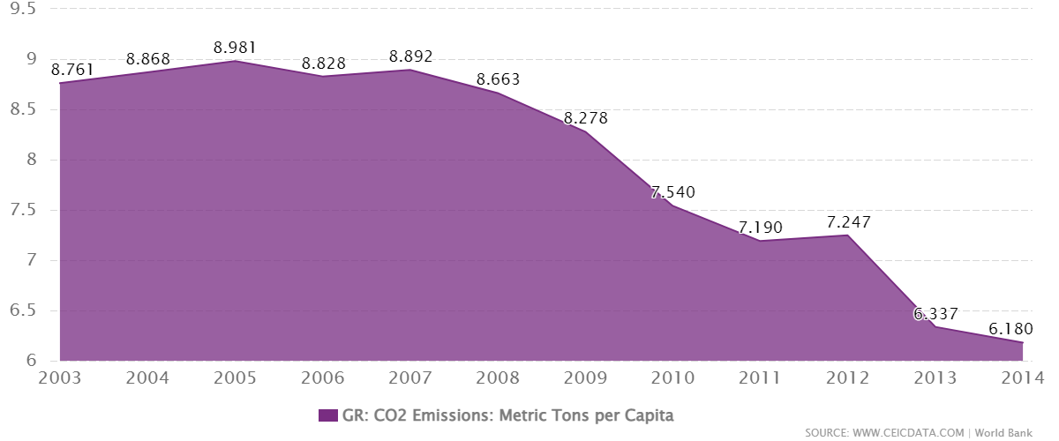
Greece’s Carbon Emissions
Greece accounts for 2.4 % of total EU greenhouse gas
The carbon intensity of the Greek economy decreased by 23 % from
2005 to 2019, at a slower rate than the EU average.

Slide 6
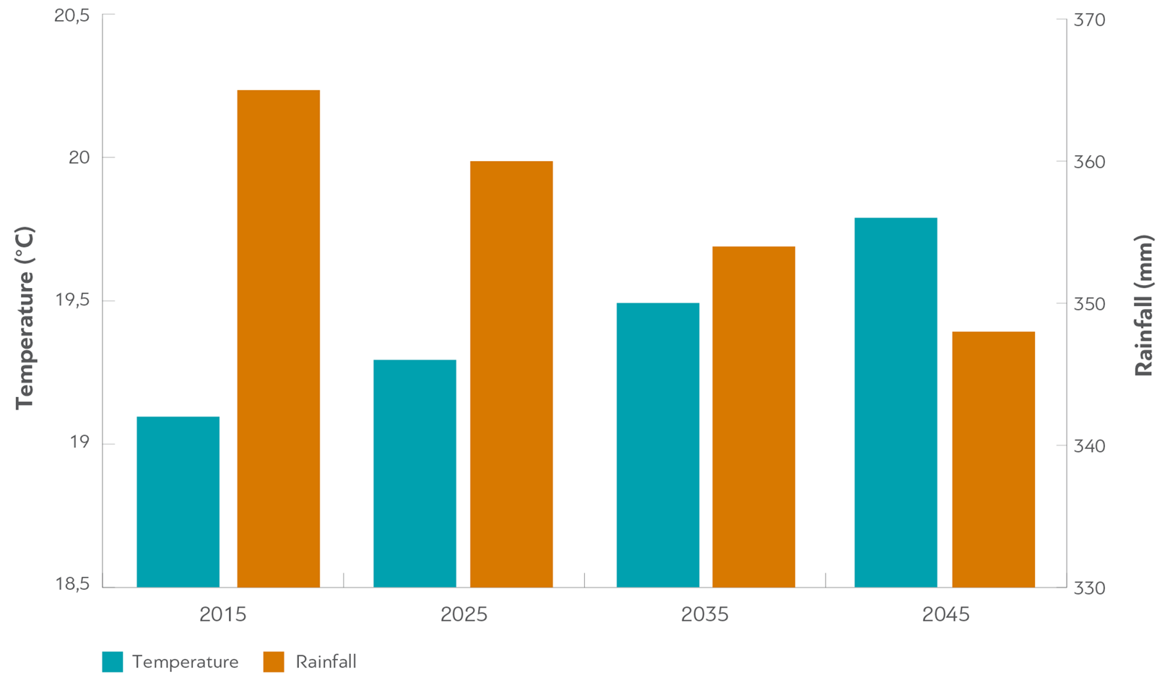
Athens Temperature/Rainfall Diagram

Slide 7
Wildfires

Slide 8
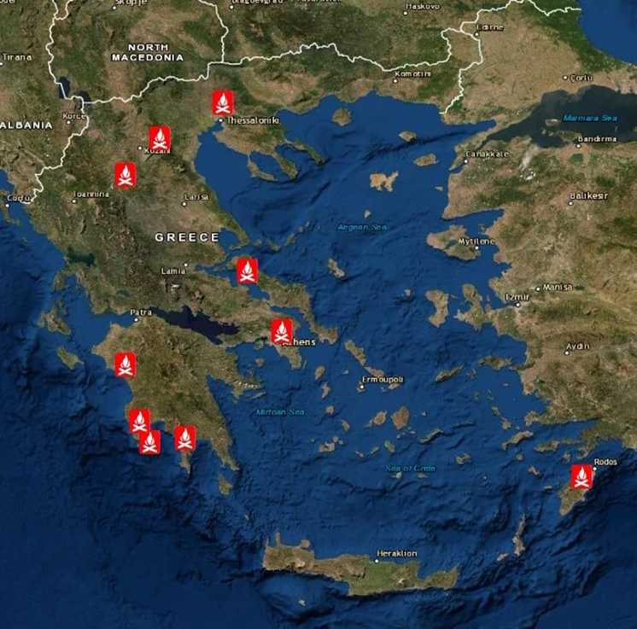
Greece’s forest fires of 2021
Temperature reached 47.1 °C
Greece was experiencing the
worst heatwave since 1987
Places mostly affected:
Northern Greece
Southwestern Greece
Central Greece

Slide 9
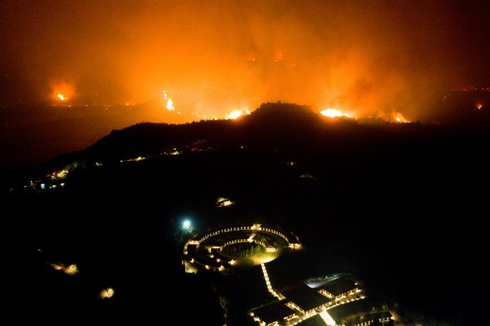
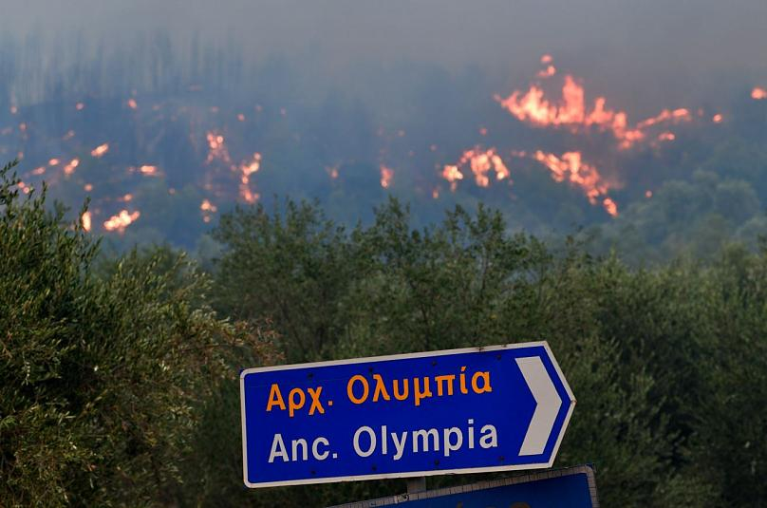
Wildfires threaten the sites of ancient Olympia
(wildfires in the region of Ilia / 2021)

Slide 10
Statistics about the fires of 2021
Total fires: 140+
Total area burnt: 125,000 hectares (the worst fire season since 2007)
The World Meteorological Organization highlighted the Greek wildfires, noting the wildfires as an example of the extreme weather being caused by climate change

Slide 11
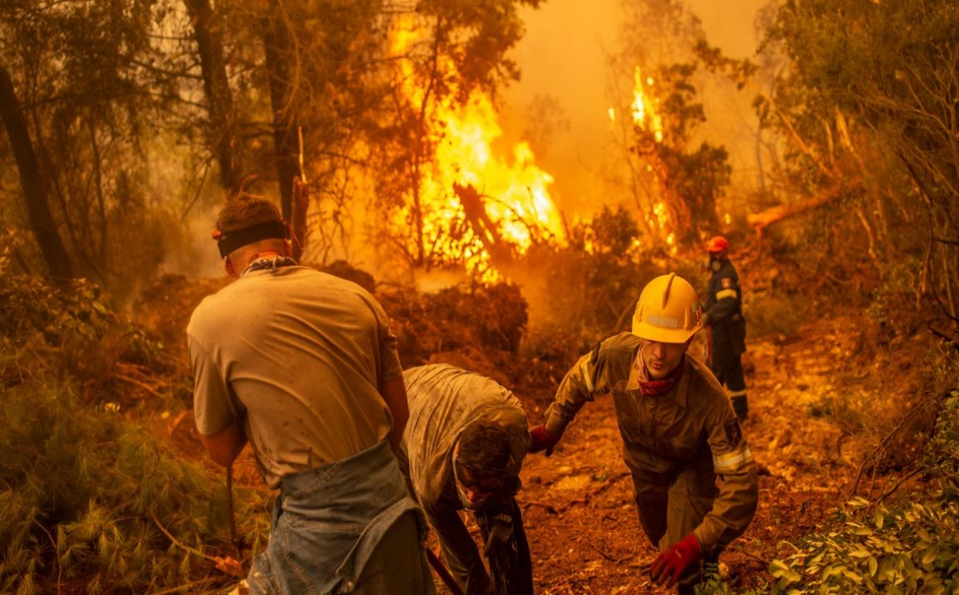
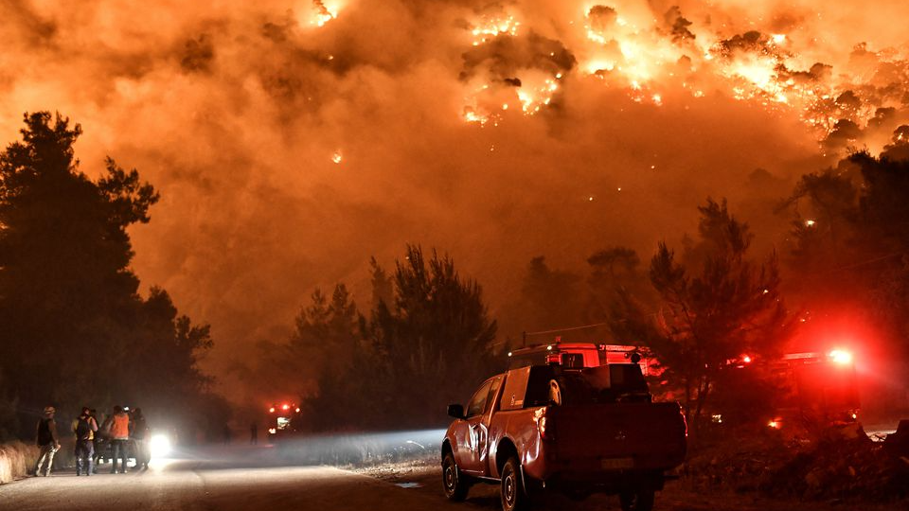
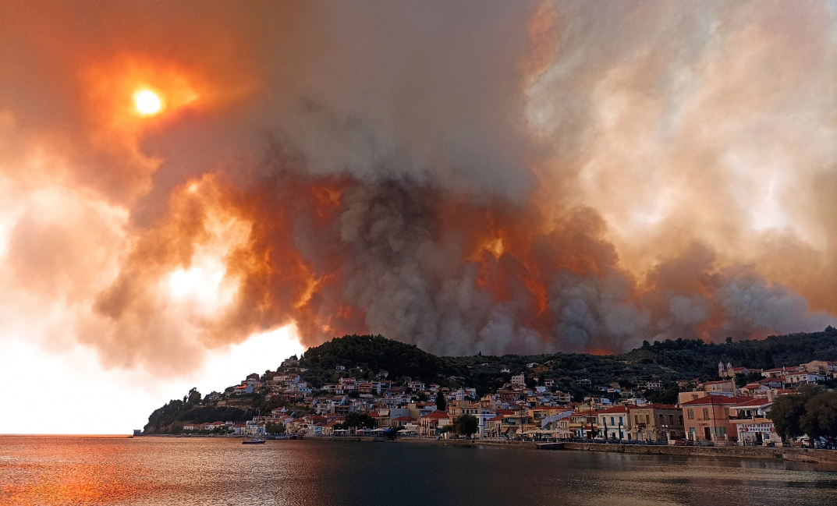
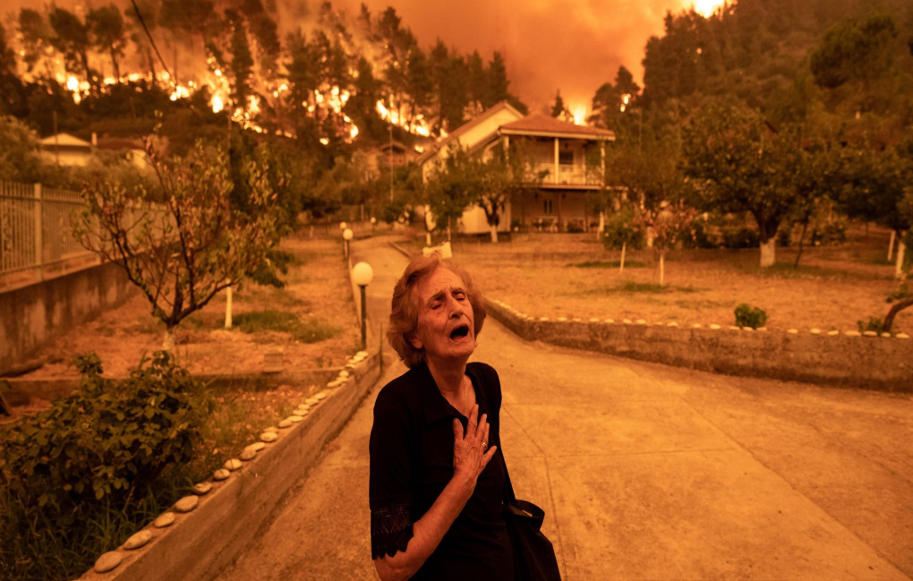

Slide 13
Floods

Slide 14
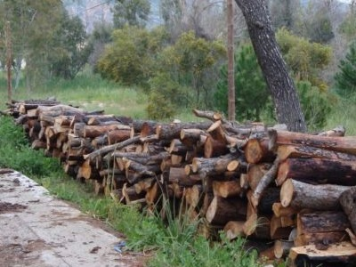
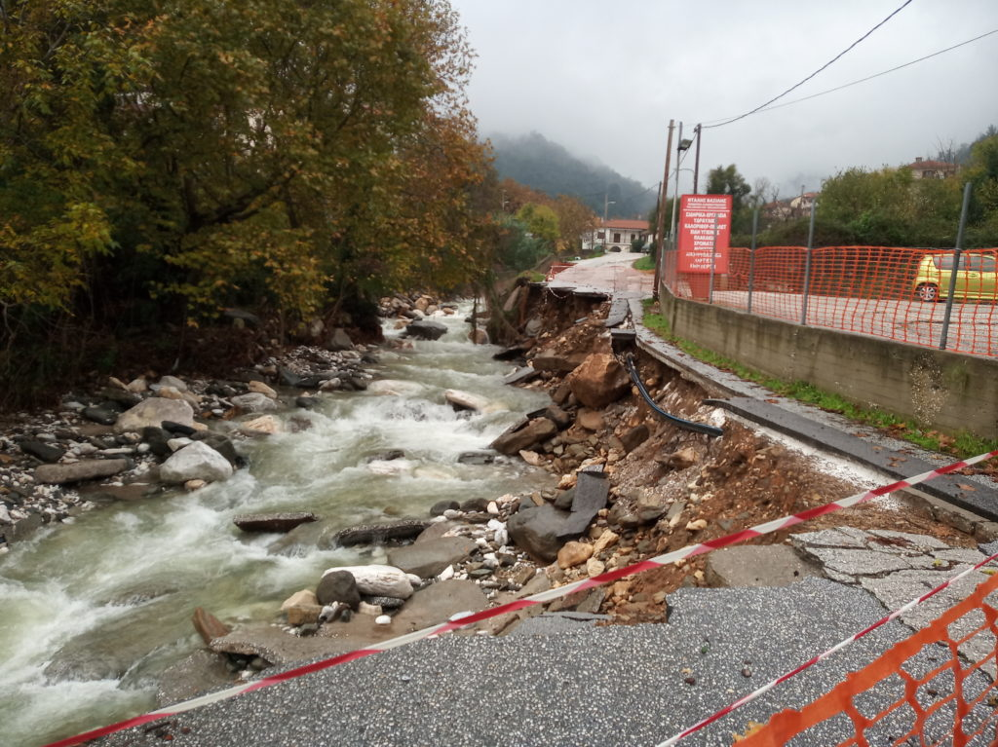
Illegal logging and streams
Illegal logging has contributed significantly to the occurrence of floods. It has been highly affected by the economic crisis
The rubble of streams is a big problem in Greece because a lot of city’s even Athens are build on top of streams and rivers. Those rivers start to flood during the rain and the city fills with water.

Slide 15
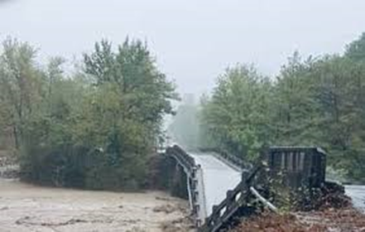
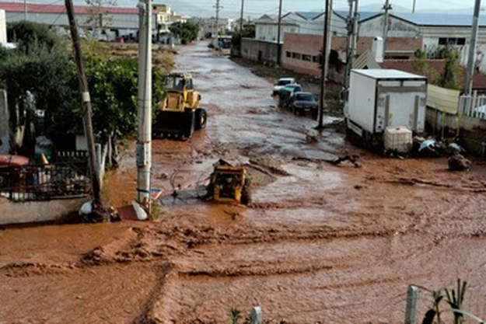
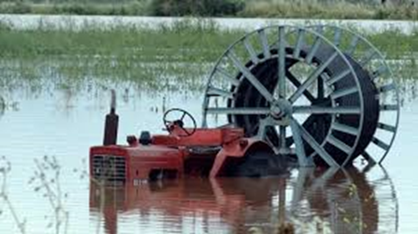

Slide 16
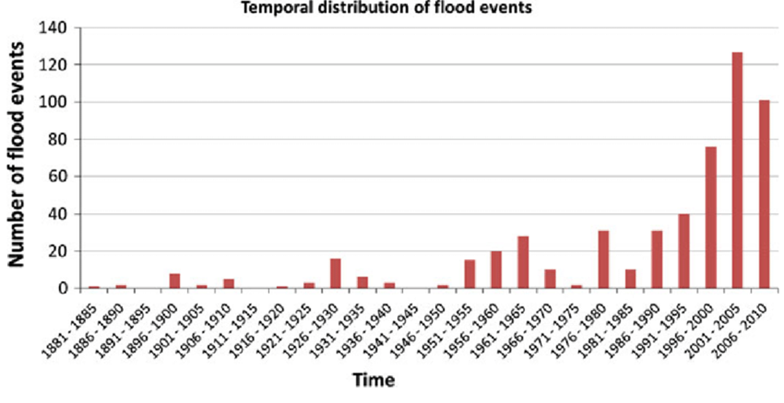
Flood timeline

Slide 17
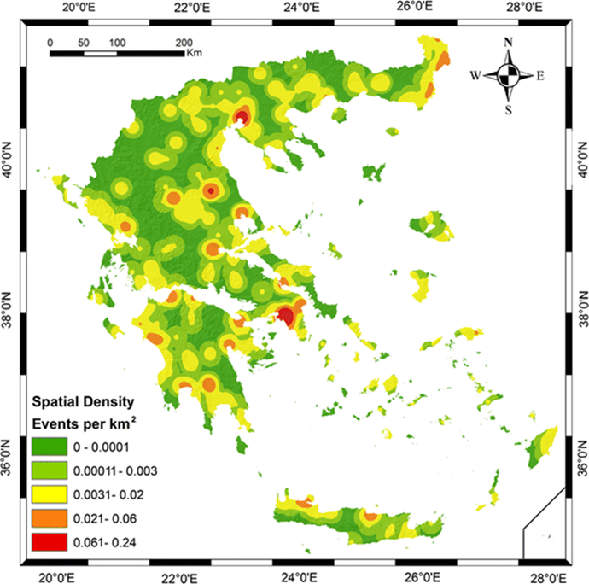
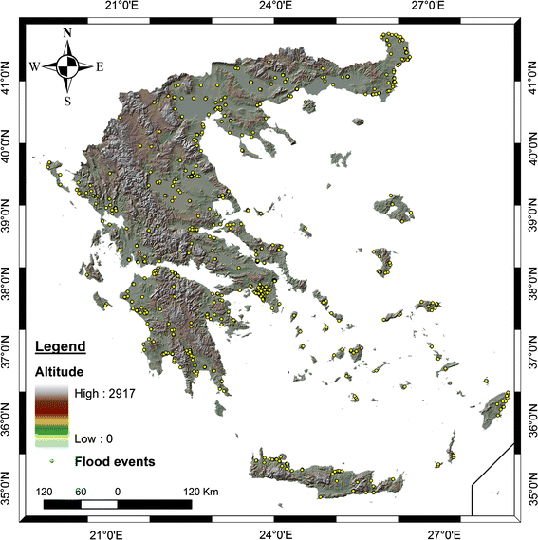
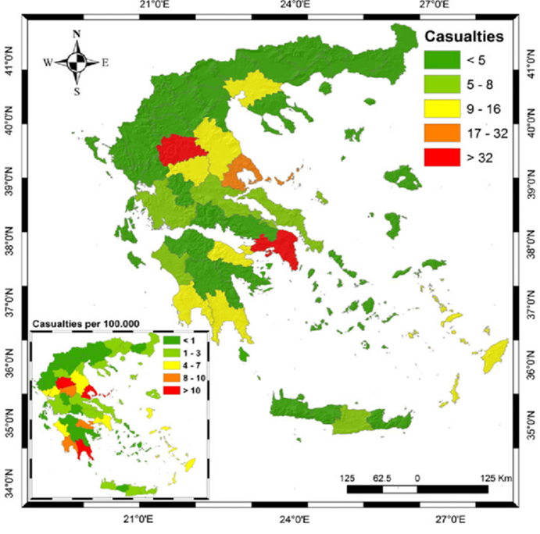

Slide 18
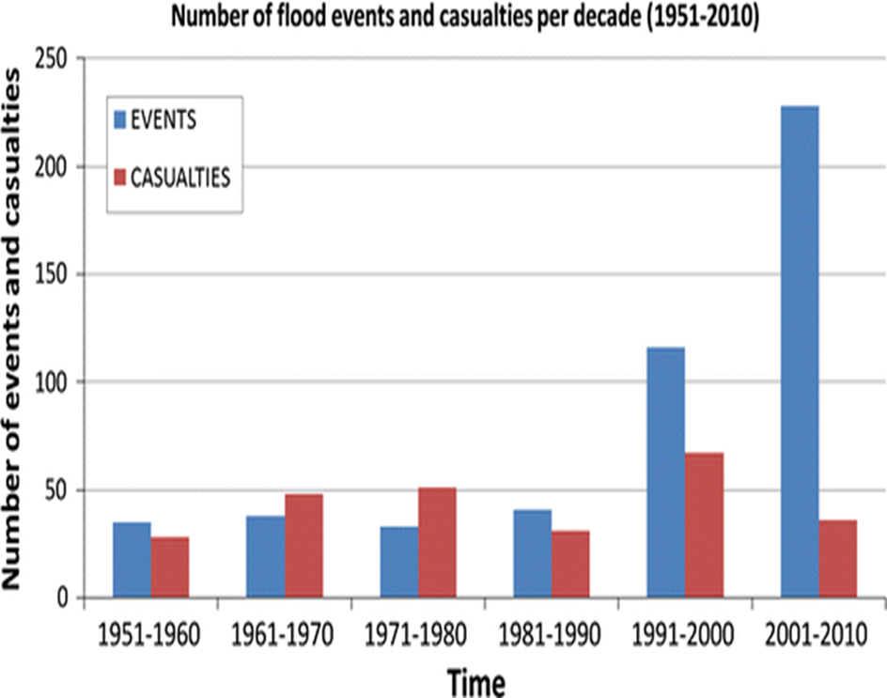

Slide 20
Consequences Of Climate Change
Fatalities:
Floods: 156 deaths (since 1980)
Wildfires: more than 120 death (since 2000)
Destruction of material properties:
(e.g. more than 10 million euros worth of damage per flood event)
Problems in agriculture (destruction of fields and land)
Higher energy requirements

Slide 21
End Of Presentation
Thank you for your attention :D

