Slide 1
Animal Rights
(Unit 5)

Slide 2
Useful Vocabulary
Animal cruelty
Activists / protesters
Animal rights groups
RSPCA/ ASPCA
PETA
WWF

Slide 3
Useful Vocabulary
Animal testing
Vivisection
Animal welfare
Blood sports

Slide 4
Useful Vocabulary
Factory farming
Farming methods
Battery hens
Free range egg / hens
Endangered species
Organic farming
Vegetarian / vegan

Slide 5
Animal testing Mind Map
In the name of animal testing more than 100 million animals die each year. Is this good or bad?
The following mindmap will help you generate ideas for and against animal testing

Slide 6
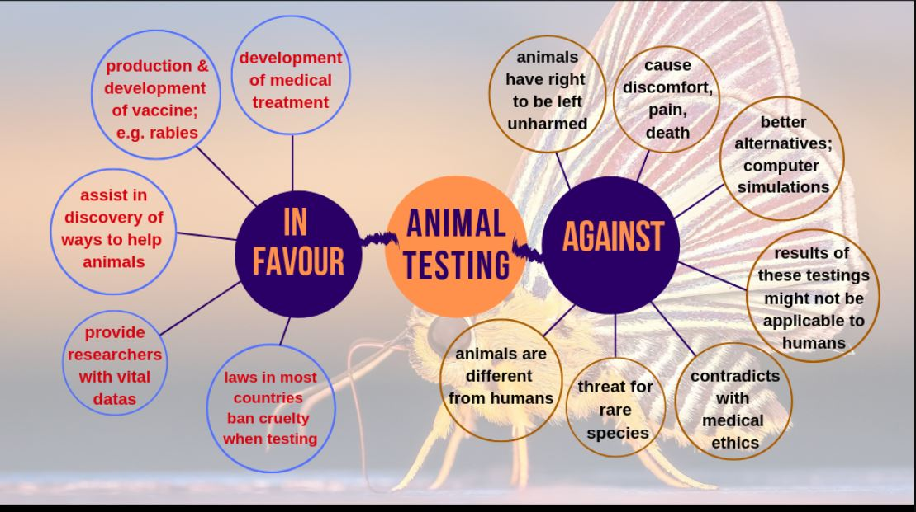

Slide 7
Writing task (opinion essay)
Topic: Some people feel it is cruel to use animals for laboratory testing of drugs or products such as cosmetics. Others believe animal testing is necessary to develop vaccines and products that are safe for human use. Do you believe animals should be used in experiments? Explain your opinion and give specific details and reasons to support your viewpoint.

Slide 8
A) Structure:
Par 1. Present the issue and state your opinion.
Do you think that animal testing is acceptable? (eg I wholeheartedly agree.)
Give two reasons to support your opinion (Not only are these experiments extremely expensive, but they also cause unnecessary pain and suffering to innocent creatures.
Par.2 Present one reason with supporting details or examples
E.g. experiments are expensive: 1) why spend money on testing products when there are hundreds on sale in stores already 2) most drug trials are unsuccessful
Par 3: Present the second reason with supporting details or examples
Test animals suffer pain and distress: 1) no pain relief given / 2) animals confined in cages/ often killed when the research is completed
Par 4. Sum up with a strong statement
e.g. The suffering caused to animals far outweighs any benefits

Slide 9
B) Emphasizing your points with the use of cleft sentences, passive voice and appropriate expressions
1. First we must consider the money required for testing.
What must be considered first is…..
2) We should invest the funds developing alternative medicines.
What we should do is invest……
3) We should also think about the pain animals suffer
Another factor to take into account is
4) They never get any form of pain relief.
At no time is any form of pain relief administered.)
5) Because the animal ‘s welfare is being ignored, people are upset.
It is this total disregard for animal welafare that upsets people.

Slide 10
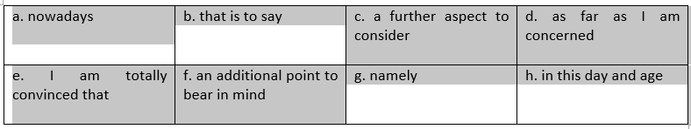
C) Varying your language / vocabulary you use will improve the quality of your writing.
1. Large mammals may suffer from zoochosis; in other words, they may show symptoms of distress.
2. In my view, animal testing is cruel and should not be allowed.
3. One aspect of conservation is saving endangered species. Another factor to take into consideration is preserving natural habitat.
4. In this era of modern technology, scientists are using technology to save and protect endangered animals

Slide 11
D) VOCABULARY / Matching
1. We must consider the funding used for testing new products.
2. Using human cells in a lab is a viable means of testing drugs without using animals.
3. Activists argue that scientists show a total disregard for the suffering of primates.
4. The risks of this treatment to the patient far outweigh the benefits of a possible cure.
5. Some support animal testing on the grounds that testing on human beings is illegal.
a. exceed the advantages
b. complete indifference to
c. feasible
d. for the reason
e. money

Slide 12
