Slide 1

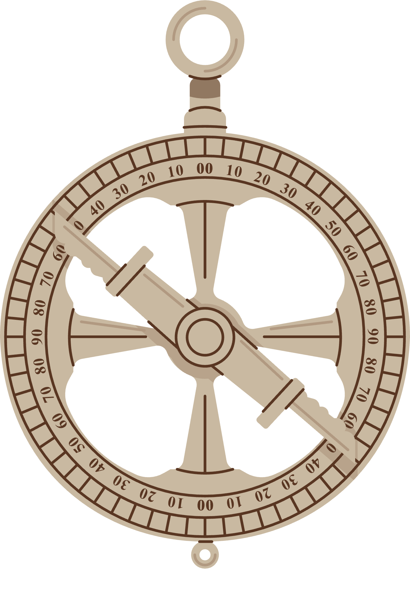



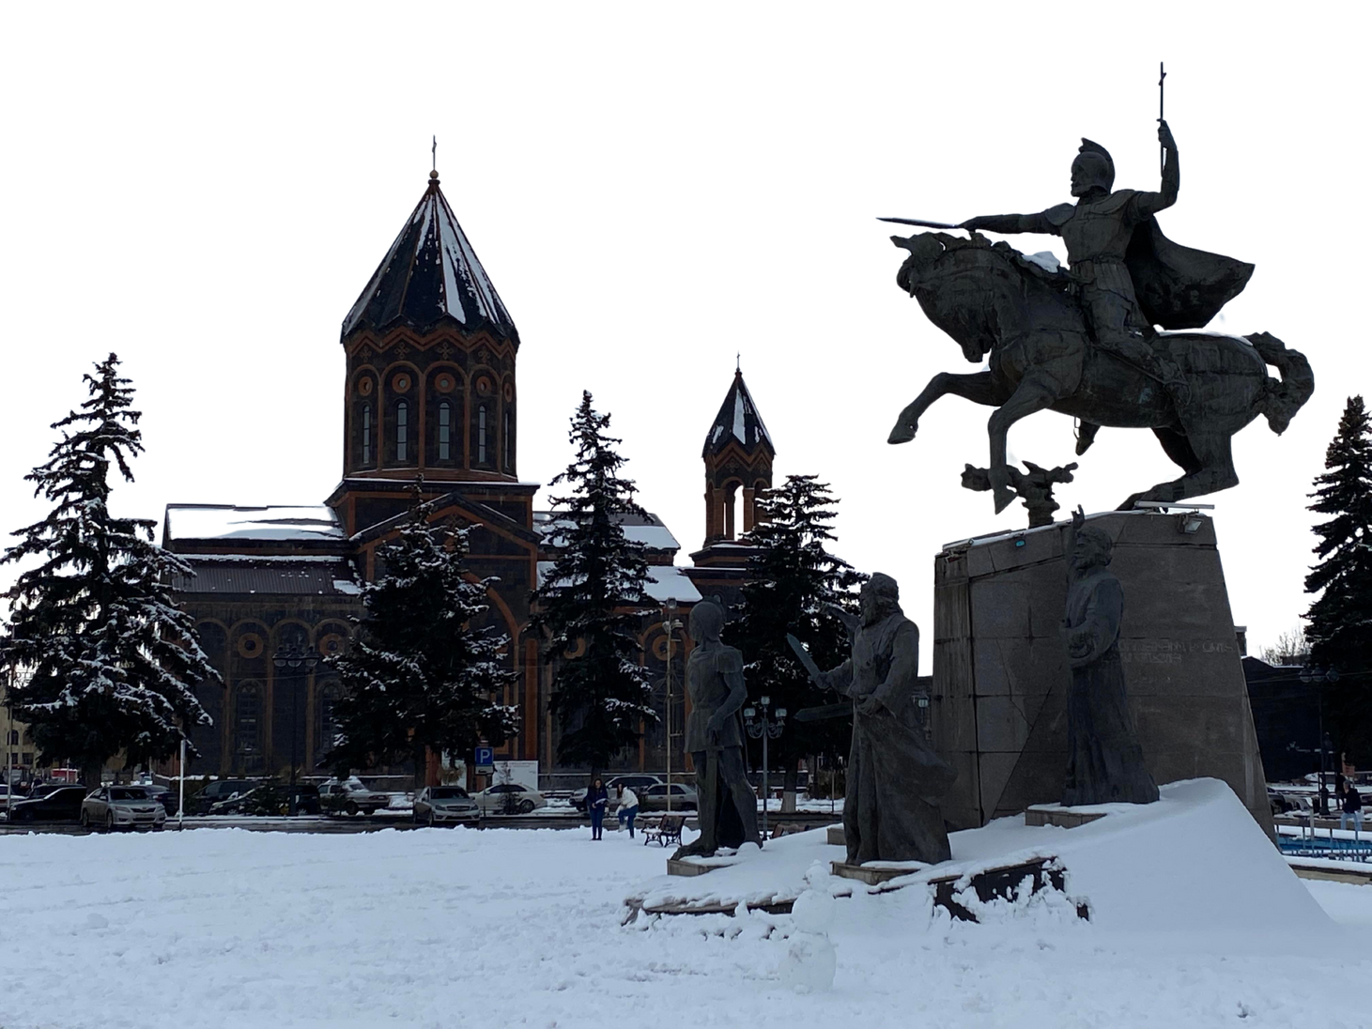
Vartanants 2025
Α’ Γυμνασιου

Slide 2
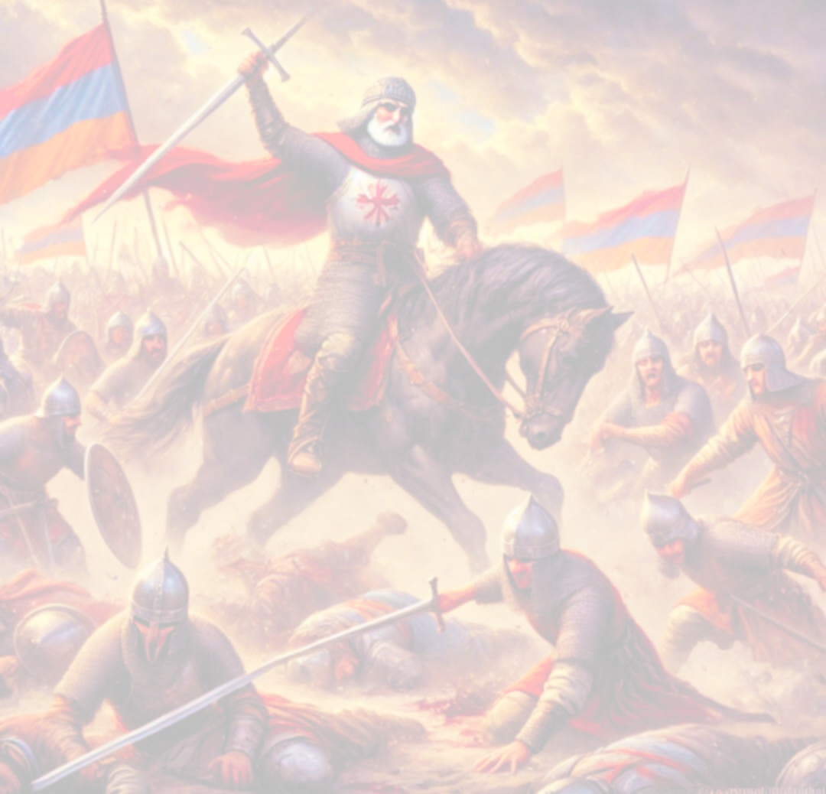
Vardan Mamikonian 387–451 AD
Վարդան Մամիկոնեան
Vartan Mamigonian was born in 388, right after the division of Armenia between Persia and Byzantium. He was the elder son of sparapet (generalissimus) Hamazasp Mamigonian and Sahakanush, the daughter of Catholicos Sahak I Partev. He studied at the school that St. Sahak and St. Mesrop Mashtots had opened in Vagharshapat, the capital of Armenia, right after the invention of the Armenian alphabet. By order of emperor Theodosius II, he was recognized as stratelates (general) of Byzantine Armenia in Constantinople (420). Two years later, he left for Ctesiphon, the capital of Persia, where Sasanid king Bahram V (420-438) acknowledged him as Armenian sbarabed, and after the fall of the Arshakuni (Arsacid) dynasty in Persian Armenia (428), he was confirmed as sbarabed of the marzbanate (border province) of Armenia. In 442, by order of Bahram V’s successor, Yazdegerd II (438-457), the Armenian cavalry led by Vartan Mamigonian fought against the Kushans, who had invaded Persia.

Slide 3

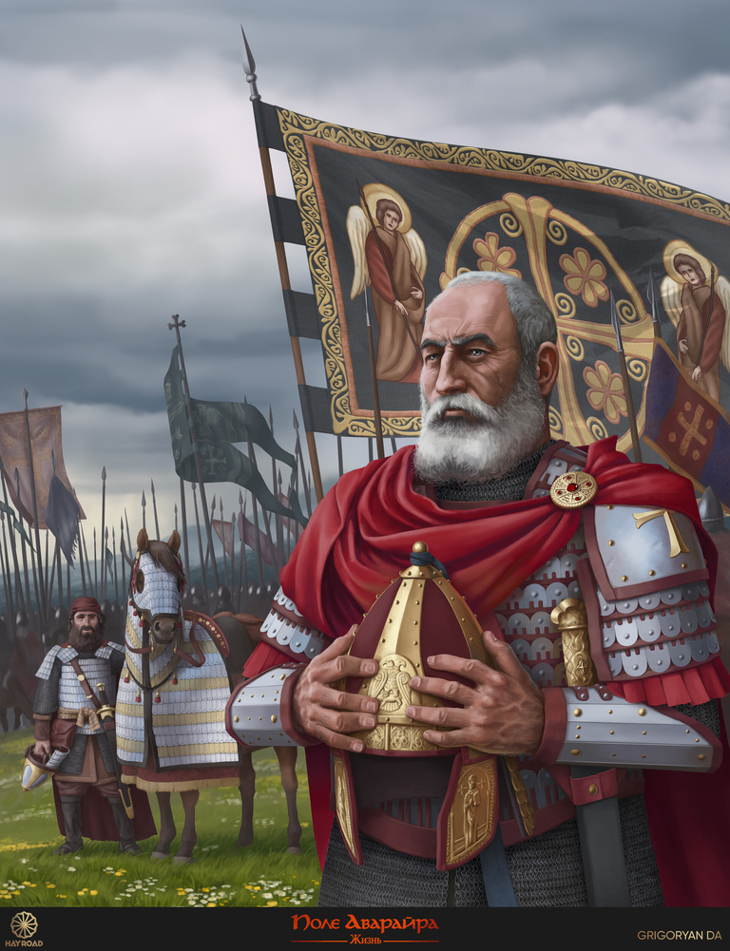
Persia and Religious Assimilation
In 449 Yazdegerd II embarked into a policy of assimilation and called upon the Armenians by decree to renounce Christianity and become Zoroastrians. An assembly gathered in Artashat with the participation of Vartan Mamigonian refused the Persian request. Georgians and Caucasian Albanians also sent similar refusals. The representatives of the Armenian, Georgian, and Caucasian Albanian governments, along with Vartan Mamigonian, were called to Ctesiphon in April 450. Yazdegerd II demanded from them to abjure the Christian faith, threatening them with exile along with their families and confiscation of their properties. The princes decided to accept the demand as a formality and revolt as soon as they returned. However, Yazdegerd II kept Ashusha, the prince of Gugark, and the sons of Vasak Siuni, the marzban of Armenia, as hostages.

Slide 4

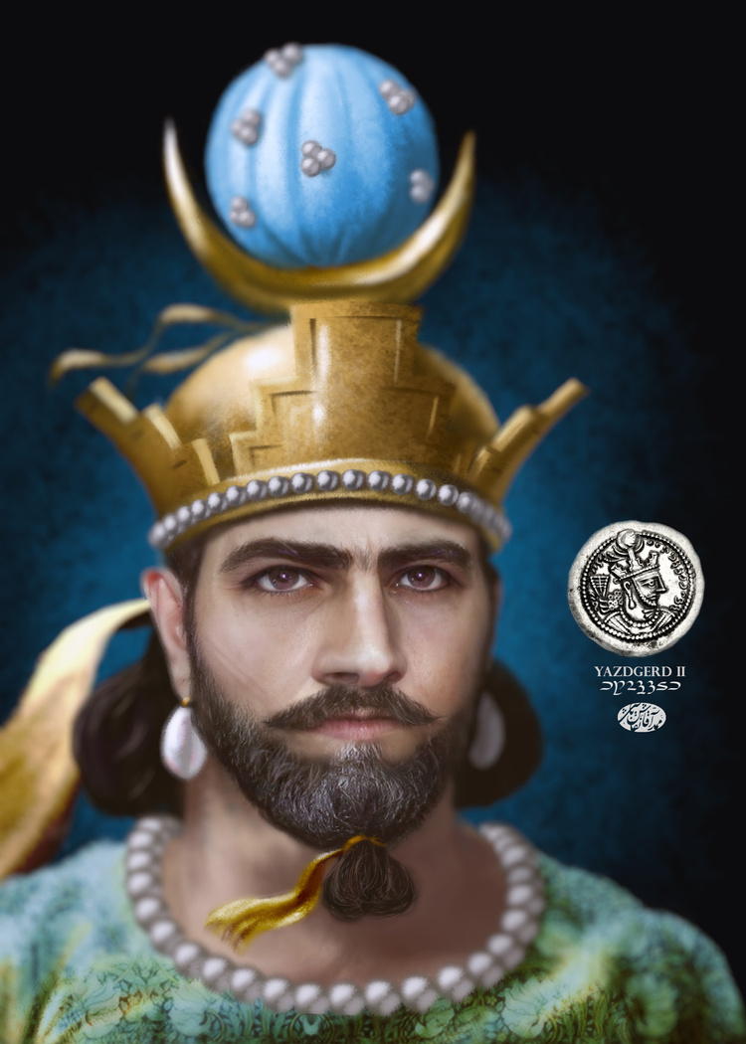
Loyal Christian
The Persian king sent back the Armenian noblemen with 700 magi and a guard, with instructions to turn the churches into pagan temples and build fire altars. After the Armenians captured the magi when they tried to turn the church of the town of Angegh into a Zoroastrian temple, Vartan Mamigonian called an assembly and declared that his conversion was untrue.

Slide 5
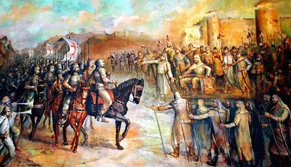
Preparing for War
The Armenians prepared for war. Vartan sealed a military pact with the governors of the Georgians and Albanians, and asked for help from Byzantium, but emperor Marciano refused. Vartan helped the Albanians to repel a Persian invasion in the same year.
After Vasak Siuni refused to join the rebellion, fearing for his children and arguing that victory was impossible without Byzantine help, Vartan returned to Armenia and took the government in his hands.

Slide 6
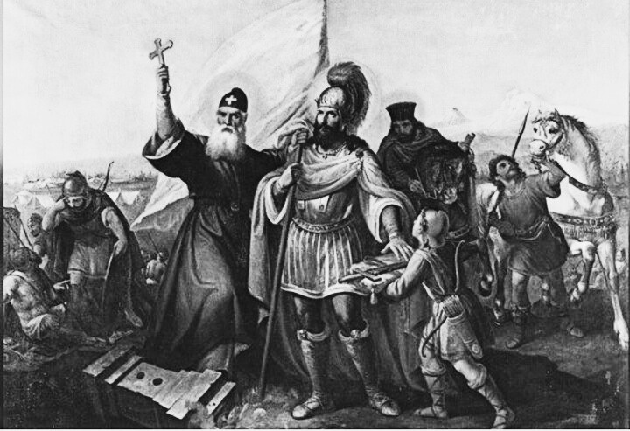
The Battle of Avarayr
The decisive clash with the Persian army happened on May 26, 451, in the field of Avarayr, in the district of Artaz (province of Vaspurakan). Vartan Mamigonian divided the Armenian forces (66,000 soldiers) into four sections, one of them under his immediate command. He attacked the first, but he was surrounded and died in battle.
Despite his death, the Persians, who had superior forces (90,000 soldiers and elephants) were forced to call back their troops due to the Armenian resistance. The plan to force Armenian conversion was shelved.

Slide 7
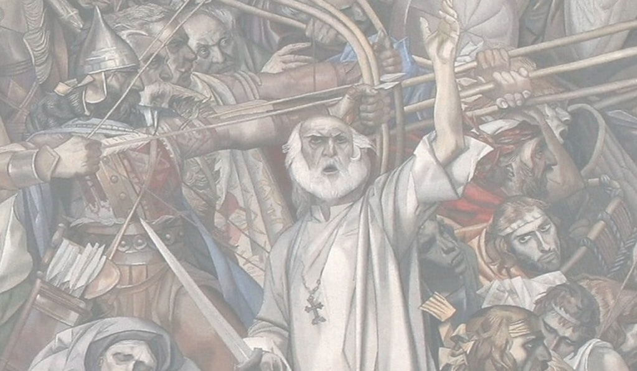
An Art Inspiration of Faith
The heroic figure of Vartan Mamigonian has been a frequent subject of literature, sculpture, painting, and theater. The liturgical hymns Norahrash, by Catholicos St. Nerses Shnorhali, and Ariatsialk, by Catholicos Petros I Getadartz, were devoted to the heroes of Vartanants.
Churches dedicated to Vartan Mamigonian and the Vartanants heroes, who were later canonized, have been built in different provinces of Armenia since medieval times, then in Armenian communities and now in the Diaspora. Two churches in the Eastern Prelacy remember them: Sts. Vartanants Church of Ridgefield, New Jersey, and Sts. Vartanants Church in Providence, Rhode Island.

Slide 8
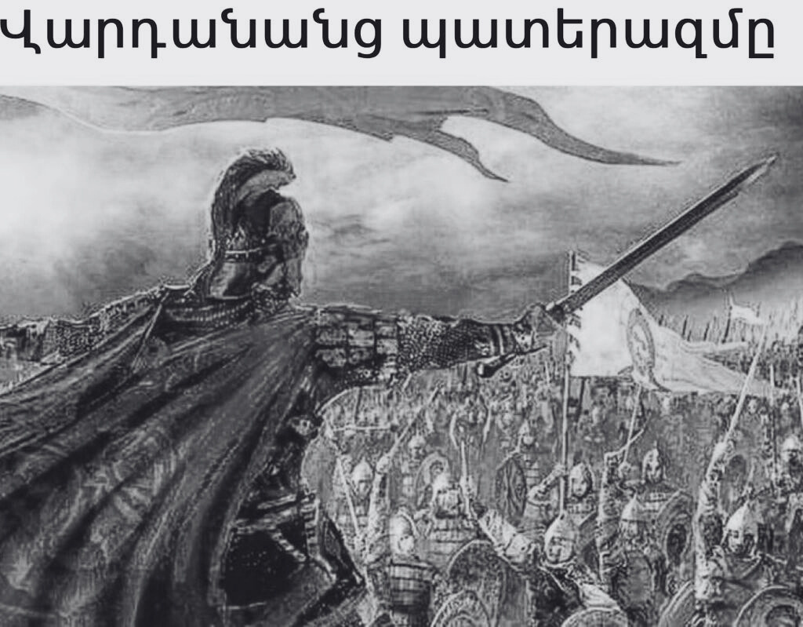
Vardan’s Legacy: Victory through Defeat
The Vartanants war was more than a one-day battle.
It all began on May 26, 451 A.D. with the Battle of Avarayr, but it did not end there. It did not end with the martyrdom of Vartan and his 1,035 comrades. Rather, the Vartanants war lasted 33 years and ended with the victorious Treaty of Nuvarsak in 484 A.D. Thus, this heroic war can be described as a chain of events beginning with the defeat on the field of Avarayr and ending with a victory at Nuvarsak.

Slide 9
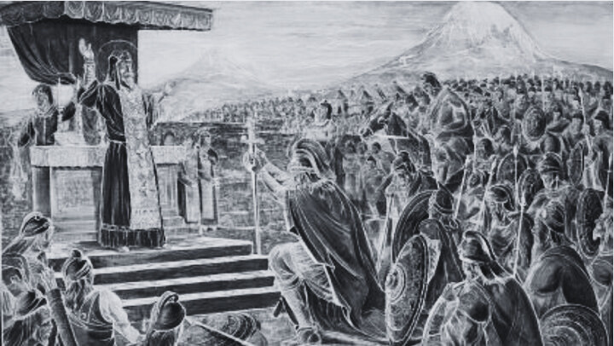
What are we celebrating through Vartanants’ heroic struggle?
First, we are celebrating a commitment to freedom. Freedom in all its forms is the cornerstone of a nation, the desire for freedom has always been, and will always be, one of the deepest longings of the human heart. Freedom for individuals and nations means to be themselves—to live their own lives, to think their own thoughts, to seek their own answers, and to decide their own destinies.
Living above the consensus is the heroic dimension to reject that which is reprehensible to human sensibility and conscience. It is the moral courage to reject that which is expedient and to do what is right. It is not easy to live above the consensus. Sometimes it is very costly. Vartanants resistance became a baptism of fire, but it eventually kept the Armenians a Christian nation. Christianity became firmly rooted in Armenia thanks to the Vartanants heroic stance to live above the consensus.
Freedom can be kept only with great vigilance and sacrifice. It can be lost overnight by a generation that exploits its privileges and renounces its responsibilities. Freedom is a spiritual quality which lives in the hearts and the wills of those who are determined to keep it.
Thirdly, we are celebrating a commitment to our Christian faith. Vartan’s faith was more than belief in the existence of God; it was trust and confidence. Vartan and his comrades were faced with a choice: Survival without Christ, or physical death for Christ. Their decision saved the Soul of the Armenian nation.
Secondly, we are celebrating a commitment to living above the consensus. Living above the consensus is the capacity to say “no” to something that is not right and is against one’s conscience. Conscience is a gift that God has endowed human beings with. It is an internal sense of right and wrong.

Slide 10
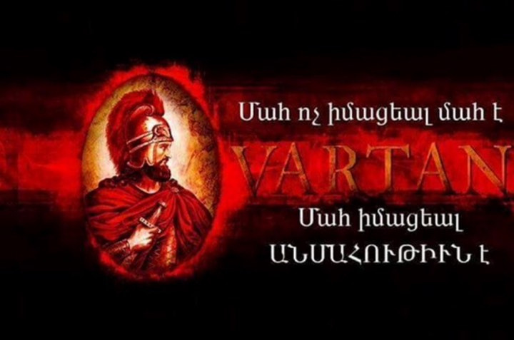
“I entreat you, therefore, my brave companions, especially because many of you surpass me in valor and precede me in princely rank. But since you, of your own free will, have selected me as your leader and commander, let my words be pleasant and agreeable to you all, great and small: Fear not the heathen hordes and never turn your backs to the frightful sword of mortal men; because should our Lord grant us victory, we shall destroy their might and the cause of righteousness shall be exalted. But if the time has come for us to meet a holy death in this battle, let us accept our fate with joyful heart, without mingling cowardice with our valor and courage. … Our Commander is not a mere man, but the Commander-in-chief of all martyrs. Fear is a sign of doubt; but as we have repudiated doubt long since, let fear also disappear from our hearts and minds.”

Slide 11
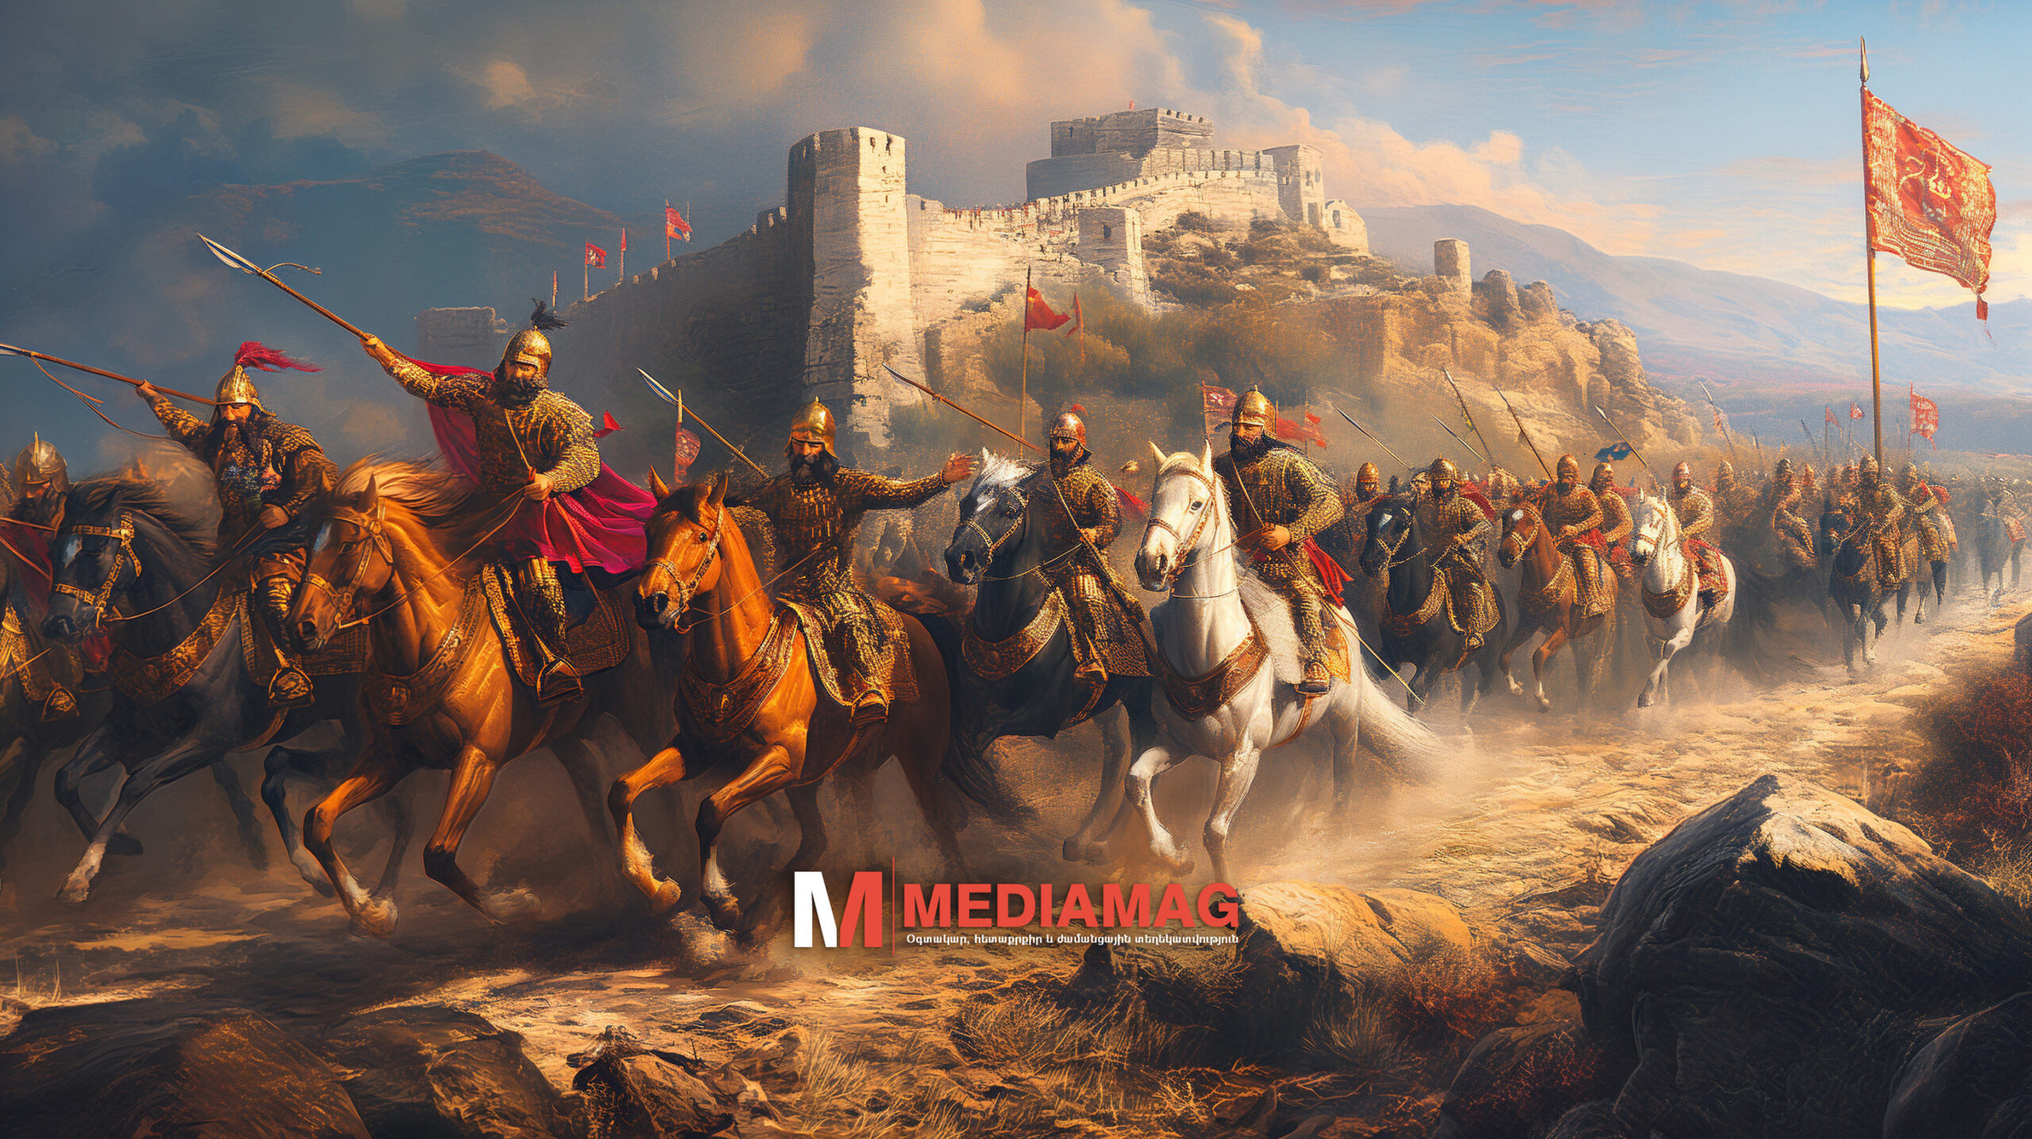
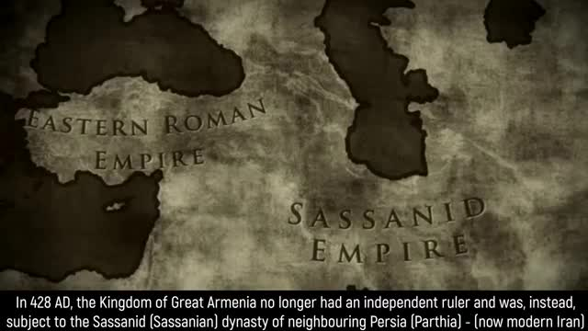
The Battle of Avarayr (Video)

Slide 12
Thank You

