Slide 1
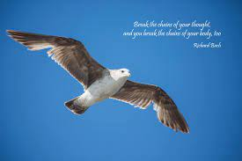
By Richard Bach
Jonathan Livingston Seagull

Slide 2
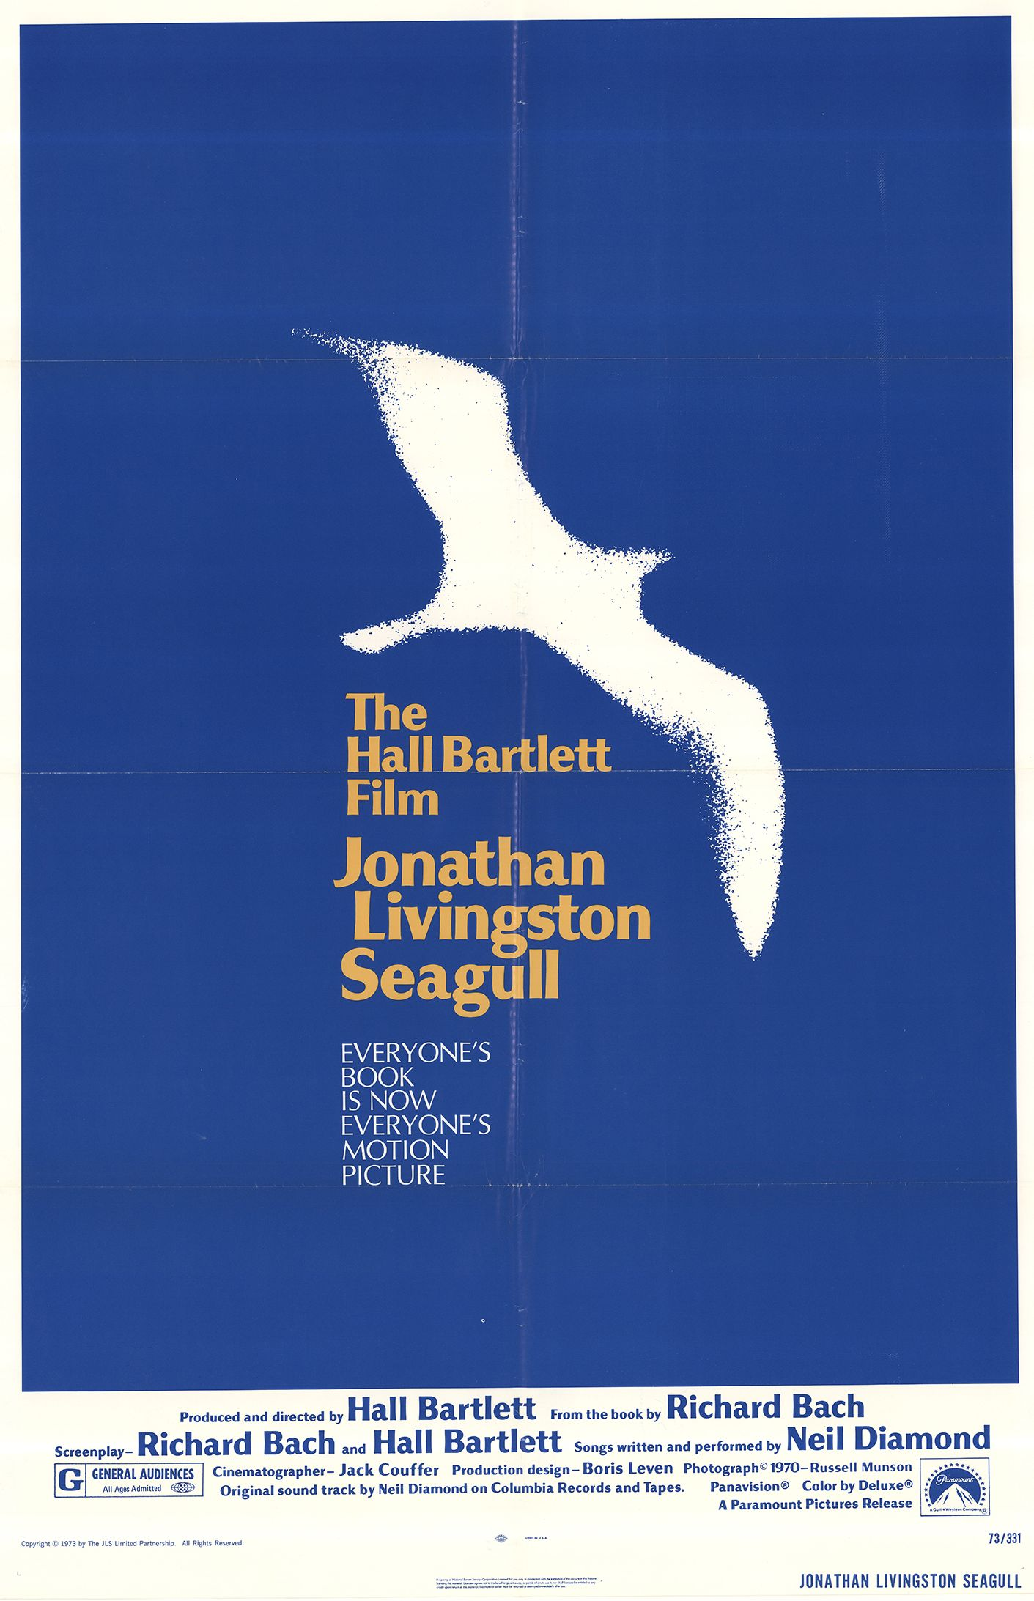
9. Now take a look at the paragraph that follows, from Bach's Jonathan Livingston Seagull, and do the following:
Comment on the dedication right below the title. What do you think it talks about?
b. What do you think Jonathan Livingston Seagull was practising? Why?
c. Where would you place the opening paragraph and the opening line of the second paragraph within the story framework you worked on in activity 3 earlier?
The verb form should help you decide. This activity introduces a prose text on a topic similar to that of the song. Its aim is to introduce you to different but thematically related genres. The dedication may refer to every person’s need to ‘fly high’ or ‘experiment’. As for the two opening paragraphs, following the story mind map earlier, we could place the first one in the background information section and the second in the zooming in on the story part

Slide 3
10. Can you predict what happens next in the story? Form groups and write down a possible continuation. Then present it to the rest of the class, explaining what drove you to the specific scenario.
In this activity, you are invited to write the continuation of the story, developing your prediction along with your story-writing skills.
11.Now read the rest of the text below and compare it with yours. How accurate were you in your predictions? Can you now re-evaluate the comments you made on the dedication in 9a above? Here, you are expected to read through the actual story, compare it to your own version and go back to the dedication task and reflect on it anew. You are thus encouraged both to see your own text as a possibility, without being tied up to the original one, and to go back and forth in the process, reconsidering your choices.
12. Reflect on the text as a whole. Can you draw Jonathan's portrait? Which of the words below would you use? You can add more of your own.
You can now use your interpretation skills to draw the seagull’s character profile. You can also reason about your choices, going back to the story.
.

Slide 4
13. Compare the text above with the Blackbird poem. Discuss how the two are similar. If you were to draw the blackbird's portrait, would it be the same as Jonathan's above? Would you borrow any of the adjectives in activity 12 in drawing this portrait?
You are now encouraged to develop your comparison skills and think critically, by comparing the song and the text and drawing the seagull’s portrait.
14. Have you felt the need to "fly"? Does the real Jonathan Seagull really live within us all? What are the obstacles on one's way to freedom and non-conformity?
You can get more ideas for your discussion from the book blurb below. In this activity, you build on the work done so far on the seagull text to personalize things and have a class discussion about the deeper meaning of ‘flying’ and how you would process or deal with it personally.
15. Jonathan's parents were "dismayed", desperate, unhappy and disappointed at their son's behaviour. Is this parents' reaction to their children's "flight" generally?
This is a role-play activity carried out in steps. Learners role-play a parent-child interaction with regard to the idea of ‘flight’.
Create a pool of arguments and select the most convincing ones.

Slide 5
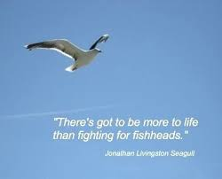
16. The text above combines action with comments. For example, ….. Can you single out all action parts and reflect on what the text would be like without the comments?
Go back to the story mind map and the use of simple past forms of action verbs taking the action a step further. Can you see the importance of further information in enriching a story. You should be able to single out ‘lowered’, ‘lifted’, ‘strained’, ‘slowed’ and so on, as forming the story backbone.
17a. What makes the above book extract literary? Make some suggestions and then read the revised version of the opening sentence below. How is it different from the original sentence? Discuss.
17a. A sequel to activity 16, this activity aims to illustrate how the use of finer, more varied, more specialized language may help make a text more literary. It can be extended further to provide you with more samples of literary text to be made plain or of plain text to be made literary.

Slide 6
17b. Now go back to the story you had written about the blackbird earlier and add or modify elements to make it more literary, like the book extract above. Work in groups.
Go back to the blackbird text you have written earlier and embellish it to make it more literary.
18. Listen to the book read out on YouTube ("Jonathan Livingston Seagull, narrated by Richard Harris") and do one or more of the following:
This pool of activities aims to address different types of intelligence, while also familiarizing you with different genres in writing – diaries and reviews. The main properties of these text types can be discussed before you engage in the task.
19. Watch the trailer of the filmed version of the book on YouTube ("Jonathan Livingston Seagull - Trailer") and discuss how the effect might have been different from that of reading the book. Have you experienced this with other books made into film?
This is an exercise in the effects of the medium, showing how a film might be different from a book, a printed text. Like most of the activities in this scenario, it is open-ended.

