Slide 1
FILMS
At the cinema

Slide 2
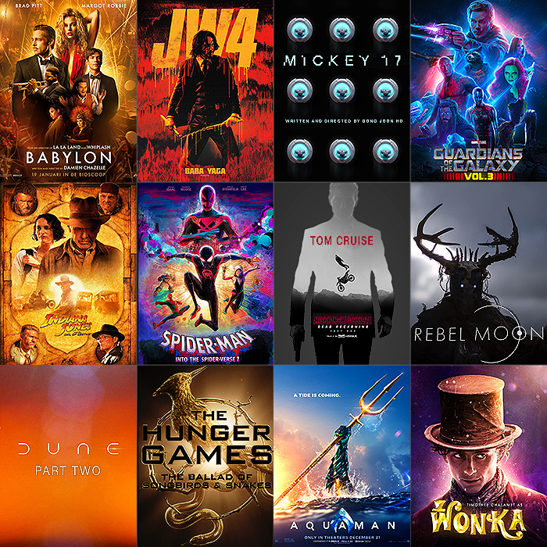

Slide 3
Have you seen any good films recently?
What did you like most?
Who’s your favourite actor or actress?
What kind of films do you prefer?

Slide 4
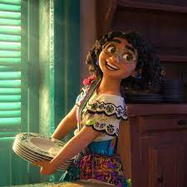
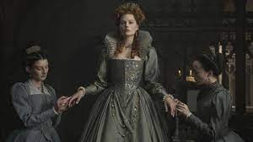
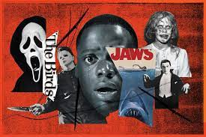
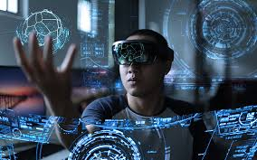
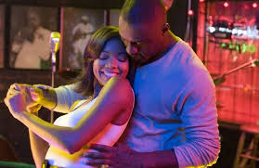
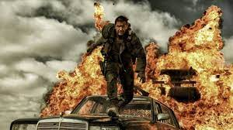
Match the pictures to the genres of films.
Historic drama Action Science fiction
Romantic comedy Cartoon Horror

