Slide 1
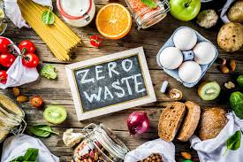
Food Waste Lesson
Gymnázium Mnichovo Hradiště
April 2025

Slide 2
TASK ONE
ARE the following statements true or false?
We waste about 1/3 of the food we produce.
True
The most food waste happens at the consumer level in developing countries.
False
Food waste only affects food availability and not the environment.
False

Slide 3
Only meat waste has an environmental impact; fruits and vegetables don't matter.
False
If food waste were reduced, more resources could be used to fight food insecurity.
True
Food donations are illegal in most countries due to safety concerns.
False

Slide 4


TASK TWO read the article and answer the questions

Slide 5
1. What is an appropriate title for the previous article?
a. Sustainability at Home: Reducing Your Environmental Footprint
b. Wasted Potential: The Hidden Cost of Food Waste
c. Solving Hunger: Innovations in Global Food Distribution
d. The Modern Kitchen: Managing Meals and Minimizing Costs

Slide 6
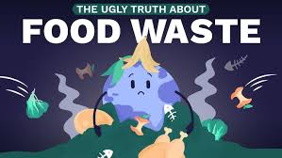
The correct answer is ….
b. Wasted Potential: The Hidden Cost of Food Waste

Slide 7
2. What is one major reason food waste is a global issue?
a. It leads to an increase in food prices worldwide.
b. It reduces the demand for packaged goods.
c. It creates job shortages in the agricultural sector.
d. It contributes to global hunger and environmental damage.

Slide 8
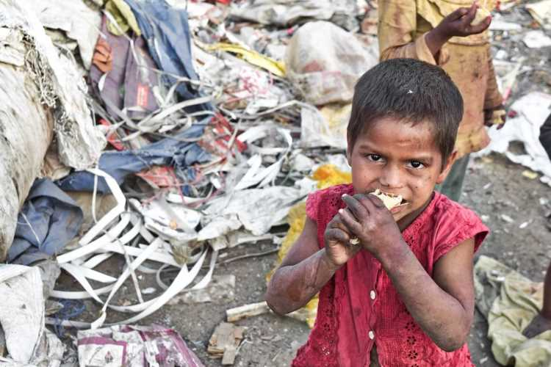
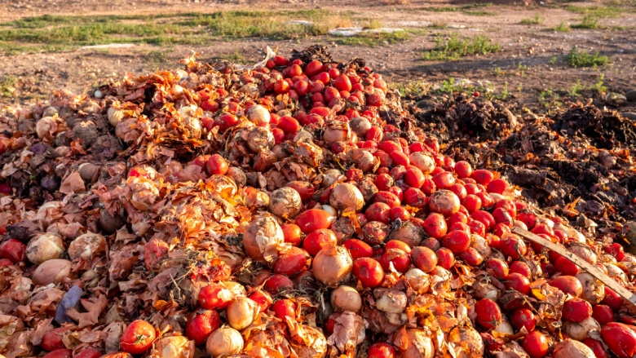
The correct answer is ….
d. It contributes to global hunger and environmental damage

Slide 9
3. What surprising contrast is highlighted in the article?
a. While millions go hungry, large amounts of edible food are wasted.
b. Farmers grow more organic food, yet people want fast food.
c. Supermarkets are full, but prices are still rising.
d. Developed countries waste less food than developing ones.

Slide 10
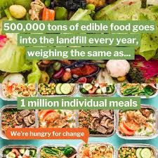
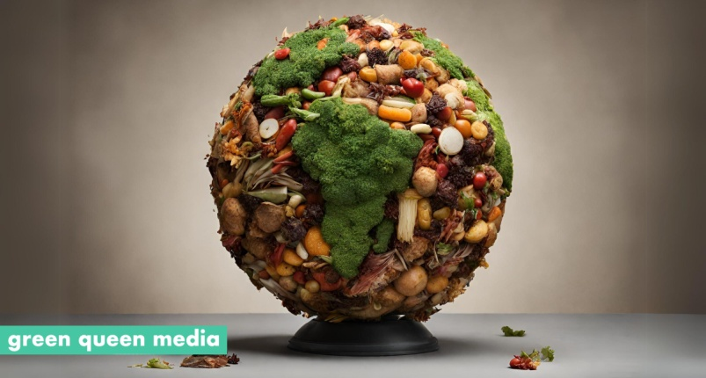
The correct answer is ….
a. While millions go hungry, large amounts of edible food are wasted.

Slide 11
4. What is one action individuals can take to reduce food waste at home?
a. Avoid eating leftovers
b. Only buy canned and frozen items
c. Plan meals and store food properly
d. Shop daily instead of weekly

Slide 12
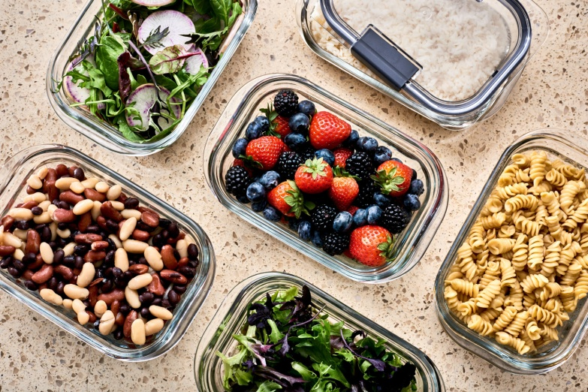

The correct answer is ….
c. Plan meals and store food properly

Slide 13
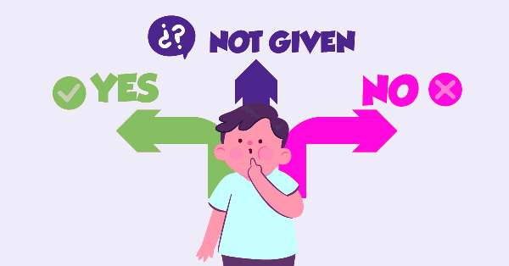
Are the following statements true, false or not stated?

Slide 14

1. A small percentage of global food production is lost before it ever reaches consumers.

Slide 15

The statement is ….
The text says a significant portion is lost during production, processing, and distribution.

Slide 16
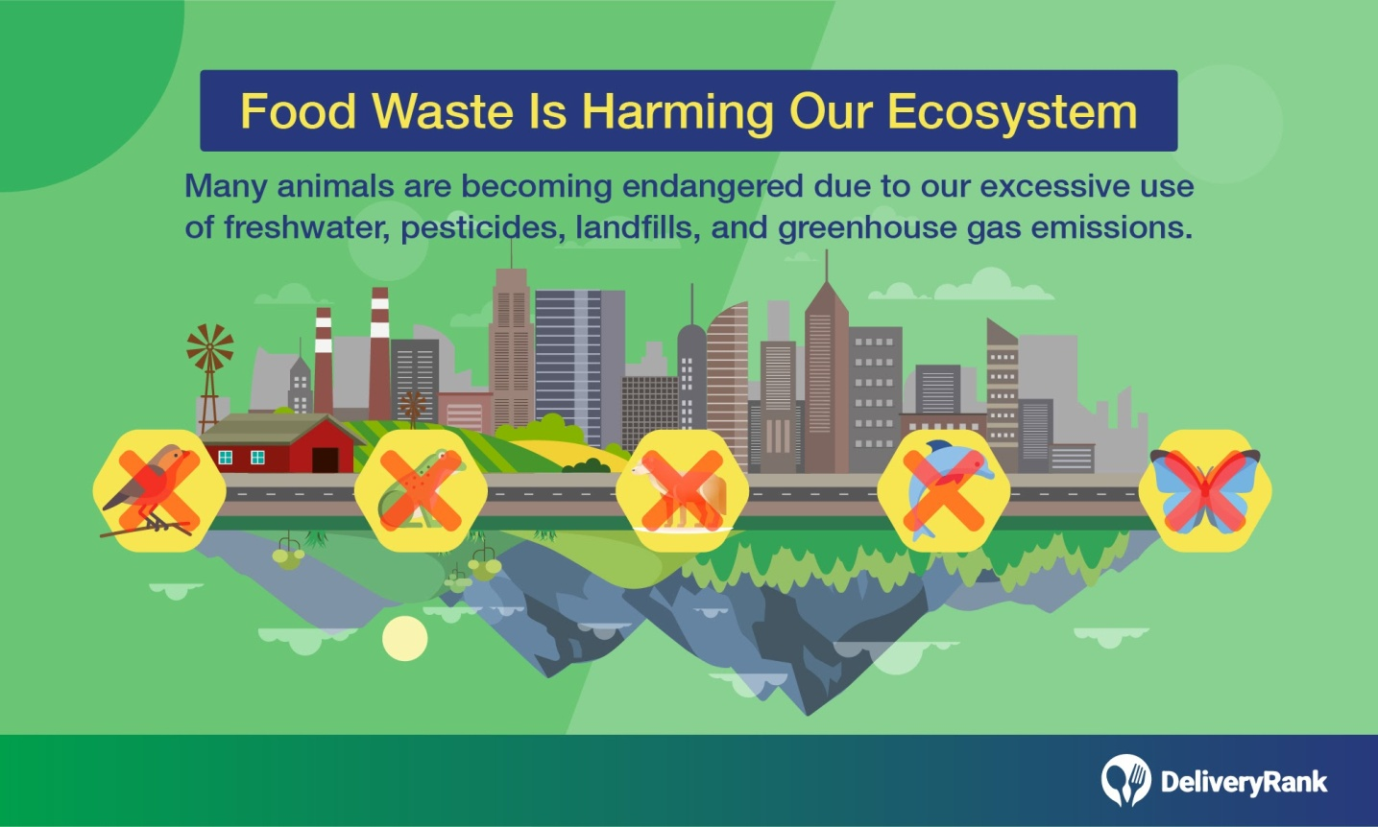
2. The text implies that modern food production methods are partly to blame for the high levels of food waste.

Slide 17

The statement is ….
The text refers to waste during production, processing, and transport, implying systemic issues.

Slide 18
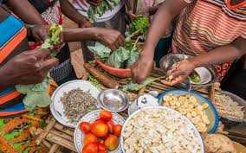
3. It is possible to feed billions of people with the amount of food that is currently being wasted globally.

Slide 19

The statement is ….
The text states that wasted food is enough to feed over 2 billion people.

Slide 20

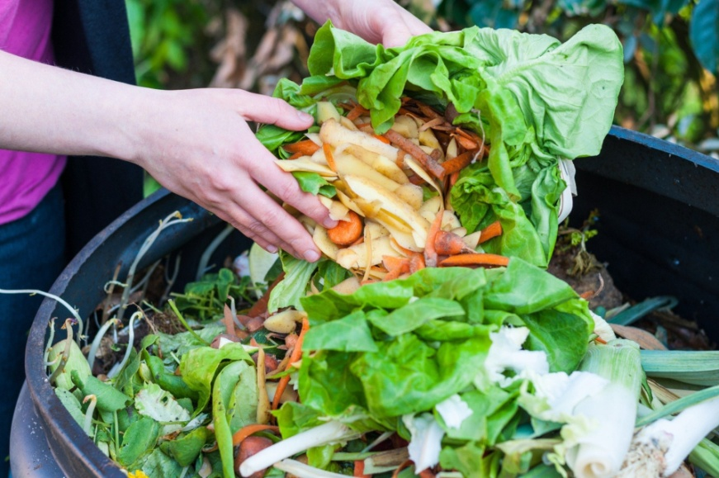
4. The average family in the UK throws away more food than the average family in the US.

Slide 21

The statement is ….
The text provides food waste data for both countries but doesn't directly compare them.

Slide 22
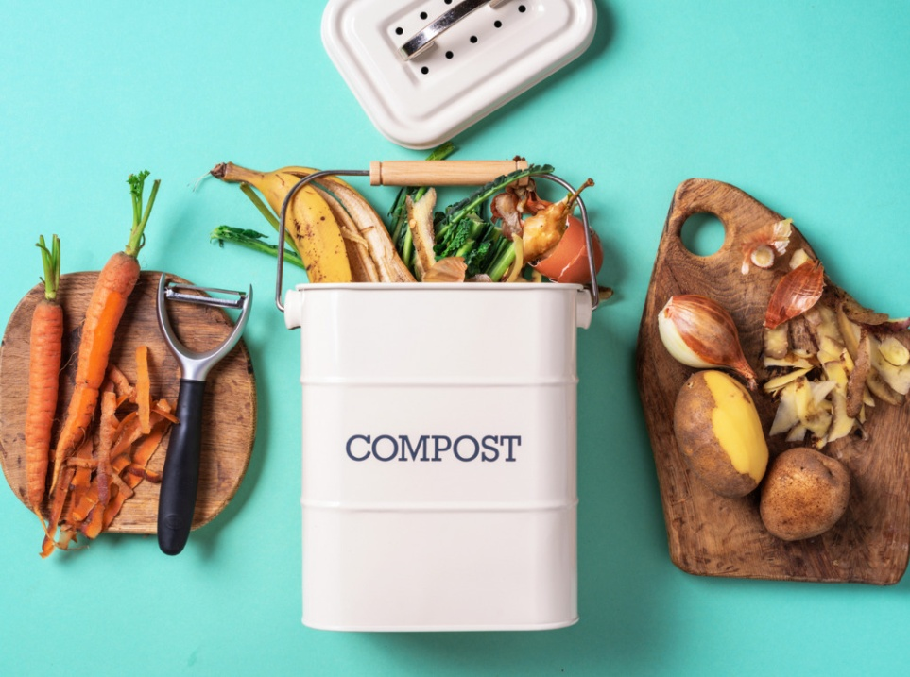
5. The author personally believes that composting is the best solution to food waste.

Slide 23

The statement is ….
The text mentions composting as one solution, but the author's personal opinion is not stated.

Slide 24
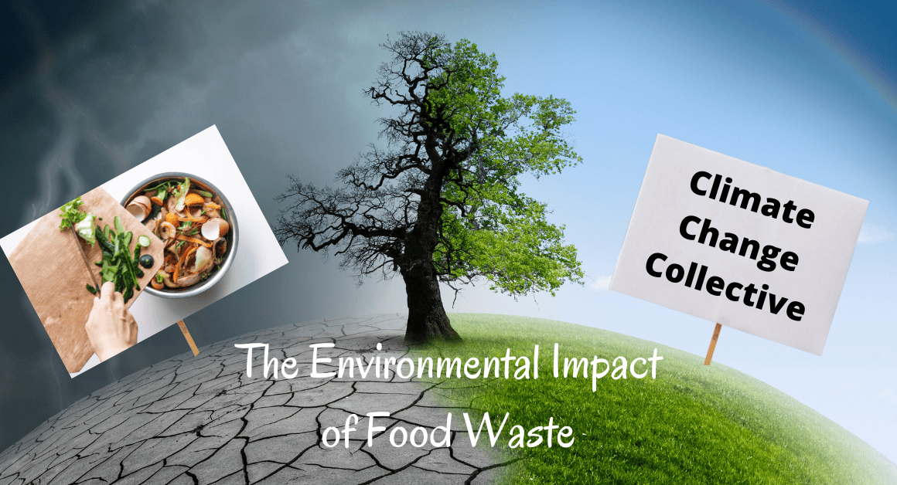
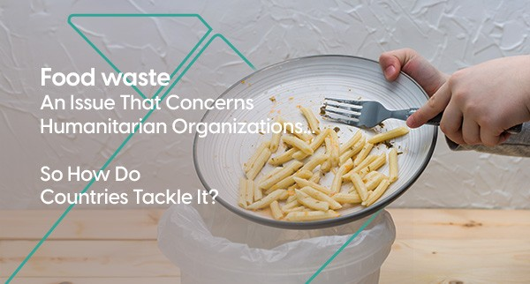
6. The environmental effects of food waste are more severe than the humanitarian consequences.

Slide 25

The statement is ….
The text emphasizes both as serious.

Slide 26

TASK THREE
Match the words to their meanings

Slide 27
The correct answers are ….
discard – b (to throw something away)
significant- e (important or meaningful)
malnutrition – d (a serious lack of proper nutrition)
methane – h (a harmful gas that contributes to global
warming)
landfill – c a site for the disposal of waste material which are
buried in the ground
consequences – g (the results or effects of an action or condition)
repurposed – a (used for something different than its original
purpose)
globally – f (all over the world)

Slide 28
TASK THREE
Match the words in Column A with their correct meanings in Column B
COLUMN A
COLUMN B
1. discard
2. significant
3. malnutrition
4. methane
5. landfill
6. consequences
7. repurposed
8. globally
a. used for something different than its original purpose
b. to throw something away
c. a site for the disposal of waste material which are buried in the ground
d. a serious lack of proper nutrition, often due to not having enough food.
e. important or meaningful
f. all over the world
g. the results or effects of an action or condition
h. a harmful gas that contributes to global warming

Slide 29
TASK FOUR: Fill in the blanks using the correct words from the box below. Each word is used only once
waste - hunger -resources - awareness - produce - campaign - composted - overbuying
1. Global __________ continues to rise, even though enough food is produced to feed the world.
2. One way to reduce food __________ is by planning meals ahead of time.
3. Families often throw away fruits and vegetables because of __________.
4. Educational programs can help raise public __________ about food waste.
5. Instead of tossing leftovers, they can be reused or _______ to benefit gardens.
6. Bread, dairy products, and fresh _________ are among the most commonly wasted items.
7. Wasting food also means wasting all the natural __________ used to grow and transport it.
8. The government launched a national __________ to encourage people to shop smarter and waste less.

Slide 30
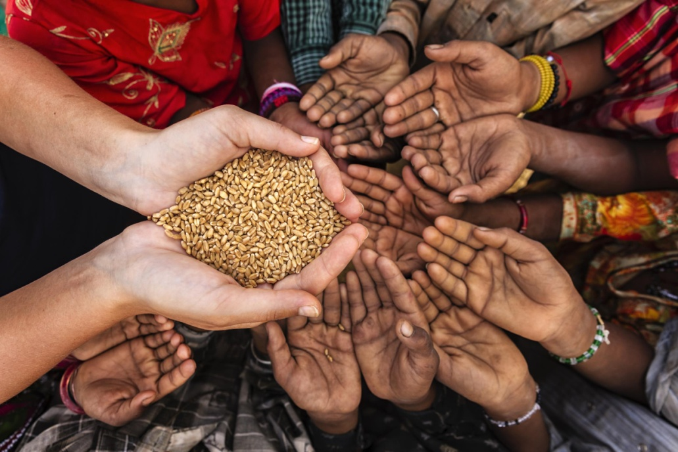
The correct answers are ….
hunger
1. Global continues to rise, even though enough food is produced to feed the world.

Slide 31
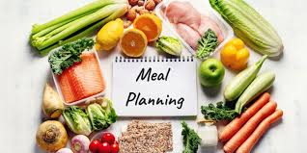
waste
2. One way to reduce food is by planning meals ahead of time.

Slide 32
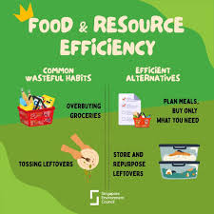
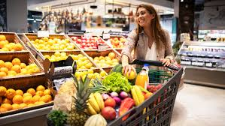
3. Families often throw away fruits and vegetables because of .
overbuying

Slide 33
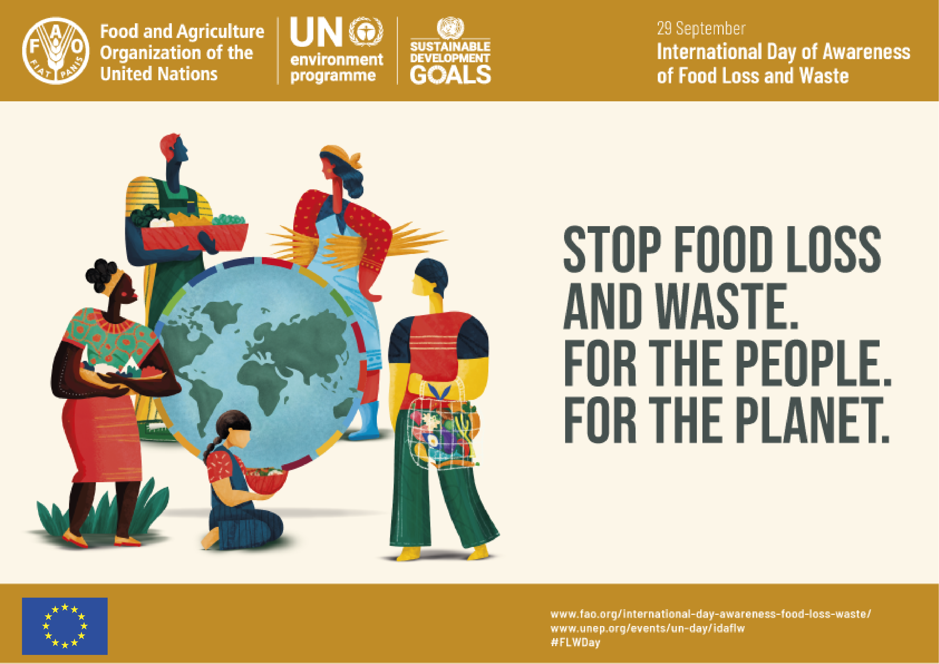
awareness
4. Educational programs can help raise public about food waste.

Slide 34
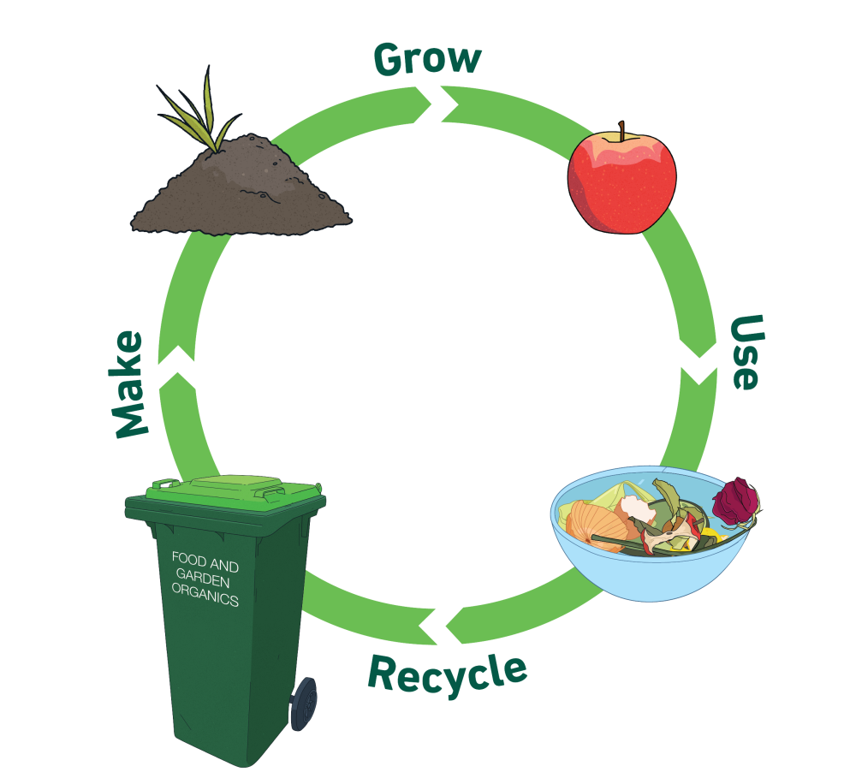
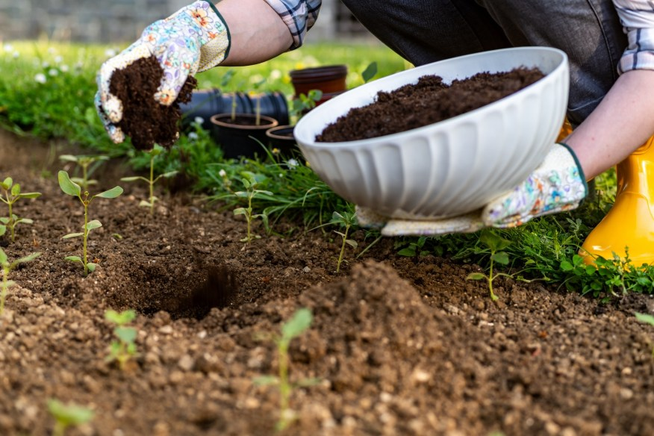
5. Instead of tossing leftovers, they can be reused
or to benefit gardens.
composted

Slide 35
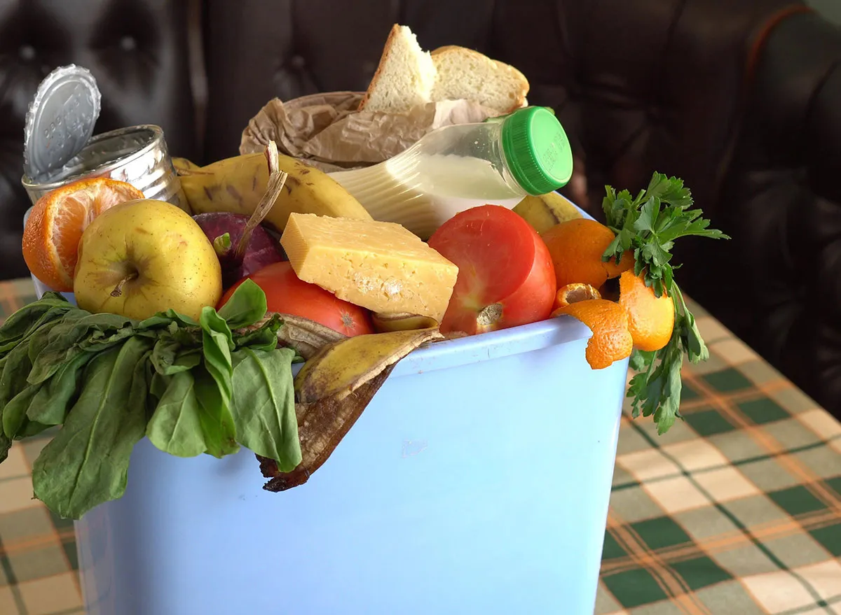
6. Bread, dairy products, and fresh are among the most commonly wasted items.
produce

Slide 36
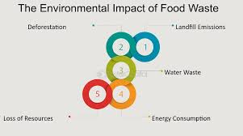
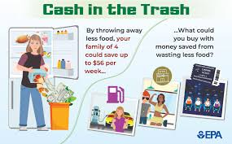
7. Wasting food also means wasting all the natural
used to grow and transport it.
resources

Slide 37
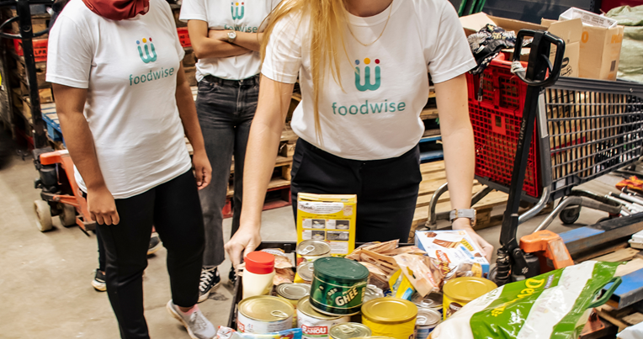
8. The government launched a national to encourage people to shop smarter and waste less.
campaign

Slide 38
TASK FIVE
Fill in the blanks with the verbs in the correct form
1. If people __________ (throw) away less food every day, we could make better use of global resources.
2. When food __________ (go) to a landfill, it releases methane, a harmful greenhouse gas.
3. If governments had launched awareness campaigns earlier, people __________ (understand) the issue better by now.
4. If you plan your meals in advance, you __________ (be) less likely to overbuy at the supermarket.
5. If I __________ (learn) about food waste sooner, I would have started reducing it years ago.
6. If more people take action, we __________ (see) a real drop in global food waste levels in the near future.

Slide 39
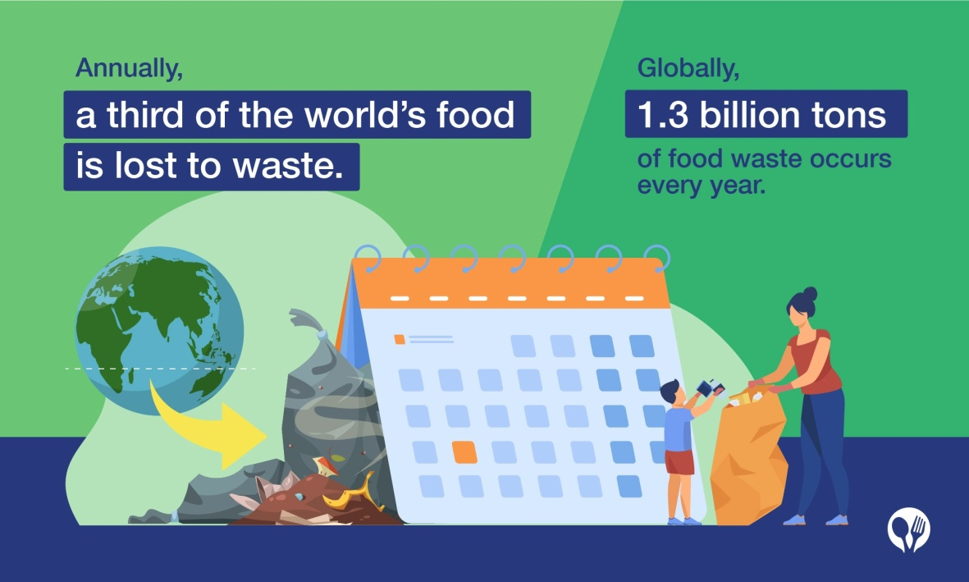
The correct answers are ….
threw
1. If people away less food every day, we could make better use of global resources.

Slide 40
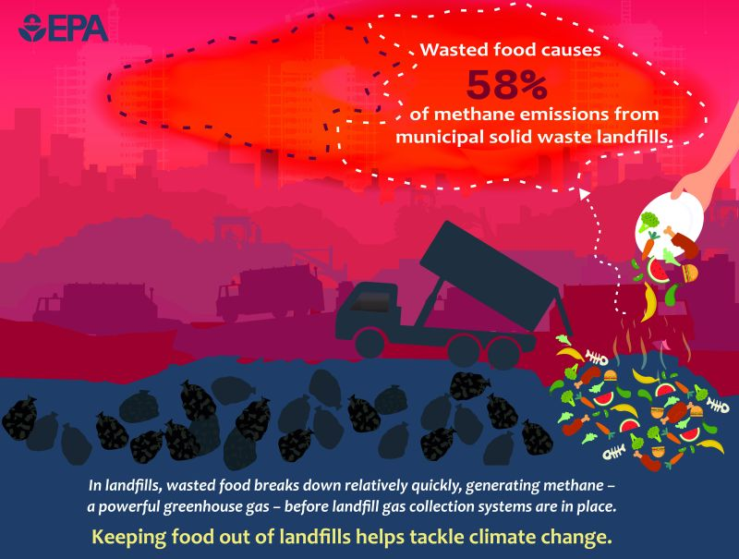
goes
2. When food to a landfill, it releases methane, a harmful greenhouse gas.

Slide 41

3. If governments had launched awareness campaigns earlier, people the issue better by now.
would have
understood

Slide 42

4. If you plan your meals in advance, you less likely to overbuy at the supermarket.
are

Slide 43
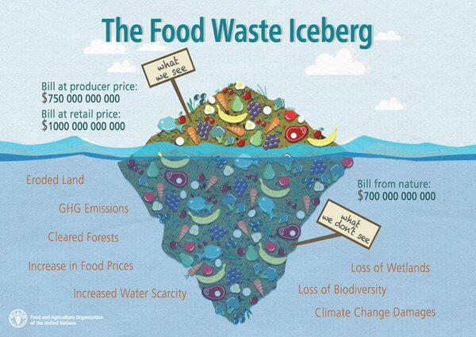
had learnt
5. If I about food waste sooner, I would have started reducing it years ago.

Slide 44

6. If more people take action, we a real drop in global food waste levels in the near future.
will see

Slide 45
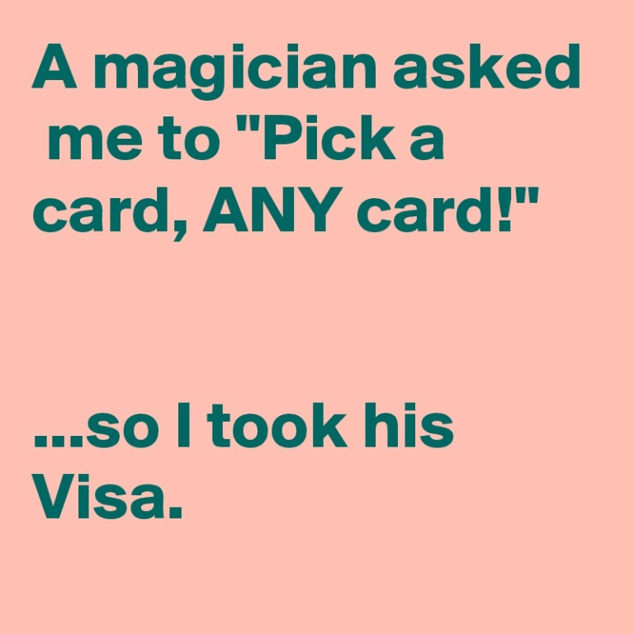

TASK SIX
What would you do in the following situations? PICK a card and tell the class

Slide 46
For example ....
You cooked too much pasta for dinner—what do you do?
I’d store the leftovers in the fridge and eat them for lunch the next day. I could also freeze it or turn it into a pasta bake.

Slide 47
TASK SEVEN : Prepare a mini campaign to raise awareness about food waste
Work in groups to design a campaign which will raise awareness about food waste. Choose one main idea or message you want to communicate. Your campaign design should include:
a catchy slogan (eg. Think before you bin!)
the main message / idea you want to convey
the method you will use to deliver your idea (eg. poster, e-book, special event, etc.)
possibly a social media idea
why your idea will work / how will it help reduce food waste

Slide 48


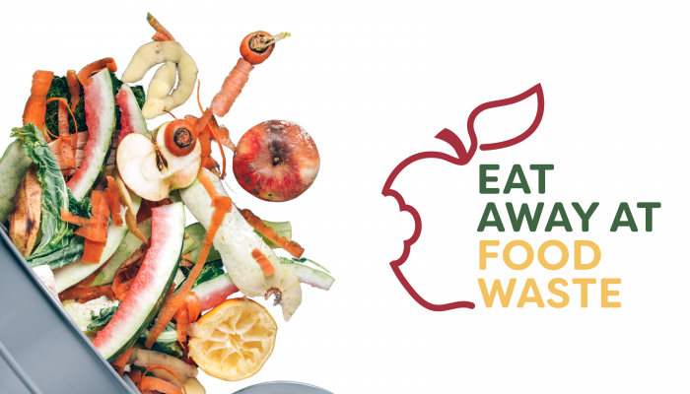
2. Present your campaign in about 2 minutes.
Make sure you:
introduce yourselves
present your idea clearly
explain your creative choices
persuade your classmates why it is effective and original

Slide 49
Thank you for your participation!

