Slide 1

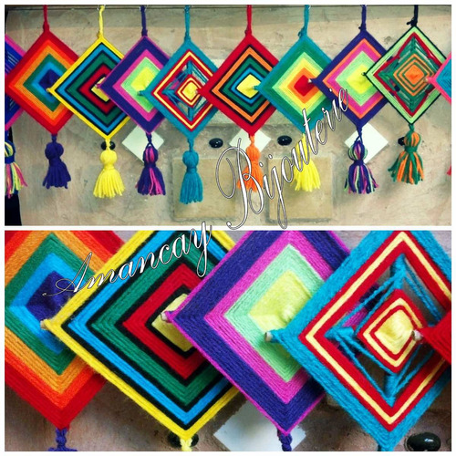
https://www.youtube.com/watch?v=yEl4TzKHgKM
https://www.youtube.com/watch?v=eBasu24q-xE
https://www.youtube.com/watch?v=NADFCl7_bFQ

Slide 2





Slide 3




Slide 4




Slide 5




Slide 6
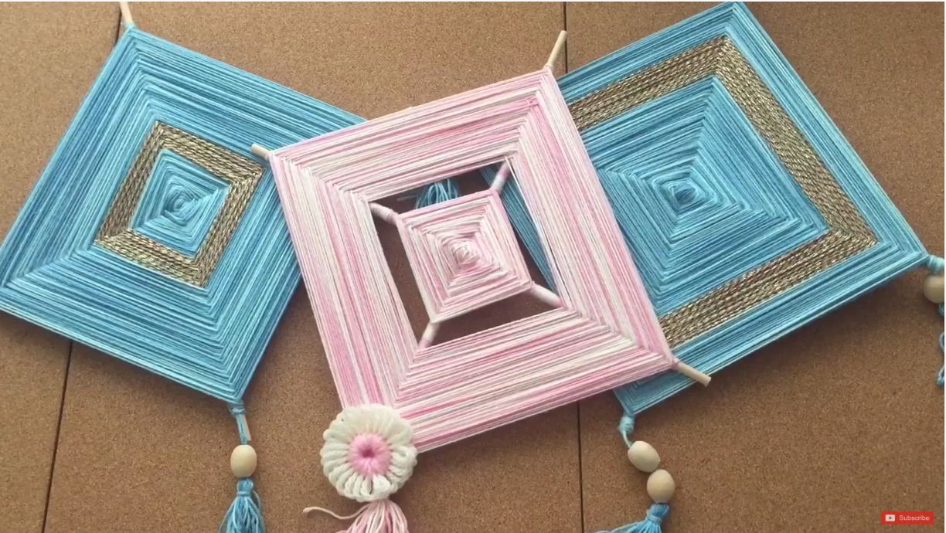
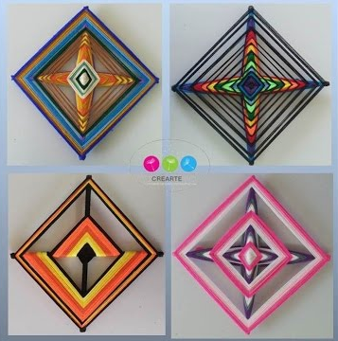

https://www.youtube.com/watch?v=MBngZZ2IHDw

Slide 7
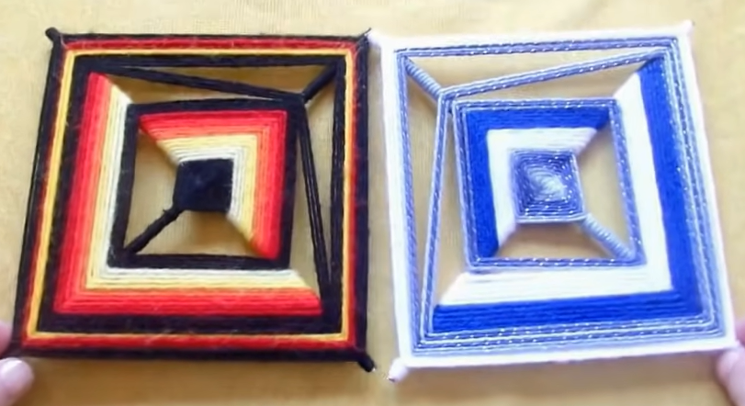

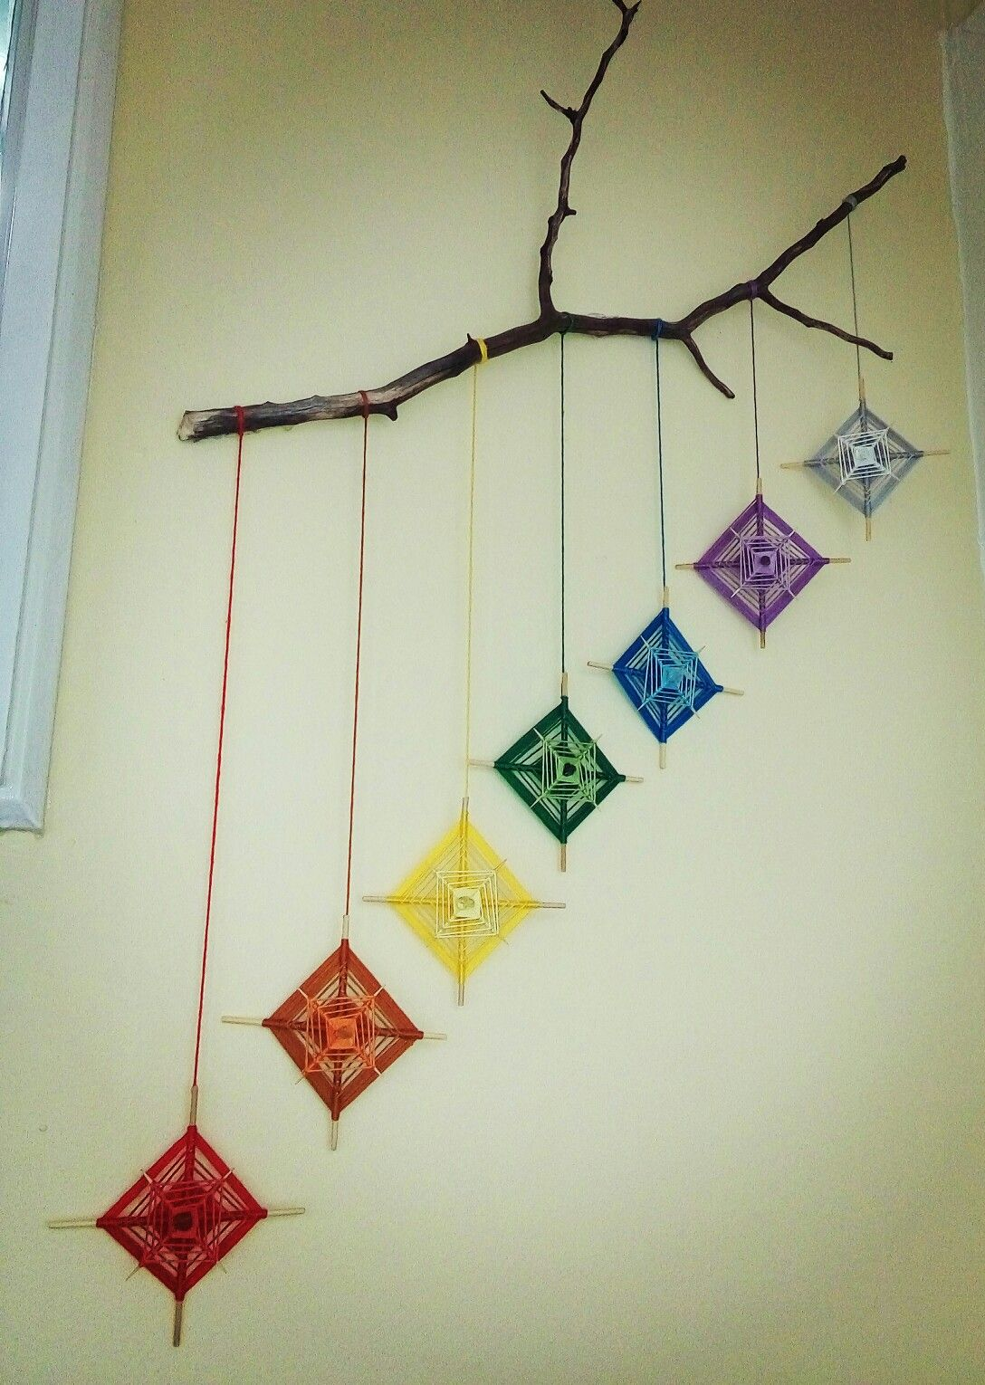
https://www.youtube.com/watch?v=SwCg8XbY9ek

Slide 8




Slide 9



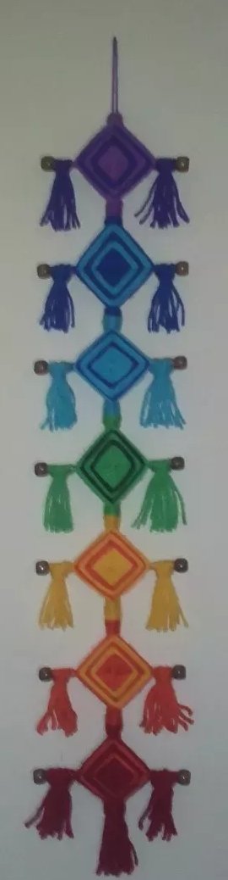

Slide 10
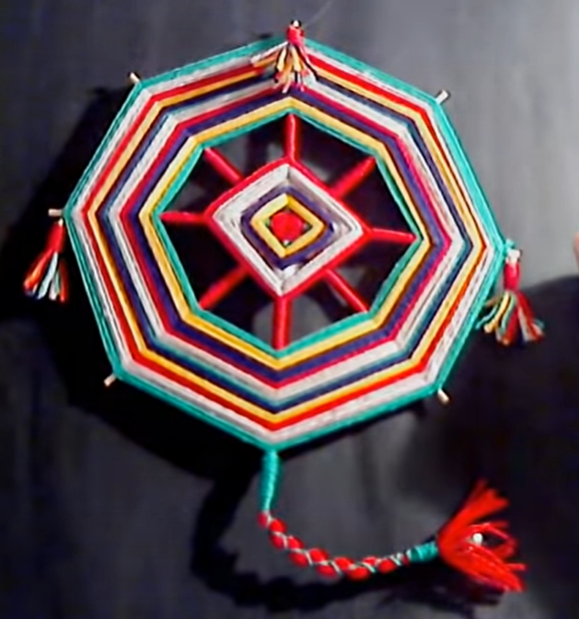

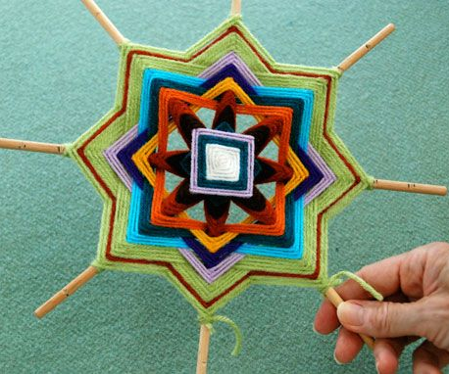
https://www.youtube.com/watch?v=uTWpMm300dE

Slide 11

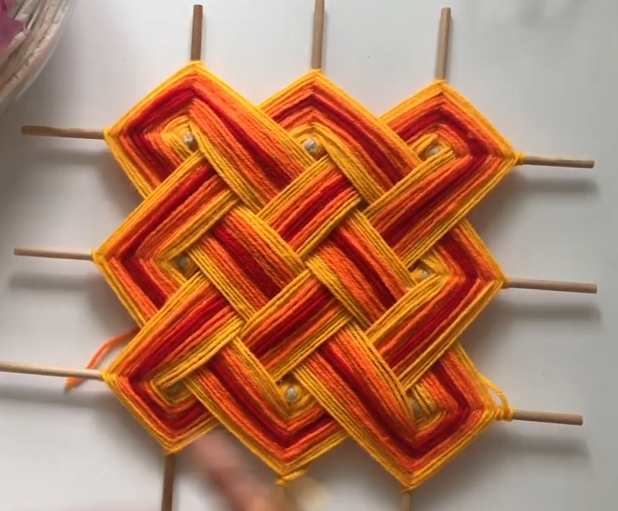
https://www.youtube.com/watch?v=l3W0YDNx2Gw
https://www.youtube.com/watch?v=l3W0YDNx2Gw

Slide 12
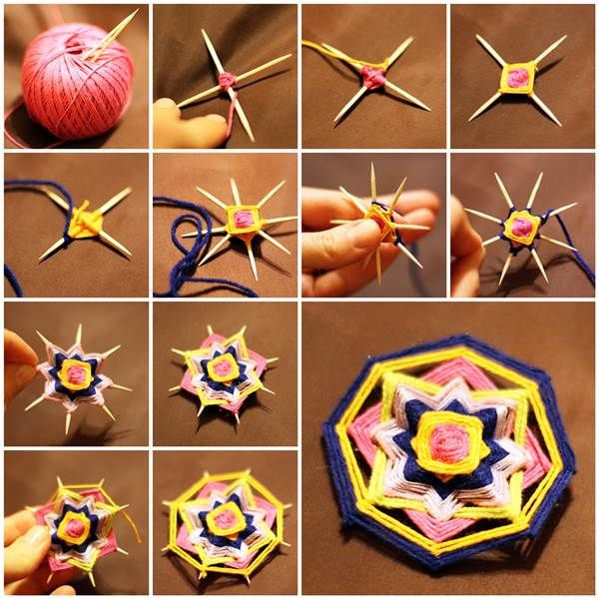


Slide 13


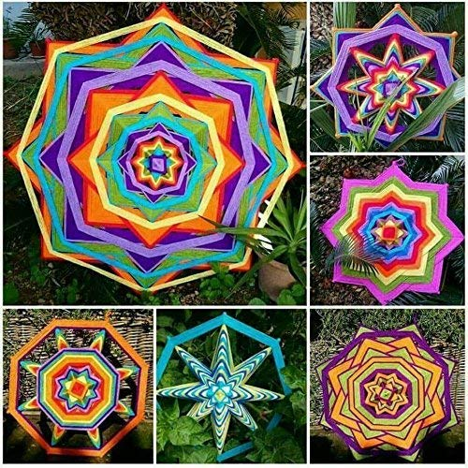
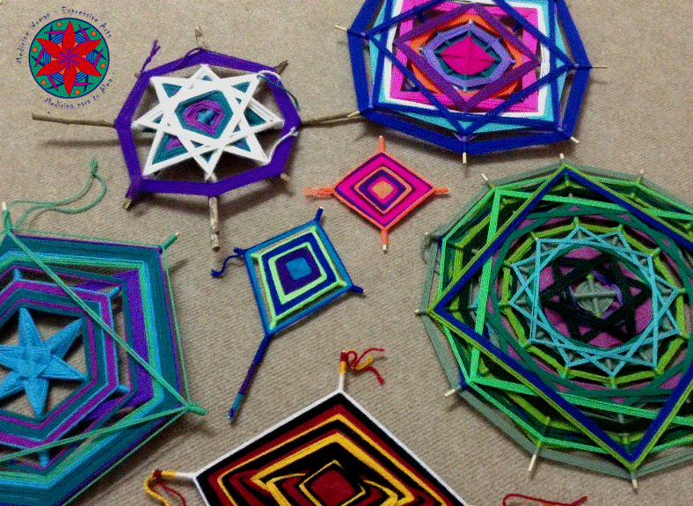

Slide 14



Slide 15




Slide 16



Slide 17
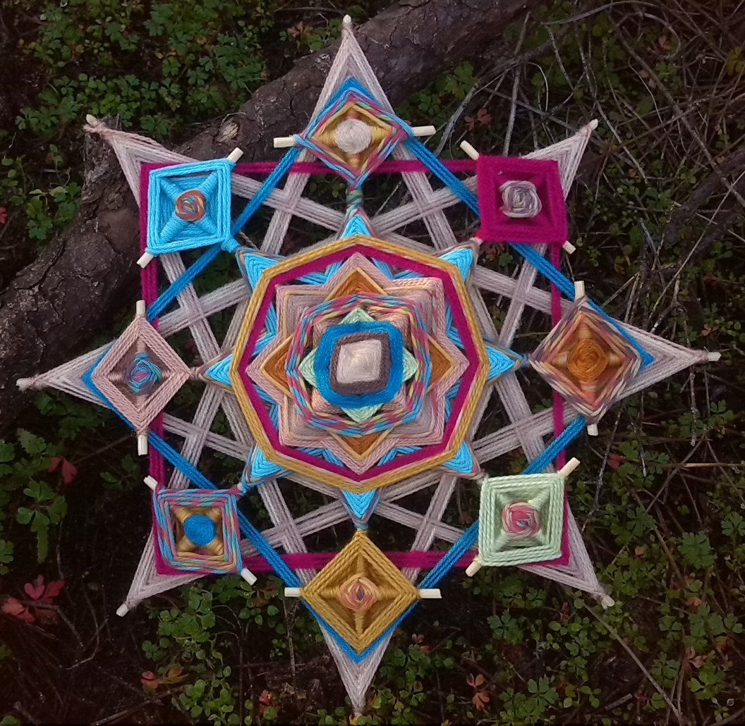


Slide 18



Slide 19

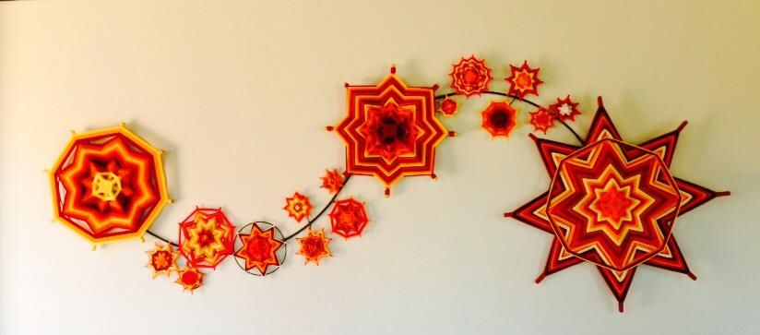
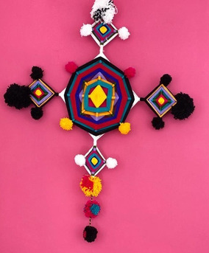


Slide 20




