Slide 1


Debate Essentials: Speak Up!
The Debate Club

Slide 2

PART 01
General Opening Lines

Slide 3
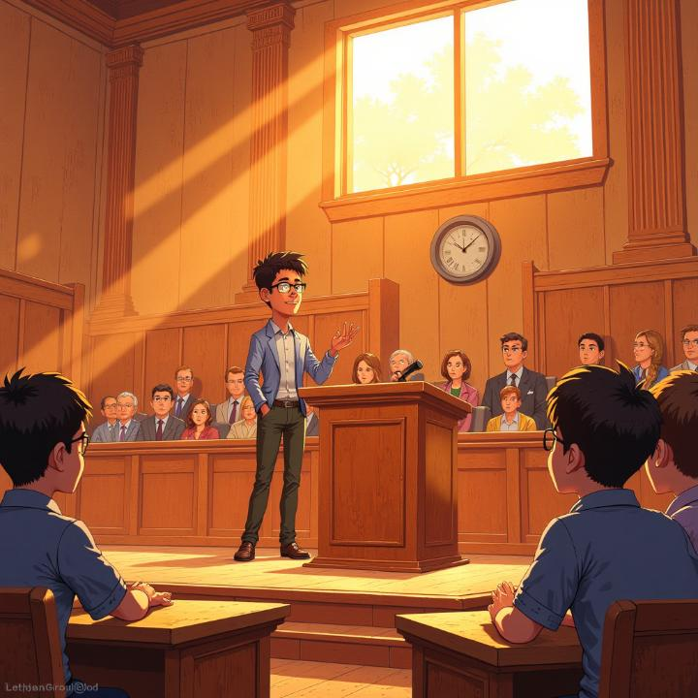
General Opening Lines
Good morning/afternoon, ladies and gentlemen.
Honourable judges, respected opponents, trustworthy timekeeper, and dear audience…
It is a great pleasure to stand before you today to discuss the motion…
Today, we are here to debate the motion that (state the topic).
We strongly believe that (state your position clearly).

Slide 4

If on the Proposition
(Define the motion)
• Allow me to begin by defining the key terms in this motion…
• As the proposition, we firmly support the idea that (state topic).
• We believe this motion is true because…
• Our team stands for (key idea), as it promotes (values: fairness, safety, progress, etc.).
• Now, let me explain why this issue is so important and relevant today…

Slide 5
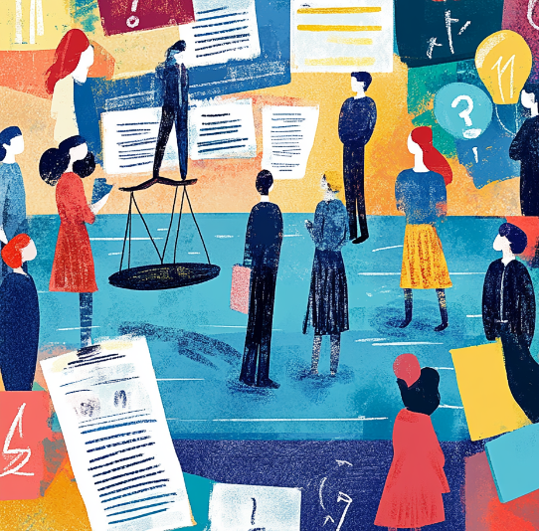
If on the Opposition
(Against the motion)
As the opposition, we completely disagree with the statement that (state topic).
We strongly oppose this motion for three main reasons…
Our opponents may claim that (summarize their main idea), but we believe this is misleading because…
We believe this motion would do more harm than good.
Let me begin by showing you why the proposition’s argument simply doesn’t hold up.

Slide 6
To Transition into Arguments
• First of all, let’s consider…
• Our first argument focuses on…
• Moving on to our second point…
• Furthermore, it’s important to note that…
• Lastly, let’s not forget that…

Slide 7
To End the Introduction Smoothly
• In summary, our team believes that (restate main stance) because of these strong reasons.
• With this, I conclude my introduction and will now move on to our first argument.
• Now, let me explain our case in detail.

Slide 8
PART 02
Rebuttals

Slide 9
Useful Phrases for Rebuttals
General Rebuttal Starters
• Now, I would like to respond to what the previous speaker said.
• Let me begin by addressing my opponent’s main points.
• Before moving on, I’d like to refute some of the arguments presented by the other side.
• The opposing team stated that (quote or paraphrase); however, this is not entirely true.
• We completely disagree with the argument that (state argument) because…
• My opponent’s argument sounds convincing at first, but when examined more closely, it doesn’t hold up.
• What my opponent fails to consider is that…

Slide 10
When You Disagree
with Their Evidence or Logic
• Their argument is based on assumptions, not facts.
• That statement might sound logical, but it lacks real evidence.
• The data they mentioned does not support their conclusion.
• The example they gave is isolated and not representative.
• They seem to confuse correlation with causation.
• This argument ignores the bigger picture.

Slide 11

When You Offer a Counterpoint
• On the contrary, we believe that…
• Instead, we should focus on…
• Our team offers a different perspective.
• There’s another way to look at this issue…
• A better solution would be…
• While they believe X, we strongly argue Y because…

Slide 12

When You Want to
Undermine Their Main Argument
• Their entire argument falls apart once we realize that…
• This point contradicts what they said earlier.
• If their claim were true, then we would expect to see…, but in reality…
• Their reasoning is flawed because it ignores…
• They fail to prove how their solution actually solves the problem.

Slide 13
To End the Rebuttal Smoothly
• Therefore, their argument cannot be accepted.
• For these reasons, the opposing side’s case is weak and unconvincing.
• In conclusion, our team has clearly shown that the opposition’s arguments do not stand.
• This is why our side remains the stronger and more logical one.

Slide 14
PART 03
End Your Speech in a Dynamic Way

Slide 15

End Your Speech in a Dynamic Way
To Summarize and Reinforce Your Main Points
• In conclusion, our team has clearly shown that (restate main stance).
• To sum up, we have proven that (key argument) is the best way forward.
• Let’s not forget the three key points that make our case stronger.
• All evidence presented today supports our position beyond doubt.
• The facts speak for themselves — this motion must stand/fall.

Slide 16
End Your Speech in a Dynamic Way
To Sound Persuasive and Passionate
• This is not just an argument — it’s a matter of what’s right and fair.
• We stand for progress, for truth, and for the future we all deserve.
• The choice is clear: we can either move forward or remain stuck in the past.
• Our team believes in change — and that change begins with your decision today.
• Let’s make the right choice — the logical, moral, and courageous one.

Slide 17

End Your Speech in a Dynamic Way
To Sound Persuasive and Passionate
• This is not just an argument — it’s a matter of what’s right and fair.
• We stand for progress, for truth, and for the future we all deserve.
• The choice is clear: we can either move forward or remain stuck in the past.
• Our team believes in change — and that change begins with your decision today.
• Let’s make the right choice — the logical, moral, and courageous one.

Slide 18
End Your Speech in a Dynamic Way
To Appeal to Logic and Reason
• Logic, evidence, and common sense all lead to one conclusion…
• When you weigh the arguments, you’ll see our side simply makes more sense.
• If we truly care about fairness and effectiveness, there is only one answer.
• We have proven not only that this motion is right — but that rejecting it would be wrong.

Slide 19
To Appeal to Emotion and Values
• At the heart of this debate lies what kind of world we want to live in.
• This issue affects every one of us — and it’s time we take a stand.
• We must act not out of fear, but out of hope and responsibility.
• Let’s stand up for what truly matters: justice, equality, and reason.
• Our words today may end, but the impact of this decision will last

Slide 20
End Your Speech in a Dynamic Way
Strong, Memorable Closings
• So, when the dust settles, remember: the truth is on our side.
• The future is listening — let’s make sure it hears the right message.
• Thank you — and let’s make the smart, fair, and forward-thinking choice.
• We rest our case — confident, clear, and convinced.
• And with that, we urge you to stand with us and make the right decision.

Slide 21
Thank you!

