Slide 1
What makes a good argument?
Strategies and Strategic Tips

Slide 2
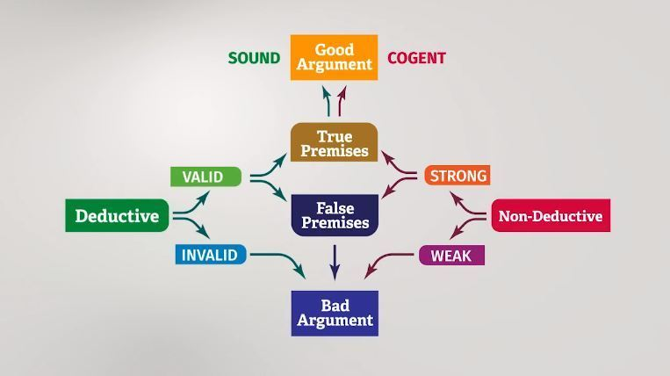
What makes a good argument

Slide 3
Invalid deductive argument
If the argument is invalid, then it’s a bad argument: it’s an argument that is intended to give conclusive support for its conclusion, but fails to do so.
Game over!!!

Slide 4
Valid deductive argument
If the argument is valid, there are two cases:
Firstly, the argument has false premises, in which case it is not sound.
The argument is bad!
Game over!!!

Slide 5
What makes a good argument?
If there is a purple elephant in the hall, then I am a giant turkey. There is a purple elephant in the hall, therefore, I’m a giant turkey
Liliane is Patrick’s sister, and Patrick is Sylvie’s brother. Therefore, Liliane is Sylvie’s sister.

Slide 6
Non-deductive argument
Weak or strong?
About 97% of climate experts agree that humans are causing global warming. Therefore, probably, humans are causing global warming.
This is a good and strong argument!!!

Slide 7
Example 1
Example 1
If you are a confident driver and have never been in an accident, then driving over the speed limit is not dangerous for you or others. You are a confident driver and have never been in an accident. Doubtless, then, driving over the speed limit is not dangerous for you or others.
What’s the conclusion?

Slide 8
Conclusion
Driving over the speed limit is not dangerous for you or others.
Is the argument deductive or non-deductive?

Slide 9
Deductive or non- deductive?
Deductive, as evidenced by the use of the word `doubtless’.
Is the argument valid?

Slide 10
Valid or not?
So the argument is valid, since it’s impossible for the premises to be true and the conclusion false.
Is the argument sound?
Now we’re asking if the premises are true. But the first premise is false. It’s not true that if you are a confident driver and have never been in an accident, that driving over the speed limit is not dangerous for you or others.

Slide 11
Sound or not?
Now we’re asking if the premises are true. But the first premise is false. It’s not true that if you are a confident driver and have never been in an accident, that driving over the speed limit is not dangerous for you or others.

Slide 12
Sound or not?
Speeding is well known to be one of the main causes of accidents, regardless of the skills and confidence of the speeding driver. Indeed, there are other drivers on the road, not all of which are confident drivers that have never been in an accident, and they might react in dangerous ways to the presence of the speeding driver.
Hence, the argument is not sound. Even though the argument is valid, it has a false premise, so it is a bad argument.

Slide 13
Example 2
Situation
We left our parrot in the house this morning. The nearest neighbour lives one kilometre away. When we got home from work, the parrot was gone. It’s most probable that our neighbour stole the parrot.
What’s the conclusion?

Slide 14
Conclusion
Our neighbour stole the parrot!
Is the argument deductive or non-deductive?

Slide 15
Deductive or non-deductive?
Non-deductive, as evidenced by the words “it’s most probable”. But also, it doesn’t seem like the argument is giving reasons that would guarantee that the conclusion is true.
Is the argument strong?

Slide 16
Is it a strong argument?
Not really. It’s a bit quick to accuse your neighbour of stealing the parrot. Think of other things that could have happened… maybe it flew out the window!
So the argument is weak. Game over. It’s a bad argument.

Slide 17
Example 3
There’s been a popular revolutionary uprising in Tunisia, which is a North African Arab nation. There’s been a popular revolutionary uprising in Libya, also a North African Arab nation. There’s been a popular revolutionary uprising in Egypt, another North African Arab nation. There’s been a popular revolutionary uprising in Bahrain, yet another North African Arab nation. Finally, there’s been a popular revolutionary uprising in Iran, which is an Arab nation. So there will be a popular revolutionary uprising in at least one other Arab country in the next few years.
What’s the conclusion?

Slide 18
Conclusion
There will be a popular revolutionary uprising in at least one other Arab country in the next few years.
Is the argument deductive or non-deductive?

Slide 19
Deductive or non-deductive?
There are no clear indicator words in this argument to help us in making a choice. If we take the argument to be a deductive one, it would be quite easy to show that it’s invalid. Furthermore, the premises do not seem to be intended to demonstrate beyond doubt that there will be a popular revolutionary uprising in at least one other Arab country in the next few years, but rather to suggest that this is quite likely to happen.
We will thus treat the argument as a non-deductive one.
Is the argument strong?

Slide 20
Stong or Weak argument?
If all the premises happen to be true, given the number of Arab countries there are, we’ll say the argument is reasonably strong. You might not agree with me, but here’s some explanation. If all premises are true, then they provide evidence that there’s some political instability that is spreading in that region of the world, and this makes it quite probable that the spread won’t stop.

Slide 21
Is the argument cogent?
That is, are all the premises true? And the answer is ‘no’, because:
Iran is not an Arab nation.
Bahrain is not a North African Arab nation.
So at least two premises of the argument are false. Hence, the argument is not cogent, and is, therefore, bad.

