Slide 1
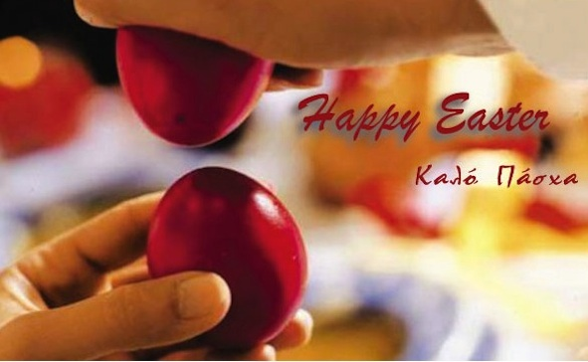
EASTER IN GREECE
1st Primary School in Maroussi
4th Grades

Slide 2
Easter customs in Greece
1
2
3
We dye eggs red. It symbolizes the blood of Christ.
We make sweets and Easter cookies.
We make Easter cake called “tsour’eki”.
Marios, Konstantina, Androniki, Christina, Konstantinos – 4th grade

Slide 3
We dye eggs red.
We make biscuits and sweets
Aggelos, Eva, Eleanna, Maria-Irene, Helen, Evi – 4th grade

Slide 4
Easter cake called “tsoureki” before …
… and, Easter cake after !!!

Slide 5
Easter candles are decorated with various things like toys, drawings and miniatures. Our godmother and godfather bring them to us and we light them on the night of Resurrection.
Danae, Iliana, Peter, Dimitris, Athena – 6th grade

Slide 6
On Good Friday morning we go to church again to kneel in front of the “epitaph”. The “epitaph” is decorated with flowers and usually young girls do that the previous night. It looks amazing!
Mike, Thanos, Bekos – 6th grade

Slide 7
In the evening the “epitaph” is brought around the church and the neighbourhood with everyone following. This ceremony is always an exciting part of the Easter celebration.
Mike, Thanos, Bekos – 6th grade

Slide 8
Holly Saturday: Resurrection night.
Candles and fireworks
Christ has risen!
“Christos Anesti!”

Slide 9
Back at home
Cracking the red eggs.
Late dinner with “magiritsa” soup and other delicacies.

Slide 10
Easter Day
People get together to celebrate the day. They eat roasted lamb on a spit, “kokoretsi”, “tzatziki”, salad and other delicacies. They drink wine and then they sing and dance all together.

Slide 11
“Stay still grandpa! It’s coming! Hurray! I won! I cracked your egg!

Slide 12
Baaaa…!!

