Slide 1

Session 1: Welcome to German(y)

Slide 2


introduction to the program
what we will talk about
  Germany and the German-speaking world
  Must-sees
  Food
  Music
  Hobbies
  School in Germany
  Holidays
  Sustainability
  German brands and products
  ….

Slide 3


What you will learn today
you will…
  get to know your instructor
  know what this program is about
  know that German is also spoken outside of Germany
  be able to say hello and good-bye in German
  know how people in the German-speaking world greet each other
  be able to introduce yourself and ask for someone's name in German
  realize that there are many similarities in the English and the German language
  know some easy words in German

Slide 4
This is me – das bin ich

Slide 5
Who are you? – Wer seid ihr?
Wie heißt du?
Ich heiße …

Slide 6
german in the world
Did you know …
  that more than 118 million people worldwide speak German as their first language?
  that Austria and Liechtenstein are also officially German-speaking countries?
  that German is an official minority language in: Switzerland, Belgium, Italy, Denmark, Luxemburg, Poland, Slovakia, Romania, Czeck Republic, Hungary and Russia
  that there are many German-speakers outside of Europe, sich as 1,000,000 German-speakers in Brazil?
  that more than 15 million people world-wide learn German?
  that more than 1 million Americans have German ancestry?
  that about 1 million people in the United States speak German?

Slide 7
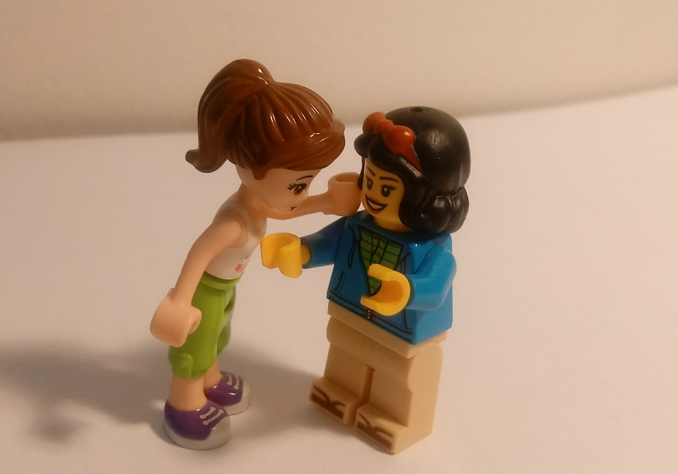
Greetings - begrüßungen
Mother and child

Slide 8
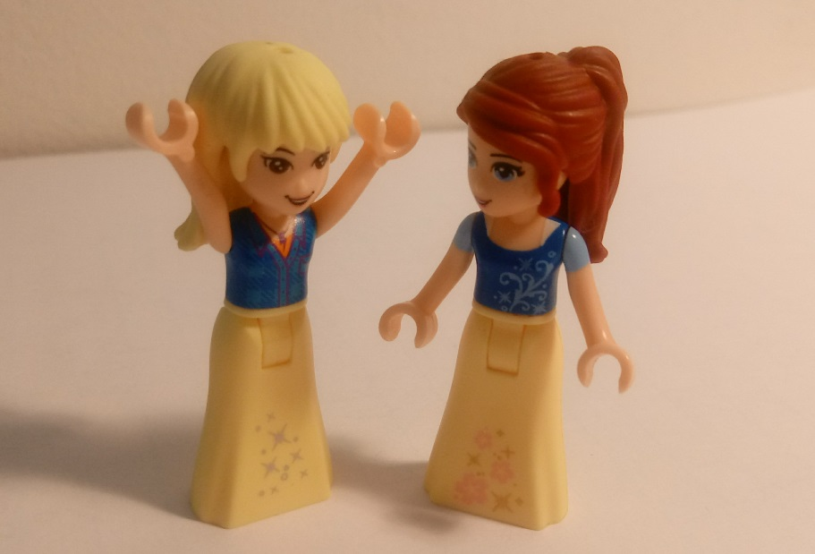
Greetings - begrüßungen
two friends

Slide 9
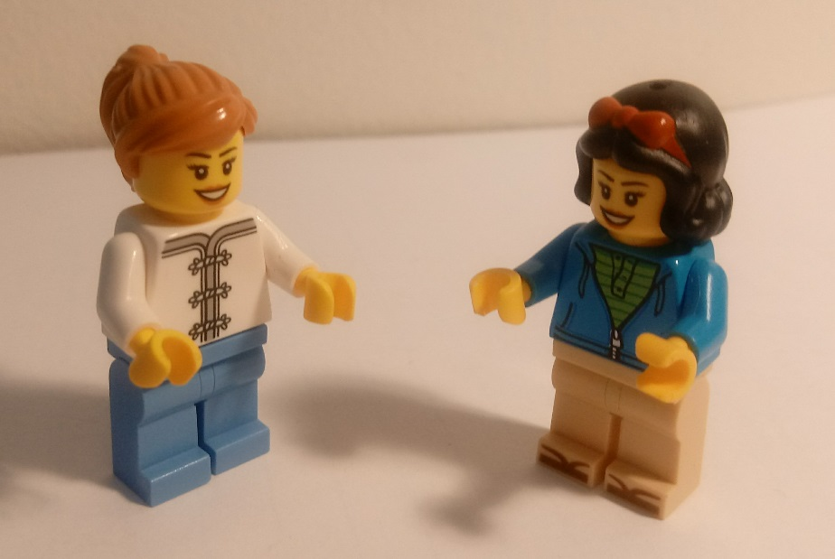
Greetings - begrüßungen
two neighbors

Slide 10
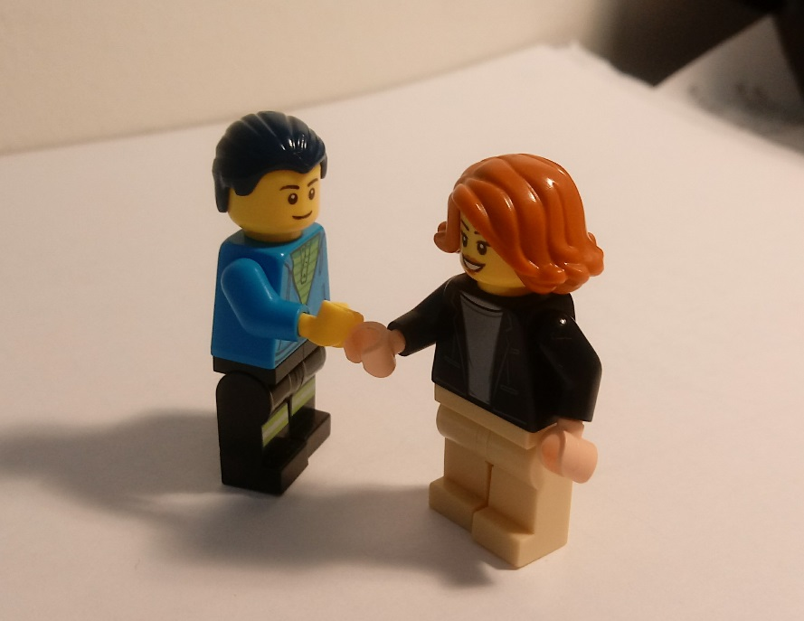
Greetings - begrüßungen
At the job interview

Slide 11
Greetings - begrüßungen
Na?
Hallo!
Mother and child

Slide 12
leave-taking - Abschied
Tschüss!
Mother and child

Slide 13
Greetings - begrüßungen
Hallo!
Grüß Gott!
Guten Tag!
Moin!
Servus!
two neighbors

Slide 14
leave-taking - abschied
Auf Wiedersehen!
Tschüss!
Servus!
Mach's gut!
Schönen Tag noch!
two neighbors

Slide 15
Greetings - begrüßungen
Hallo!
Hey!
Hi!
Na?
two friends

Slide 16
leave-taking - Abscheid
Ciao!
Tschüss!
Bis dann!
two friends

Slide 17
Greetings - begrüßungen
Guten Tag
Grüß Gott
Guten Morgen
Guten Abend
At the job interview

Slide 18
Greetings - begrüßungen
Auf Wiedersehen!
Schönen Tag noch!
At the job interview

Slide 19
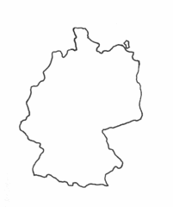



Regional greetings
Moin
Servus
Servus
Grüß Gott
Grüß Gott
Grüezi

Slide 20
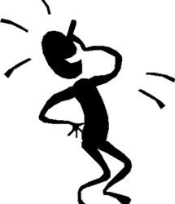
stereotypes
Funny joke? What do you think?
  Heaven is where the cooks are French, the police are British, the mechanics are German, the lovers are Italian and everything is organized by the Swiss. Hell is where the cooks are British, the police are German, the mechanics are French, the lovers are Swiss, and everything is organized by the Italians.

Slide 21
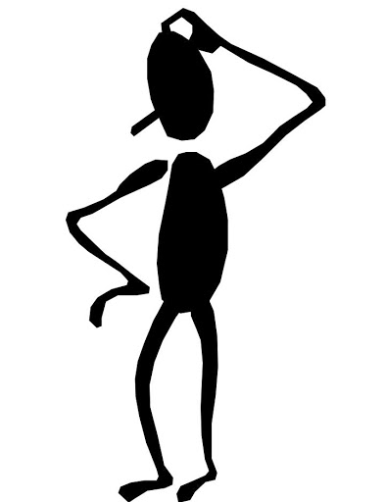
reflection round: What have you learned?
Write down the words and chunks from today's session in your personal word bank.
What have you learned today about the German language? Was there anything that surprised you?
What have you learned today about the German-speaking world – about culture, people, about differences and similarities to your own country and culture, etc.?
What surprised you most and why?
What are you curious about now? What else would you like to know about the German-speaking world? Write down questions that you have.

Slide 22

my word bank sheet
Ich heiße …
Wie heißt du?
Guten Tag/Guten Morgen/Guten Abend (formal greeting)
Hallo/Hi/Hey/Na? (informal greeting)
Grüß Gott/Servus/Moin (regional greeting)
Tschüss/Ciao/Bis dann (informal leave-taking)
Auf Wiedersehen/Schönen Tag noch (formal leave-taking)

Slide 23
Auf Wiedersehen!
Bis nächstes Mal!
Tschüss!

