Slide 1
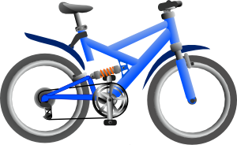
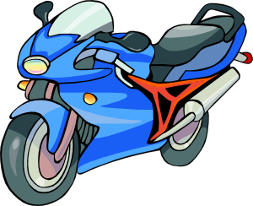
COMPARISON OF ADJECTIVES
● comparative and superlative forms
● spelling rules
● speaking activity using a chart
● making comparisons (animals)
● reading exercise (who is who?)
Notes:
se

Slide 2
young
younger
the youngest
50kg
20kg
30kg
heavy
heavier
the heaviest
cold happy short windy deep hilly

Slide 3
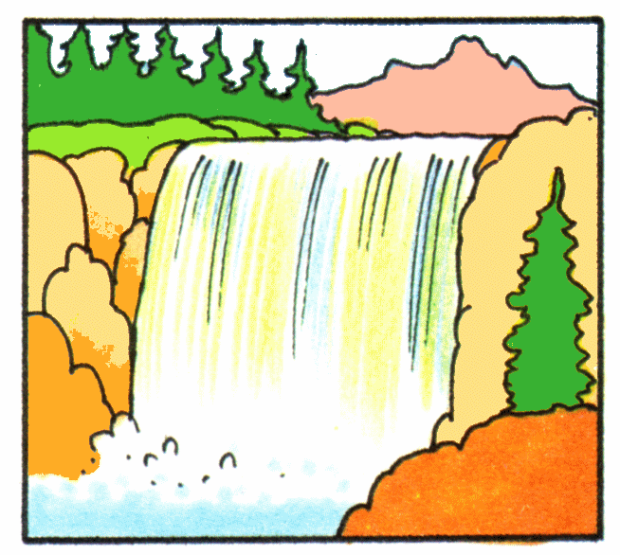
big
bigger
the biggest
wide
wider
the widest

Slide 4
the most expensive
expensive
more expensive
difficult large flat famous sunny wet red
crowded flat cheap white delicious hot
long fast beautiful gorgeous dry nice thin

Slide 5
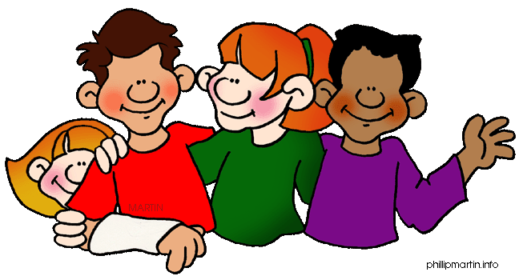
Read the information and make sentences about the boys. Use the words in the box.
 | TOM | JENNY | ADAM | DIANA
age | 15 | 10 | 12 | 11
weight | 60 kg | 42 kg | 53 kg | 48 kg
height | 187 cm | 165 cm | 162 cm | 159 cm
old young heavy light tall short
Adam is older than Jenny.
Tom is the tallest.

Slide 6
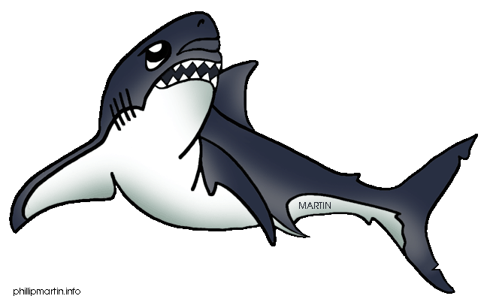
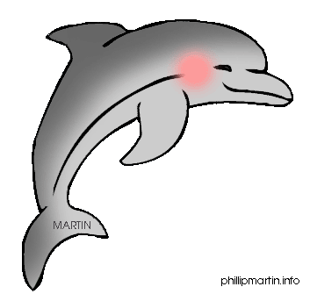
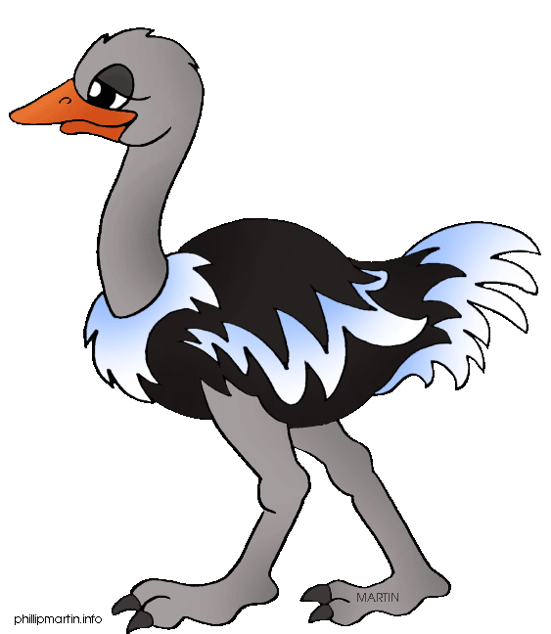
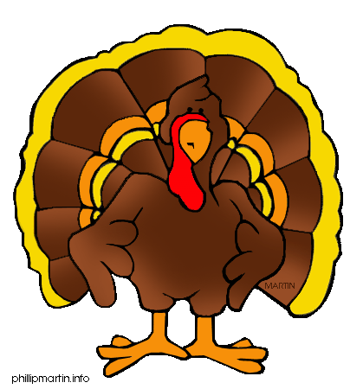
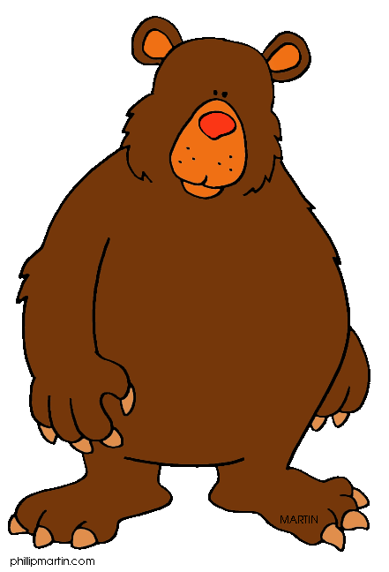
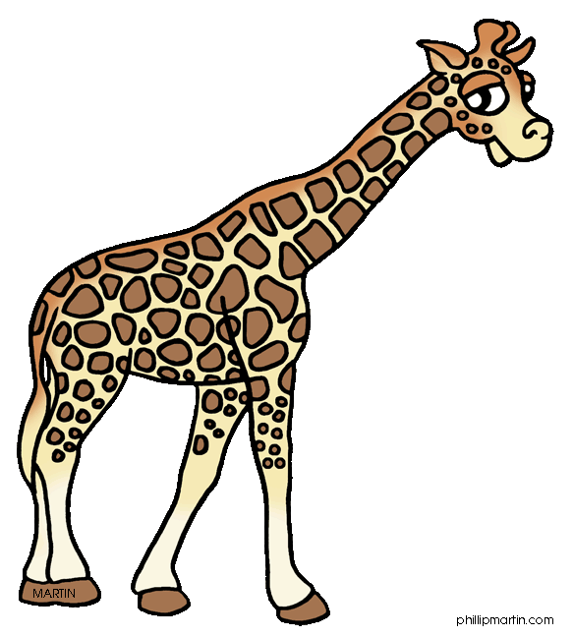
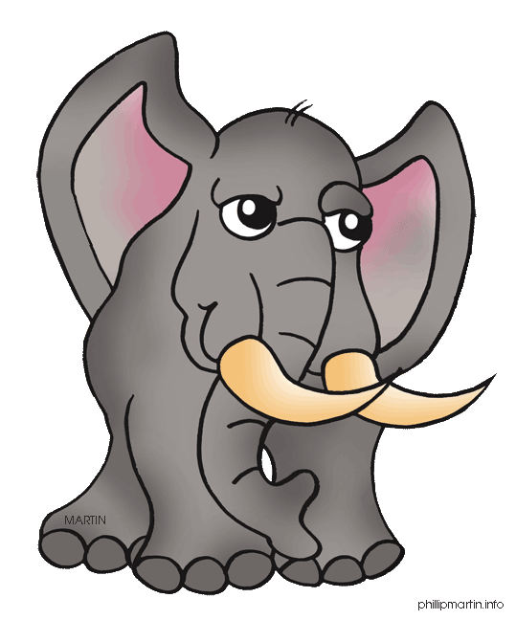
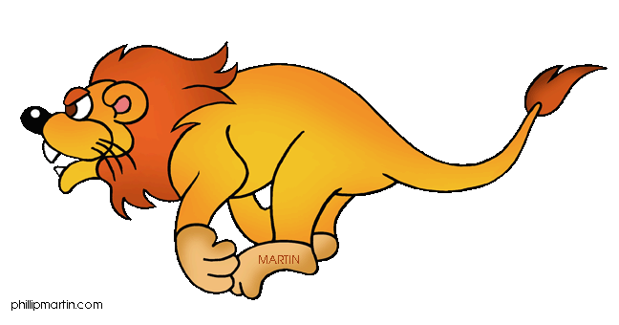
Compare these animals. Use … isn’t as …as.
dangerous / small
fast / beautiful
heavy / tall
big / strong

Slide 7
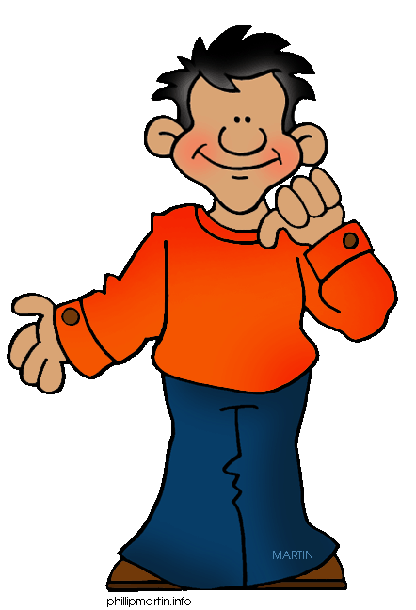
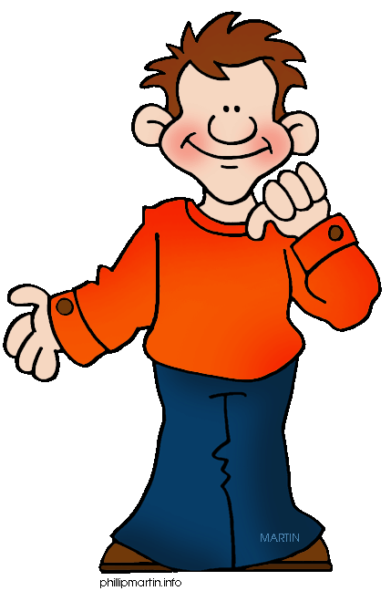
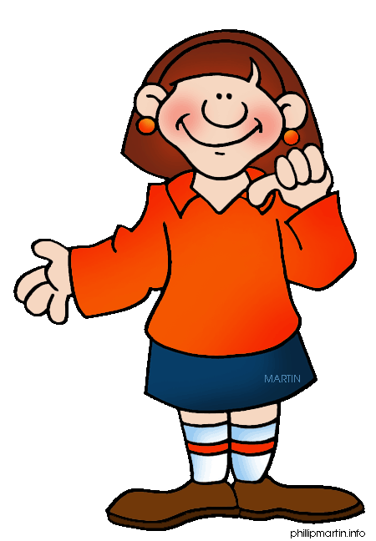
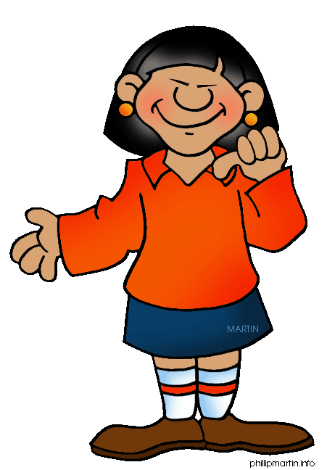
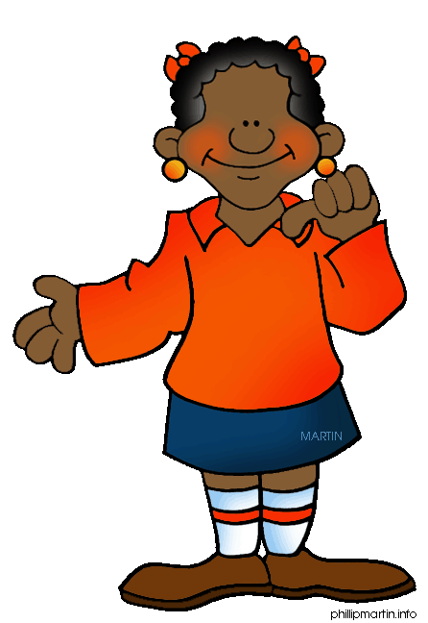
Who is who?
Jack
Nick
Mary
Jane
Kate
Kate is shorter than all the others. Mary is taller than Kate ,but shorter than the others. Jane is thinner than Mary. Nick taller than the girls, but shorter than Jack. Jack is the tallest boy.

