Slide 1
EXPRESSING FUTURE
THERE ARE MANY WAYS OF EXPRESSING FUTURE
WILL
GOING TO
PRESENT CONTINUOUS
PRESENT SIMPLE

Slide 2
will + infinitive
I will have a cup of coffee and a cheesecake.
I have just decided in the restaurant. – INSTANT DECISION
I will find the right job one day.
I think this will happen but I have no evidence. – PREDICTION WITHOUT EVIDENCE
I will help you with these bags.
I am offering my help. – OFFER
I will call you as soon as I arrive.
I promise to do that. – PROMISE

Slide 3
be going to + infinitive
I am going to visit my grandma.
This is what I have planned. – PLAN OR INTENTION – I have already decided.
It is going to rain. Look at those black clouds!
I am referring to evidence and making prediction. – PREDICTION BASED ON EVIDENCE

Slide 4
present continuous
I am staying at the Astoria Hotel.
We are getting married in July.
I have already booked my stay/ reserved the church. – FUTURE ARRANGEMENT*
*Another person or organisation is involved

Slide 5
GOING TO
PLANS / INTENTIONS
PREDICTION BASED ON EVIDENCE
PROMISE
INSTANT DECISION
OFFER
PREDICTION – WITH NO EVIDENCE
WILL
PRESENT CONTINUOUS
FUTURE ARRANGEMENTS

Slide 6
OTHER WAYS OF EXPRESSING FUTURE
Present Simple – things that happen according to a schedule or timetable.
The train leaves at 5pm. Tomorrow is Monday.
Olympiacos plays tomorrow against CSKA.

Slide 7
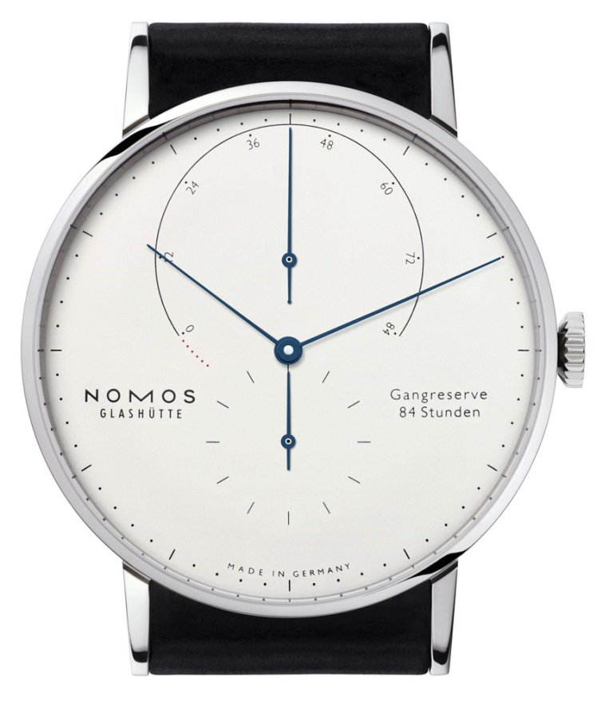
Videos for self reference
http://www.youtube.com/watch?v=JUmDT7-CfaU
http://www.youtube.com/watch?v=bHZJWpp8Gfo
PAST
NOW
FUTURE

