Slide 1
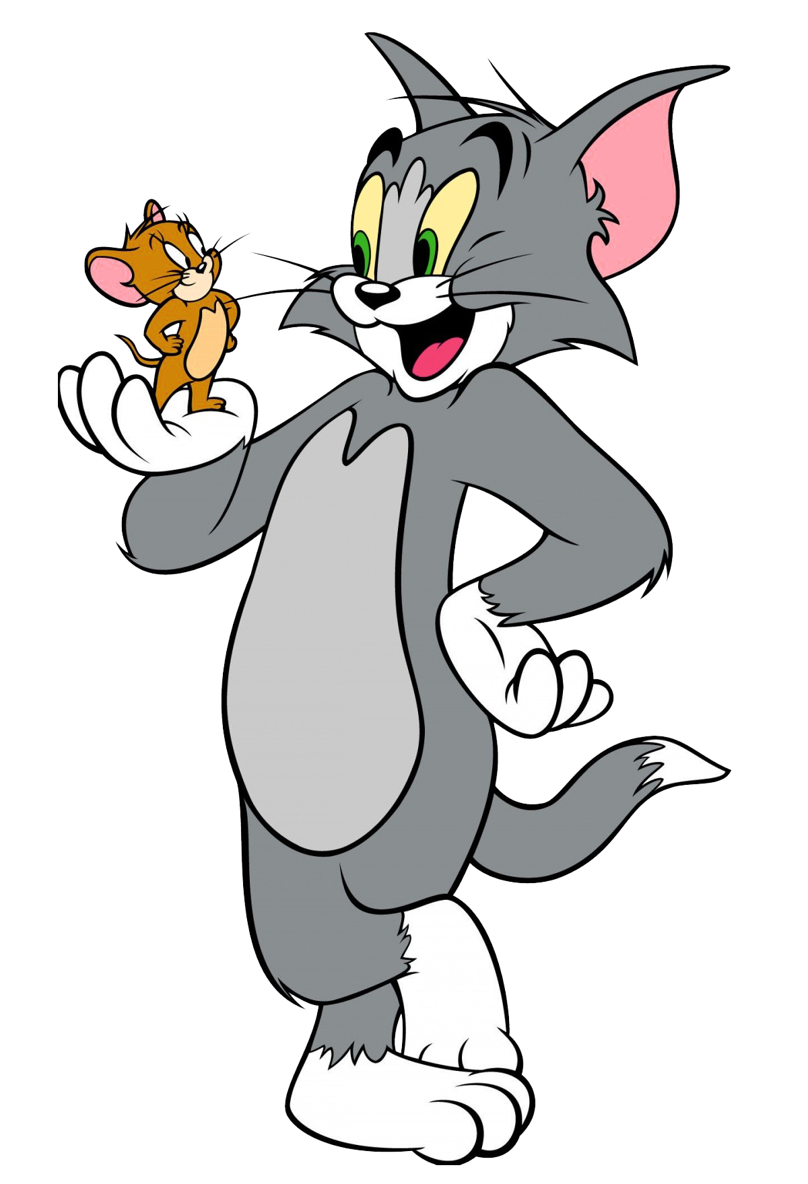
Past Simple or
Past Progressive
תמונה זו מאת מחבר לא ידוע ניתן ברשיון במסגרת CC BY-NC

Slide 2
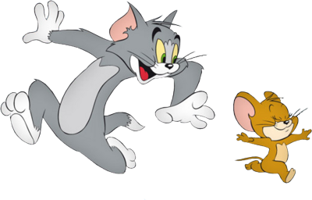
When to use:
2 or more actions happening at the same time in the past.
They were playing while I was working.
They were eating as I was cooking.
An action that was interrupted by a short action. The short action will be in past simple.
I was walking when it started to rain.
An action happening at a certain point in the past.
I was sleeping at nine o’clock last night.

Slide 3
How to use:
Positive:
rest of sentence | Verb + ing | was / were | Subject
when you came in. | eating | was | I / he / she / it
when the glass fell. | eating | were | You / we / they
Negative:
rest of sentence | Verb + ing | wasn’t / weren’t | Subject
when you came in. | sleeping | wasn’t | I / he / she / it
when the glass fell. | sleeping | weren’t | You / we / they

Slide 4
Yes / no questions:
rest of sentence | Verb + ing | subject | Was / Were
when you came in? | playing | I / he / she / it | Was
when the window broke? | playing | you / we / they | Were
Wh questions:
rest of sentence | Verb + ing | subject | was / were | Wh word
when I arrived? | doing | I / he / she / it | was | What
when I arrived? | doing | you / we / they | were | What
Wh – subject questions:
rest of sentence | Verb + ing | was | Wh – who, what
when you came in? | eating | was | Who
when you came in? | happening | was | What

Slide 5
-ing spelling rules:
+ing
talk
talking
carry
carrying
e +ing
bake
baking
ie + ying
tie
tying
CVC + Cing
sit
sitting
visit
visiting
mix
mixing

Slide 6
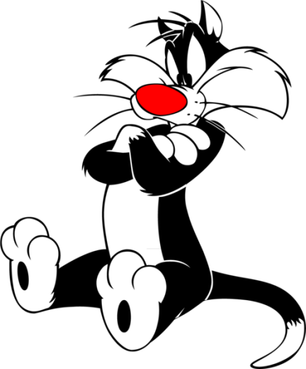

Let’s Remember Past Simple…
When to use:
Completed action in the past.
Actions in the past taking place one after the other.
How to use:
Positive:
Negative:
Question:
V1 + ed
Irregulars (v2)
didn’t + V1
Did …… V1 ……?
He played yesterday.
They flew last week.
I didn’t study last night.
Did you study yesterday?

Slide 7
Let’s practice…
The children ___________________ (play) when the teacher ___________________ (come) in.
While the teacher ___________________ (talk), the children ___________________(shout).
The teacher ________________ (get) mad and ___________________ (leave) the room. The children ___________________ (apologize) and the teacher ___________________(come) back to class.
While the teacher ___________________ (teach), the class ___________________ (listen).
They ___________________ (write) an essay when the bell ___________________ (ring). They ___________________ (stay) in class and ___________________(finish) the essay.

