Slide 1

PAST
SIMPLE
http://www.studyenglishtoday.net/past-simple-tense.html

Slide 2



USAGE
to describe actions and situations that happened at a definite time in the past.
This morning I went to the supermarket.
to tell a story and to express actions which follow each other in a story:
It happened one night in the winter. He took out the key and unlocked the door.
Common time expressions:
Yesterday, the other day, last night, last week, three days ago, in 1998, in 2012…

Slide 3
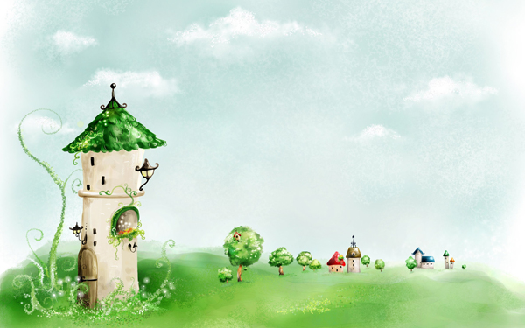
REGULAR VERBS
The past simple tense of the most English verbs is formed by adding "-ed“ to their base form.
Affirmative
I played
You played
He played
She played
It played
We played
You played
They played
Negative
I did not play / I didn’t play
You did not play / you didn’t play
He did not play / he didn’t play
She did not play / she didn’t play
It did not play / it didn’t play
We did not play / we didn’t play
You did not play / you didn’t play They did not play / they didn’t play
InterrogativeDid I play ?
Did you play?
Did he play?
Did she play? Did it play?
Did we play?
Did you play?
Did they play?

Slide 4




REGULAR VERBS
SPELLING RULES:
Verbs ending in stressed syllables and 1 vowel + 1 consonant: We double the consonant. STOP - STOPPED. *Exception: TRAVEL – TRAVELLED (UK English)
Verbs ending in –e: We only add a –d. LIVE- LIVED.
Verbs ending in –y:
-preceded by a vowel. PLAY - PLAYED.
- preceded by a consonant (change y to –i and add –ed). STUDY- STUDIED.

Slide 5

IRREGULAR VERBS
There are also some verbs called irregular verbs that have special past tense forms and we have to learn them by heart.
Affirmative
I went
You went
He went
She went
It went
We went
You went
They went
Negative
I did not go / I didn’t go
You did not go / you didn’t go
He did not go / he didn’t go
She did not go / she didn’t go
It did not go / it didn’t go
We did not go / we didn’t go
You did not go / you didn’t go
They did not go / they didn’t go
Interrogative
Did I go?
Did you go?
Did he go ?
Did she go?
Did it go ?
Did we go?
Did you go?
Did they go?

Slide 6
IRREGULAR VERBS
VERB TO BE (was / were):
Affirmative
I was
You were
He was
She was
It was
We were
You were
They were
Negative
I was not / I wasn’t
You were not / you weren’t
He was not / he wasn’t
She was not / she wasn’t
It was not / it wasn’t
We were not / we weren’t
You were not / you weren’t
They were not / they weren’t
Interrogative
Was I ?
Were you?
Was he?
Was she?
Was it?
Were we?
Were you?
Were they?

Slide 7
IRREGULAR VERBS
REST OF IRREGULAR VERBS:
All 3 forms are similar
infinitive | simple past | past participle
cost | cost | cost
cut | cut | cut
hit | hit | hit
hurt | hurt | hurt
let | let | let
put | put | put
read | read | read
All 3 forms are different
infinitive | simple past | past participle
begin | began | begun
do | did | done
eat | ate | eaten
know | knew | known

Slide 8
IRREGULAR VERBS
Infinitive and past participle are similar
infinitive | simple past | past participle
come | came | come
run | ran | run
become | became | become
Simple past and past participle are similar
infinitive | simple past | past participle
bring | brought | brought
build | built | built
buy | bought | bought
catch | caught | caught
find | found | found
get | got | got
make | made | made

