Slide 1

Past continuous vs.
Past simple
By Jasmin Gomez

Slide 2
Past simple
It is used:
For an action that started and ended in the past:
I saw a ghost last Friday.
For repeated actions in the past:
When I was young, I watched lots of TV every day.
I always gave flowers to my mother.
Regular and irregular past simple verbs:
I talked to my uncle yesterday.
I felt sick yesterday so, I went to the doctor.

Slide 3
Past continuous
It is used:
When talking about two actions in the past; one continues for a period, and the other starts and ends in the past:
While I was talking on the phone, someone stole my car.
I was making my breakfast when my sister knocked at the door.
(These sentences usually use When and While)
When = short action While = long action

Slide 4
To talk about two actions in the past, both happening over a period:
I was working in my computer and my children were watching television
To talk about temporary activities taking place over a period of time:
I was living in Boston when it happened.
She was traveling to New York while her parents were touring Italy.

Slide 5
Past simple
Affirmative statements:
Subject + Verb (regular/ irregular) + Complement.
I played soccer last week.
I saw the movie yesterday.
Negative statements:
Subject + Did + Not + Verb (base form) + Complement.
I didn’t play soccer last week.
Questions:
Did + Subject + Verb (base form) + Complement + ?
Did I play soccer last week?

Slide 6
Past continuous
Affirmative statements:
Subject + Was/Were + Verb –ing + Complement.
I was playing soccer with my friends.
We were studying for the exam.
Negative statements:
Subject + Was/Were + Not + Verb –ing + Complement.
I was not playing soccer with my friends.
Questions:
Was/Were + Subject + Verb –ing + Complement + ?
Were you playing soccer?

Slide 7
Choose which verb tense (simple past or past continuous) fits better:
I __________ I didn’t hear you come.
A) was sleeping B) slept
2. I ___________ to see her twice, but she wasn’t at home.
A) was coming B) came
3. what ___________?
I was watching TV.
A) did you do B) were you doing
4. Hey did you talk to her?
yes, I ___________ to her.
A) was talking B) talked

Slide 8
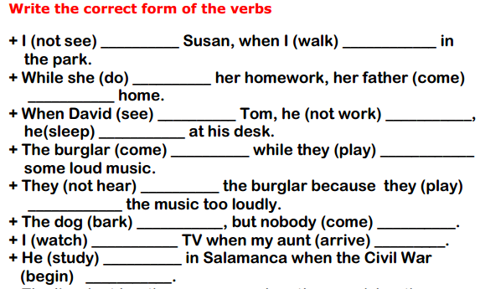

Slide 9


