Slide 1
PRESENT PERFECT CONTINUOUS
I HAVE BEEN + Ving

Slide 2
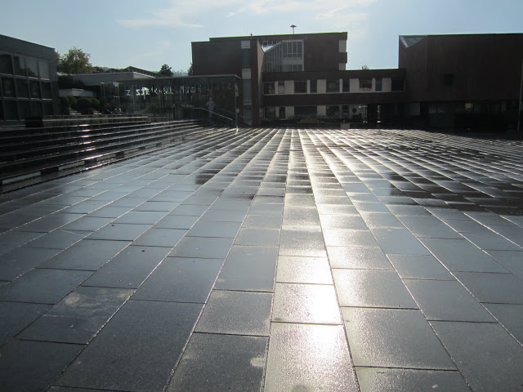
Study this situation:
Is it raining?
No, but the ground is wet.
It has been raining.
Have / has been +ing is the present perfect continuous.

Slide 3
I/you/we/they HAVE BEEN +ing
He/she/it HAS BEEN +ing

Slide 4
When do we use it?
We use the present perfect continuous for an activity that has recently stopped or just stopped. There is a connection with now!
You are out of breath. Have you been running? (=you are out of breath NOW)
Paul is very tired. He has been working very hard. (=he is tired now)

Slide 5
Study this situation:
It began raining two hours ago and it is still raining.
How long has it been raining? It has been raining for two hours.
We use the present perfect continuous in this way with how long, for ..... and since.... The activity is still happening (as in the example) or has just stopped.

Slide 6
The present perfect continuous is often used with words and phrases like all day/week/year/etc, for, since, just, etc.
As well as for actions repeated over a period of time.
How long have you been learning English? (=you are still learning it)
Tom is still watching TV. He’s been watching TV all day.
Where have you been? I have been looking for you the last half hour!
We have been walking for hours and I need a rest!
Every morning they meet in the same cafe. They have been going there for years.

Slide 7
NOTE:
The present perfect continuous is NOT normally used with the words ever and never! In this case we use present perfect simple!
Have you ever flown in a helicopter before?
Have you ever been flying in a helicopter before?

Slide 8
Sometimes there is very little difference in meaning between present perfect simple and continuous and sometimes there IS a difference in meaning.
I have worked at the airport for four years = I have been working at the airport forfour years.
I have read that book about cruise ships. (and I have finished it!)
BUT
I have been reading that book about cruise ships. (I have NOT finished it!)

Slide 9
NOTE:
The present perfect continuous is NOT used with stative verbs! In this case we use present perfect simple!
Have you known each other long? (not Have you been knowing!)
I haven’t liked ice cream since I ate too much and was sick. (not I haven’t been liking!)

Slide 10
STATIVE VERBS:
Stative verbs are NOT normally used in continuous tenses because they do not describe actions!
Some verbs (such as be, have, imagine, look, see, smell, taste, think) are stative verbs with one meaning and non-stative verbs with another meaning.
Do you have you plane ticket with you? (state: possession)
Are you having lunch at the moment? (action: eating)

