Slide 1
PRESENT PERFECT SIMPLE
VS
PRESENT PERFECT CONTINUOUS

Slide 2
How long?
How much/many?
I have been reading this book for 5 hours.
How long?
5 hours
I have read 130 pages.
How many?
130 pages

Slide 3

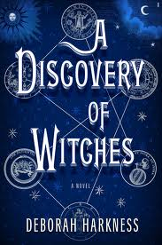
Finished? Unfinished?
She has been reading a book about witches.
She has read a book about witches.
FINISHED

Slide 4
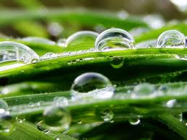
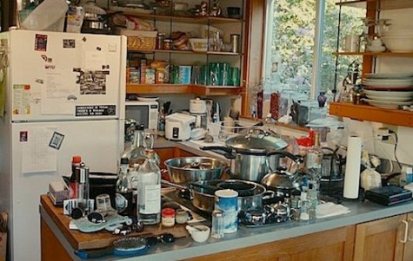
SEE THE RESULT?
Put your shoes on. The grass is wet.
It has been raining.
What’s going on here?
The children have been cooking.

Slide 5
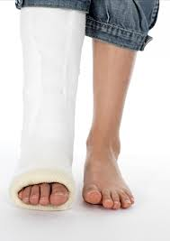
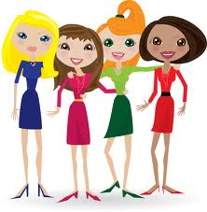
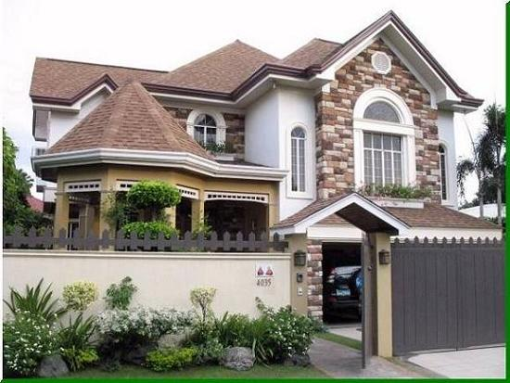

Be careful!!!
I’ve been breaking my leg.
I’ve broken my leg.
I’ve been knowing them for ages
I’ve known them for ages.
I’ve been living here for many years.
I’ve lived here for many years.

Slide 6
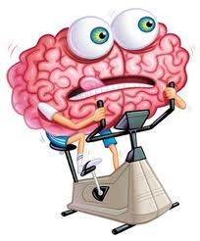
Good luck!
TIME FOR EXERCISES

