Slide 1
JUST means a short time ago.
We have JUST started this presentation.
YET is used to talk about something which is expected to happen. It means ‘at any time up to now’.
It is used in questions and negatives.
Have you been to London YET?
No, I haven't been to London YET.
ALREADY is used to say that something has happened early or earlier than it might have happened.
I have ALREADY been to Brazil.
STILL is used to talk about something that hasn’t finished – especially when we expected it to finish earlier.
The pizza we’ve ordered still hasn’t arrived.

Slide 2
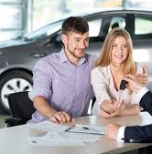
STILL
ALREADY
YET
We have ________ bought our first car.
JUST
just

Slide 3
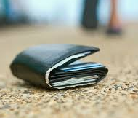
STILL
ALREADY
YET
I ________ haven’t found my wallet.
still
JUST

Slide 4
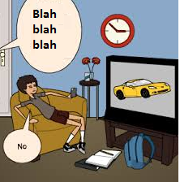
STILL
ALREADY
YET
JUST
Have you done your homework ______?
yet

Slide 5
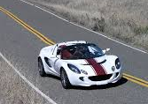
STILL
ALREADY
YET
I have _______ driven a sports car.
It was last year.
already
JUST

Slide 6
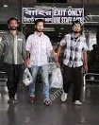
STILL
ALREADY
YET
JUST
The workers have ________ arrived.
just

Slide 7
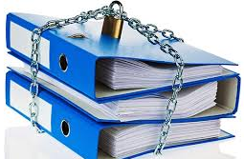
STILL
ALREADY
YET
JUST
I ________ haven’t got that information.
still

Slide 8
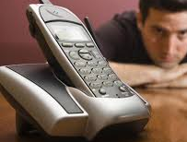
STILL
ALREADY
YET
JUST
She hasn’t phoned me ________.
yet

Slide 9
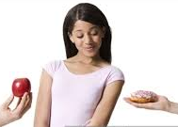
STILL
ALREADY
YET
No, thanks. I’ve ________ had breakfast. It was early this morning.
JUST
already

Slide 10
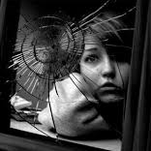
STILL
ALREADY
YET
JUST
Silly! Look at what you’ve _______ done! What now?
just

Slide 11
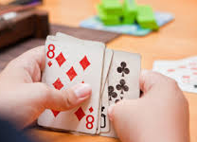
STILL
ALREADY
YET
JUST
I can’t believe they ________ haven’t finished that game.
still

Slide 12
STILL
ALREADY
YET
JUST
Have you met anyone famous ________?
yet

Slide 13
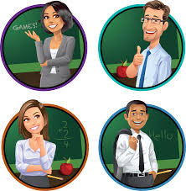
STILL
ALREADY
YET
The teachers have ______ prepared their lessons. They can’t change them.
JUST
already

Slide 14
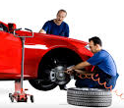
STILL
ALREADY
YET
I guess they’ve ________ done that. Let’s check.
JUST
already

Slide 15
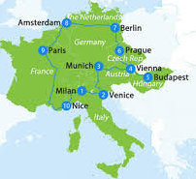
STILL
ALREADY
YET
Have you been to Europe ______?
No, not ______.
JUST
yet
yet

Slide 16
STILL
ALREADY
YET
They______ haven’t learned how to use that app.
still
JUST

Slide 17
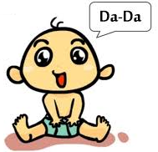
STILL
ALREADY
YET
Amazing! Her baby has ______ learnt his first word.
JUST
just

