Slide 1
Present CONTINUOUS

Slide 2
Grammar notes
Use PRESENT CONTINUOUS to describe something that is happening right now. (for example, now, at the moment.)
NOW
EXAMPLES:
Thomas is visiting Claudia.
He’s speaking English right now.
He´s speaking English
PAST
x
FUTURE

Slide 3
2. Use the PRESENT CONTINUOUS to describe something that is happening in the extended present time (for example, nowdays, these days, this month, this year), even it’s not happening at the moment of speaking.
NOW
EXAMPLES:
We’re studying U.S. customs this month.
Laura is teaching in France this year.
PAST
x
FUTURE
She’s studying

Slide 4
We use the PRESENT CONTINUOUS to talk about an action which is scheduled in the near future.
EXAMPLES:
I am getting married next month.
My brother is flying to Rome tonight.

Slide 5
SPELLING RULES
If the verb ends in vowel + consonant + “e”, remove “e” first.
Write writing
Take taking
2. If the verb ends in consonant + stressed vowel + consonant, double the last letter first.
STOP STOPPING
RUN RUNNING
S | T | O | P
 | consonant | stressed vowel | consonant

Slide 6
SPELLING RULES
3. If the verb ends in “ie” change “ie” to “y” first. Example:
Lie Lying
Die Dying

Slide 7
GRAMMAR PRESENTATION
AFFIRMATIVE STATEMENTS
SUBJECT | BE | BASE FORM OF VERB + ING
I | am | teaching | now.
You | are
He She It | is
We You They | are

Slide 8
NEGATIVE STATEMENTS
SUBJECT | BE | NOT | BASE FORM OF VERB + ING
I | am | NOT | teaching | now.
He | is
We | are

Slide 9
YES / NO QUESTIONS
BE | SUBJECT | BASE FORM OF VERB + ING
Is | he | teaching | now?
SHORT ANSWERS
YES, | HE | IS
NO, |  | ISN’T

Slide 10
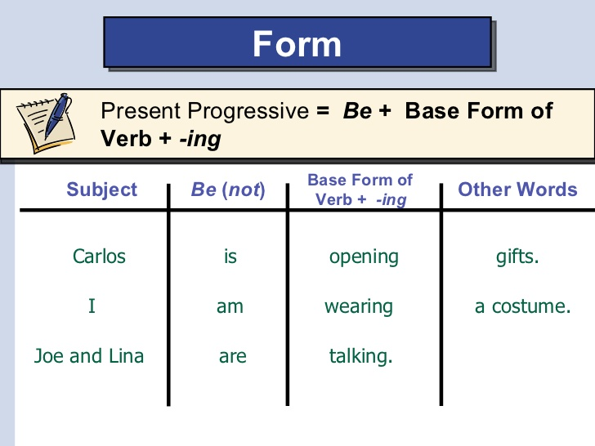

Slide 11
