Slide 1
Present Simple

Slide 2
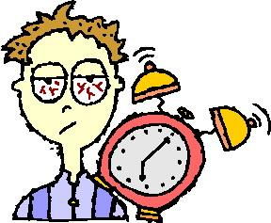
When do we use Present Simple?
To describe things that happen regularly. ( για συνήθειες, πράγματα που κάνω τακτικά)
I wake up at 6:10

Slide 3
When do we use Present Simple?
To describe things which are generally true. ( για γενικές αλήθειες )
Water freezes at 0ºC.
0ºC

Slide 4
Present Simple – Form - Affirmative
I You | Play
He She It | PlayS
We You They | Play

Slide 5
Present Simple – Form – Affirmative 3rd person singular
I/ You/ We/ They | He/ She/ It
write | writes
kiss | kisses
fix | fixes
go | goes
play | plays
fly | flies
Usually → verb + S
Verbs ending in -ss/ -x/ -ch/ -sh → verb + ES
Verbs ending in -o → verb + ES
Verbs ending in vowel + -y → verb + S
Verbs ending in consonant + -y → verb – y + IES

Slide 6
Present Simple – Form - Negative
I You | Don’t | Play
He She It | Doesn’t | Play
We You They | Don’t | Play

Slide 7
Present Simple – Form - Questions
Do | I You | play?
Does | he she It | play?
Do | we you they | play?

