Slide 1
Unit 1
Lesson 1:
Meeting the newcomers

Slide 2
Reading
Ukraine
Albania
Georgia

Slide 3
I come from: κατάγομαι από …
I come from Greece.
I come from Italy.
back to text

Slide 4
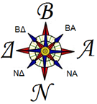
North
West
East
South
back to text

Slide 5
the capital: an important city where the main government of a country, state etc is/ πρωτεύουσα
The capital city of Greece is Athens.
The capital city of the United Kingdom is London.
my hometown: the place where you were born and spent your childhood./ η πόλη που γεννήθηκα
My hometown is Thessaloniki.
back to text

Slide 6
coast:
the area where the land meets the sea./ ακτή,
on the coast of
Peraia is located on the south coast of the Thermaic Gulf.
back to text

Slide 7
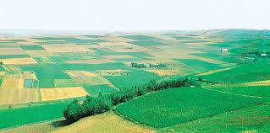
plain: a large area of flat land/ πεδιάδα
back to text

Slide 8
such as: used when giving an example of something
Cartoon characters such as Mickey Mouse and Snoopy are still popular.
High mountains, such as the Carpathians.
back to text

Slide 9
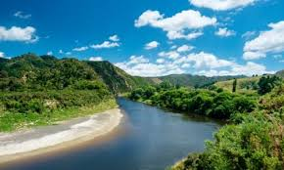
river = ποτάμι
back to text

Slide 10
flow: when a liquid, gas, or electricity flows, it moves in a steady continuous stream/ κυλάω, ρέω
The river flows across the country.
split: to divide or separate something into different parts or groups, or to be divided into different parts or groups/ χωρίζω, διαιρώ
The book is split into six sections.
back to text

Slide 11
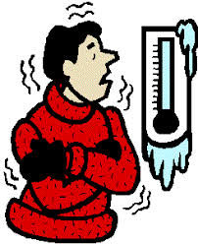
the weather: the temperature and other conditions such as sun, rain, and wind/ ο καιρός
In winter the weather gets cold.
back to text

Slide 12
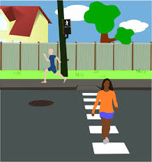
across: from one side of something to the other./ από τη μια πλευρά στην άλλη.
She walked across the road.
back to text

Slide 13
cool: low in temperature, but not cold, often in a way that feels pleasant / δροσερός
She swam out into the cool water.
The evening air was cool.
back to text

Slide 14
along: from one place on something such as a line, road, or edge towards the other end of it / κατά μήκος
We were driving along Follyfoot Road.
back to text

Slide 15
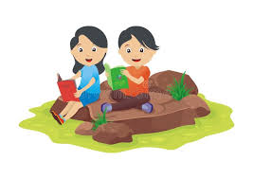
outdoors: outside
It’s warm enough to eat outdoors tonight.
back to text

Slide 16
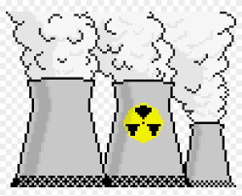
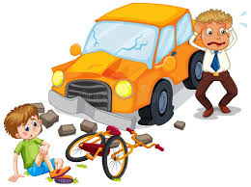
nuclear power plant: a building where electricity is produced to supply a large area/ εργοστάσιο παραγωγής ηλεκτρικής ενέργειας
accident: a situation in which someone is injured or something is damaged without anyone intending them to be/ ατύχημα
back to text

Slide 17
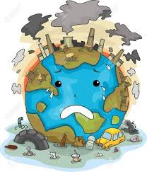
cause: to make something happen / προκαλώ
environmental problems: problems that affect the air, land, or water on Earth/ περιβαλλοντικά προβλήματα
back to text

Slide 18
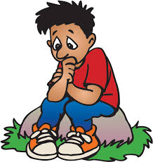
worry: to be anxious or unhappy about someone or something, so that you think about them a lot/ ανησυχώ
I worry about my daughter.
back to text

Slide 19
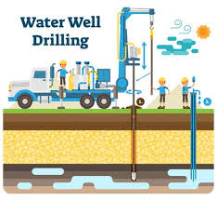
enough: the degree that is necessary or wanted/ αρκετός, -ή, -ό
Are the carrots cooked enough?
You can go to school when you’re old enough.
drinking water supplies: an amount of drinking that is available to be used/ αποθέματα πόσιμου νερού
back to text

Slide 20
despite: used to say that something happens or is true even though something else might have prevented it/ παρά, παρόλο
Despite all our efforts to save the school, the authorities decided to close it.
outgoing: someone who is outgoing likes to meet and talk to new people/ εξωστρεφής
We’re looking for someone with an outgoing personality.
I am an outgoing, lively person who enjoys adventures and meeting new people.
back to text

Slide 21
brave: dealing with danger, pain, or difficult situations with courage and confidence/ γενναίος, -α, -ο
No matter how hard I tried to be brave and strong, I couldn't stop myself from crying.
country: χώρα
My country is Greece.
I like travelling to a foreign country.
back to text

Slide 22
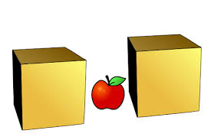
between
The apple is between the two boxes.
The pink rabbit is between the blue
and the yellow rabbit.
back to text

Slide 23
ancient: belonging to a time long ago in history, especially thousands of years ago/ αρχαίος, -α, -ο.
He's not just old, he's ancient.
This is an ancient Greek vase.
share borders with: if one country, state, or area shares borders with another, it is next to it./ συνορεύω
Albania shares borders with Serbia, Montenegro and Greece.
back to text

Slide 24
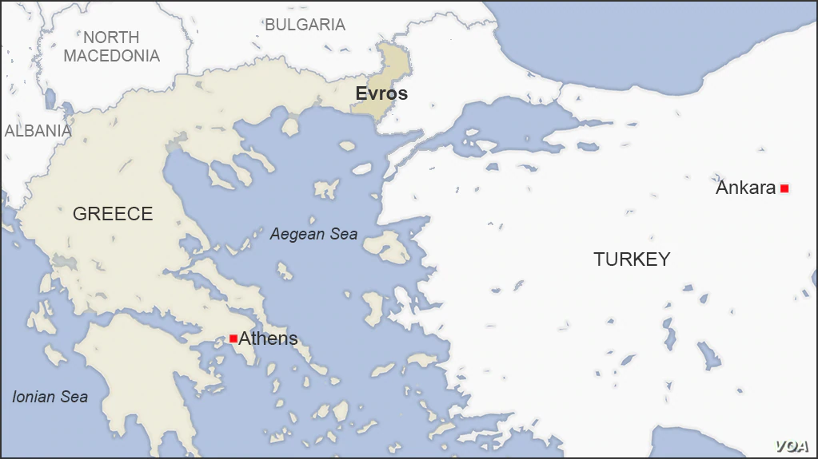
border (verb): συνορεύω, γειτνιάζω
The Black Sea borders a half-dozen countries.
Greece is bordering with Albania, North Macedonia, Bulgaria and with the Turkey
back to text

Slide 25
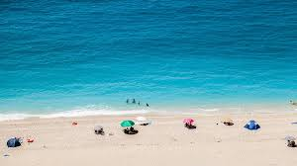
during: from the beginning to the end of a period of time. / κατά τη διάρκεια
During the summer she worked as a lifeguard.
He slept calmly during the early part of the night.
beach: παραλία
We have fun at the beach every
summer.
b
back to text

Slide 26
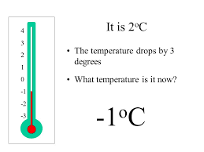
the temperature: a measure of how hot or cold a place or thing is/ θερμοκρασία
drop (verb): 1) to stop holding or carrying something so that it falls/ αφήνω κάτι να πέσει,
2) to fall suddenly onto the ground or into something/ πέφτω
In winter, the temperature usually drops.
back to text

Slide 27
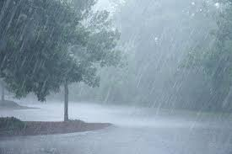
It rains heavily: in large amounts, to a high degree, or with great severity/ σε μεγάλο βαθμό
It rained heavily yesterday.
back to text

Slide 28
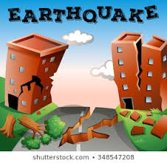
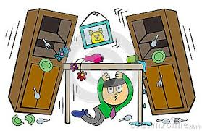
natural disaster: a sudden event such as a flood, storm, or accident which causes great damage or suffering / φυσική καταστροφή
earthquake: a sudden shaking of the Earth’s surface that often causes a lot of damage/ σεισμός
back to text

Slide 29
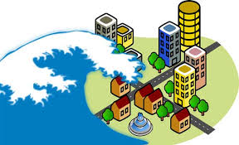
tsunami: a very large wave, caused by extreme conditions such as an earthquake, which can cause a lot of damage when it reaches land/ τσουνάμι
back to text

Slide 30
popular: liked by a lot of people/ δημοφιλής
Hilary was popular at school.
Coffee is probably the most popular drink in the world.
back to text

Slide 31
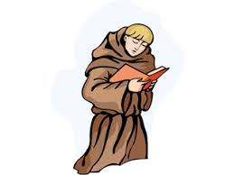
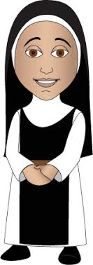
nun: someone who is a member of a group of religious women that live together in a convent/ καλόγρια.
monk (καλόγερος)
back to text

Slide 32
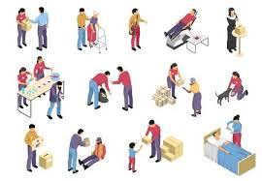
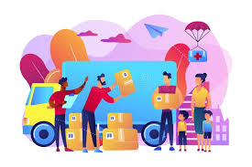
humanitarian : someone who cares about people and helps the ones who are suffering/ ανθρωπιστής, φιλάνθρωπος
back to text

Slide 33
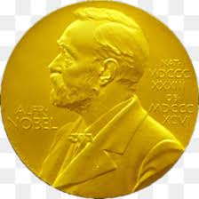
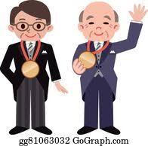
Nobel Prize winner: someone who has won a Nobel Prize/ κάποιος ή κάποια που κέρδισε βραβείο Νόμπελ
back to text

Slide 34
is of Albanian origin: κατάγεται από την Αλβανία
She is of Hispanic origin.
This word is of Greek origin.
homeland: the country where someone was born/ πατρίδα, γενέτειρα
Greece is his homeland.
back to text

Slide 35
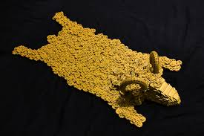
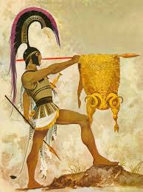
the Golden Fleece
fleece: the woolly coat of a sheep/ προβιά
back to text

Slide 36
call: to use a word or name to describe someone or something in a particular way
call somebody something:
He is calling her a liar.
to have a particular name or title, or use a particular name or title for someone or something.
Our son is called Matthew.
back to text

Slide 37
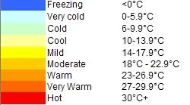
The temperature is mild: the temperature is fairly warm/ η θερμοκρασία είναι ήπια.
back to text

Slide 38
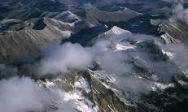
mountainous: a mountainous area has a lot of mountains.
Greece is a mountainous country.
back to text

Slide 39
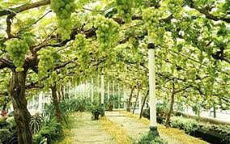
grow vines:
grow: to make plants or crops develop and produce fruit or flowers/ καλλιεργώ
vines: a plant that produces grapes/ κληματαριά
back to text

Slide 40
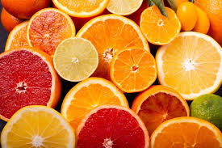
citrus fruit: εσπεριδοειδη φρούτα
back to text

Slide 41
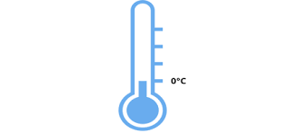
the temperature rarely drops below zero
rarely: not often/ σπάνια
drop below zero: πέφτει κάτω από το μηδέν
leave their hometown: go away from the place where you were born and spent your childhood.
leave: go away from a place: φεύγω
back to text

Slide 42
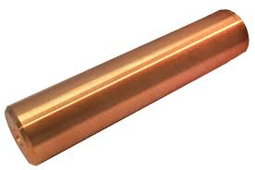
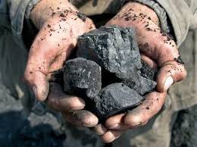
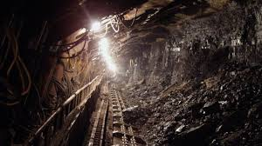
copper and coal mines
copper coal mine
χαλκός κάρβουνο ορυχείο
back to text

Slide 43
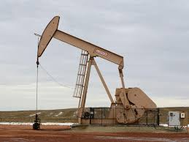
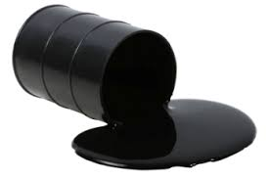
oil wells: a hole that is dug in the ground so that oil can be taken out / πετρελαιοπηγή
back to text

