Slide 1
Past progressive

Slide 2
Was
+ -ing
Were

Slide 3
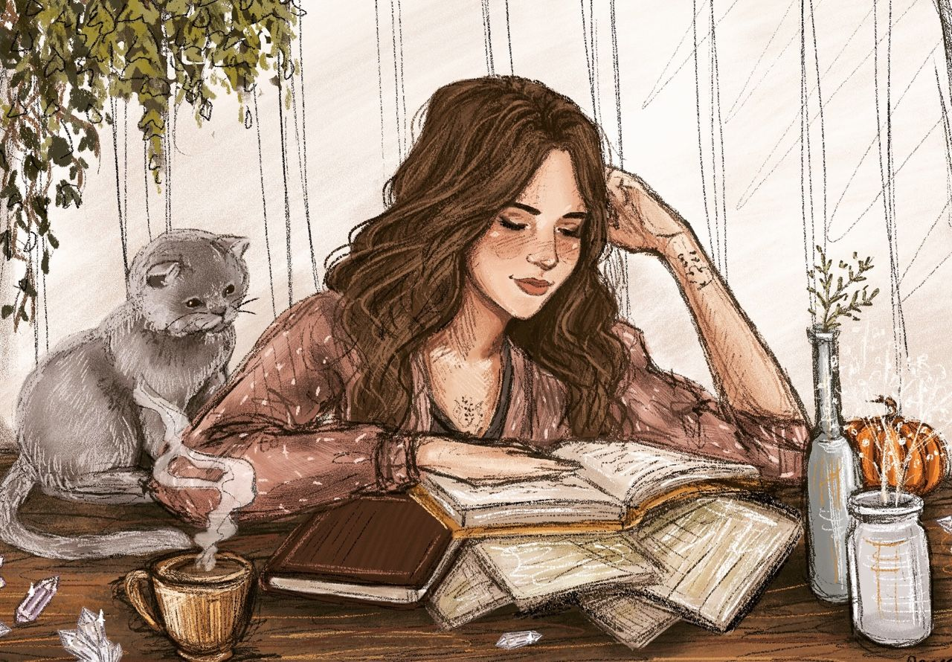

It is used for an action interrupted by another action in the past
I was reading a book when the phone rang

Slide 4

It is used for an action in progress at a specific time in the past
They went to the supermarket at 3 o’clock yesterday and they stayed there until 4:10.
At 3:30 they were buying fruit and vegetables

Slide 5

For actions happening at the same time in the past / Parallel actions
She was watching T.V. while he was listening to music

Slide 6

Background information in a story
It was morning. The sun was shining, the flowers were blooming, the birds were singing…. He woke up.

