Slide 1
Review unit 5

Slide 2
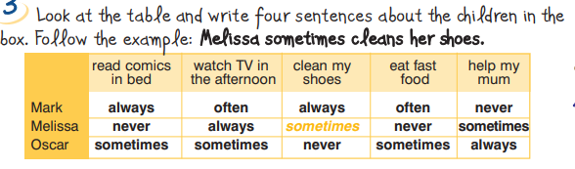
p. 67
Mark always reads comics in bed.
Melissa never reads comics in bed.
Oscar sometimes reads comics in bed.
Mark often watches T.V. in the afternoon
Melissa never watches T.V. in the afternoon
Oscar sometimes watches T.V. in the afternoon
Mark always cleans his shoes.
Melissa sometimes cleans her shoes.
Oscar never cleans his shoes.
Mark often eats fast food.
Melissa never eats fast food.
Oscar sometimes eats fast food.
Mark never helps his mum.
Melissa sometimes helps her mum.
Oscar always helps his mum.

Slide 3
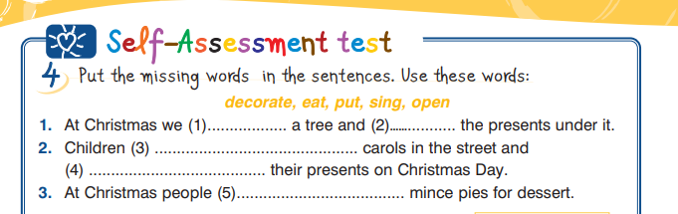
p. 68
decorate
put
sing
open
eat

Slide 4
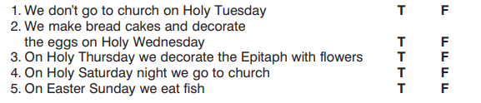
p. 68

Slide 5
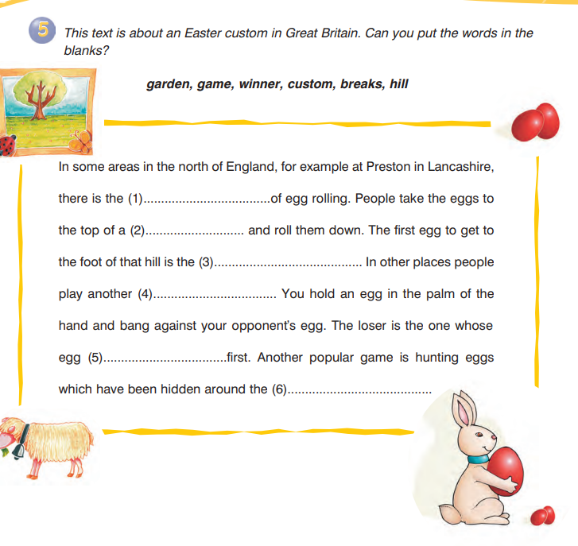
custom
hill
winner
game
breaks
garden

