Slide 1
THE PRESENT SIMPLE

Slide 2
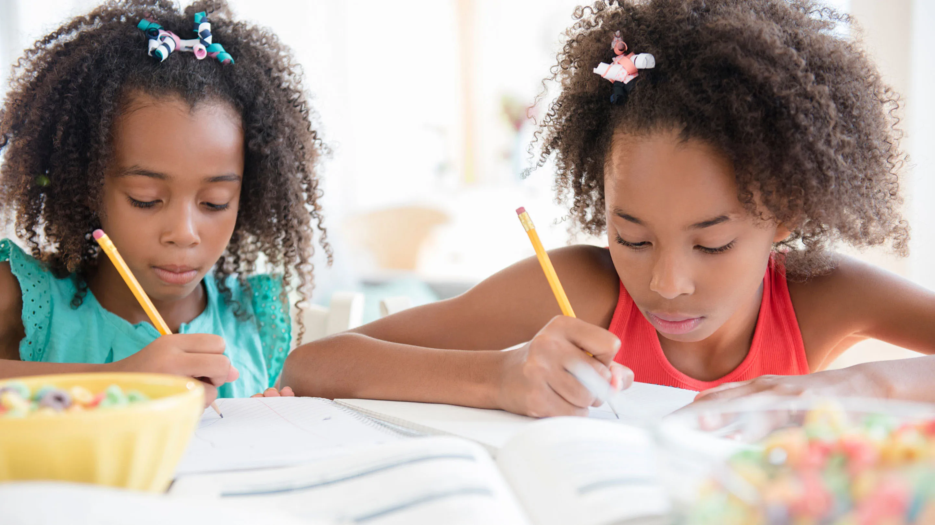
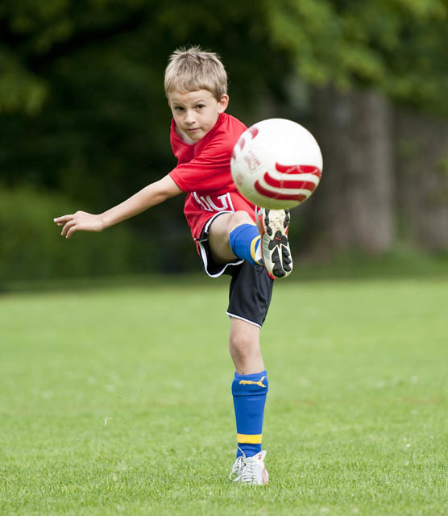
Do they do their homework every day?
Yes, they do.
Does he always play football at night?
No, he doesn’t.

Slide 3
Questions
Do you like broccoli? Yes, I do
Does he swim in the sea? No, he doesn’t
REMEMBER!!!
he
she
it
Negatives
I do not/don’t play soccer
She does not/ doesn’t watch horror movies
+ s
BUT
s
ss
sh
ch
x
o
BUT
Consonant +y y ies e.g. I study-he studies
Vowel +y s e.g. I play –she plays
+ es
a, e, i, o, u

Slide 4
always
Use the adverbs of frequency before the main verbs or after auxiliary verbs.
He seldom wears a coat.
She is always late.
Do they often play chess?
They don’t usually sleep late.
usually
often
sometimes
rarely/seldom/ hardly ever
Other time expressions:
every day/week/month/year
Once a week
Twice a year
Three times a month
On Mondays
At the weekend
never

Slide 5
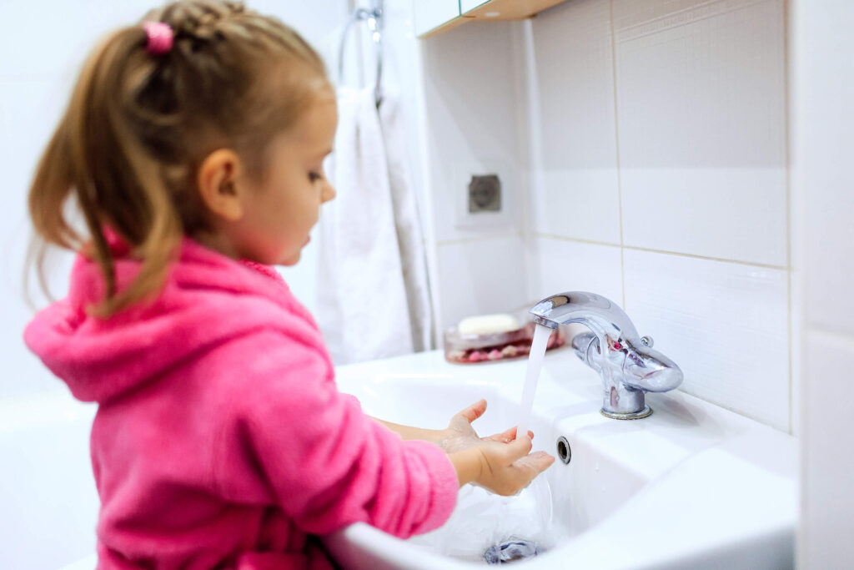
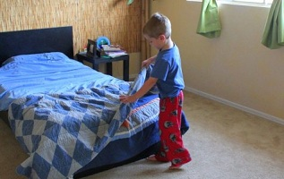
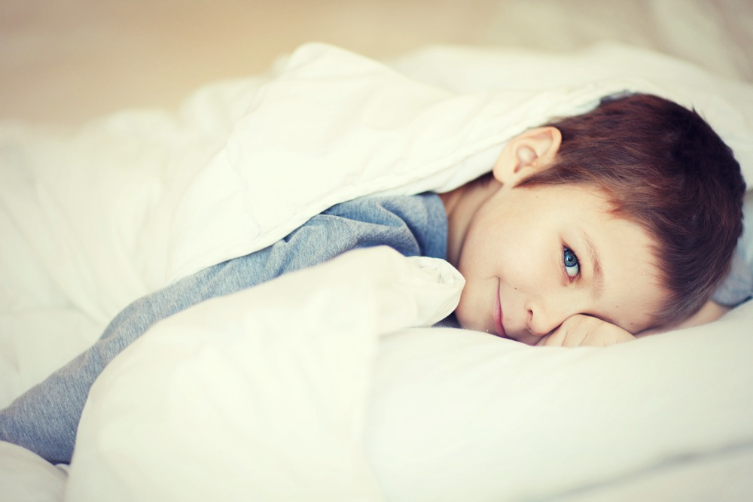

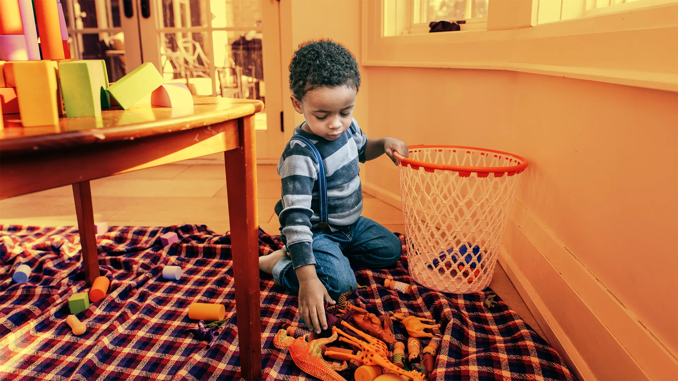
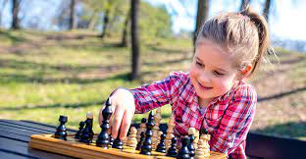
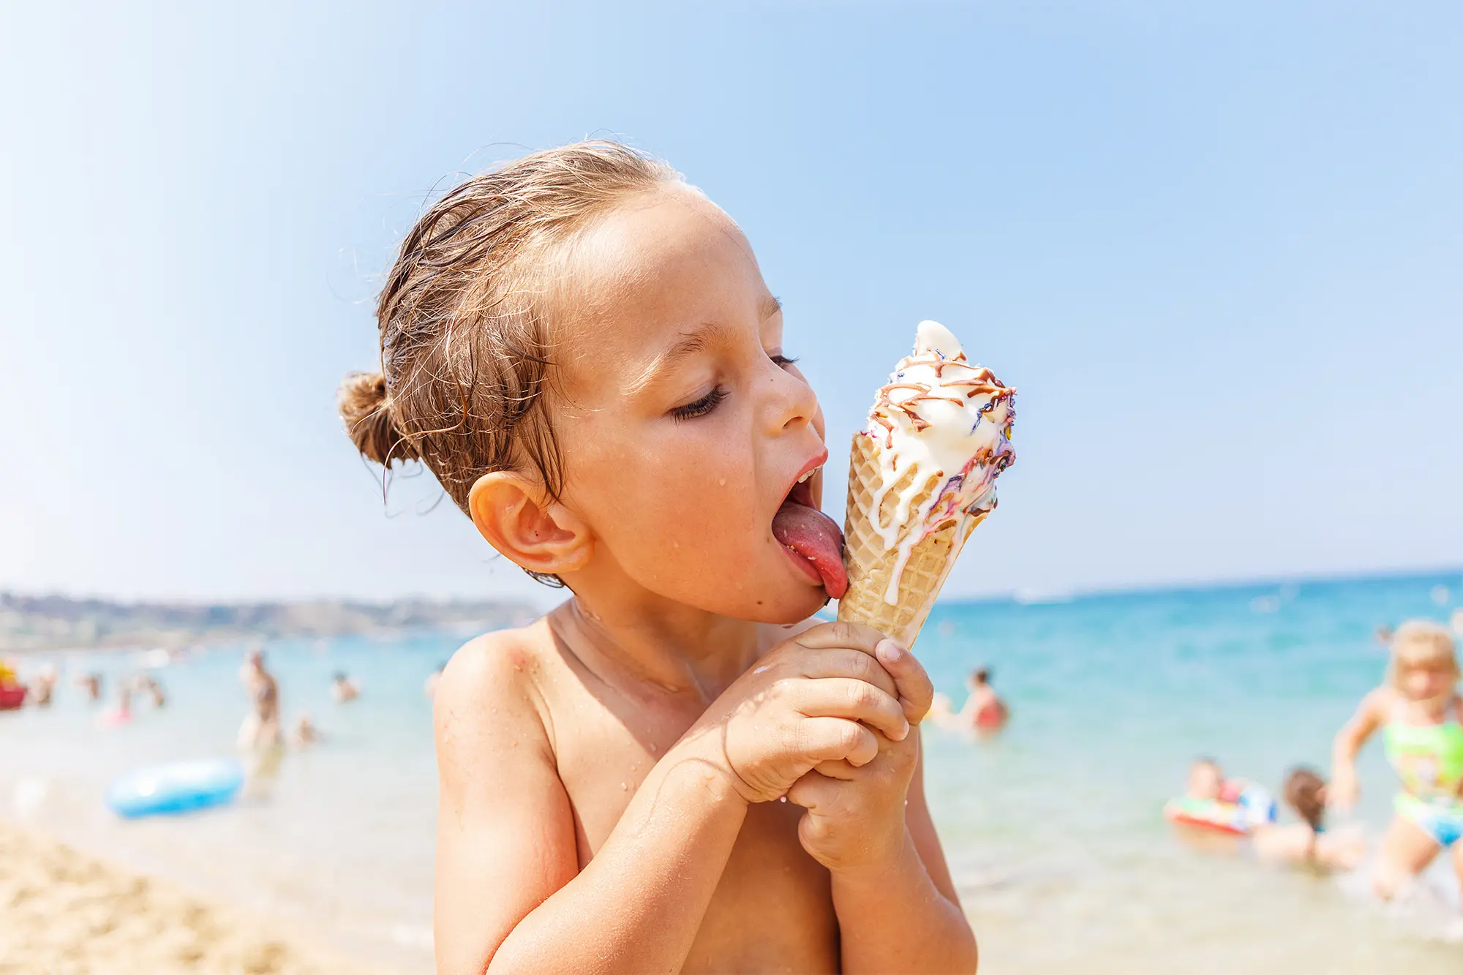
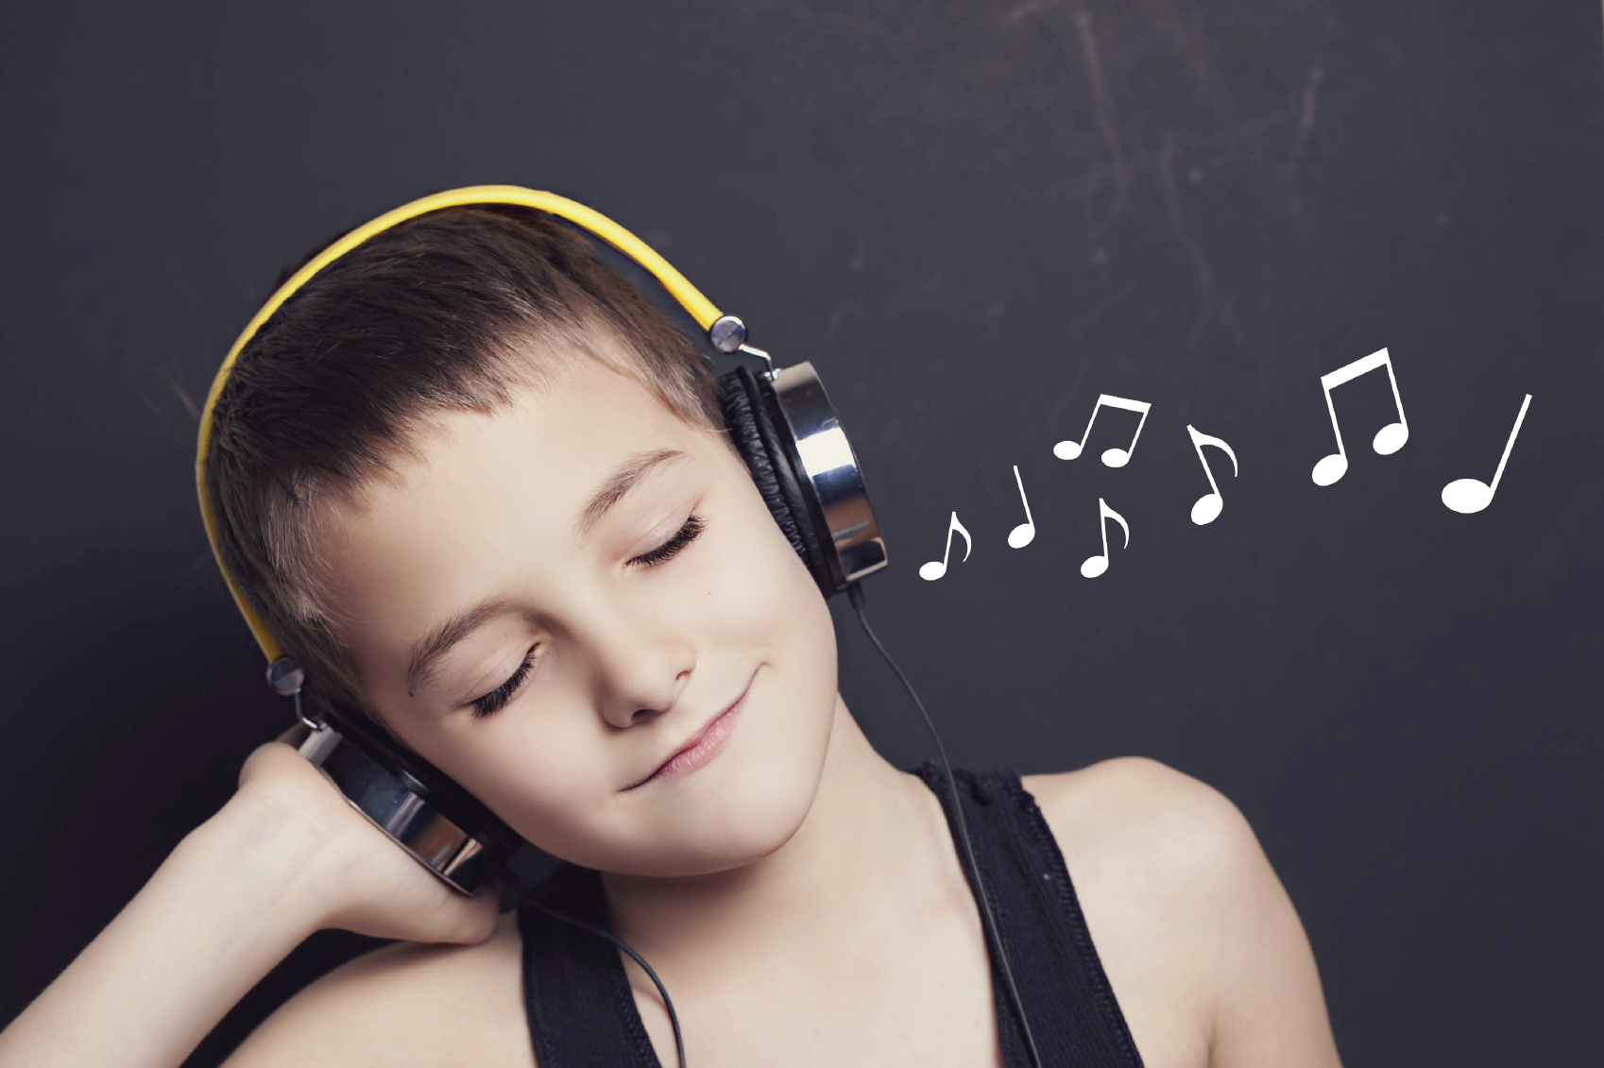
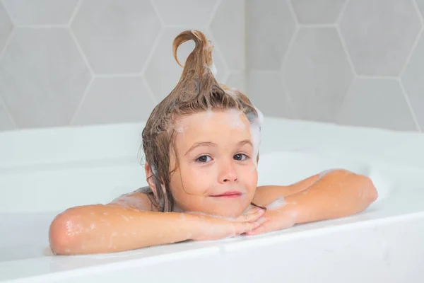
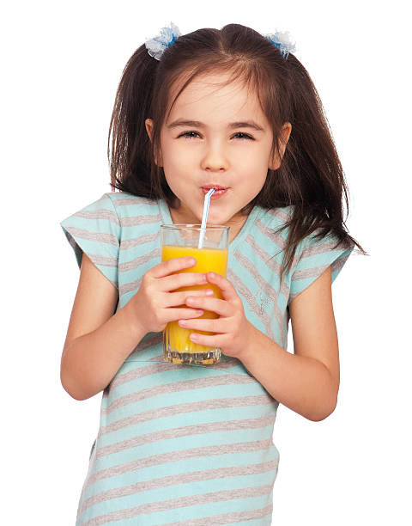
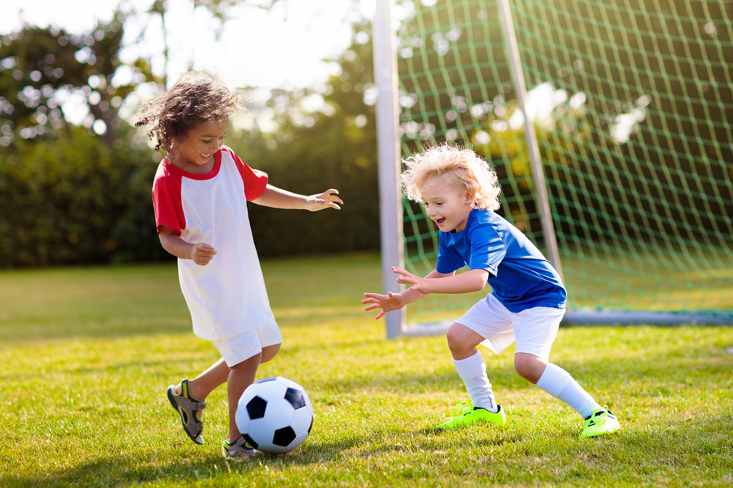
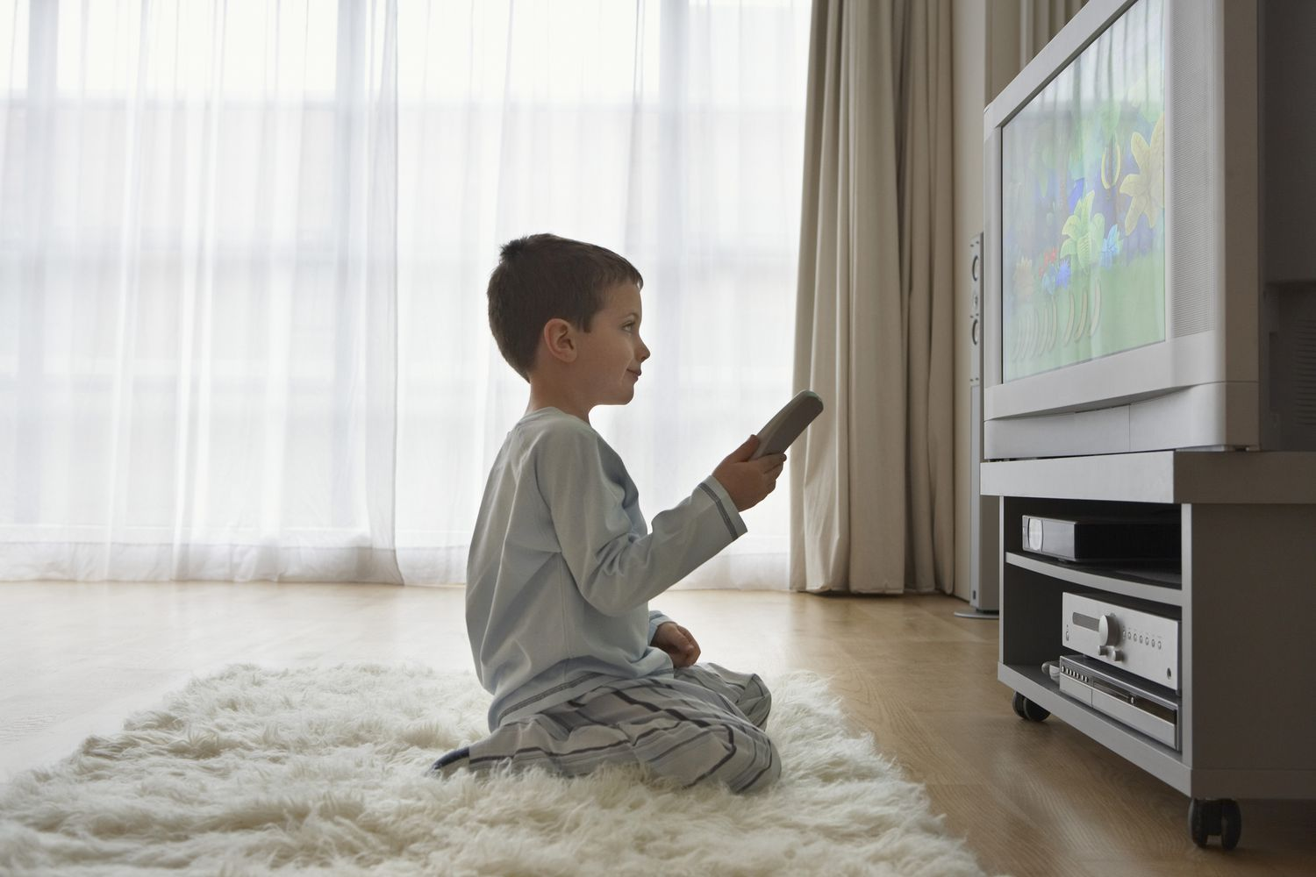
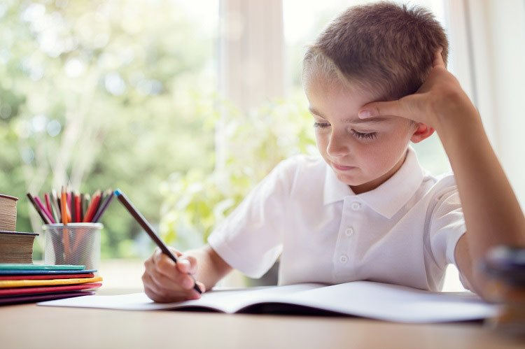
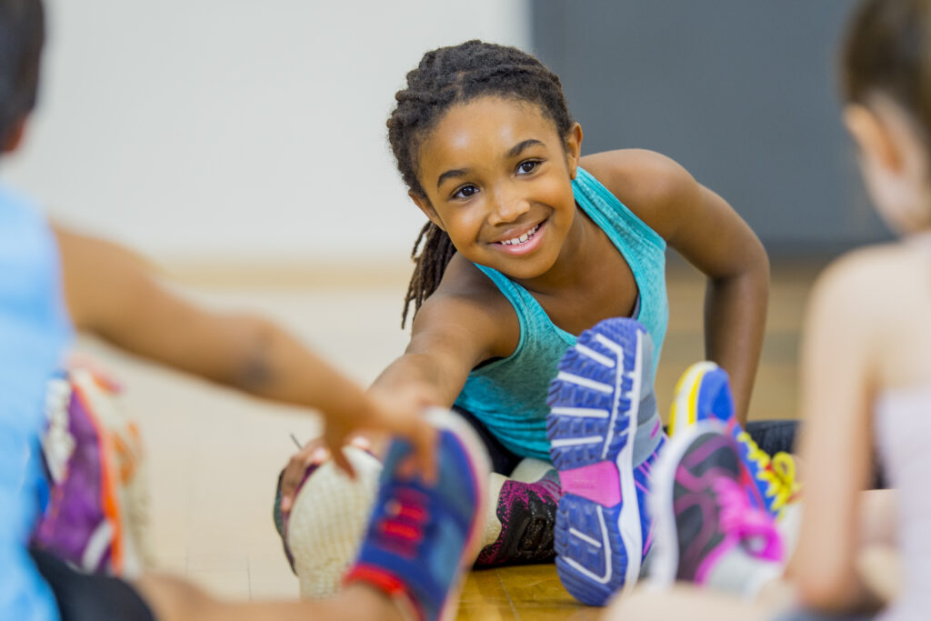
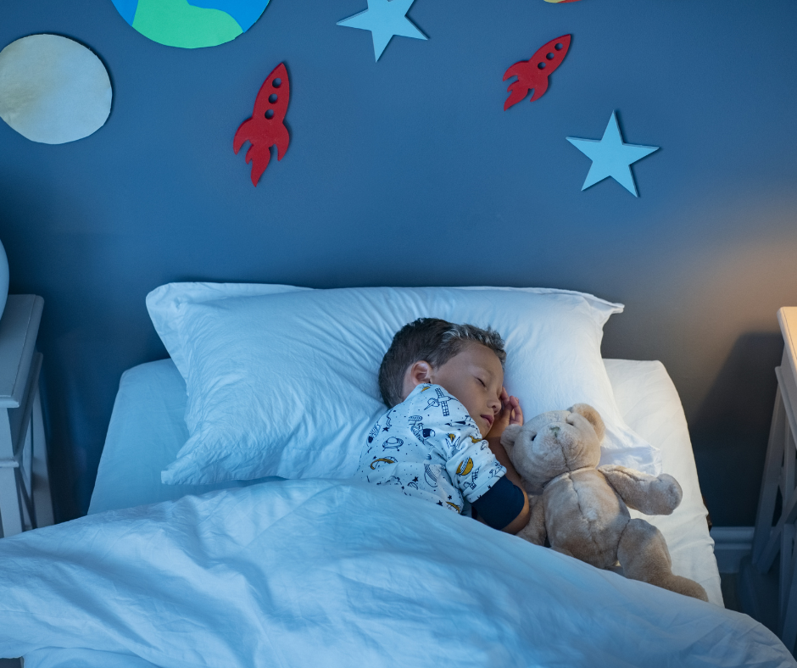
What do they do? How often?
Samantha
Oliver
Henry
Adam
Amy
Claire
Olive
Dylan
Julia
Olivia
Jack
Eric & Oscar
Leo
Naomi
Luke

