Slide 1
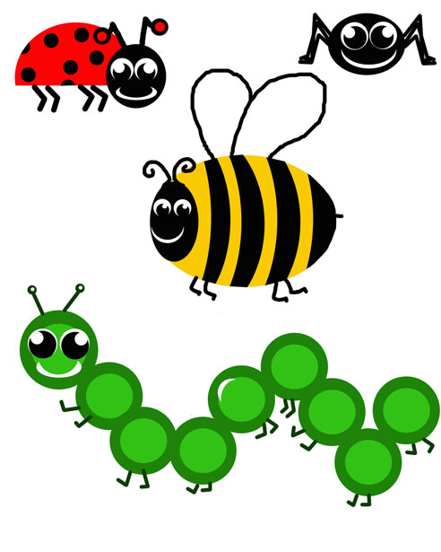
Les scarabées des verbes
Verb bugs
Verb bugs
Conjugaison
caterpillars

Slide 2
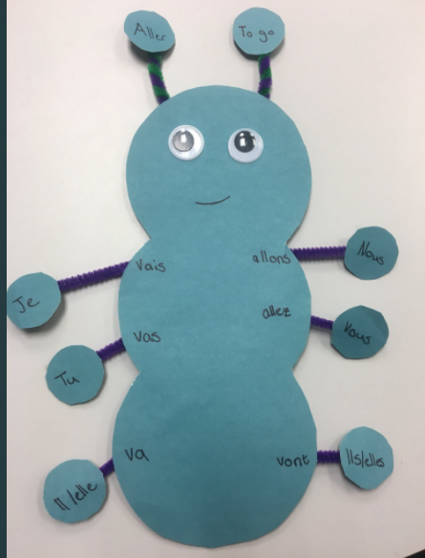

Slide 3
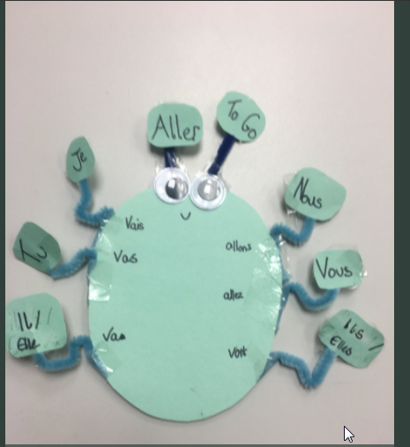

Slide 4
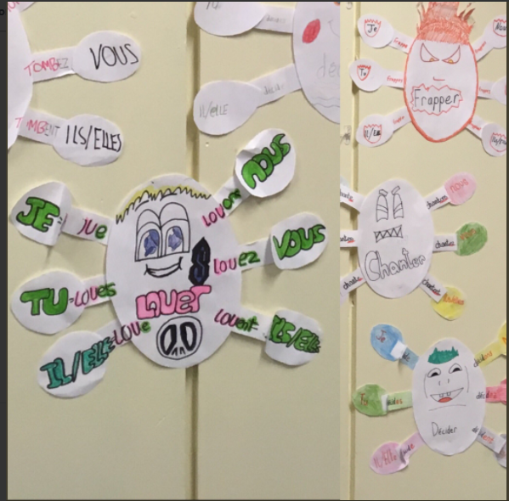

Slide 5
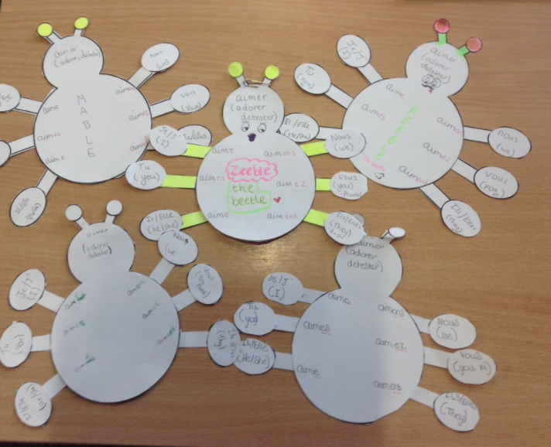

Slide 6
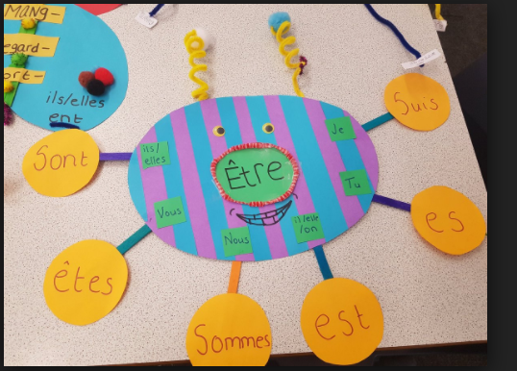

Slide 7
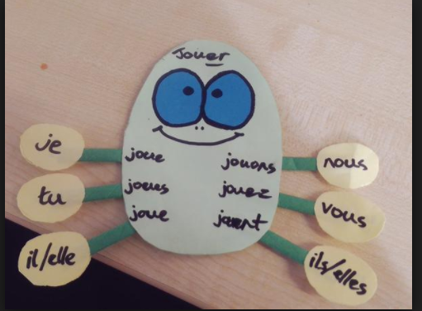

Slide 8
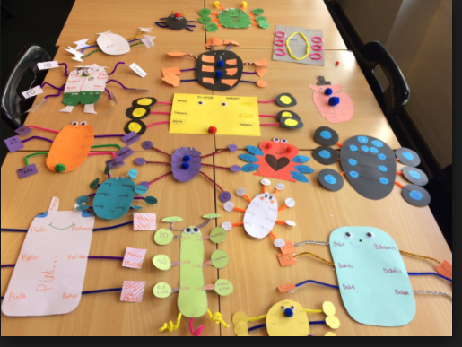

Slide 9
Parler (to talk)
Aimer (to like)
Danser (to dance)
Regarder (to look)
Donner (to give)
Jouer (to play)
I Je parle
You Tu parles
He/She Il/Elle parle
We Nous parlons
You Vous parlez
They Ils /Elles parlent

Slide 10
Verbes à conjuguer
aimer (to like)
danser (to dance)
regarder (to look)
donner (to give)
jouer (to play)
adorer (to adore)
détester (to hate)
regarder (to look)
rentrer (to go back)
diner (to eat diner)
parler (to talk)
chanter (to sing)
arriver (to arrive)
habiter (to live)
cuisiner (to cook)
porter (to bring)
quitter (to live)
déjeuner (to have lunch)
écouter (to listen)
travailler (to work)
Répéter (to repeat)

Slide 11
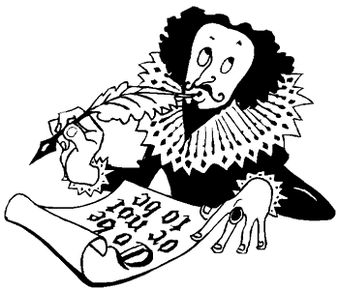
Être
je suis
tu es
Il/elle est
nous sommes
vous êtes
Ils/elles sont

Slide 12


