Slide 1
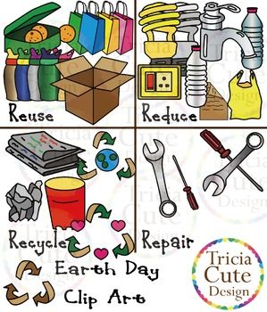
UNIT 5
READY FOR ACTION

Slide 2
Recycle ανακυκλώνω
Recycling ανακύκλωση

Slide 3
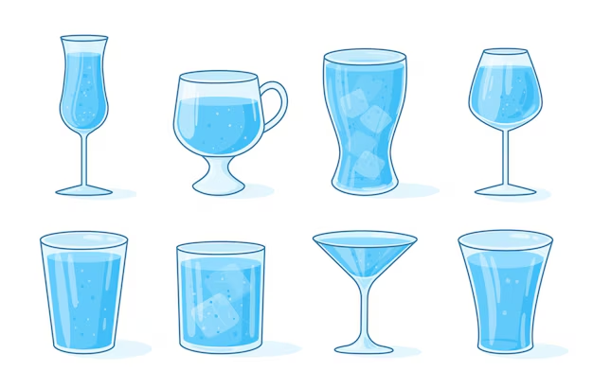
Glass

Slide 4
Paper

Slide 5
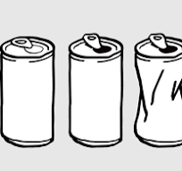
aluminium

Slide 6
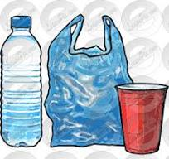
Plastic

Slide 7
Reduce μειώνω

Slide 8
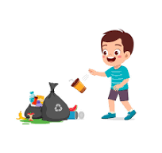
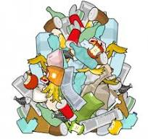
litter garbage
rubbish
litter bin

Slide 9
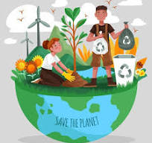
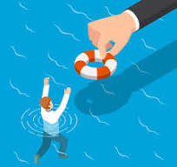
Save σώζω

Slide 10
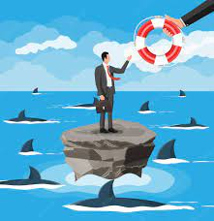
Survive επιβιώνω

Slide 11
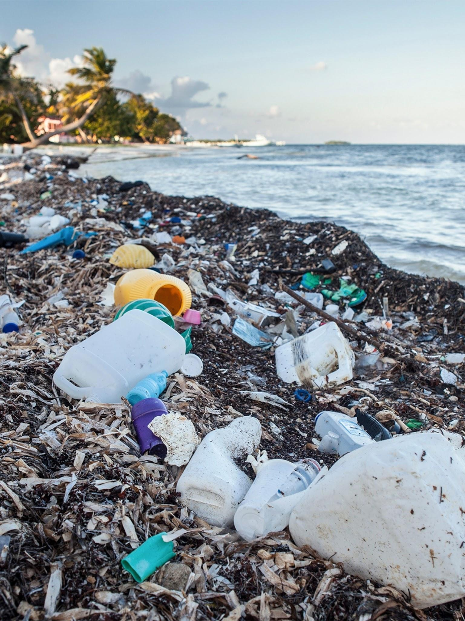
What can you see?

Slide 12
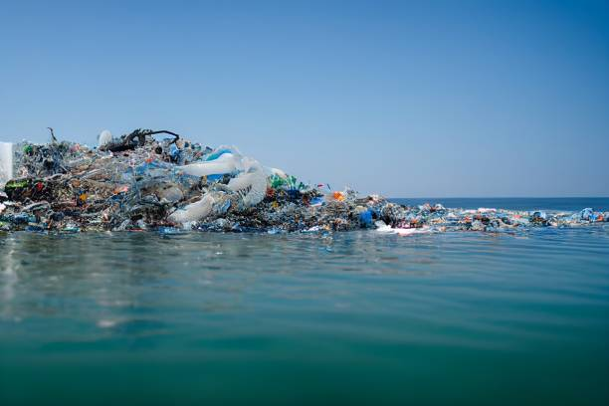
What can you see?

Slide 13
