Slide 2
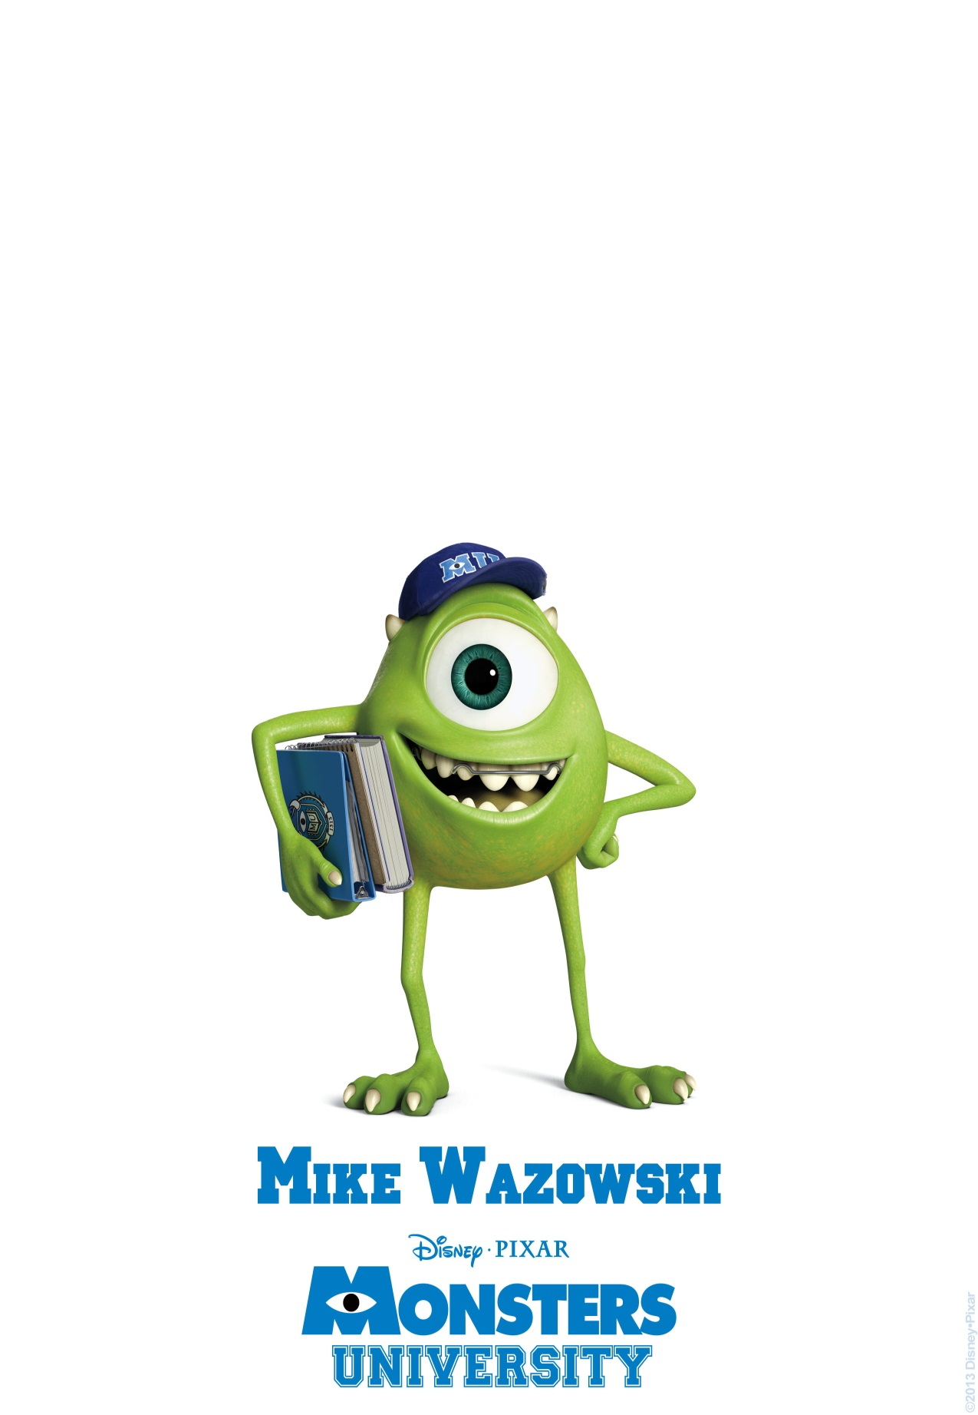
His name is ________
His body is __________ He has got ______ big _____
He hasn’t got a ________ His mouth is _____________ He has got ______ long _____
and two long ______
He is wearing a _______ _______

Slide 3
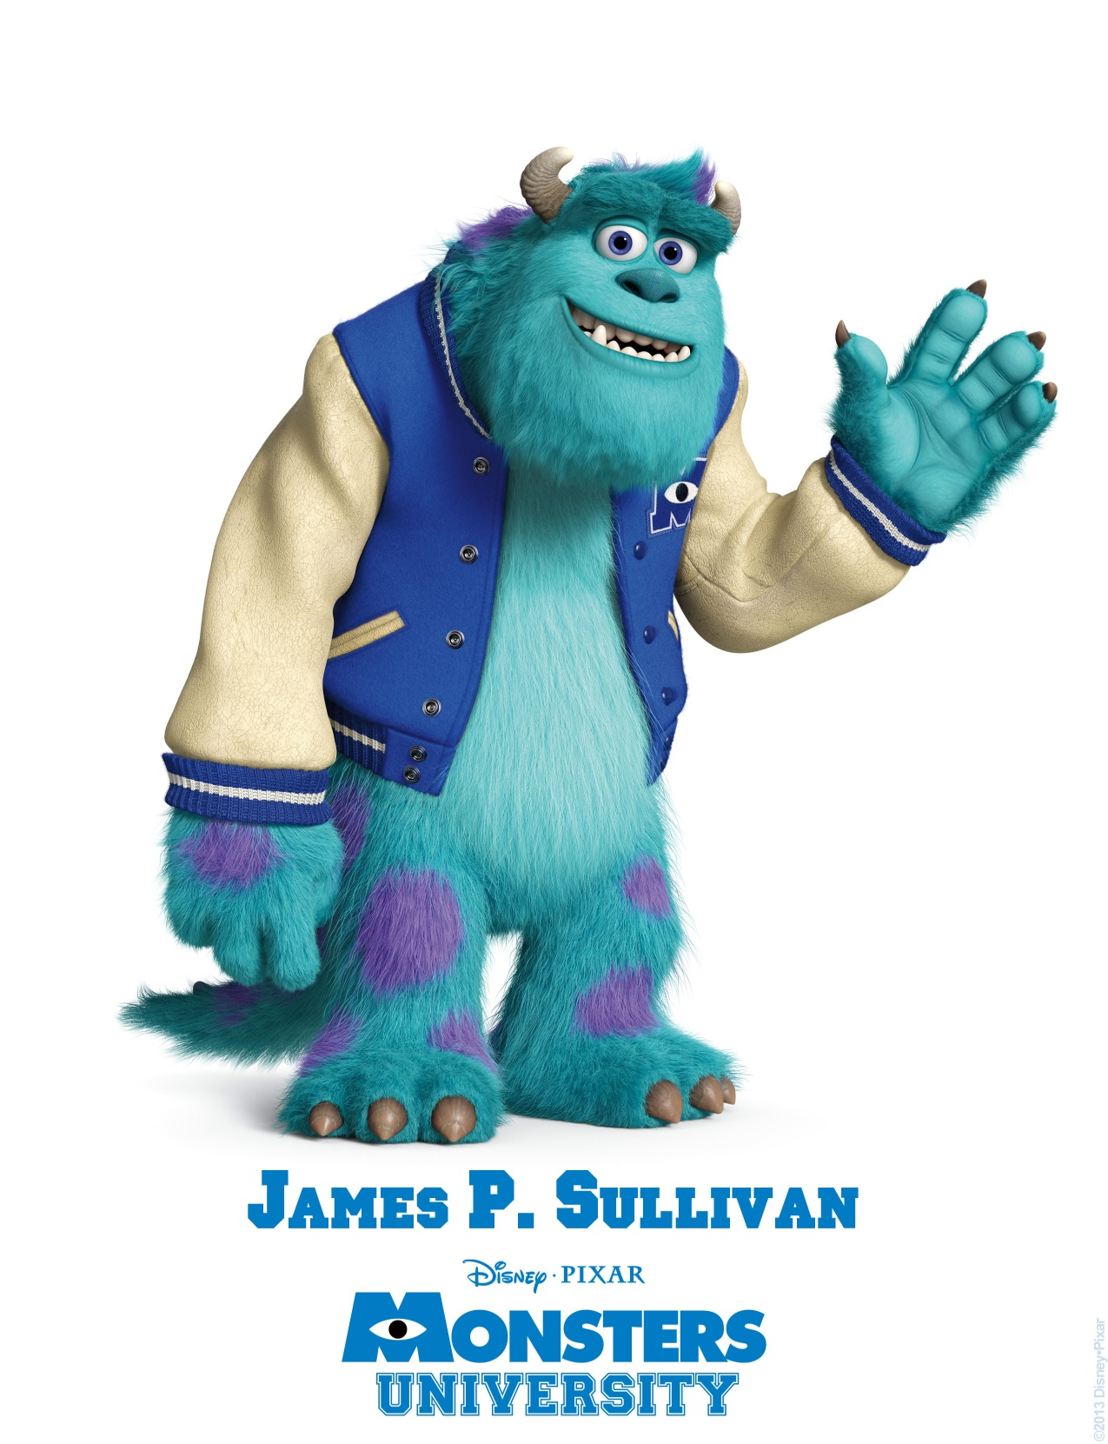
His name is ____________
His body is _____ and ______ He has got two _____ , a big ________, a big _______ and _____ white _______
His hands are _____ he has got _______ fingers His feet are ______ He is wearing a _______ and _______

Slide 4
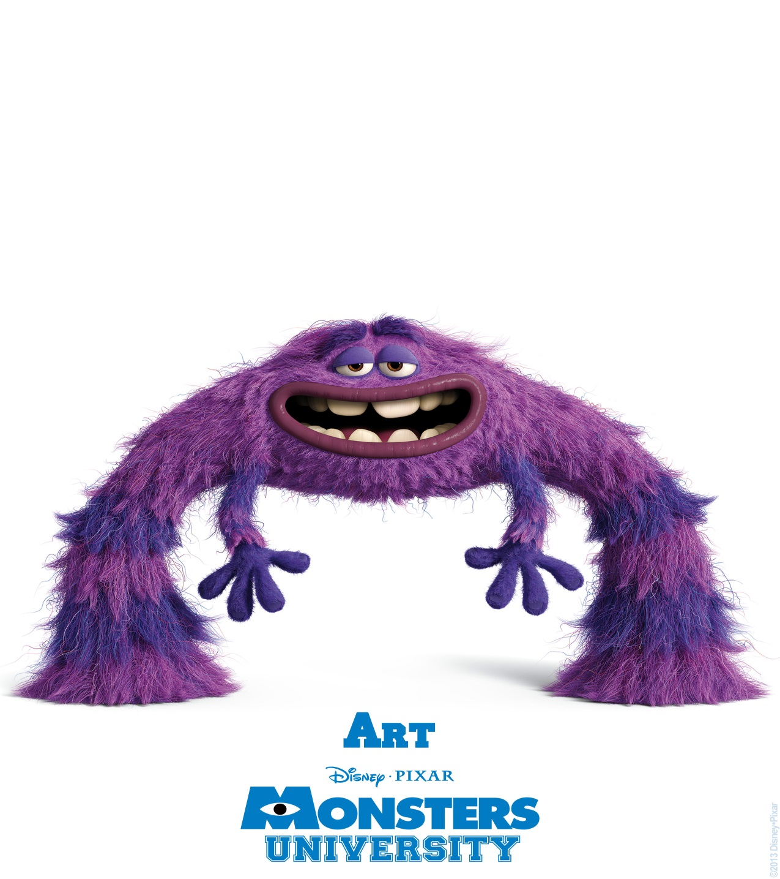
His name is _____________
His body is _________ He has got ______ small _____
He hasn’t got a ________ His mouth is _____________ He has got ______ long _____ and four _______
He has got two ________ _______

Slide 5
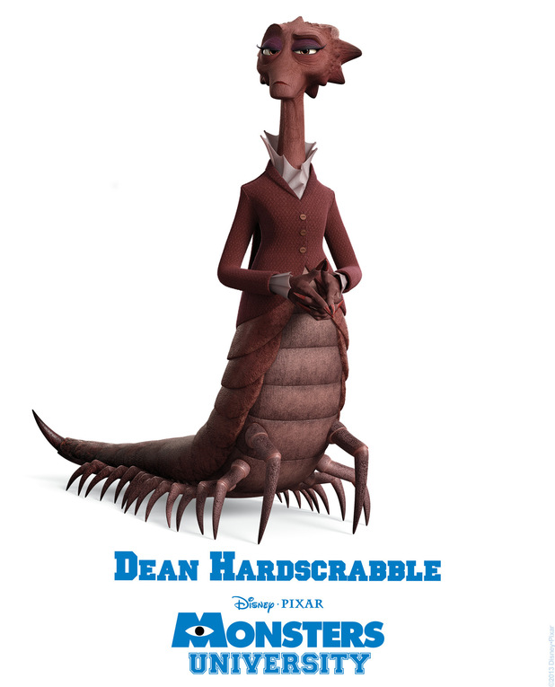
Her name is ___________
She has got ______ eyes. She hasn’t got a ________ His mouth is ___________ She has got two _____
and twenty eight ______
She is wearing a ______ _____ and a ______ ______

Slide 6
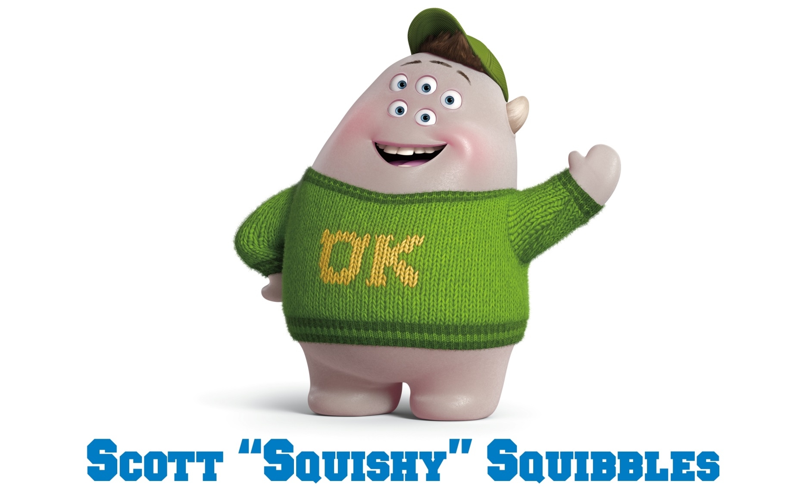
His name is ____________
His body is _______ He has got _______ eyes, a big ________, two______ but he hasn’t got a ________ His hands are _______he hasn’t got His legs are ______ He is wearing a _______ and _________ sweater.

Slide 7
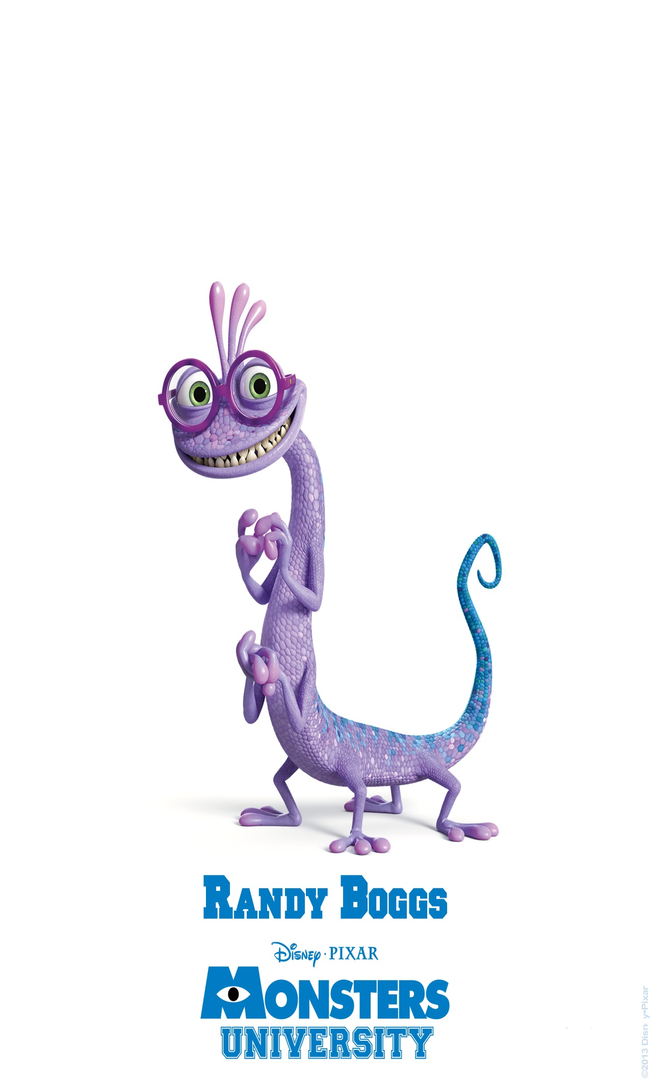
His name is _______________
His body is _____ and ______ He has got two _____eyes , a big ________ He hasn’t got a _________ he hasn’t got ___________ He has got ________ arms and _________ fingers. He has got ___________ legs and a ________ tail.

