Slide 1
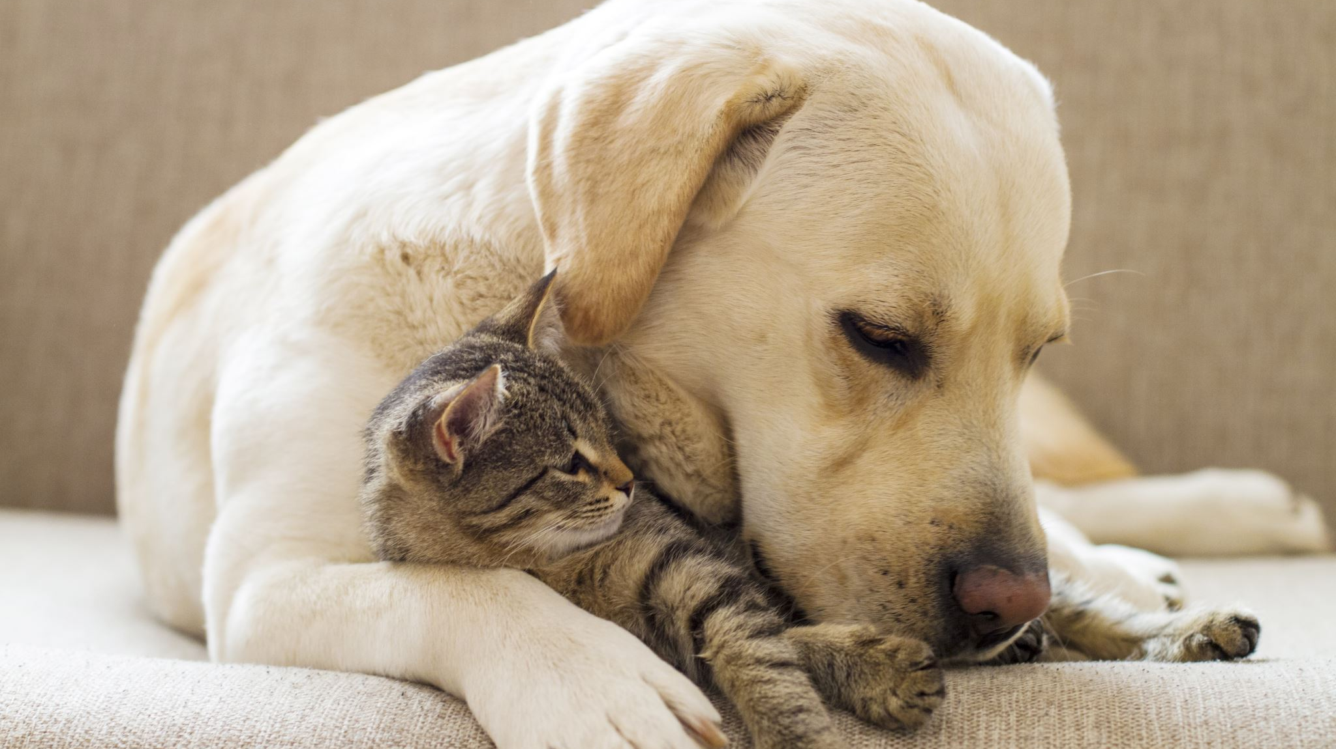
Possessive Adjectives
This is Misa, my lovely dog

Slide 2
Possessives
Personal Pronouns
I
You
He
She
It
We
You
They
Possessive Adjectives
My
Your
His
Her
It
Us
You
Them

Slide 3
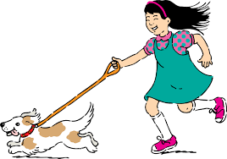
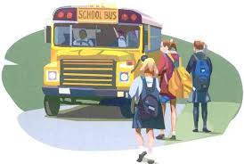
Possessive Adjectives
This is Mary. Tobby is her dog.
These children go to school.
There is their school bus.

Slide 4
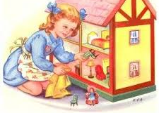
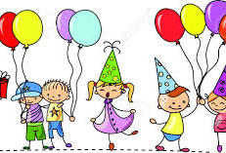
Possessive Case
Whose doll house is this?
It’s Lucy’s
Whose party are you going?
To children’s party

Slide 5
of
The legs of the chair
The roof of the house

