Slide 1
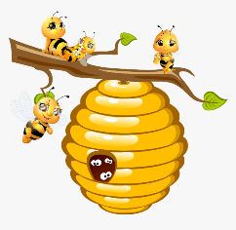
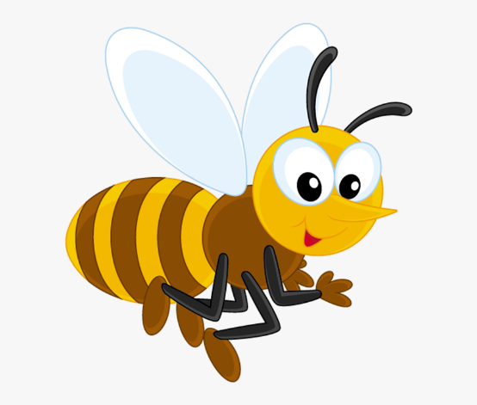
The Verb to
is
am
are

Slide 2
Affirmative
I am
You are
He is
She is
It is
We are
You are
They are
I am a person.
You are at school.
He is a boy.
She is a girl.
It is my dog.
We are friends.
You are here.
They are my parents.

Slide 3
Negative
I am not
You are not
He is not
She is not
It is not
We are not
You are not
They are not
I am not American.
You are not at home.
He is not my brother.
She is not my sister.
It is not my cat.
We are not from here.
You are not hungry.
They are not my friends.
is not = isn’t / are not = aren’t

Slide 4
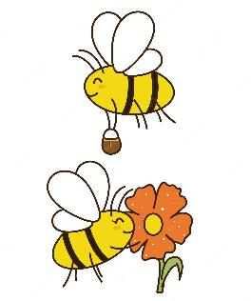
Interrogative
Am I?
Are you?
Is he?
Is she?
Is it?
Are we?
Are you?
Are they?
Am I your teacher?
Are you my student?
Is he your friend?
Is she your sister?
Is it your notebook?
Are we alone?
Are you American?
Are they your friends?

Slide 5
Complete:
Amelie _______ a woman.
She _______ my mother.
She _______ at work.
She _______ at home.
_____ she in the bathroom?
- No, she _________.
is
is / isn’t
isn’t
is
Is
isn’t

Slide 6
Complete:
Alfred _______ my neighbor.
He _______ very friendly.
He _______ at work.
He _______ at home.
_____ he at home now?
- Yes, he _________.
is
is / isn’t
isn’t
is
Is
is

Slide 7
Complete:
Tom _______ a small dog.
It _______ my neighbor’s dog.
It _______ on the street.
It _______ at home now.
_____ it a good dog?
- Yes, it _________.
is
is
isn’t
is
Is
is

Slide 8
Complete:
We _______ Tim and Andy.
We _______ brothers.
We _______ from Mexico.
We _______ Americans.
_____ we Mexicans?
- Yes, you _________.
are
are
are
aren’t
Are
are

Slide 9
Complete:
You _______ my student.
You _______ American.
You _______ from this country.
You _______ at home.
_____ you at school?
- Yes, I _________.
are
aren’t
are
aren’t
Are
am

Slide 10
Complete:
I _______ Ms. Young.
I _______ American.
I _______ from the U.S.
I _______ at home.
_____ I your teacher?
- No, you_________.
am
am
am
am not
Am
aren’t

Slide 11
Complete:
They _______ Ann and Beth.
They _______ sisters.
They _______ from the U.S.
They _______ Mexicans.
_____ they your friends?
- No, they _________.
are
are
are
aren’t
Are
aren’t

