Slide 1
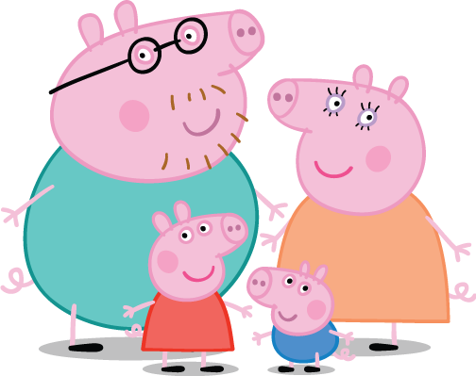
Family Members

Slide 2
Hello!
My name’s Peppa!

Slide 3
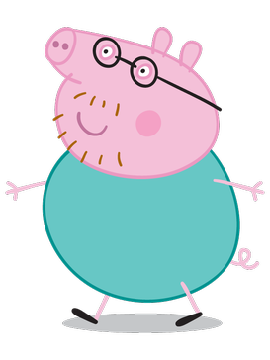
That is my
daddy

Slide 4
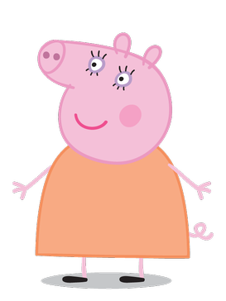
That is my
mommy

Slide 5
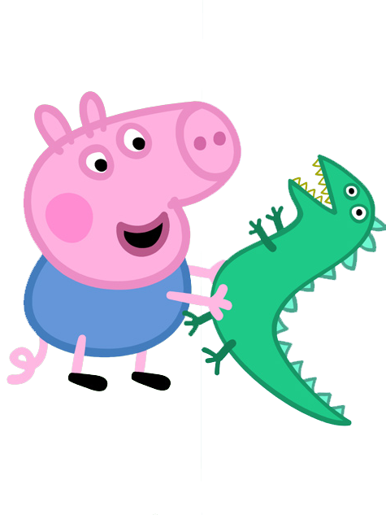
That is my
brother

Slide 6
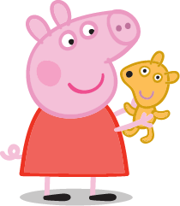
That is my
sister

Slide 7
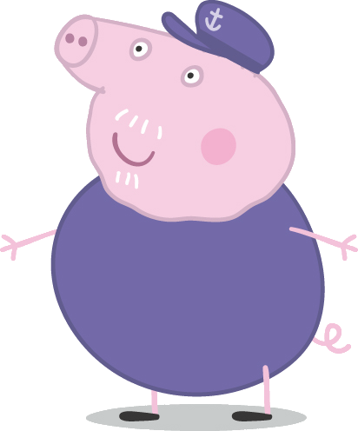
That is my
grandpa

Slide 8
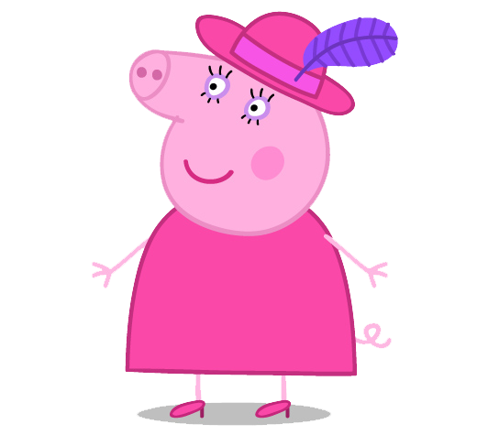
That is my
grandma

Slide 9
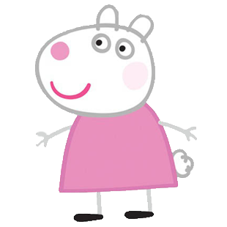
That is my
friend

Slide 10
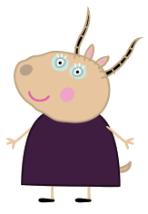
That is my
teacher

Slide 11
Good Bye!
See you later!

