Slide 1
JULES VERNE
Project by: Daphne R

Slide 2
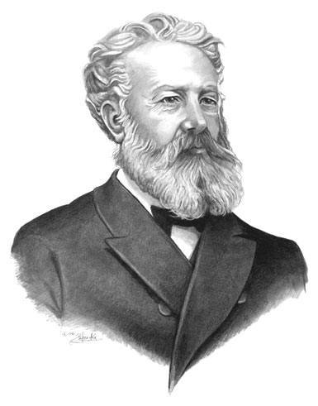
JULES VERNE
Jules Verne was born in 1828 in France.

Slide 3
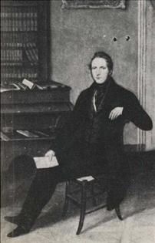
JULES VERNE
His father was a prosperous lawyer.

Slide 4
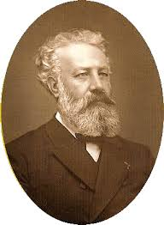
JULES VERNE
Jules Verne was always rebellious and when he was twelve years old he wanted to work as a cabin boy on an ocean - going ship but the ship was stopped by his father before it went to sea.

Slide 5
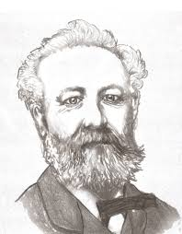
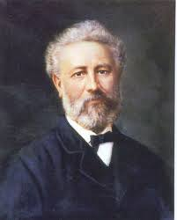
JULES VERNE
In 1847 Jules Verne went to Paris to study law, although he was already planning a literary career.

Slide 6
JULES VERNE
His first book “Five Weeks in a Balloon” was published in 1863 and was an immediate success. The book describes a journey by air over central Africa which at that time was largely unexplored.

Slide 7
JULES VERNE
His next book “A Journey to the Centre of the Earth” was published in 1864 and describes the adventures of a party of explorers who get into the crater of a volcano and discover an underground world.

Slide 8
JULES VERNE
Verne wrote his two masterpieces when he was in his forties.
Twenty Thousand Leagues Under the Sea was published in 1870 and describes the voyages of the submarine Nautilus and its commander the mysterious Captain Nemo.
Captain Nemo is a literary figure in whom Verne shows many of his character traits.

Slide 9
JULES VERNE
Around the World in Eighty Days was published in 1873 and is the story of a successful bet made by a typical Englishman, Phineas Fogg, a character modeled on Verne’s father who had a mania for punctuality.

Slide 10
JULES VERNE
Other popular novels include The Mysterious Island (1875) and Michael Strogoff (1876).
Verne’s personality was complex. He was basically a shy man feeling happy when he was alone in his study.

Slide 11
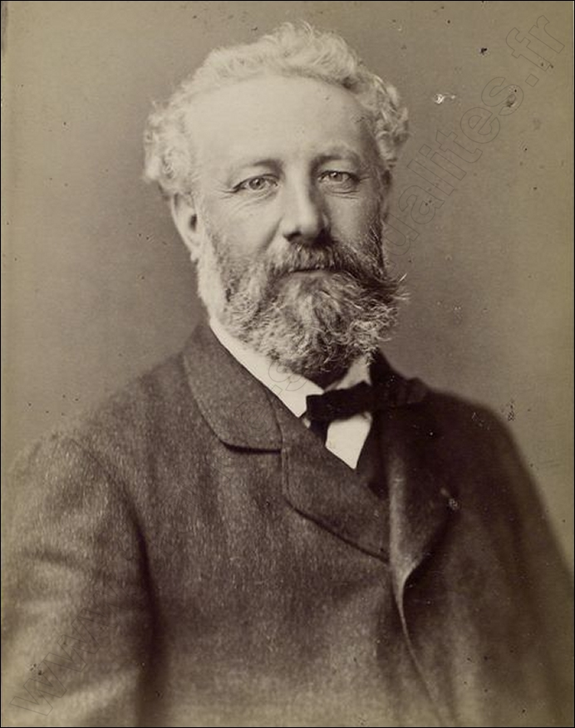
JULES VERNE
In 1886 Verne was shot and was left disabled by his nephew. In 1902 he became partially blind and he died on March 24, 1905.

Slide 12
