Slide 1
Unit 1:
Internert friends around Europe
English 6th Grade

Slide 3
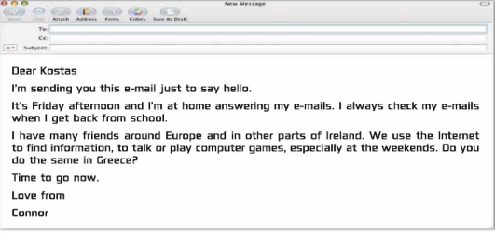
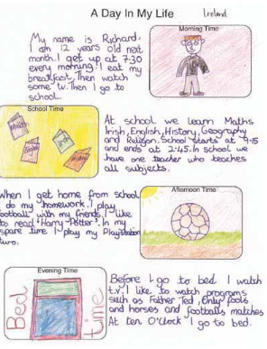
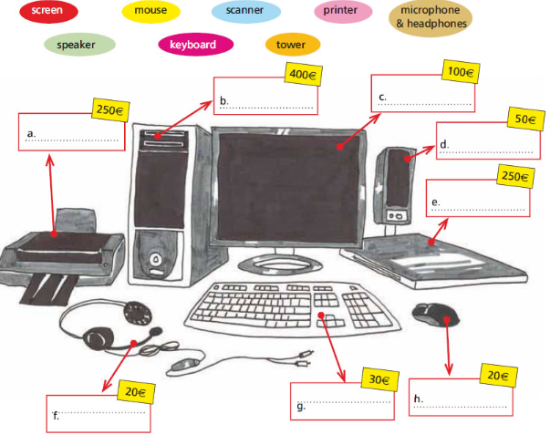
-Email
-Computers
-Daily life!

Slide 4
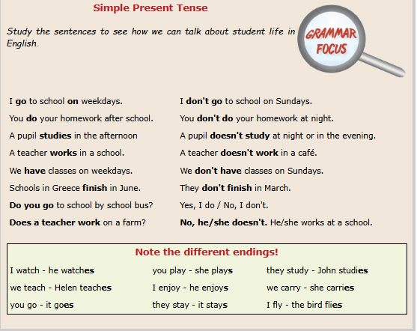
Grammar

Slide 5
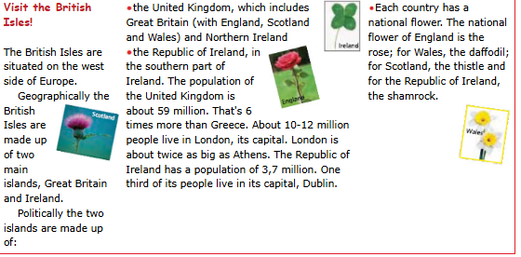
The British Isles

