Slide 1

















OUR ENGLISH CLASS
Words we have in common & tips
D
E

Slide 2



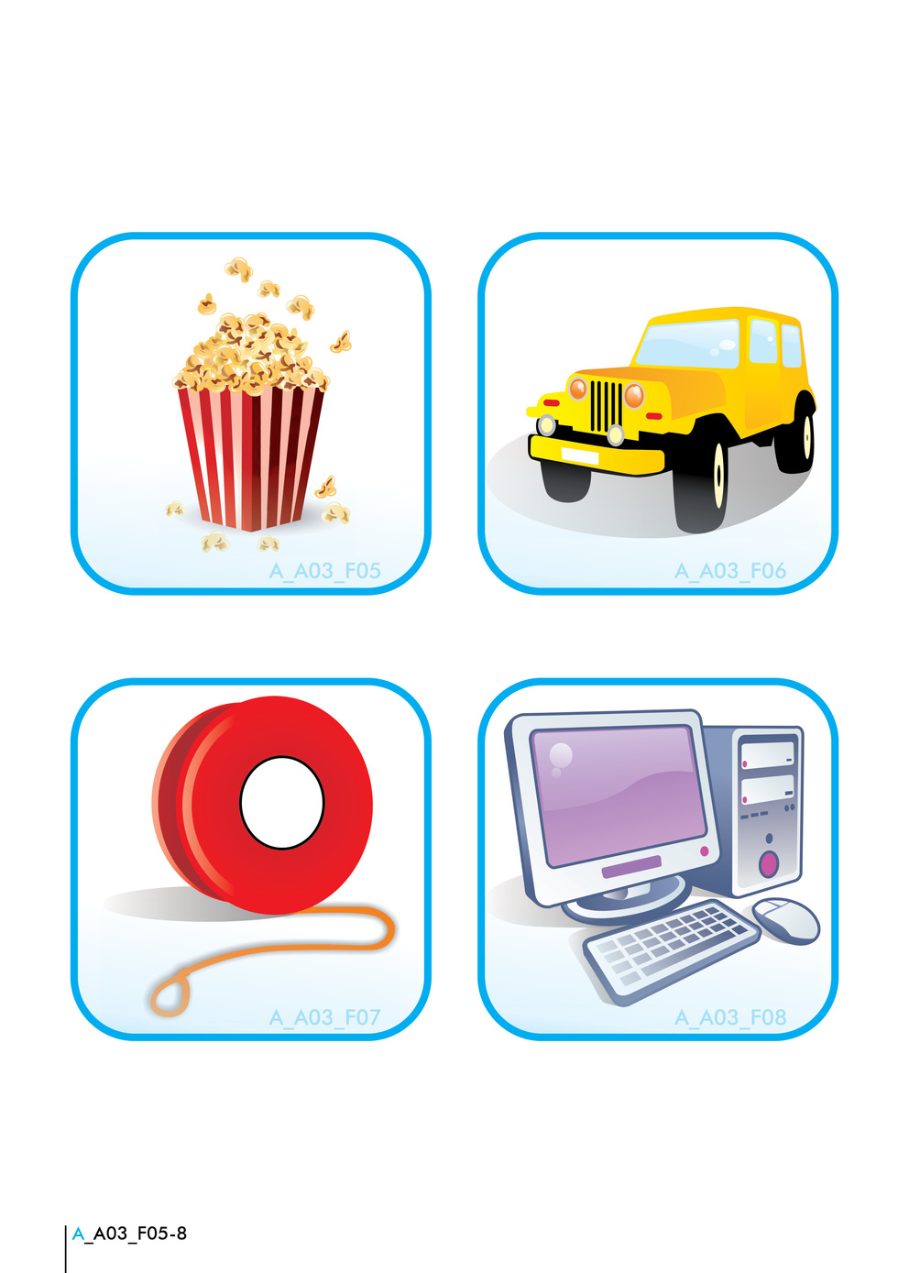



1

Slide 3
















2
Use Flashcards with Pictures
Flashcards help remember new words visually and through associations.
m
M
Parrot
Fish

Slide 4

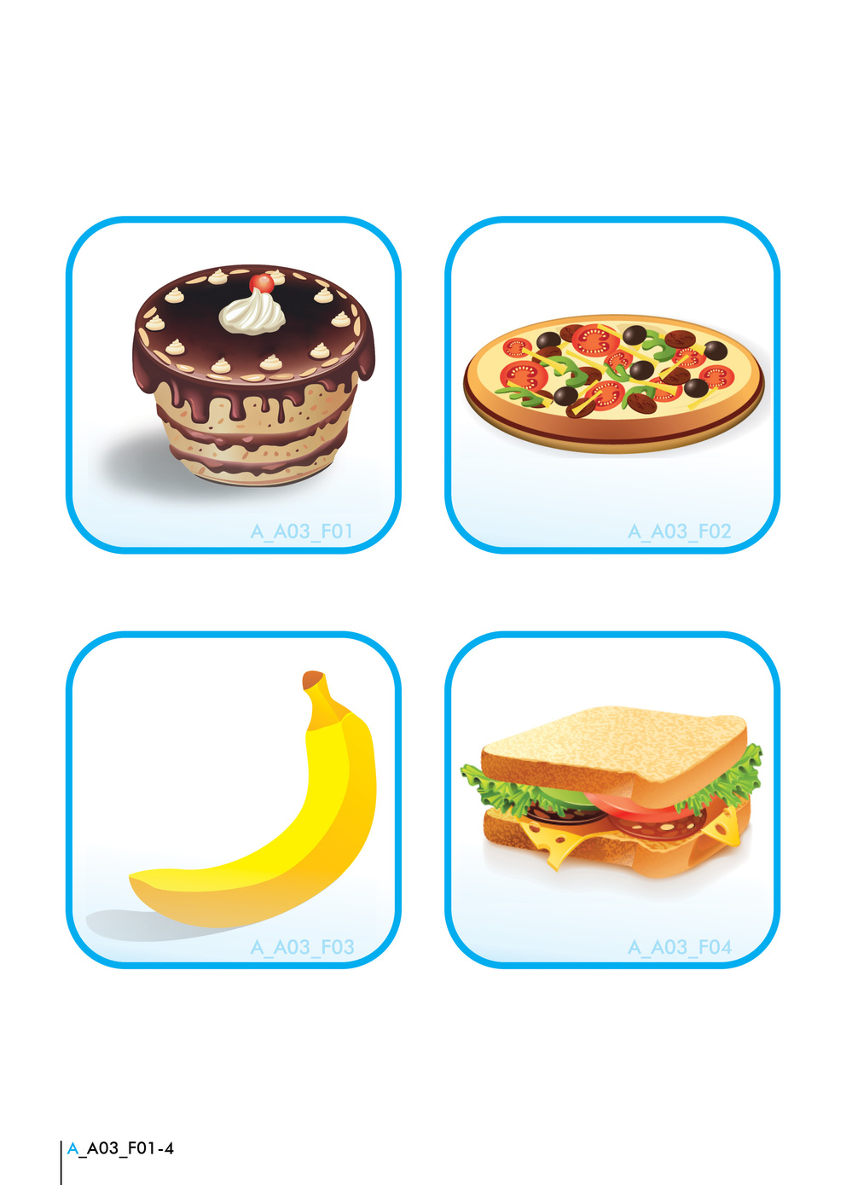







3

Slide 5











4
Sing Songs in English
  - Songs with simple lyrics help children remember words and phrases.
- Singing improves pronunciation and listening skills in a fun way.
E

Slide 6






5
Use Educational Apps
Leaf
Mobile apps make learning the language engaging and interactive.
D
E

Slide 7









8
Read Books in English
  Start with simple picture books so that the child associates words with images. Gradually move to more complex stories to build vocabulary and comprehension skills.
  Choose books that match your child's interests to keep them engaged.
  Discuss the stories together to enhance understanding and retention.
C
E
A
D
B

Slide 8





Thank You
Ms Georgia Vovou
D
E

