Slide 1

Gerunds
What’s a gerund?
English people use gerunds a lot.

Slide 2
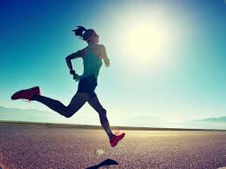
But WHAT IS a gerund?
-gerunds LOOK like a verb but they’re actually a noun.
Now, we all know that a verb is an ACTION, right?
We DO a verb.
For example: I jog every morning.
But sometimes l just want to talk about an action, not do it.
E.g. Jogging is one of my favourite ways to exercise.
I love jogging.

Slide 3
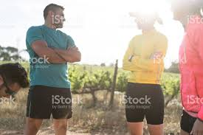
I’m talking about jogging as an action.
I’m not jogging right now. I’m just talking about some THING that l love to do.
In other words l am referring to jogging as a noun.
I’ve JUST used the gerund.
I’ve used a word that LOOKS like a verb, as a noun.

Slide 4
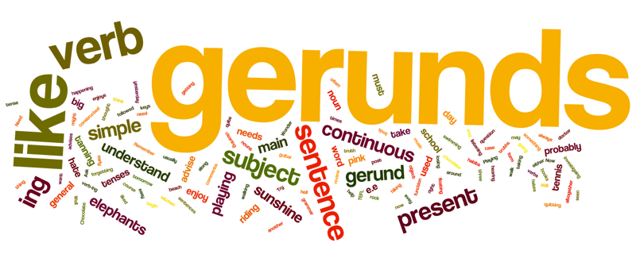
So, how can we recognize the gerund? What does it look like?
Well, the gerund is formed by adding -ing to the base form of a verb. (aka the bare infinitive form)
So, if the base form is JOG, the gerund is JOGGING.
I love jogging.

Slide 5
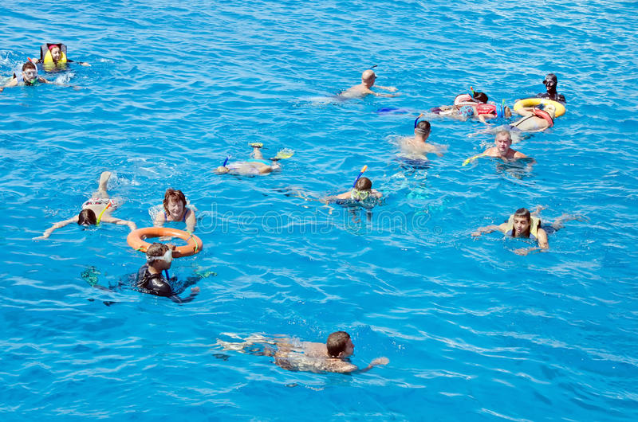
Now l know it can be confusing because it really looks a lot like the present continuous. But it isn’t. There is no TO BE which makes up the present continuous.
e.g.
Look mum. I am swimming on my own.
Swimming is my favourite summer time activity.
The verb “to be” =
Subject + am/is/are + verb-ing
WHO – AM/IS/ARE – VERB (ING)

Slide 6
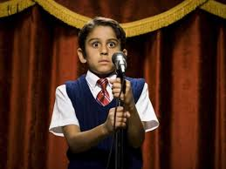
Now, to recognize a gerund you need to really pay attention to how it’s used in a sentence.
Look at this example:
I absolutely love singing.
But performing in front of an audience makes me nervous.
Standing on a stage in front of a crowd is terrifying.
Can you spot the gerunds?
‘singing’, ‘performing’, ‘standing’

Slide 7
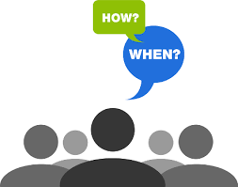
To move on, the next question is:
WHEN and HOW do we use gerunds?

Slide 8
Just like nouns, gerunds can be used in many different situations:
1.
-as a subject of a sentence: (usually the beginning of a sentence)
Eating fruit and vegetables is important for a healthy diet.
Studying gerunds is fun.

Slide 9

Now answer this question and try to use a gerund.
What else is important to your health?
eating
sleeping
exercising
drinking
having check-ups

Slide 10
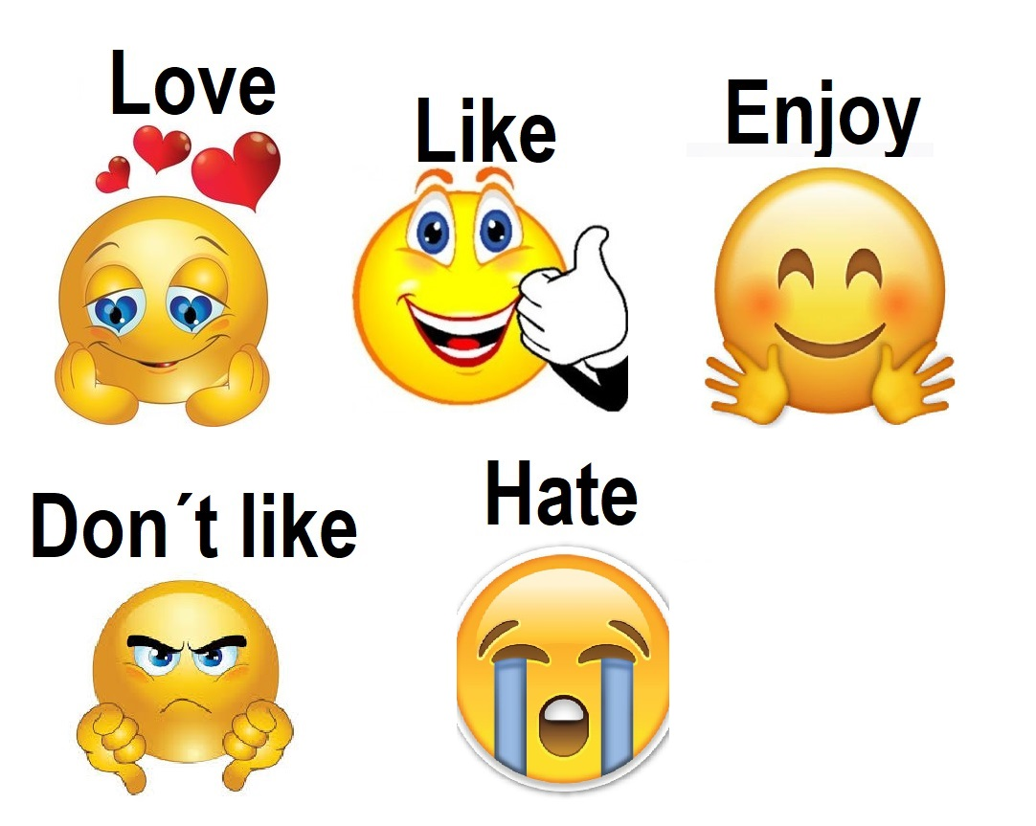
2.
-as an object of a sentence: keep in mind there are some very common verbs that take gerunds as an object.
love, like, hate, dislike, prefer, enjoy
All these verbs can be followed by a gerund.
I really like cooking but my wife is a much better cook than me.
She really enjoys taking pictures of sunsets.
I prefer buying meat from the supermarket. It is cheaper.

Slide 11
Now, you try answering this question: What do you dislike doing?
What do you prefer doing?
going to school
doing homework
studying for a test
going to the doctor
riding my bike

Slide 12
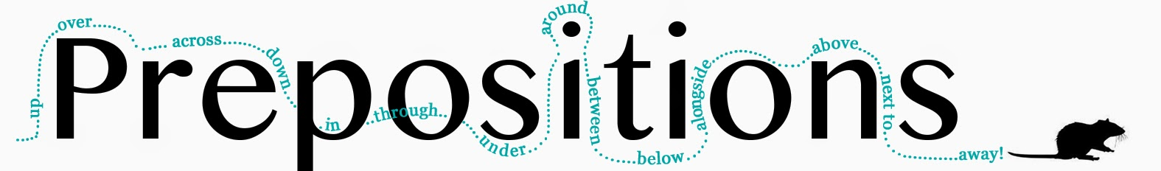
3.
-after prepositions:
When you see a verb after a preposition it’s often a gerund.
(in, on, at, under, behind, between, near, without etc)
She walked out of the room without saying a word.
This also includes phrases that end in prepositions like
in spite of…. e.g. In spite of training for years, she lost the tournament.
There’s no point in…. There’s no point in taking your jacket. It’s really hot outside.
Fed up with…… I’m fed up with asking you to be quiet!

Slide 13
4.
-with fixed expressions: These you just need to learn and remember.
Can’t help: She can’t help being so quiet.
Can’t stand: I can’t stand waking up early in the morning.
It’s no use: It’s no use leaving a message, she won’t call you.
(to be) worth: It’s not worth spending so much money.
These are really common expressions followed by a gerund.

Slide 14
5.
-after another verb:
Now you may even see a gerund with another verb.
Some verbs can be followed by a gerund OR the to-infinitive
(verb) + gerund
(verb) + to-infinitive
and this can be a little confusing as it may change the meaning of the sentence because in one sentence the word is a noun and in the other, it’s a verb.
e.g.
I’ll never forget visiting the Parthenon. It was really stunning.
Don’t forget to take your grandma to the supermarket.

Slide 15
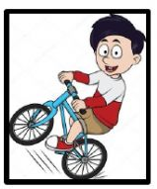
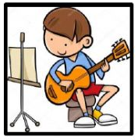

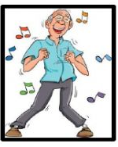
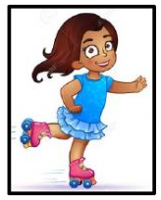
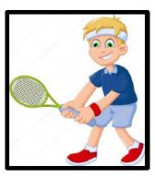
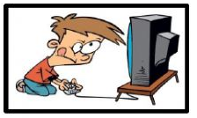

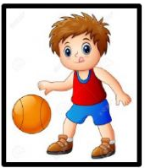
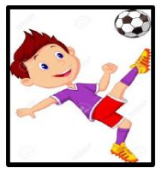
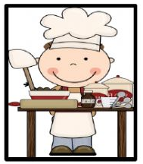

Make sentences using gerunds. E.g. I like skating./I prefer skating to cooking/Skating is my hobby.
dance ride a bike skate play tennis play the guitar play the piano
play video games listen to music play basketball play football cook read a book

Slide 16
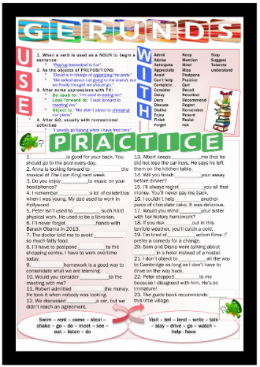
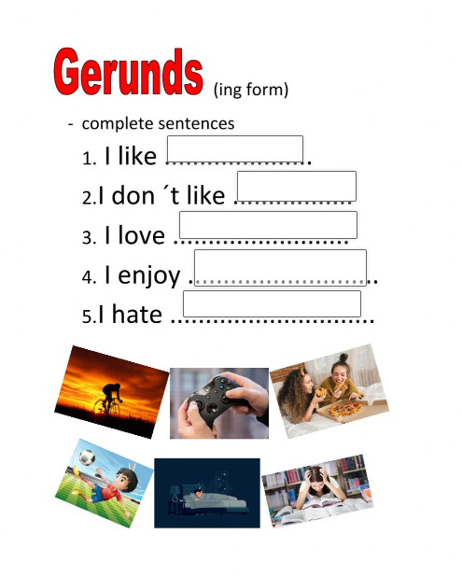
CHOOSE one of the two worksheets and complete.
Do only 1,3,6,7,14,18 &19 and send. I will e-mail you the answers.

Slide 17
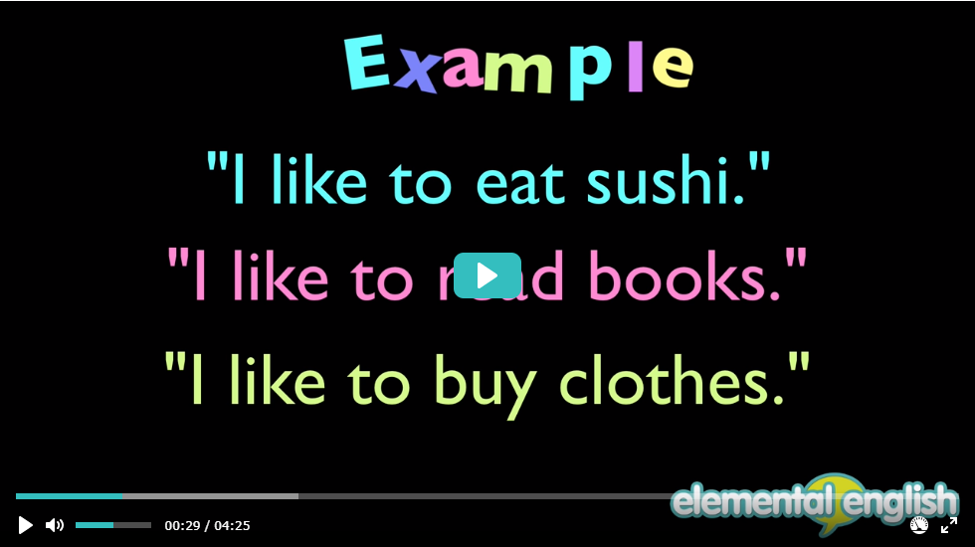
Now, if you would like to watch a short video on GERUNDS, click on the picture below. It has some more information about gerunds which you may find interesting.
Click here to watch the video

Slide 18
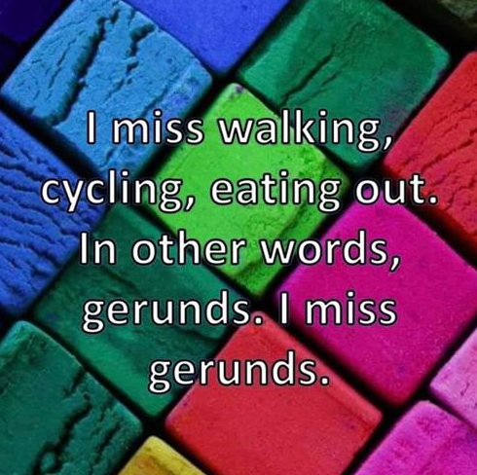
What an English teacher misses most during the Coronavirus lockdown.

Slide 19
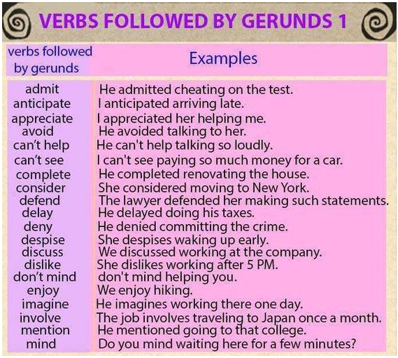
CREDITS TO: https://vocabularyhome.com/verbs/verbs-followed-by-gerunds/

Slide 20
Next lesson: INFINITIVES

Slide 21
The End
Credits for the entire unit:
https://www.youtube.com/watch?v=ZWhtHcKaNNg
mmmEnglish
Επεγεργασία κειμένων σε powerpoint, προσθήκη εργασιών
& μετάφραση: Αναστασία Παπαδομανωλάκη ΠΕ06

