Slide 1
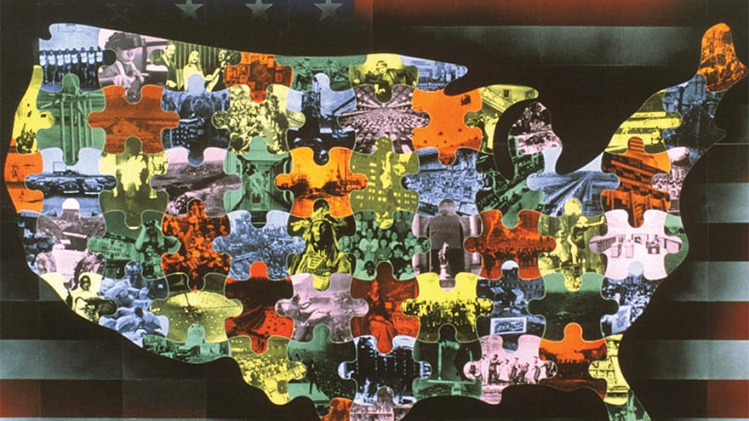
What Did Americans Use To Do In The 20th century?

Slide 2
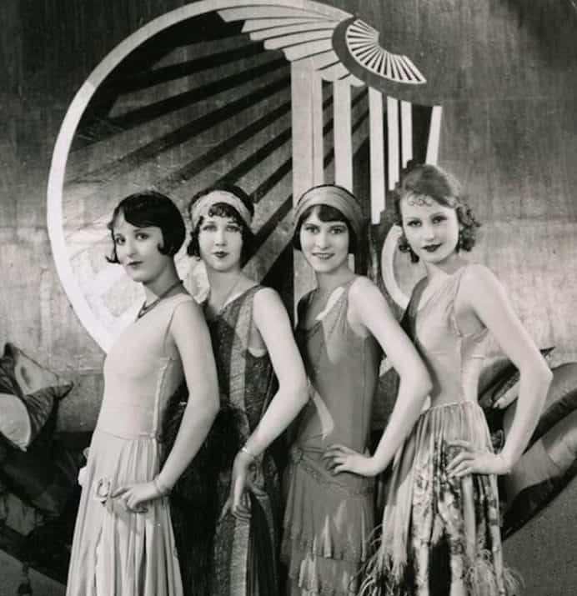
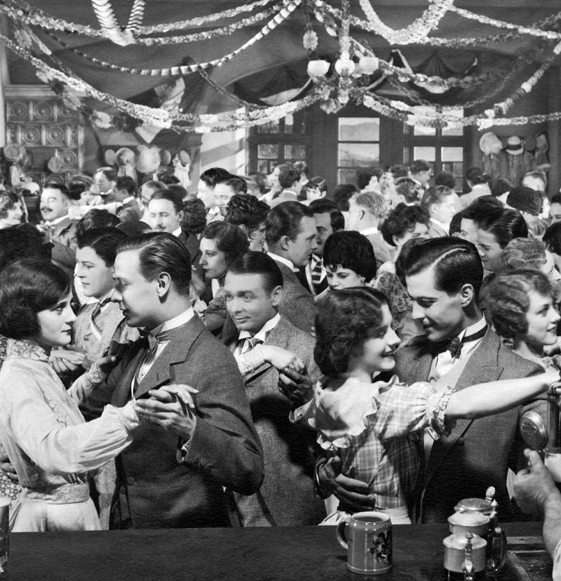
In the 1920s
FLAPPER DRESSES
JAZZ MUSIC
ALCOHOL &PARTY
Flapper: νεαρή κοπέλα της δεκαετίας του ‘20

Slide 3
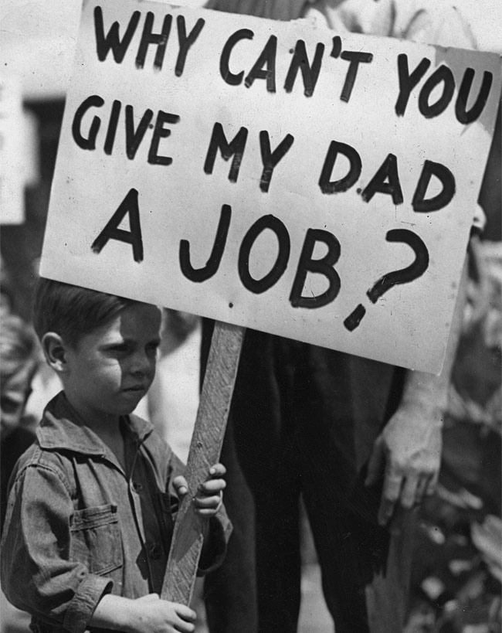
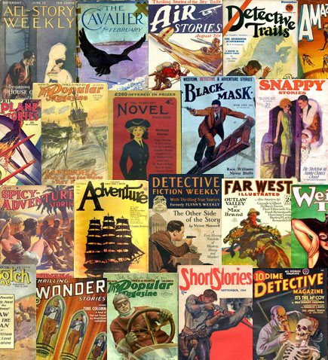
In the 1930s
JOBLESS
DETECTIVE STORIES & COMICS
HOLLYWOOD MOVIES

Slide 4
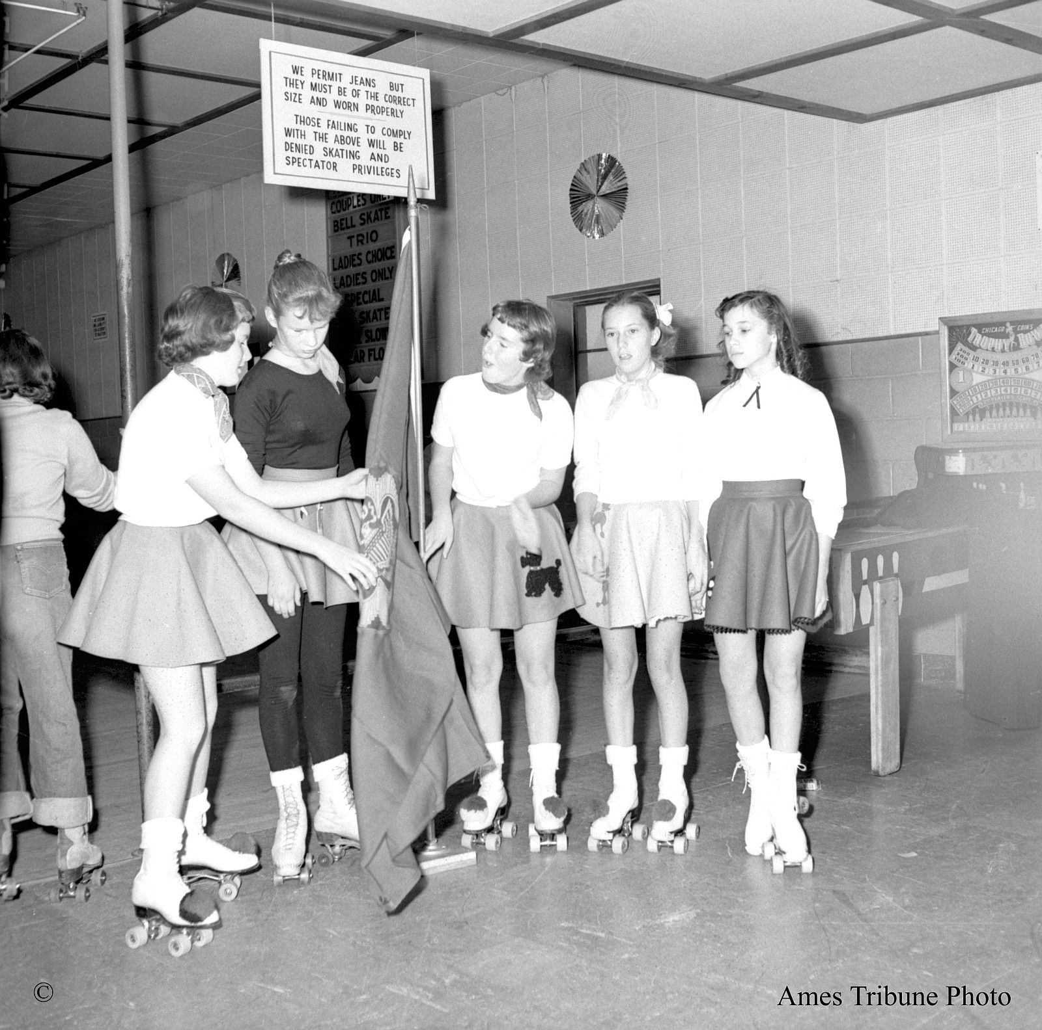
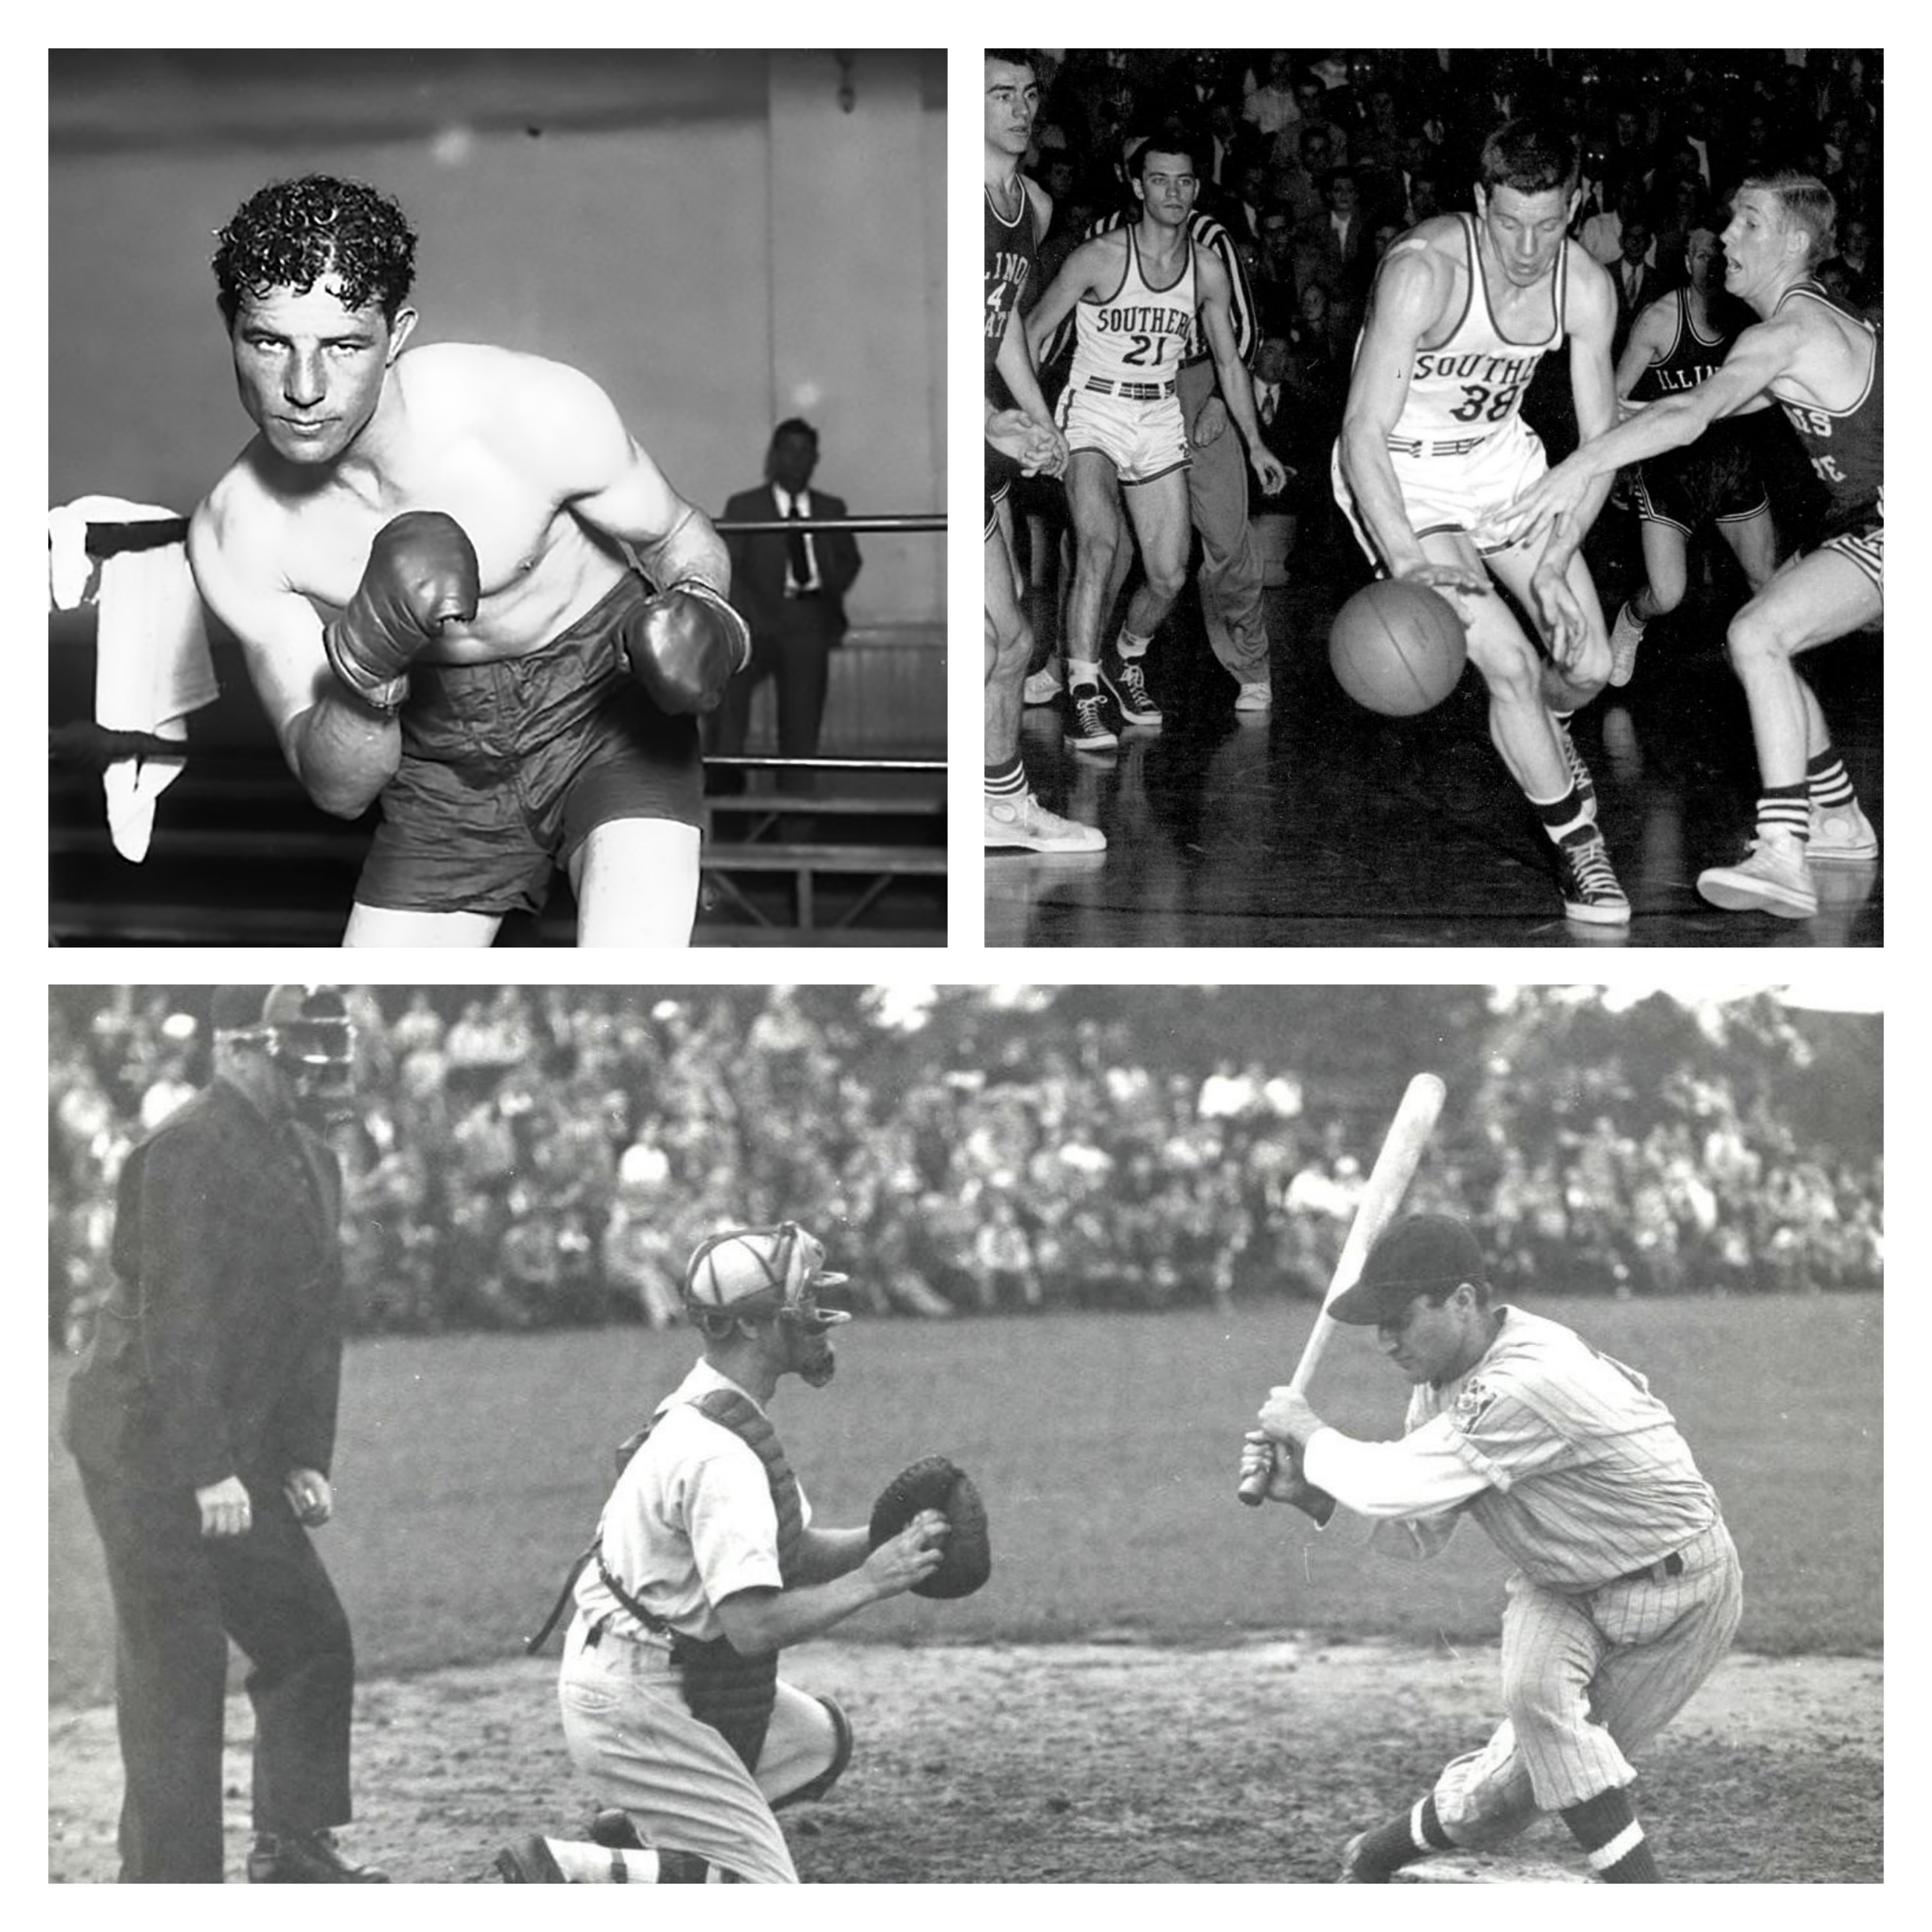
In the 40s
SWING MUSIC & DANCE
ROLLER SKATE
BOXING, BASKETBALL, BASEBALL

Slide 5
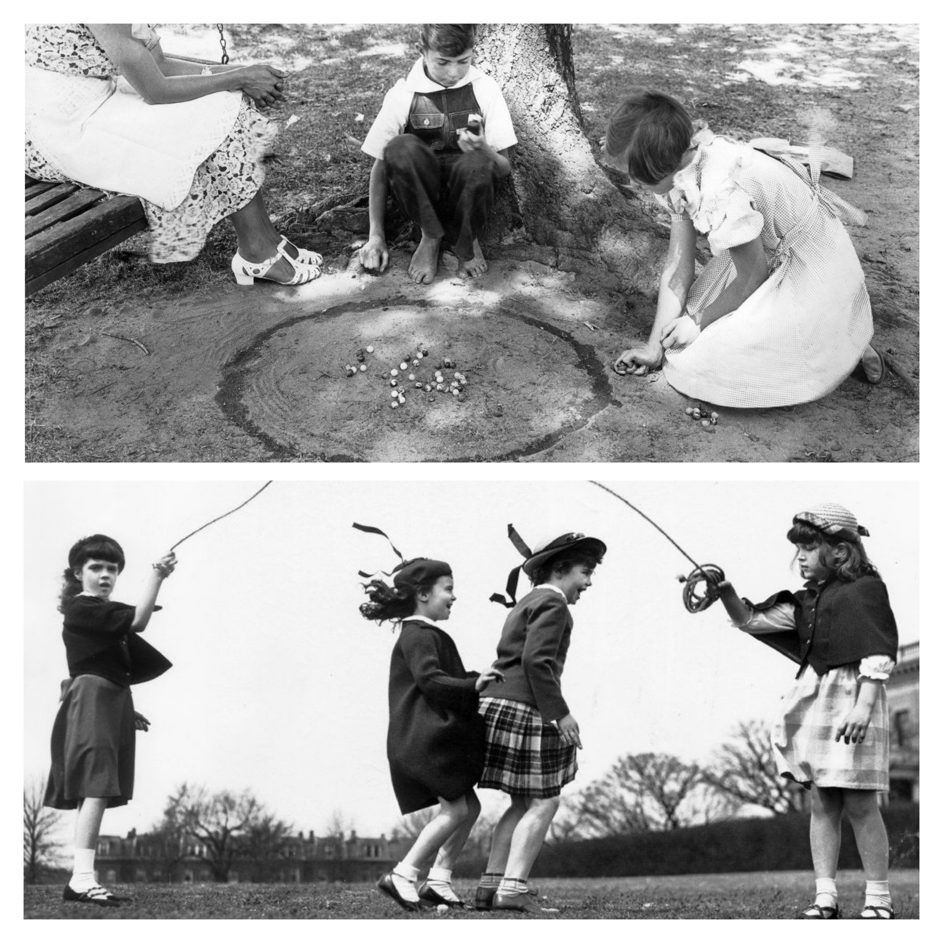
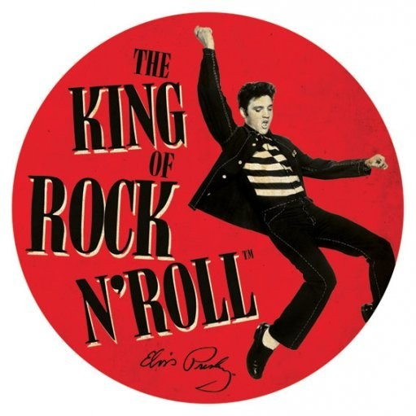
In the 50s
ROCK & ROLL MUSIC
MARBLES & JUMPING ROPE
TV & DRIVE-IN MOVIES
marbles: βόλοι

Slide 6
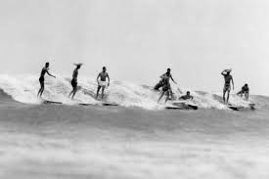
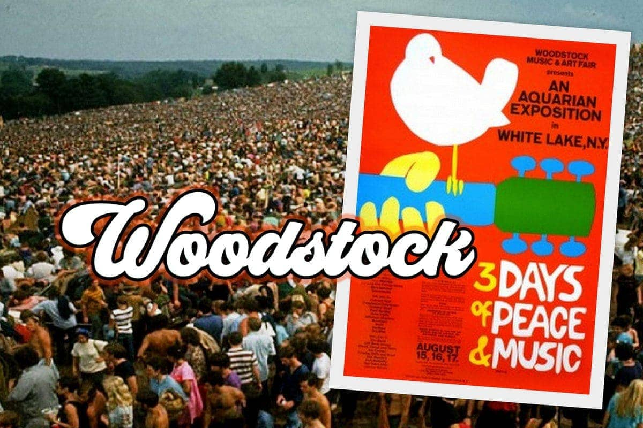
In the 60s
ROCK & POP MUSIC
SURF
FESTIVALS & CONCERTS

Slide 7
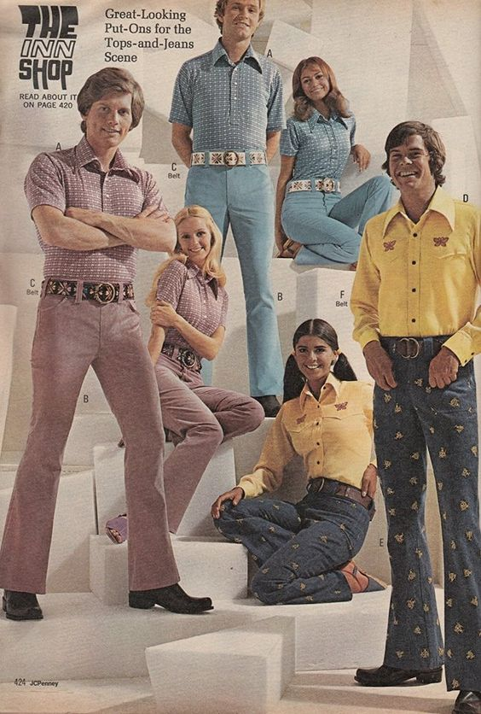
In the 70s
DISCOTEQUES
FUNK, SOUL & DISCO MUSIC
FLARED TROUSERS

Slide 8
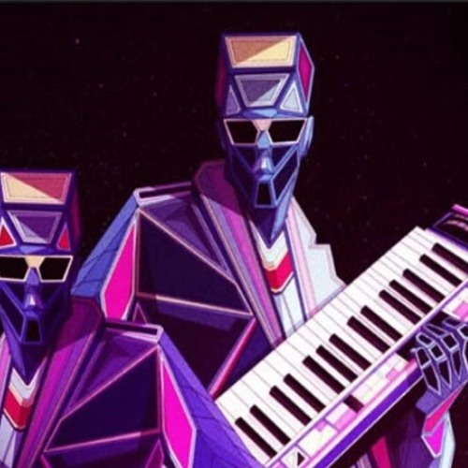
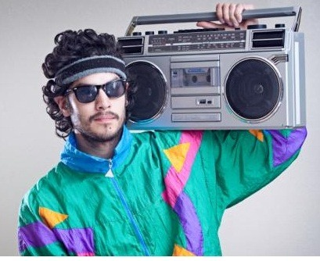
In the 80s
ARCADE GAMES
ELECTRONIC POP MUSIC
COLOURFUL JACKETS

Slide 9
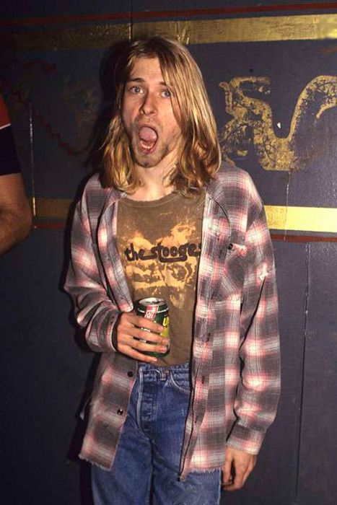
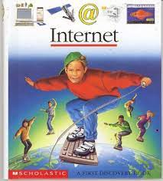
In the 90s
HIP HOP, RAP MUSIC
JEANS AND CHECKERED SHIRTS
INTERNET
CHECKERED: καρό

