Slide 1
Transportation of the past

Slide 2
Animals were the first means of transport

Slide 3
The elephant was used in Asia

Slide 4
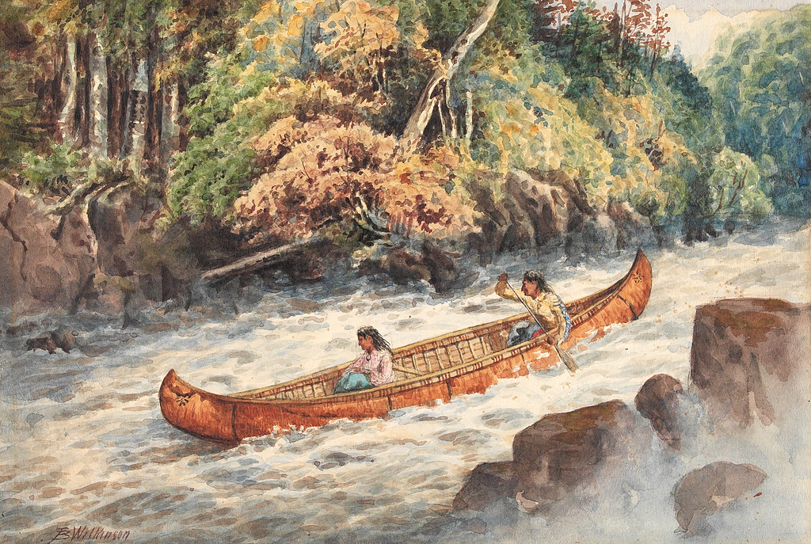
Canoes, puddle boats and sailboats were used in the past to transport people and goods
Αυτή η φωτογραφία από Άγνωστος συντάκτης με άδεια χρήσης CC BY

Slide 5
Horse and carriage

Slide 6
A omnibus was a horse bus

Slide 7
The balloon

Slide 8
The steam train: They burnt coal to produce steam

Slide 9
Transportation in the present

Slide 10
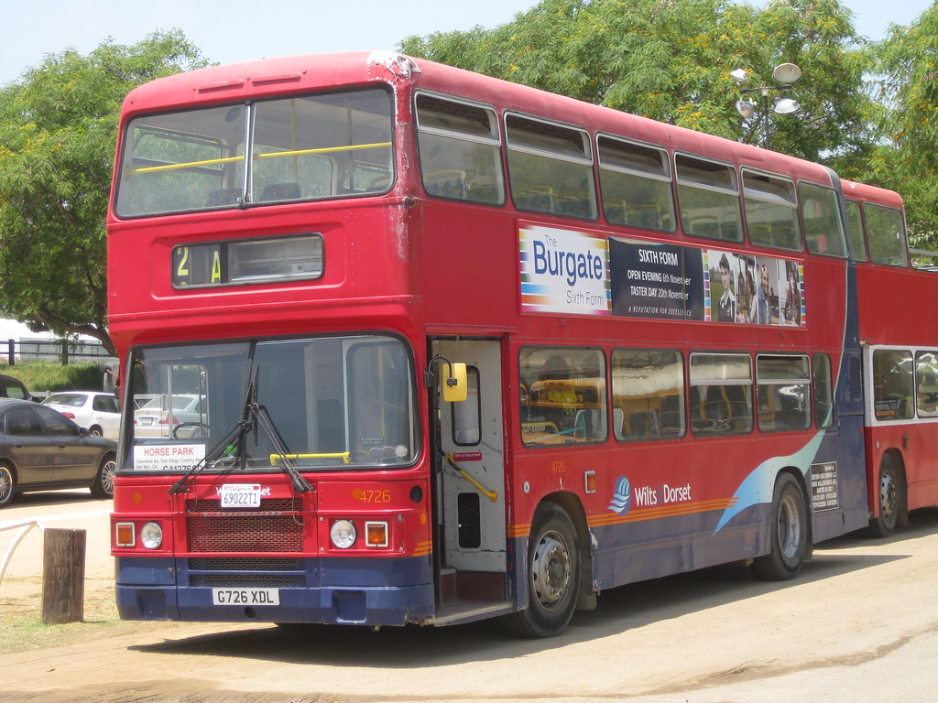
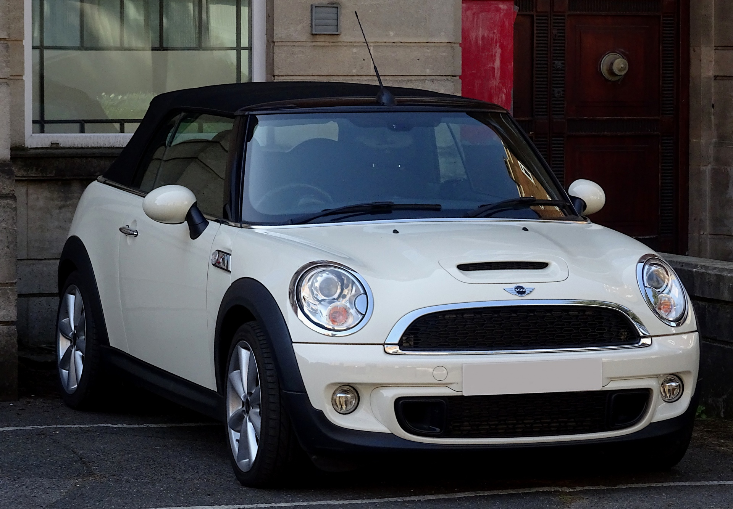
LAND TRANSPORTATION

Slide 11
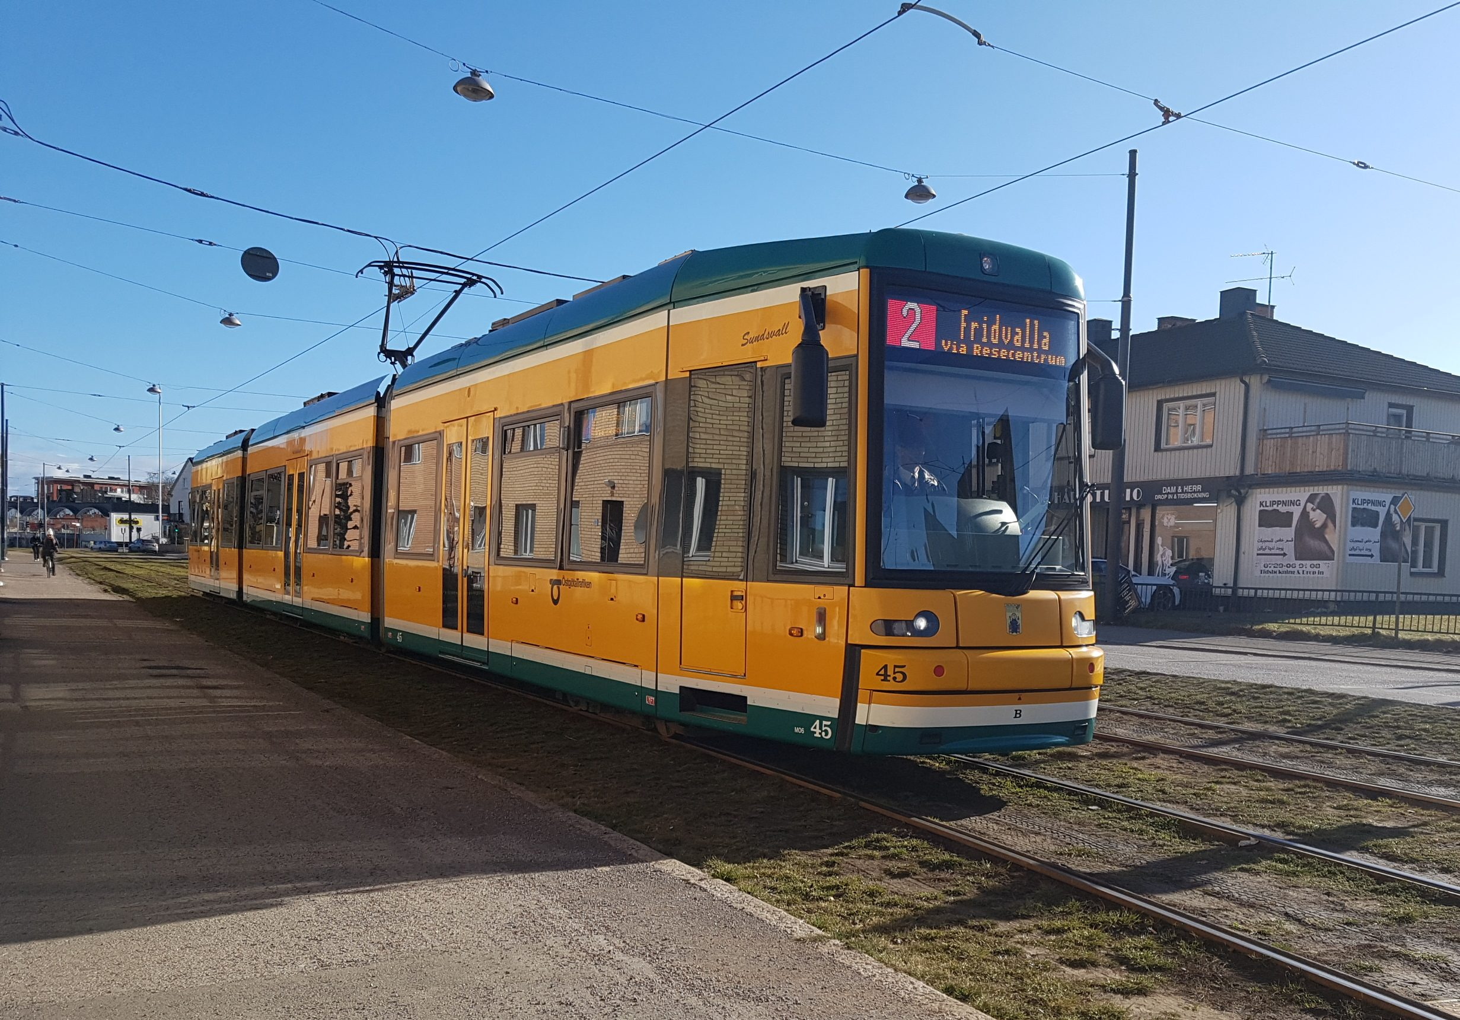
RAIL TRANSPORTATION
Αυτή η φωτογραφία από Άγνωστος συντάκτης με άδεια χρήσης CC BY

Slide 12
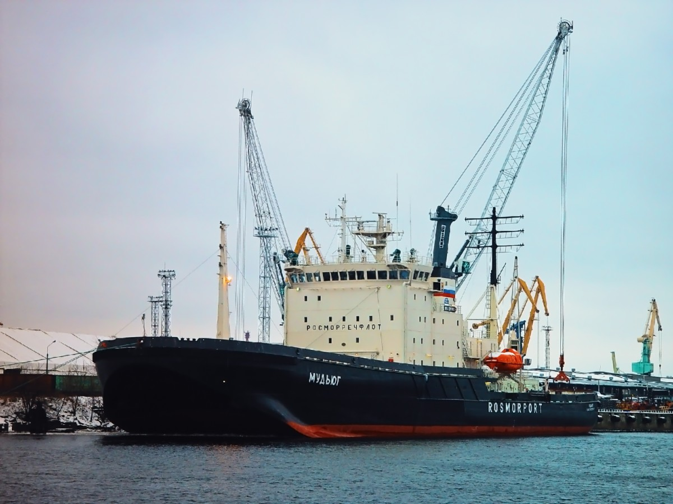
WATER TRANSPORTATION

Slide 13
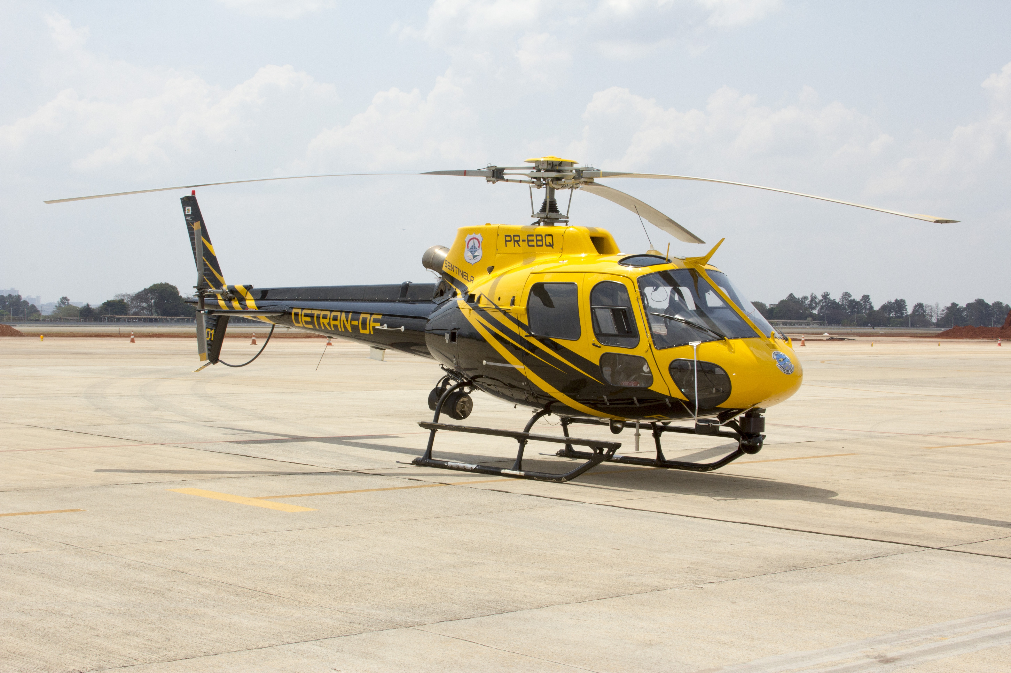
AIR TRANSPORTATION

Slide 14
Writing: groups of 4
Student 1: write a paragraph (10-12 lines) about the old means of transport. How did people use to travel in the past? What were some means of transport and how did they use them? What were some advantages (good points) and some disadvantages (bad points) of them?
Student 2: write a paragraph about the present means of transport. What are they and how do we use them? What are some advantages and disadvantages of the modern means of transportation.
Student 3: write a paragraph about your favourite means of transport of the past. Why do you like it? Write some advantages and disadvantages
Student 4: write a paragraph about your favourite means of transport of the present. How often do you use it? Where do you go?Why do you like it? Write some advantages and disadvantages

