Slide 2
1/20
When I grow up I would like to help people be healthy.
I can be a _________ .
doctor
NEXT
HINT
CHECK

Slide 3
2/20
When I grow up I would like to take care of people’s teeth.
I can be a _________ .
dentist
NEXT
HINT
CHECK

Slide 4
3/20
When I grow up I would like to design all kind of buildings.
I can be an _________ .
architect
NEXT
HINT
CHECK

Slide 5
4/20
When I grow up I would like to advocate for my client’s rights.
I can be a _________ .
lawyer
NEXT
HINT
CHECK

Slide 6
5/20
When I grow up I would like to take care of animals health.
I can be a _________ .
vet
NEXT
HINT
CHECK

Slide 7
6/20
When I grow up I would like to provide patient care and carries doctor’s orders.
I can be a _________ .
nurse
NEXT
HINT
CHECK

Slide 8
7/20
When I grow up I would like to repair and install pipes.
I can be a _________ .
plumber
NEXT
HINT
CHECK

Slide 9
When I grow up I would like to mix and bake ingredients to make bread, cakes and pastries.
I can be a _________ .
baker
NEXT
HINT
CHECK

Slide 10
When I grow up I would like to install and repair electrical systems.
I can be an _________ .
electrician
NEXT
HINT
CHECK

Slide 11
When I grow up I would like to repair car engines and change tires.
I can be a _________ .
mechanic
NEXT
HINT
CHECK

Slide 12
When I grow up I would like to cut, carve and design objects made of wood.
I can be a _________ .
carpenter
NEXT
HINT
CHECK

Slide 13
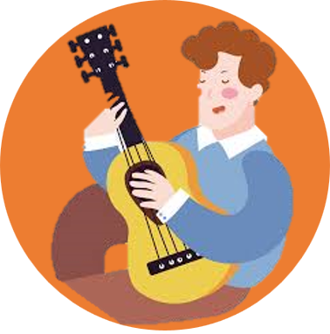
When I grow up I would like to play musical instruments.
I can be a _________ .
musician
NEXT
HINT
CHECK

Slide 14
When I grow up I would like to serve customers drink and food orders.
I can be a _________ .
waitress
NEXT
HINT
CHECK

Slide 15
When I grow up I would like to fight fires and rescue people in danger.
I can be a _________ .
firefighter
NEXT
HINT
CHECK

Slide 16
When I grow up I would like to look out for the safety of my community.
I can be a ______________ .
police officer
NEXT
HINT
CHECK

Slide 17
When I grow up I would like to raise the animals and grow the plants.
I can be a _________ .
farmer
NEXT
HINT
CHECK

Slide 18
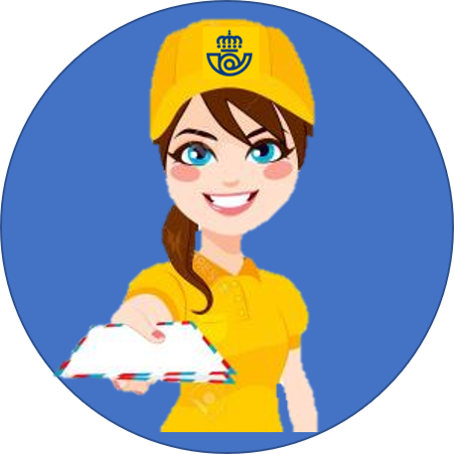
When I grow up I would like to deliver letters and parcels.
I can be a ____________ .
postwoman
NEXT
HINT
CHECK

Slide 19
When I grow up I would like to cut, colour and style people’s hair.
I can be a ____________ .
hairdresser
NEXT
HINT
CHECK

Slide 20
19/20
When I grow up I would like to deliver quality education to students.
I can be a ____________ .
teacher
NEXT
HINT
CHECK

Slide 21
20/20
When I grow up I would like to vocalize musical sounds with tone and pitch.
I can be a ________ .
singer
EXIT
HINT
CHECK

