Slide 1
Magic Book 2
Unit 1. Lesson 2.
Let’s learn English

Slide 2
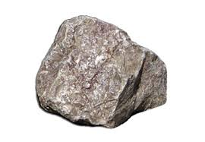
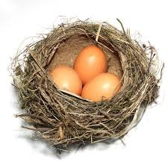
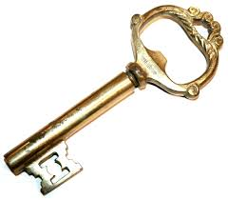
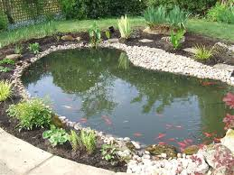
1
4
2
This is a stone.
This is a nest.
3
This is a key.
This is a pond.

Slide 3
What’s this?
It’s a key.

Slide 4
What’s this?
It’s a stone.

Slide 5
What’s this?
It’s a nest.

Slide 6
What’s this?
It’s a pond.

Slide 7
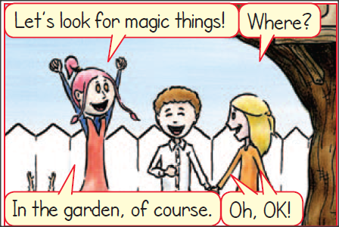
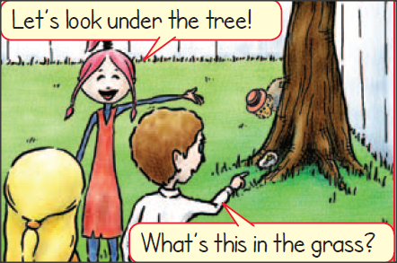
look for… = ψάχνω
garden = κήπος
Where = Πού;
of course = φυσικά
under… = κάτω από…
grass = χόρτο, γρασίδι

Slide 8
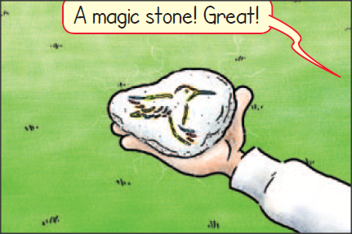
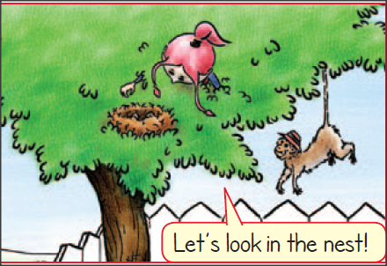
a magic stone = μια μαγική πέτρα
Great! = Υπέροχα!
nest = φωλιά

Slide 9
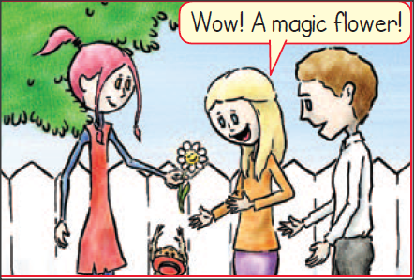
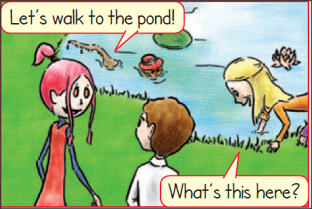
flower = λουλούδι
pond = λιμνούλα
Lets walk = Ας περπατήσουμε
here = εδώ

Slide 10
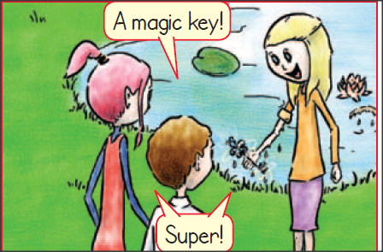
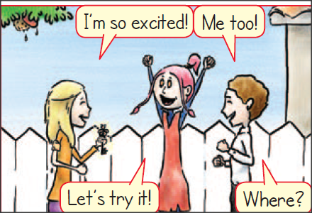
A magic key = ένα μαγικό κλειδί
excited = ενθουσιασμένος
me too! = κι εγώ επίσης!
Let’s try it! = Ας το δοκιμάσουμε!

Slide 11
Match the pictures with the words
stone
nest
pond
key

Slide 12
Thank you, kids!

