Slide 1
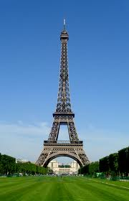
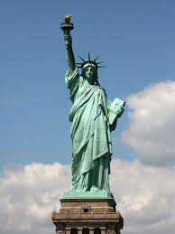
SHORT - HIGH
EIFFEL TOWER - PARIS
STATUE OF LIBERTY – N.Y
The Eiffel tower is _________________ than the Statue of Liberty

Slide 2
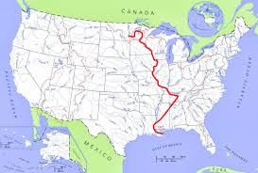
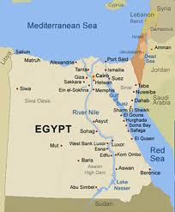
LONG - SHORT
MISSISSIPPI RIVER - USA
THE NILE - EGYPT
The Mississippi river is ___________ ________ the Nile.

Slide 3
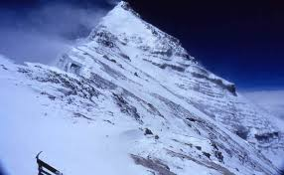
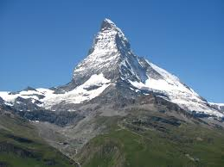
HIGH - SHORT
EVEREST- HIMALAYA- ASIA
MATTERHORN – ALPS - SWITZERLAND
Matterhorn is not as ______________ as the Everest.

Slide 4
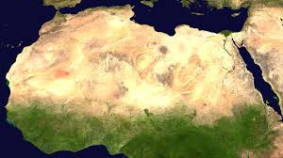
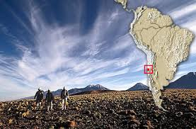
BIG – SMALL/ DRY (ξηρό)
SAHARA DESERT - AFRICA
ATAKAMA DESERT – SOUTH AMERICA
The Sahara desert is __________ ______ Atakama desert, but Atakama is the __________________ of all deserts.

Slide 5
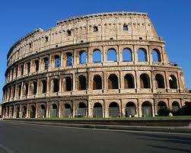
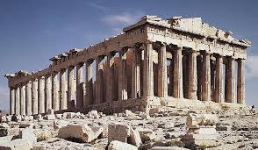
OLD - NEW
COLOSSEUM – ROME - ITALY
THE PARTHENON - ATHENS
Colosseum isn’t so ______________ ______ the Parthenon

Slide 6
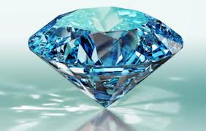
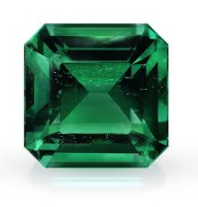
EXPENSIVE
DIAMOND
EMERALD
The diamond is _______ ________________ than the emerald.

Slide 7
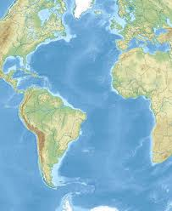
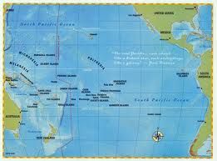
DEEP - SHALLOW
ATLANTIC OCEAN
PACIFIC OCEAN
The Pacific Ocean is _______________ _________ the Atlantic.

Slide 8
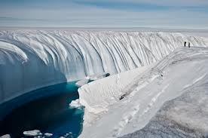
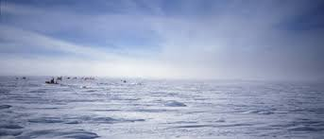
COLD - HOT/WARM
North Pole
South Pole
The North Pole isn’t ____ ________ as the South Pole. Actually the South Pole is the ________________ place on Earth.

Slide 9
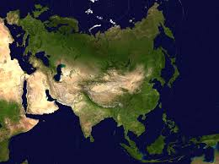
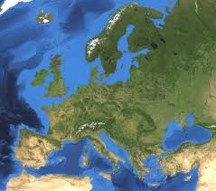
LARGE
ASIA
EUROPE
Asia is _______________ ________ Europe. Actually, Asia is _____ ______________ continent in the world.

Slide 10
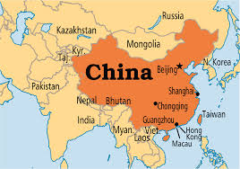
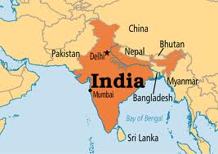
POPULATED
CHINA
INDIA
India is ______ ___________________ than China. It has only 1 billion people!

Slide 11
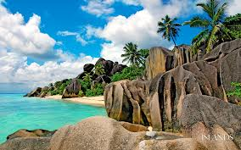
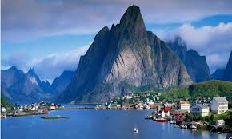
HOT
SEYCHELLES - AFRICA
NORWAY
Norway can never be as _____________ ________ Seychelles.

Slide 12
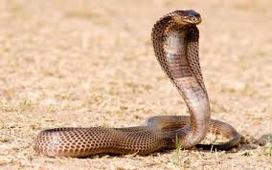
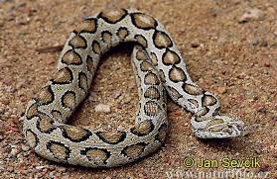
DANGEROUS
COBRA
VIPER
The cobra is ____________ _________________ _______ the viper.

