Slide 1
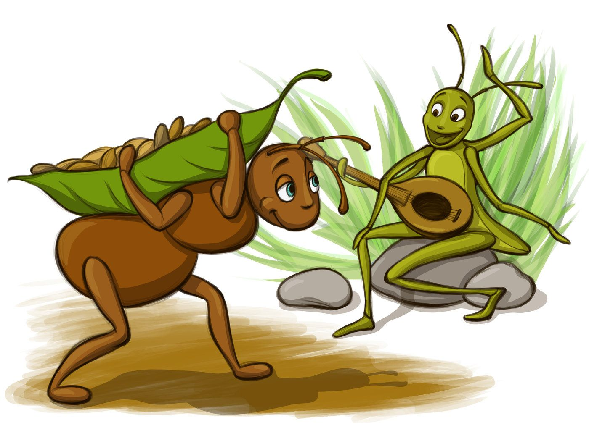
This picture comes form a famous Aesop’s fable. Do you know which fable it is?

Slide 2
The Ant And The Cricket

Slide 3
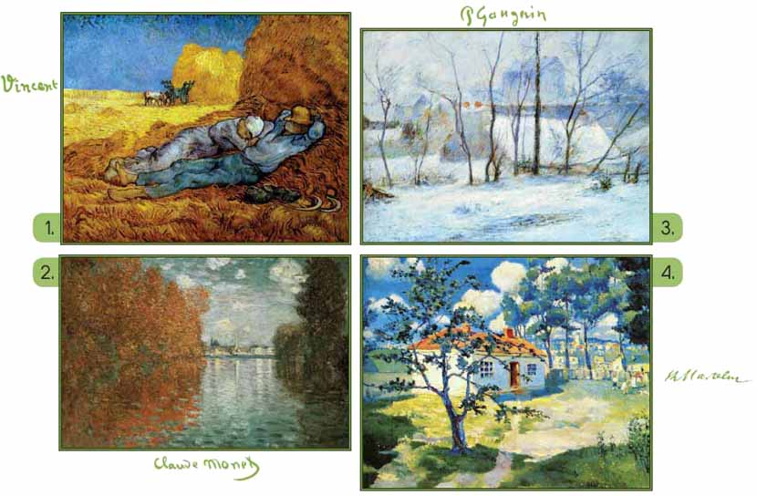
The four seasons Look at the pictures. What season is it?
SS
Summer
Winter
Spring
Autumn/ Fall

Slide 4
Do you know what happens in the story?
Watch the video and while watching it be ready to
answer some questions.
https://edpuzzle.com/media/5ea590bbe2711b3f10a5239d
https://www.youtube.com/watch?v=7IMZ_Xa76Qc

Slide 5
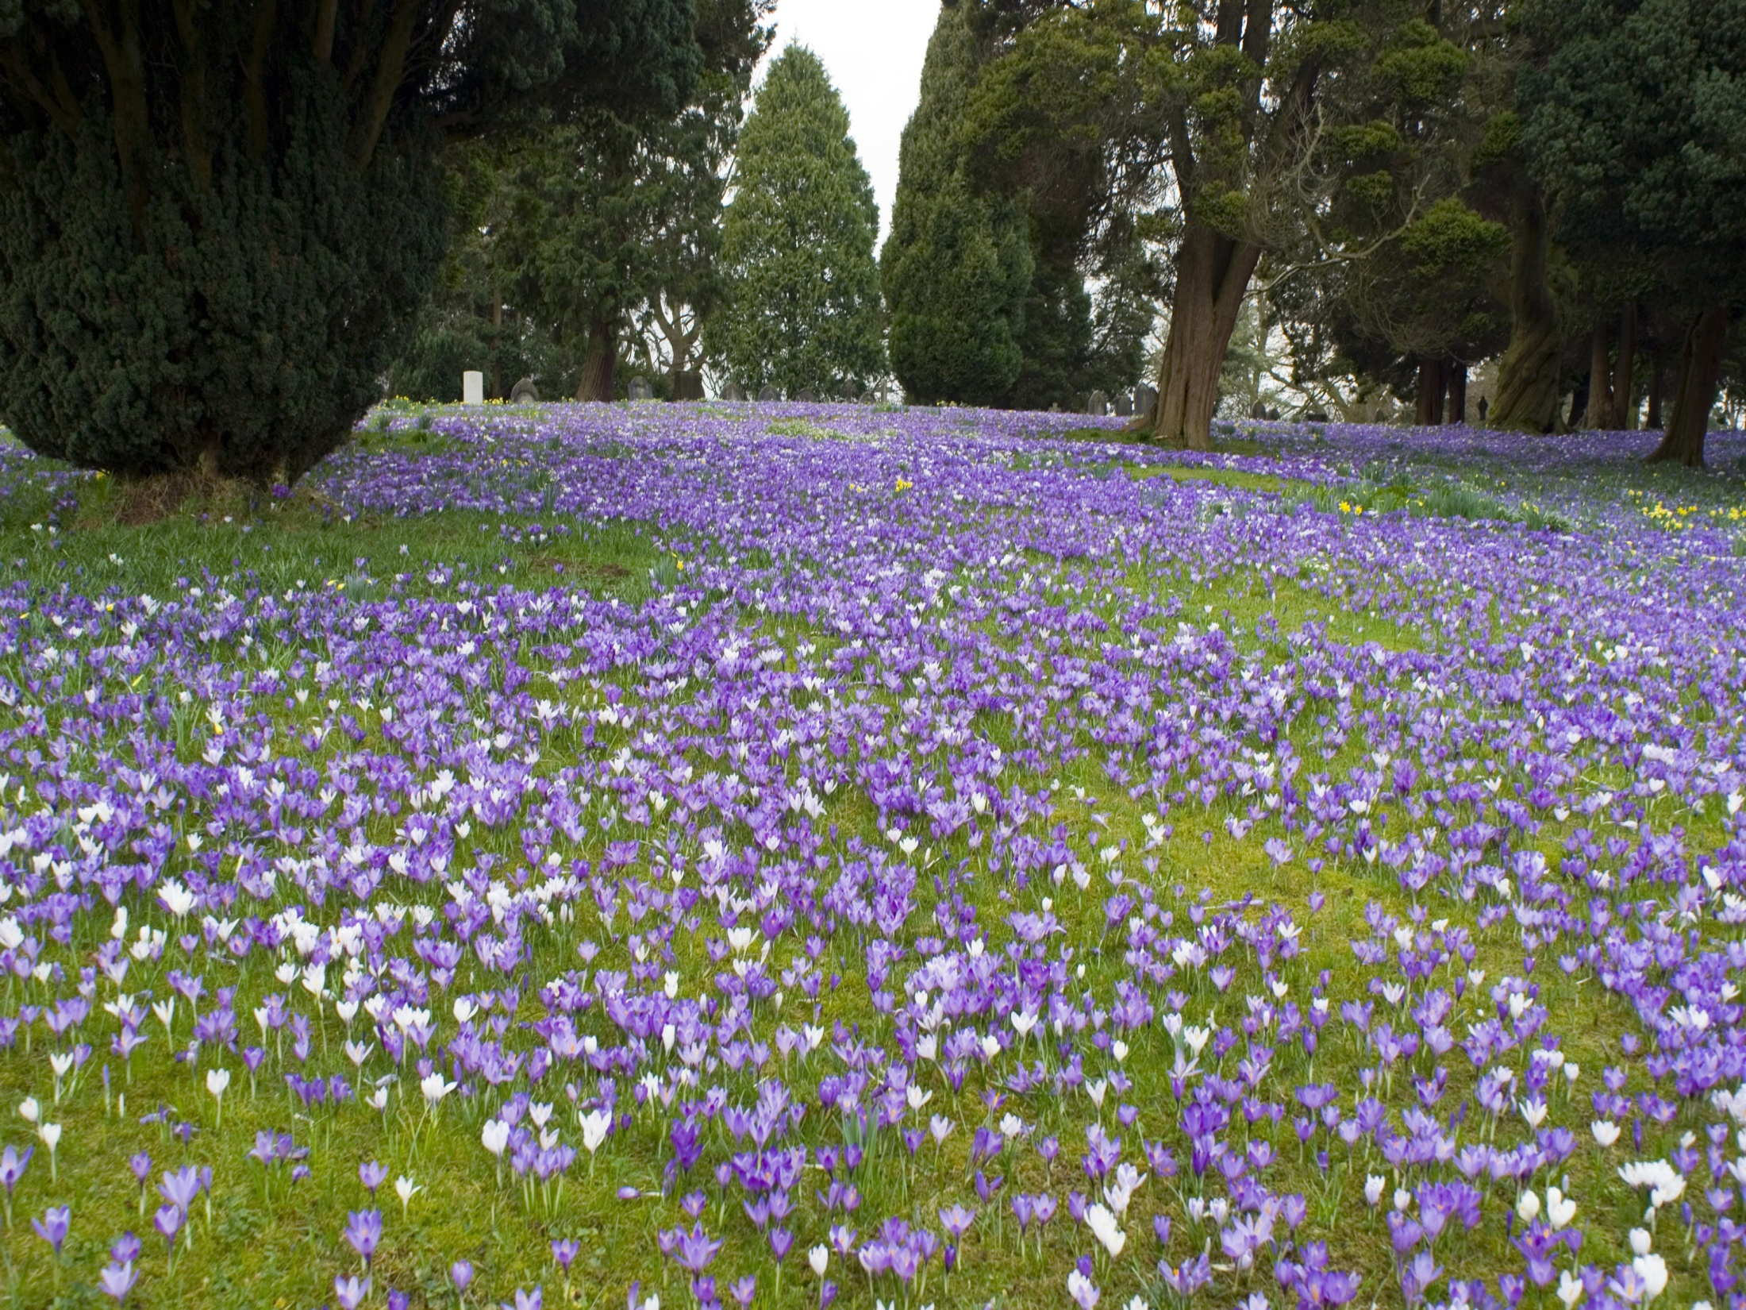
TT
Mystery Game:
The cricket lost his guitar. Let’s help him find it.
http://photodentro.edu.gr/v/item/ds/8521/8526
Let’s have some practice:
EZ Match
Crossword
Now it’s time to play a Guessing Game:
Guess Who (Lesson 2, exercise 3)
http://ebooks.edu.gr/modules/ebook/show.php/DSDIM-C107/736/4822,21971/

Slide 6
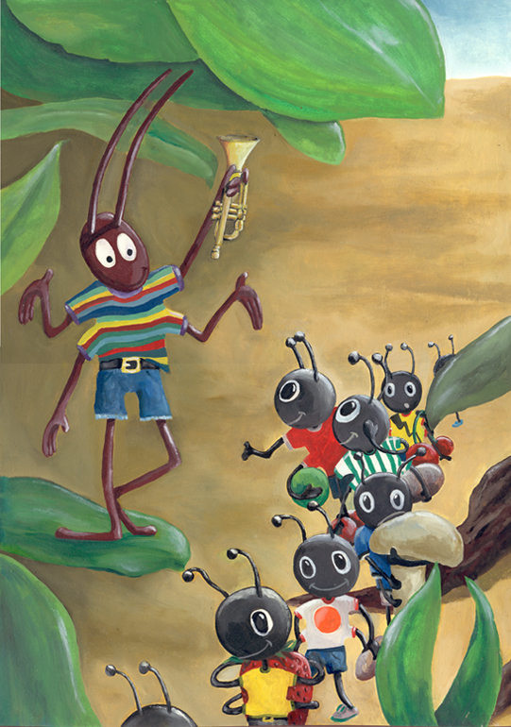
It’s OK to play and have happy moments. But you must also
work hard and save
for a rainy day!

Slide 7
SOURCES
ΔΙΑΔΡΑΣΤΙΚΑ ΣΧΟΛΙΚΑ ΒΙΒΛΙΑ http://ebooks.edu.gr/new/course-main.php?course=DSDIM-C107
British Council https://learnenglishkids.britishcouncil.org/
edpuzzle https://edpuzzle.com/home
GOOGLE https://www.google.gr/
YouTube “The Ant and The Cricket”
https://www.youtube.com/watch?v=7IMZ_Xa76Qc

