Slide 2
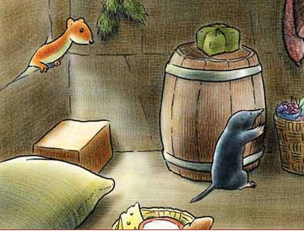
The weasel and the mole
The right kind of food
Let’s try to remember what happens in the story. Go through the Flipbook and describe what you see (Lessons 1-2).
http://photodentro.edu.gr/v/item/ds/8521/7479

Slide 3
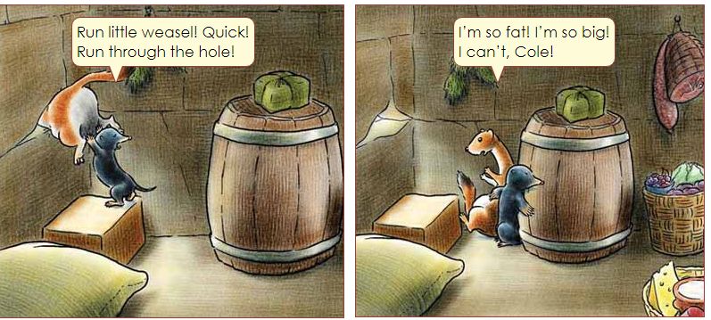
How does the weasel feel? Why?
What do you think must she do?
What kind of food must she eat?

Slide 4
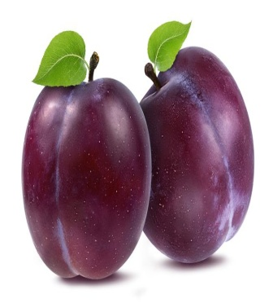
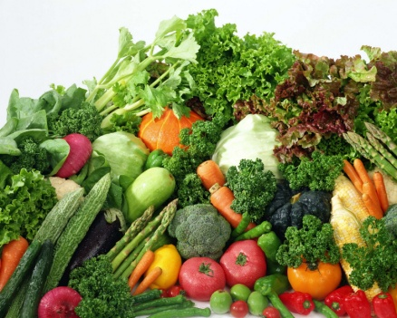
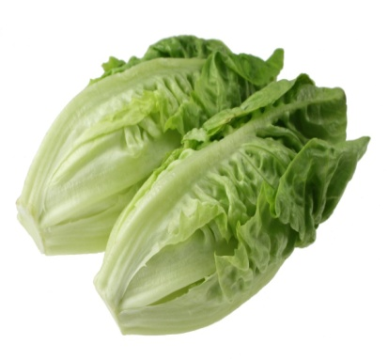
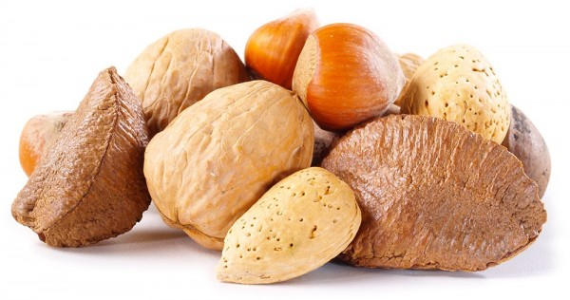
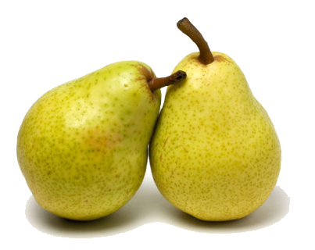
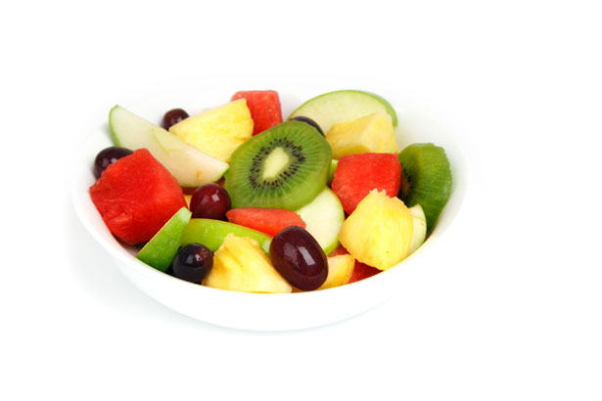
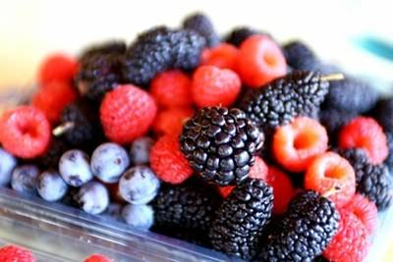
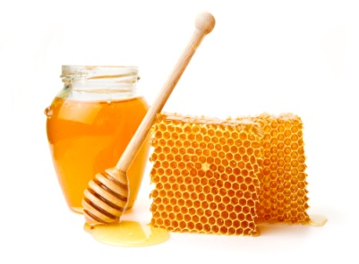
Do you know the names for these food items?
vegetables
cherries
plums
nuts
lettuce
pears
berries
fruit
honey

Slide 5
So let’s watch the story and see what happens next:
http://photodentro.edu.gr/v/item/video/8522/998
How does the weasel feel in the end? Why?
Listen to the story again and then try to match the days of the
week with the right food item.
http://photodentro.edu.gr/v/item/video/8522/998

Slide 6
Monday - Tuesday
Wednesday - Thursday
Friday and Saturday
Sunday
Eating right can make you happy!

Slide 7
Now listen and read and when the song comes be ready to sing along
https://www.youtube.com/watch?v=a175th1BclE&t=81s
Homework Τime 1
Before our next meeting you will work on some exercises in our e – class: Click on C Class and then on The weasel and the mole.
Do Ex 1 and Ex 2
Watch the videos on Plurals and Irregular Plurals
Do Ex 3

Slide 8
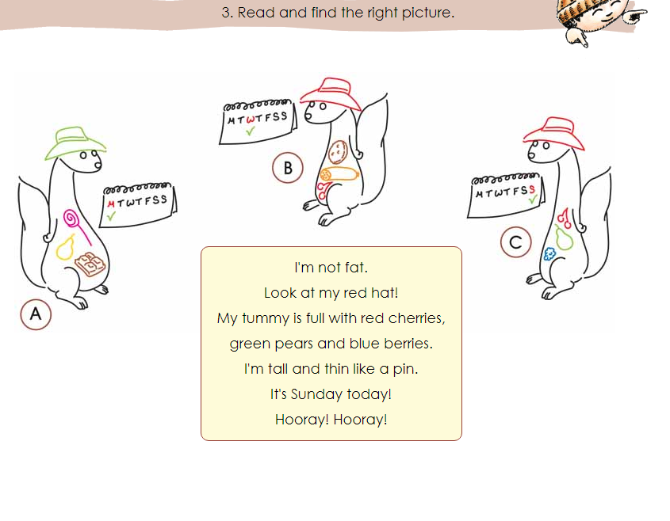
What happened in our story so far? Do you remember?
Who says that? Cole the mole or Easel the weasel? Listen and say.
http://ebooks.edu.gr/modules/ebook/show.php/DSDIM-C107/736/4822,21956/
Now read and find the right picture.
V

Slide 9
So what must we do if we want to be healthy? Let’s see what we have
learnt. Fill in with must (πρέπει) or mustn’t (δεν πρέπει)
http://aesop.iep.edu.gr/node/7049/2130
Now Make the right decisions to be healthy ! Which sentence is right?
http://aesop.iep.edu.gr/node/7049/1901
What is it? Let’s solve some Food riddles. Read the riddle and find
what it is. You can write it in the chat box for all of us to see.
http://aesop.iep.edu.gr/node/7049/1837

Slide 10
Homework Τime 2
Before our next meeting you will work on some exercises in our e – class. Click on C Class and then on The weasel and the mole.
Watch the video Sing and Learn – What are you doing?
Study the document on Present Continuous (Now)
Do the exercise What are they doing?
Do the Food Words activities (Can you remember? & Let’s write)
Project : Use the pictures of Easel the weasel and make a poster to
help young children have healthy eating habits. Fill the weasel’s
tummy with healthy or unhealthy food. You can also write slogans
e.g. Eat the right kind of food! - Keep fit and healthy! – Eating right
can… etc

Slide 11
SOURCES
AESOP http://aesop.iep.edu.gr
ΔΙΑΔΡΑΣΤΙΚΑ ΣΧΟΛΙΚΑ ΒΙΒΛΙΑ http://ebooks.edu.gr/new/course-main.php?course=DSDIM-C107
British Council https://learnenglishkids.britishcouncil.org/
ΦΩΤΟΔΕΝΤΡΟ http://photodentro.edu.gr/v/item/video/8522/982
YouTube https://www.youtube.com/watch?v=a175th1BclE&t=81s

