Slide 1
Verb to be Song

Slide 2
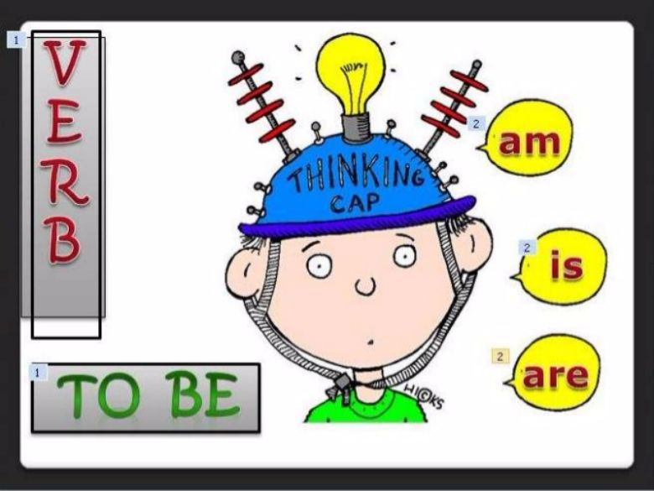

Slide 3
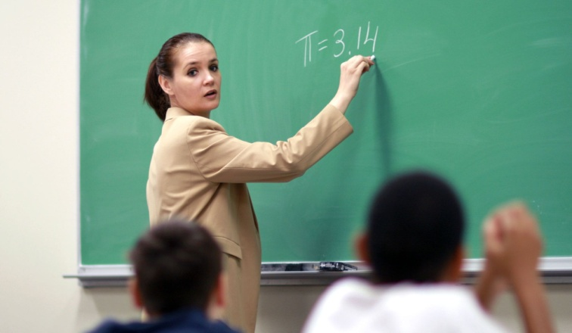
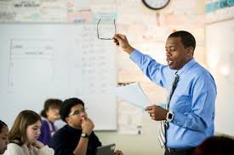
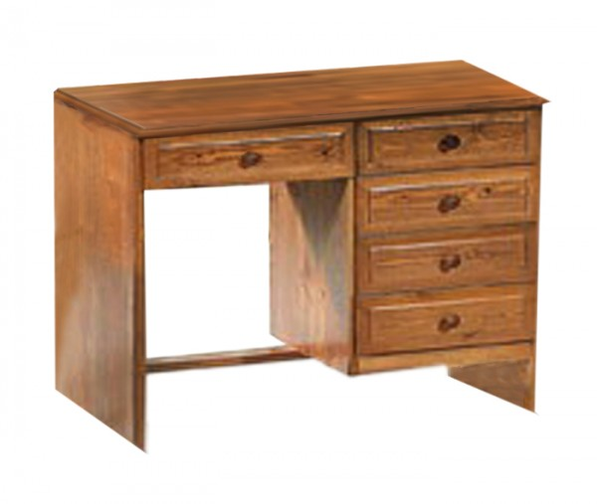
This is a woman.
She is a teacher.
She’s
Is she at home?
No, she isn’t
is not => isn’t
This is a man.
He is a teacher.
He’s
Is he at school?
Yes, he is
This is a desk.
It is brown.
It’s

Slide 4
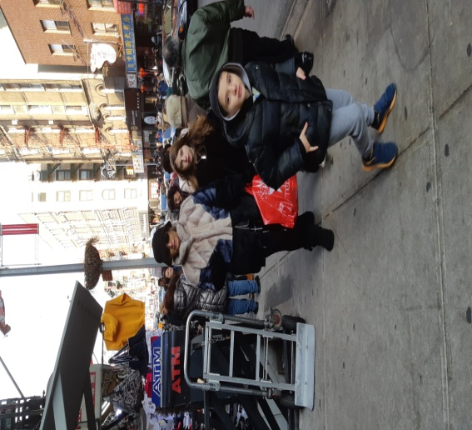
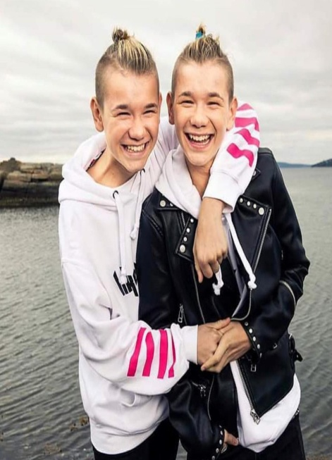
I am from Patras.
I’m
Am I a doctor?
No, I’m not
I am not => I’m not
This is my family.
We are in New York
We’re happy.
These are Marcus and Martinus
They are singers.
They’re
Are they old?
No, they aren’t
are not => aren’t

Slide 5
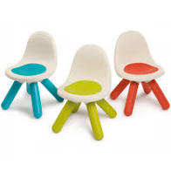
These are chairs.
They are small
They’re
Are they black?
No, they aren’t

Slide 6
Verb to Be Practice
https://www.youtube.com/watch?v=vsuyn4_actA
Verb to Be (on line exercise)
https://www.liveworksheets.com/kt220806qs

