Slide 1
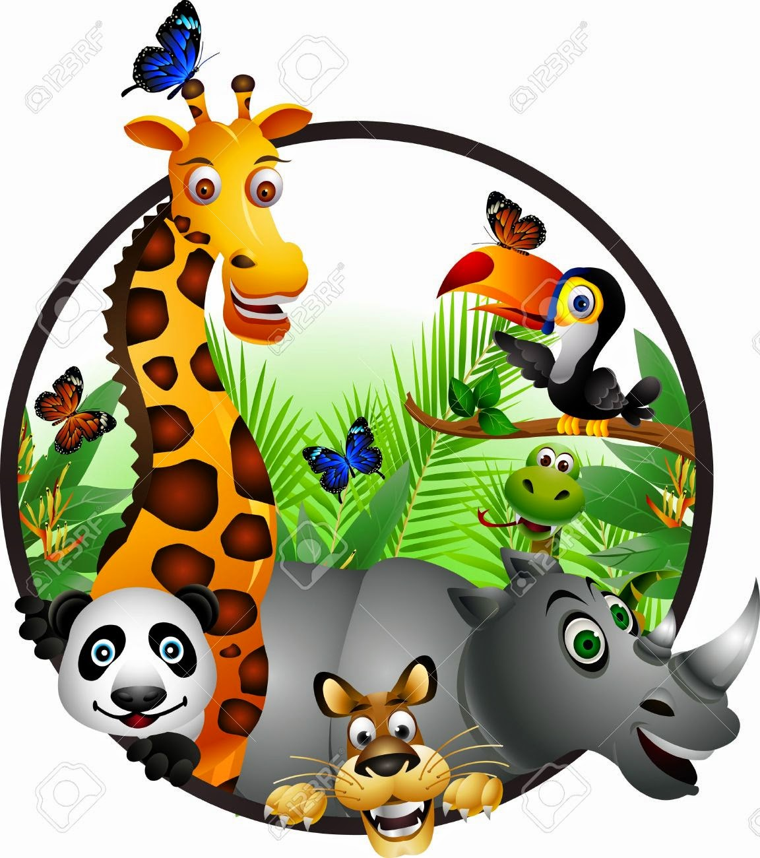
ENDANGERED
ANIMALS

Slide 2
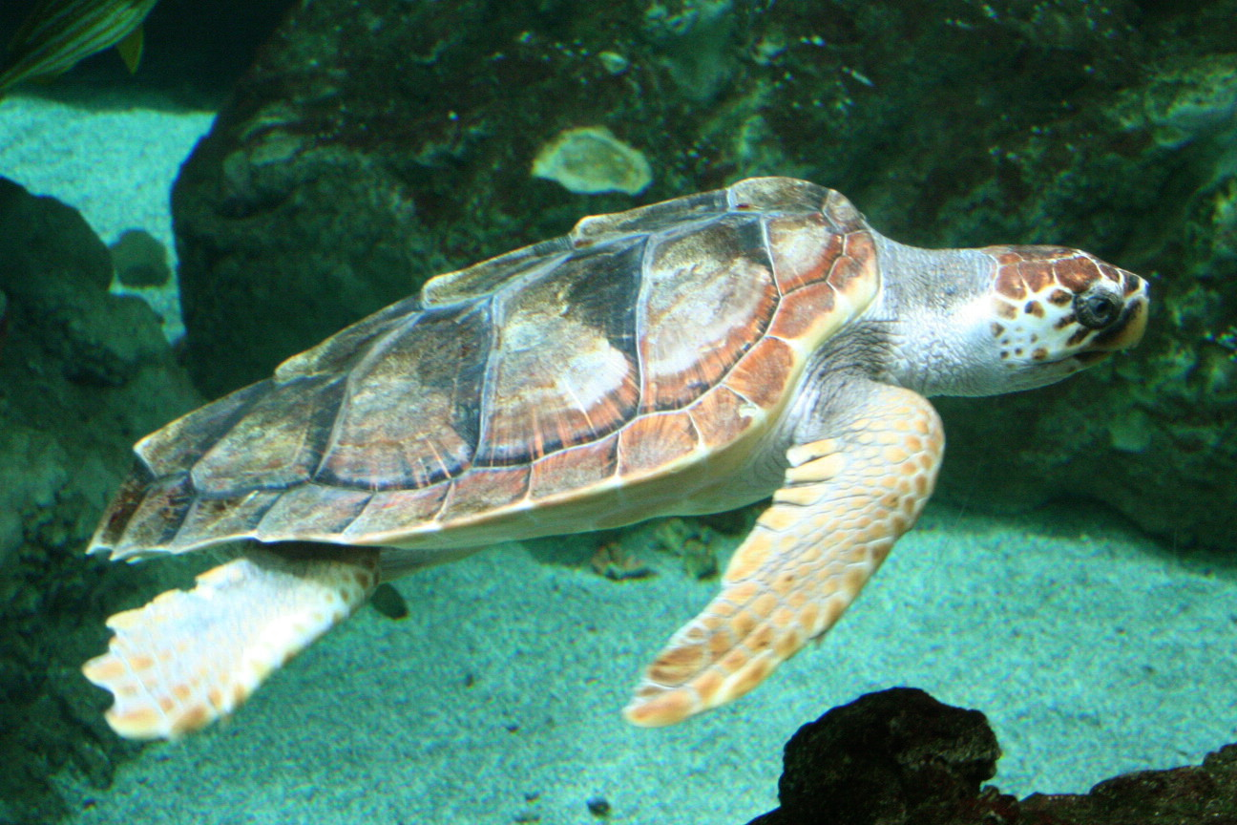
What do we mean by the term “endangered animals”?
Do you know any endangered species?
Why are these animals in danger?
Look at the following picture. Do you know the name for this
animal?
In your notebooks make a list about what you know about caretta caretta. Share your knowledge with your classmates.

Slide 3
Now listen to some information about the sea turtle caretta
caretta. In your notebook note down any piece of information
that you find interesting.
http://ebooks.edu.gr/modules/ebook/show.php/DSDIM-D101/693/4597,20868/
Now listen and read to complete your notes.
What more did you learn about caretta caretta? Exchange
information with your classmates.
Let’s see what we’ve learnt. Use the information you
collected to do the following activity. Remember to give full
answers.
http://aesop.iep.edu.gr/node/20140/5008
Read the text and choose the correct word to fill in the
blanks
http://aesop.iep.edu.gr/node/22182/5569

Slide 4
Homework Time 1
Before our next meeting you will work on some exercises in our e – class. Click on D Class and then on Endangered Animals.
Do ex. 1: Animals and Food – What are they eating?
Do ex 2: Monachus monachus is an endangered species. Read the
paragraph and fill in the gaps.

Slide 5
What do we mean by ‘wild animals’?
Can you name some wild animals?
Let’s see how much you know about animals through the Amazing
Animals Hangman Game.
http://ebooks.edu.gr/modules/ebook/show.php/DSDIM-D101/693/4597,20868/extras/British_Council/U6L2_Amazing_Animals/index.html
Watch the video about wild animals and learn more about them.
Then look at the pictures and write the words (in your notebooks or in
the chat box)
http://aesop.iep.edu.gr/node/21840/5467
Time to play a game!!!

Slide 6
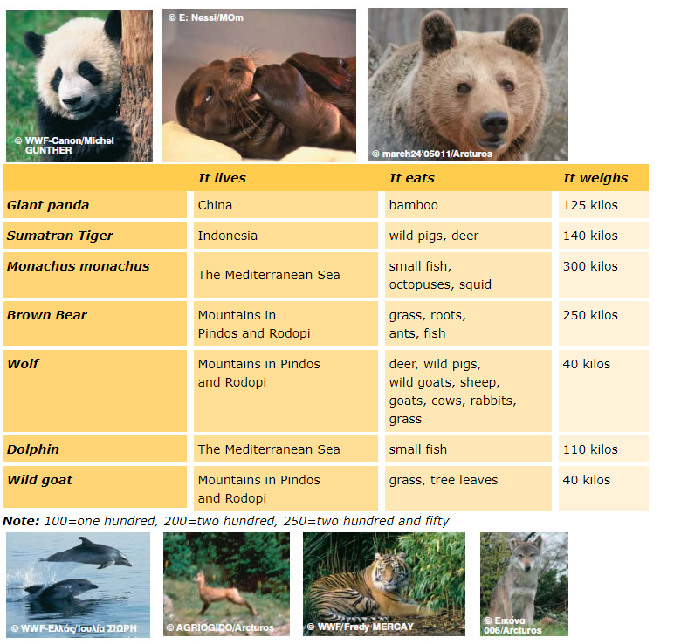
http://ebooks.edu.gr/modules/ebook/show.php/DSDIM-D101/693/4597,20868/
Below you can see some wild animals and a table with information about them. Read through the facts and see if you understand everything.

Slide 7
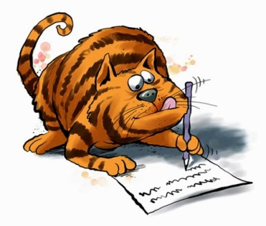
Look at the facts about the wild animals again and use the notes to
talk about them.
Project: Endangered Animals
Find information about endangered species in Greece and around the world. You can find useful information and pictures in the following sites:
https://www.wwf.gr/endangered-species
https://www.arcturos.gr/en/animals/
Use the questions below to help you collect information and guide you through your writing:

Slide 8
Use your answers to the above questions to write a paragraph about an
endangered animal / endangered animals in Greece and around the world.
Illustrate your paragraph with pictures and prepare a leaflet to present
your endangered animal(s) to your classmates.
You can look up words you do not know in dictionaries or on the web (e.g.
Google). You can also check the Picture Dictionary for useful words.
When your leaflet is ready you can upload it here (Remember to double
click anywhere on the board) or you can show it to your classmates at our
next Webex meeting.
A final activity for you to see what your paragraph could be like. Read the
text and fill in the blanks.
http://ebooks.edu.gr/modules/ebook/show.php/DSDIM-D101/693/4597,20868/extras/British_Council/U6L2_Polar_Bears/index.html

Slide 9
Homework Time 2
Before our next meeting you will work on some exercises in our e – class:
Click on D Class and then on Endangered Animals.
Do Ex 1: Animals In Danger - Vocabulary Review
Project: Prepare your leaflet about Endangered Animals.

Slide 10
SOURCES
AESOP http://aesop.iep.edu.gr
ΑΡΚΤΟΥΡΟΣ https://www.arcturos.gr/en/animals/
British Council https://learnenglishkids.britishcouncil.org/
ΔΙΑΔΡΑΣΤΙΚΑ ΣΧΟΛΙΚΑ ΒΙΒΛΙΑ http://ebooks.edu.gr/new/course-main.php?course=DSDIM-C107
Padlet https://padlet.com/dimipb/Bookmarks
WWF https://www.wwf.gr/endangered-species

